Slide 1
LCBB5015
Principles of Marketing
Week 7 Session 1
Stakeholders

Slide 2
Learning Objectives
To identify what is a stakeholder
To determine the difference between internal and external stakeholders
To analyse how companies communicate with their internal and external stakeholders
To determine the impact of various stakeholders on the marketing activities of a company.

Slide 3
What is a Stakeholder?
A stakeholder is an individual or group that has a legitimate interest in a company.
A stakeholder is also an individual or group who can affect or be affected by the actions of a business.

Slide 4
Internal Stakeholders
Internal stakeholders refer to the individuals and parties, within the organisation.
Internal Stakeholders are those parties, individual or group that participates in the management of the company. They can influence and can be influenced by the success or failure of the entity because they have vested interest in the organisation. Primary Stakeholders is another name for the Internal stakeholders.

Slide 5
Different Types of Internal Stakeholders
Employees: Employees are the group of people who work for the company, for remuneration.
Owners: The individual or group who owns the organisation. E.g. partners.
Board of Directors: They are the group of individuals who control the company.
Managers: The person who manages the entire department is known as a manager. For example Sales Manager, General Manager, etc.

Slide 6
External Stakeholders
External Stakeholders are those interested parties, who are not a part of the management, but they indirectly affected by the work of the company. They are the outside parties which form part of the business environment. They are also known as Secondary Stakeholders

Slide 7
Different Types of External Stakeholders
Suppliers: They provide inputs to the organisation like raw materials, equipment, etc.
Customers: They are considered the king of the business because they are the one who is going to consume the product.
Creditors: They are the individual, bank or financial institution who provides funds to the organisation.
Intermediaries: They are the marketing channels that create a link between the company and customers like the wholesaler, retailer, etc.
Competitors: They are the rivals who compete with the organisation for resources and the market.
Society: A firm has its responsibility towards society because the enterprise uses its valuable resources.
Government: A firm is guided and controlled by government rules and regulations

Slide 8
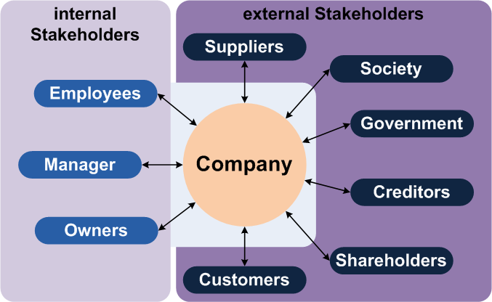

Slide 9
Stakeholder Analysis
Stakeholder Analysis is the first step in Stakeholder Management , an important process that successful people use to win support from others. Managing stakeholders helps them to ensure that their projects succeed where others might fail.

Slide 10
Why Use Stakeholder Analysis?
A stakeholder-based approach gives you four key benefits:
Getting Your Projects Into Shape
You can use the opinions of your most powerful stakeholders to help define your projects at an early stage. These stakeholders will then more likely support you, and their input can also improve the quality of your project.

Slide 11
Winning Resources
2. Gaining support from powerful stakeholders can help you to win more resources, such as people, time or money. This makes it more likely that your projects will be successful.

Slide 12
Building Understanding
3. By communicating with your stakeholders early and often, you can ensure that they fully grasp what you’re doing and understand the benefits of your project. This means that they can more actively support you when necessary.

Slide 13
Getting Ahead of the Game
4.Understanding your stakeholders means that you can anticipate and predict their reactions to your project as it develops. This allows you to plan actions that will more likely win their support.

Slide 14
How to Conduct a Stakeholder Analysis
Step 1: Identify Your Stakeholders
Start by brainstorming who your stakeholders are. As part of this, think of all the people who are affected by your work, who have influence or power over it, or have an interest in its successful or unsuccessful conclusion.

Slide 15
Step 2: Prioritize Your Stakeholders
You may now have a list of people and organisations that are affected by your work. Some of these may have the power either to block that work or to advance it. Some may be interested in what you are doing, while others may not care, so you need to work out who you need to prioritize.
You can map out your stakeholders, and classify them according to their power over your work and their interest in it, on a Power/Interest Grid

Slide 16
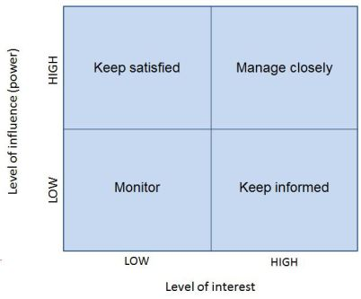
Diagram: The Power Interest Grid

Slide 17
The position that you allocate to a stakeholder on the grid shows you the actions you need to take with them:
High power, highly interested people (Manage Closely): you must fully engage these people, and make the greatest efforts to satisfy them.
High power, less interested people (Keep Satisfied): put enough work in with these people to keep them satisfied, but not so much that they become bored with your message.
Low power, highly interested people (Keep Informed): adequately inform these people, and talk to them to ensure that no major issues are arising. People in this category can often be very helpful with the detail of your project.
Low power, less interested people (Monitor): again, monitor these people, but don’t bore them with excessive communication.

Slide 18
Step 3: Understand Your Key Stakeholders
You now need to discover how your key stakeholders feel about your project. You also need to work out how best to engage them, and how to communicate with them.
Key questions that can help you understand your stakeholders include:
What financial or emotional interest do they have in the outcome of your work? Is it positive or negative?
What motivates them most of all?
What information do they want from you, and what is the best way of communicating with them?

Slide 19
4. What is their current opinion of your work? Is it based on good information?
5.Who influences their opinions generally, and who influences their opinion of you? Do some of these influencers therefore become important stakeholders in their own right?
6. If they aren’t likely to be positive, what will win them around to support your project?
7.If you don't think that you’ll be able to win them around, how will you manage their opposition?

Slide 20
8.Who else might be influenced by their opinions? Do these people become stakeholders in their own right?

Slide 21
Exercise
Relate the Power Interest matrix to a well-known organisation of your choice.

Slide 22
Business Ethics
The definition of business ethics is the set of moral rules that govern how businesses operate, how business decisions are made and how people are treated.

Slide 23
The Marketing Mix and Unethical Marketing Practices
Product
Price
Place
Promotion

Slide 24
Exercise
Choose a company and discuss their unethical marketing practices in relation to one of the marketing mix elements.

Slide 25
Summary
In this lecture we have discussed what is a stakeholder
We have determined the difference between internal and external stakeholders
We have analysed how companies communicate with their internal and external stakeholders
We have determined the impact of various stakeholders on the marketing activities of a company.
We have outlined the unethical marketing mix practices carried out by companies.

Slide 26
References
Goodpaster, Kenneth E. Business Ethics and Stakeholder Analysis. Boston, Mass. (Soldiers Field, Boston 02163), Division Of Research, Harvard Business School, 2018.
Grace, Damian, et al. Business Ethics. Don Mills, Ontario, Canada, Oxford University Press, 2021.
Eagle, Lynne, and Stephan Dahl. Marketing Ethics & Society. Los Angeles (Calif.) Etc., Sage, 2019.
Vance-Borland, Ken, and June Holley. “Stakeholder Network Mapping, and Analysis.” Conservation Letters, vol. 4, no. 4,
13 Apr. 2023, pp. 278–288, https://doi.org/10.1111/j.1755-263x.2011.00176.x.

