Slide 1

Mastering Metrics
Unit 2 Chris Thomas
The Major Areas of Marketing Metrics

Slide 2
Learning Outcomes
Fully understand resources at your disposal
Overview of key areas of marketing metrics
  Market metrics
  Brand Metrics
  Customer Metrics
  Channel Metrics
  Financial Metrics and ROI
  Sales Metrics
  Promotional Metrics
  Digital Metrics

Slide 3
Key Dates Revised
Study Sessions
25.04.18
2.5.18
09.05.18
19.5.18 (10am start) - Draft task 1
30.5.18
6.6.18 7.6.18?
16.6.18 (10am start) - Draft task 2
20.6.18
23.06.18 - Draft task 3
Assessment Booking Deadline
30th May 2018
Assignment Deadline
29th June 2018

Slide 4
Familiarise yourselves with links on Moodle and MyCIM study section

Slide 5
Assessment
CIM give an audio detailed assignment brief:
https://vimeo.com/247323856/d4ba5b1108

Slide 6
Assessment
Assignment
  Useful to have the assessment in mind as we work through the lectures…

Slide 7
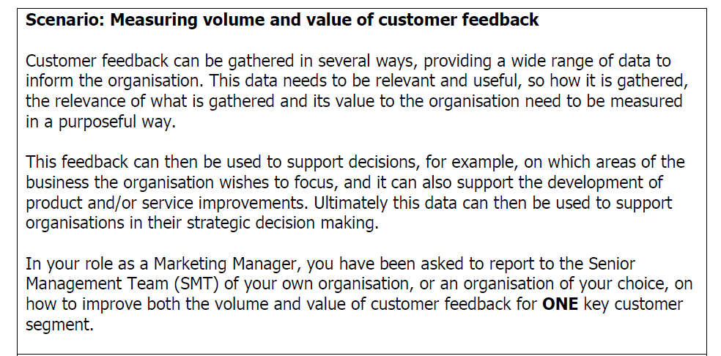
Assessment

Slide 8
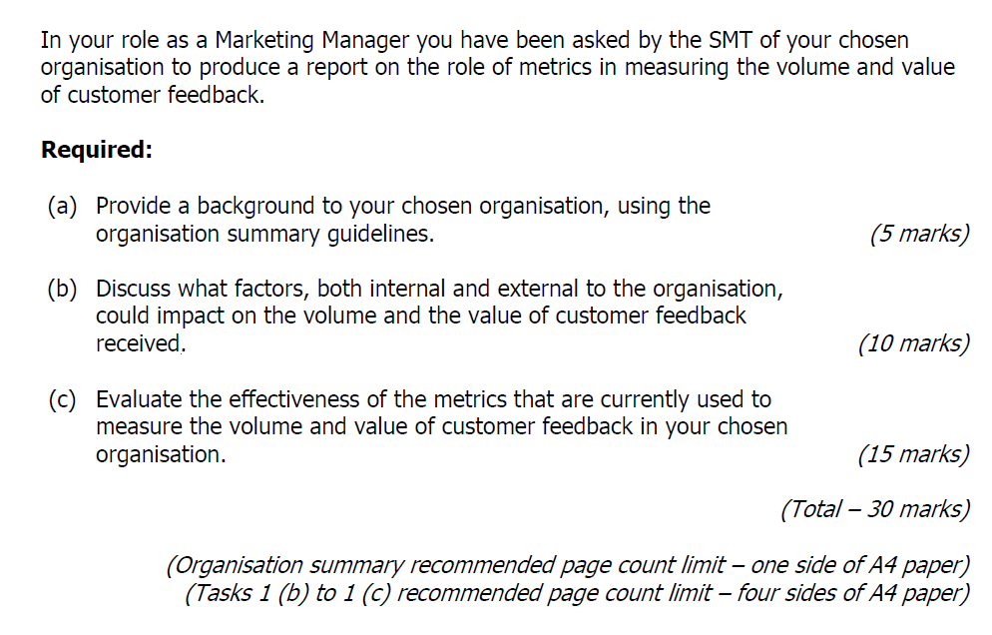
Task 1 - Report

Slide 9
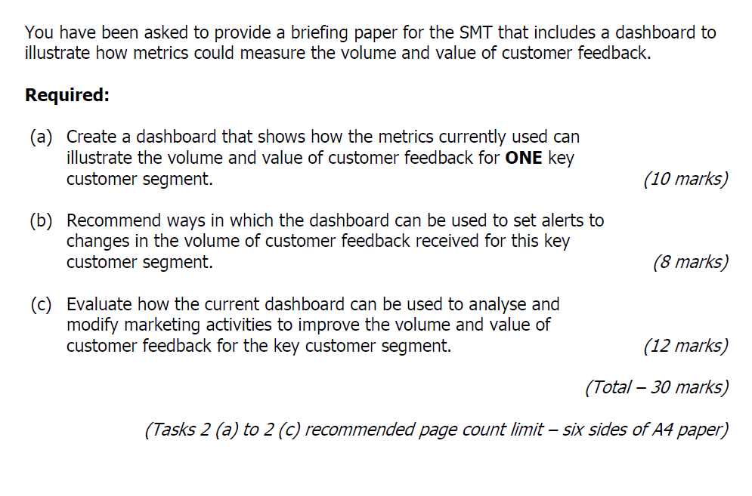
Task 2 – Briefing Paper

Slide 10
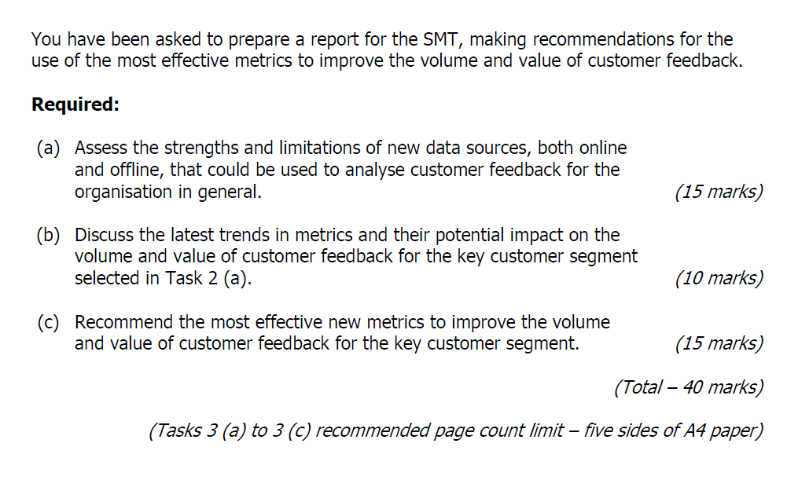
Task 3 - Report

Slide 11
What is strategy?
What also is the problem with setting a strategy?
  Rapidly changing external environment
  Strategies need to be flexible

Slide 12
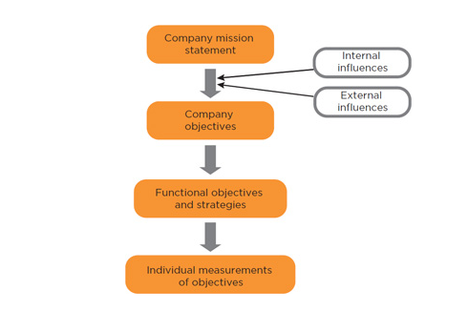
Aligning business objectives, strategies and metrics
Hierarchy of mission and goals (adapted)
CIM Mastering Metrics pg 236

Slide 13
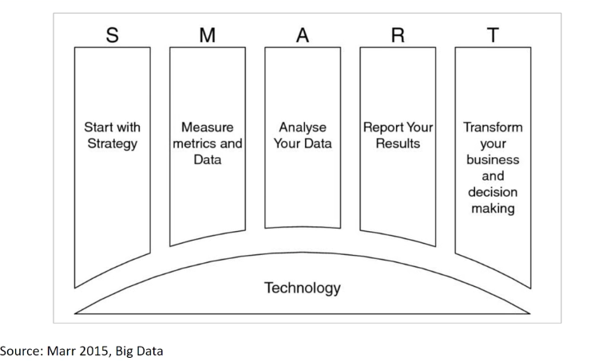
The SMART approach to Metrics

Slide 14
Choice of Metrics
Most clearly related to the objectives that you’ve set
In keeping with how the organisation measures the success of its activities, strategies and objectives.

Slide 15
Objectives
Functional and individual goals should be aligned with overall business objectives.
This helps employees and organisations maximise their chances of meeting their objectives.
Should be S.M.A.R.T.

Slide 16
Market Metrics
Markets are one for the most important areas for marketers to measure as they are the ultimate source of their revenue.
Market Share
Relative Market Share
Market Growth
Market Penetration

Slide 17
Market Share
Measure of sales as a percentage of total sales volume in industry/sector/market/product
Expressed in units or monetary value

Slide 18
Relative Market Share
Used to compare the organisation and its closest competitor

Slide 19
Market Growth
Comparing sales in one year against sales in a previous period.

Slide 20
Market Penetration
Related to market share. One of Ansoff’s (1957) four growth strategies – increasing sales to the existing market,
Compare current sales against potential market demand.
No. of customers as a % of total customers in the market.
If you have a large customer penetration, but a low market share, then you are making many low-value sales and one way to increase share is to increase the value of the sales, rather than chase more customers.

Slide 21
Brand Metrics
“Your brand is what other people say about you when you’re not in the room.”
Jeff Bezos, CEO & Founder, Amazon

Slide 22
Metrics Brand, Sales and Business results
What is a brand?
What is brand equity/value?
  Financial value of the brand
  How it attracts and retains customers

Slide 23
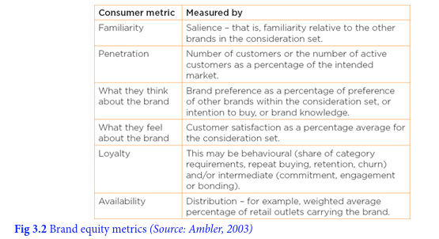
How do we measure it?

Slide 24
Brand Metrics
Brand metrics can help to provide marketers with an understanding of the complexities of brand valuation, while enabling non-marketers to gain an appreciation of the factors that can drive brand value.

Slide 25
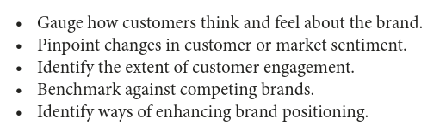
Brand Objectives

Slide 26
Brand Equity/Value
Involved measuring of intangible assets best left to specialist companies such as Interbrand and Brand Finance who produce annual lists of brands ranked by value.

Slide 27
Brand Image/Position
Customers perception of the brand in comparison with competitors.

Slide 28
Brand Metrics
Brand awareness
Brand value
Brand positioning
Impact on brand metrics by various campaigns
Use ones most relevant to your objectives

Slide 29
Customer Profiling, Satisfaction and Loyalty Metrics
Key role of a marketer is to consider the needs of customers and how to segment the market into customer groups.

Slide 30
Customer needs
Customer needs can be identified as:
Articulated – Those things that a customer asks for clearly and directly
Latent – The needs that the customer has but are largely hidden or unknown

Slide 31
Marketers need to not only meet customers existing needs but also identifying the needs that customers have but sometimes are not even aware of.
Understanding customer needs, but articulated or latent enables an organisation to increase its appeal to particular customer groups.

Slide 32
Customer segments
Identifiable and recognisable
Exist independently
Measurable
Substantial
Externally accessible
  McDonald (2004)

Slide 33
Metrics that define and track a segment over time
Needs and wants
Attitudes and opinions
Demographic
Geographic
Geodemographic
Pyschographic
Media Consumption
McDonald and Mouncey (2009)

Slide 34
Metrics relating to the performance and goals of the segment itself
Market Share
Sales Volumes
Gross Margin
Brand Image
Customer Value

Slide 35
The most important metrics for measuring customer satisfaction, customer service and loyalty
Customer satisfaction
  Generally based on survey data and is expressed as a rating, often a simple percentage approval rating.
A key measure within many organisations as it helps to focus employees’ attention on meeting customer’s needs.
Usually a major objective of most marketing teams, because without satisfied customers an organisation will not survive.

Slide 36
Willingness to recommend
When a customer is highly satisfied with a product/service or an organisation they may be willing to recommend it to others.
Word of mouth is a powerful tool and it is free. Social media has made this even more important.
Conversely, negative comments can spread quickly too.

Slide 37
Net Promoter Score (NPS)
Assesses to what extent someone would recommend a certain company, product or service to his or her friends, relatives or colleagues , using a scale of 0 - 10.

Slide 38
Net Promoter Score (NPS)
The results allow companies to divide customers into three groups:
Promoters – Those willing to recommend the organisation (rating of 9 or 10)
Passives – Satisfied but enthusiastic (7 or 8)
Detractors – Unwilling to recommend (0 to 6)

Slide 39
A high net promoter score indicates the organisation is doing well in terms of customer satisfaction.

Slide 40
Retention Rate
Cheaper to keep existing customers than acquire new ones.
%of the organisation’s customers that it retains over a given time period

Slide 41
Churn rates
Churn or attrition, is the rate at which a company loses customers.
Understanding how many are moving on each year and what trends are is important.

Slide 42
Customer Lifetime Value (CLV)
A forward-looking indicator that forecasts the value of the relationship between an organisation and a customer and ho much profit the organisation will make out of that customer.
How much that customer is worth to that organisation as a lump sump in current money terms.
It helps organisations decide which customers are worth the most not just based on past spend but potential future spend.

Slide 43
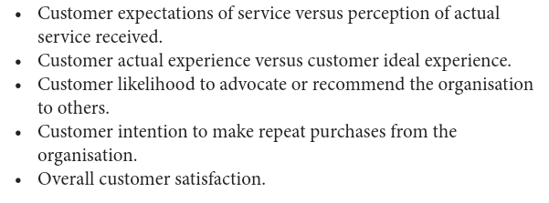
Service and satisfaction metrics
Traditionally not a strong area for marketers in demonstrating strategic impact.
Key metrics for real insight:

Slide 44
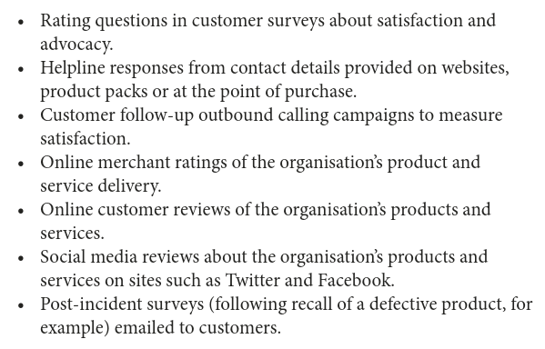
Measurement tools to assess impact of customer activity

Slide 45
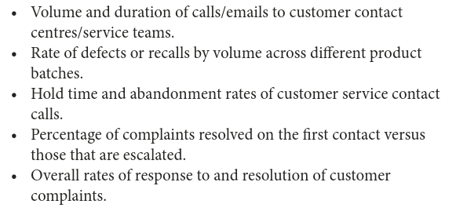
Measurement tools to test internal responsiveness to customer queries and complaints

Slide 46
Customer loyalty and Customer Lifetime Value (CLV) are more strategic measures than customer satisfaction alone.
Combining them can give both short-term satisfaction measures and longer-term relational building activities. E.g….

Slide 47
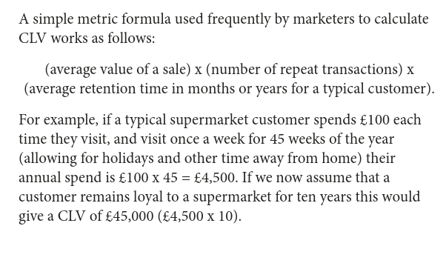

Slide 48
Resources on Customer Feedback
Use Voice of Customer Data to Improve Customer Experience Analytics - Smarter With Gartner
Voice of Customer: How to 10x Your Business With VOC Data
How to Measure Customer Satisfaction in 5 Simple Steps
Customer Engagement vs. Customer Satisfaction
What’s the Difference Between Customer Satisfaction and Customer Loyalty?
What Every Business Needs to Know About Customer Feedback
Customer Feedback Strategy: The Only Guide You'll Ever Need
20 quotes on customer feedback | Customer Thermometer
The 5 Best Ways to Get Feedback from Your Customers
Customer Experience or Customer Feedback?
Do You Know the Difference Between Customer Satisfaction and Customer Loyalty?
https://www.rug.nl/cic/downloads/rugcic_report_summary_201401.pdf

Slide 49
Channel Metrics
Channel or ‘place’ . Where and how customers buy products.

Slide 50
Key Channel metrics
Average transaction value/size
  The average purchase by the customer from the channel. Ideally should increase over time.
Average items per transaction
  Gives marketers a good grasp of their customers purchasing habits

Slide 51
Inventory turnover
  How quickly total inventory is sold or replaced Generally measured over the course of a year, or average number of days an items is held in stock before being sold.
Sales per unit of floor area
  Shows how efficiently retail space is being used.

Slide 52
Margin and profitability metrics
For commercial organisations the overriding objective is likely to be profit related.

Slide 53
Key metrics for profitability
Revenue (turnover)
  A key measurement but it may have been achieved at a high cost:
  ‘turnover is vanity, profit is sanity’
Gross profit
  Total revenue minus the costs of the goods sold
Net profit
  Total revenue minus total costs: taxes, admin costs, interest etc

Slide 54
Operating profit
  Based on net profit but calculated before interest and tax
  It is effectively the profit resulting from a sale.

Slide 55
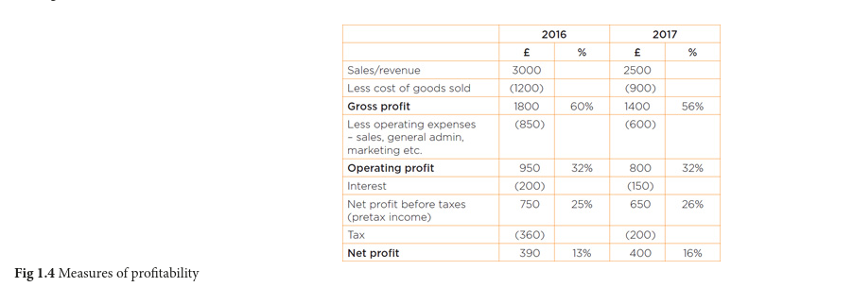

Slide 56
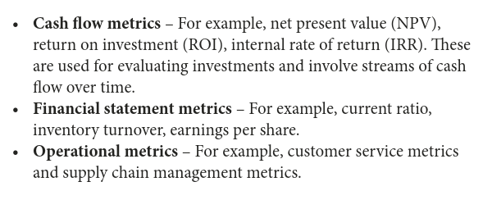
Financial and Operational Metrics

Slide 57
Marketing ROI
Compare different types of expenditure actual or proposed by looking at the cash profit return after deducting the cost of the activity i.e. Return minus investment.
More generally ROI measures tends to be calculated as return divided by investment expressed as a percentage.
Problem is actually calculating the profit and the actual expenditure.

Slide 58
Return on Investment (ROI)
Marketing ROI measure is most useful for comparing different potential uses of the marketing budget – you can forecast the activity which is likely to yield the highest returns. Use it post implementation for future planning.
http://www.cimmarketingexpert.co.uk/page/2974/return-on-investment-roi-

Slide 59
Return on Investment (ROI)
This provides a snapshot of profitability, adjusted for the size of the investment assets tied up in the business.
ROI(%) = (net profit/investment) x 100
Very useful for comparing different types of marketing activities

Slide 60
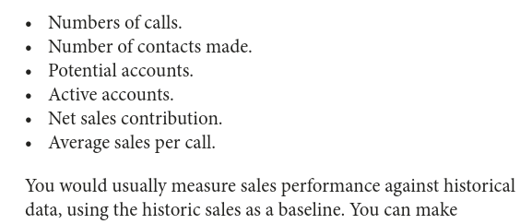
Sales force Metrics

Slide 61
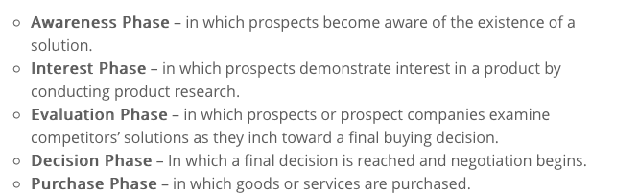
Sales Funnel
Sales process customer is taken through. Channel and company dependent.
Salesforce example:

Slide 62
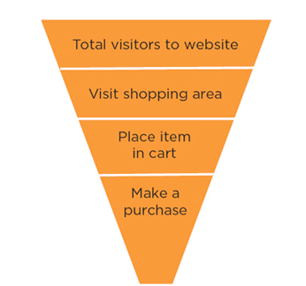
Sales Funnel
Website example:

Slide 63
Sales Funnel Metrics
Numbers and percentages can be shown for each stage
Sourcing and engagement: where customers come from and how people are engaged (usually web analytics software). Understanding this can help increase flow to top of funnel.
https://support.google.com/analytics/answer/6367342?hl=en

Slide 64
Sales Funnel metrics (Digital focus)
Conversion rate: ratio of deals that are closed that enter the funnel
Funnel value: This represents the potential value of prospective customers in the funnel. If the ‘normal’ funnel conversion rates are understood , you can use this to estimate future income.
Time spent at each stage: Important measure because it builds understanding of future potential, and allows you to speed up the process.
Average sales value: the average spend of customers in that channel, particularly if related to the costs involved in attracting and converting them. It can be a critical measure.

Slide 65
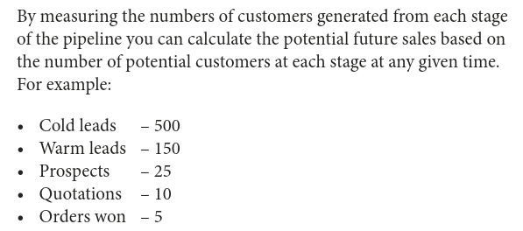
Sales Funnel Metrics
(offline emphasis)

Slide 66
CIM Sales Funnel Metrics
http://www.cimmarketingexpert.co.uk/page/9475/sales-funnel-metrics

Slide 67
Promotional Metrics
Share of voice
  This measures the organisation’s media spend on a product compared with the total expenditure for the product category in the marketplace.

Slide 68
Recall – The test of overall brand awareness or advertising impact.
  Top of mind – first brand recalled
  Dominance – The only brand recalled
Recognition – measures whether a customer remembers the organisation, advert or product.

Slide 69
Conversion rate – the conversion from enquiry to order.
  The % of prospective customers who purchase products from the organisation.
Redemption rates – any promotion wit ha direct offer such as a coupon.
  % of coupons redeemed out of those issued.

Slide 70
Reach - % of people reached (or exposed to) an advertisement or promotional campaign over a specified period of time.
Exposure is defined as opportunity to see or hear a particular advertisement.

Slide 71
Key Digital Metrics
Unique visitors refers to the number o unique individuals that visit a website within a specific timeframe
Page impressions – no. of times a page is loaded. More interesting the site the more page impressions.
Total clicks

Slide 72
Cost per Click – Not all enquiries become orders, and the cost per click measures the visits to the website against the advertising costs incurred.
Bounce rates number of visitors to a site who leave after visiting just one page.

Slide 73
Social media activity
Top line followers/likes but are they engaging with you?
Active members v total members.
Sentiment analysis tools

Slide 74
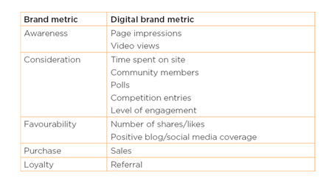

Slide 75
Activity metrics
Aggregates and reporting
  Number of leads at a trade show
  Number of visitors to a website
RARELY DEMONSTRATE THE CONTRIBUTION MARKETING MAKES TO BUSINESS OUTCOMES
Think of some further examples

Slide 76
Discussion
Consider how your organisation/department measures its marketing activity. How do they relate to your strategic objectives?

Slide 77
Summary
Marketing Metrics are important as they:
  justify your job
  justify any project you want to drive forward
  enable better business decisions
  Therefore ultimately increase profitability/value of company

Slide 78
Summary
Some metrics are better than others (to inform business decisions:
  Some are just ‘vanity metrics’/totals: they tell of quantity not quality
  Better metrics should give an idea of costs for comparison i.e. ROI
  Any task undertaken should be linked to the overall business strategy so some metrics should be strategic
  Some really useful metrics are predictive: trends, sales funnel, CLV
  Some metrics may be strategic and/or predictive but not relevant to the task you are considering. I you cant justify it as a measure of your promotional activity for your assignment – don’t use it.

