Slide 1


Using Beachfront Development to Counter the Effects of Global Warming
Trace King
Research Proposal

Slide 2


Hypothesis
Using Man Made Coastal Construction Would Slow the Effects of Global Warming, Possibly Long Enough to Reverse It
By improving coastal defences we could increase usable land mass without fear of flood and danger to life.

Slide 3
Aims and Objectives
Identify
Identify how badly UK gets hit by coastal floods
Determine
Determine how many flooded towns have coastal defences
Consider
Consider why Tidal Lagoons haven’t been used more widely

Slide 4

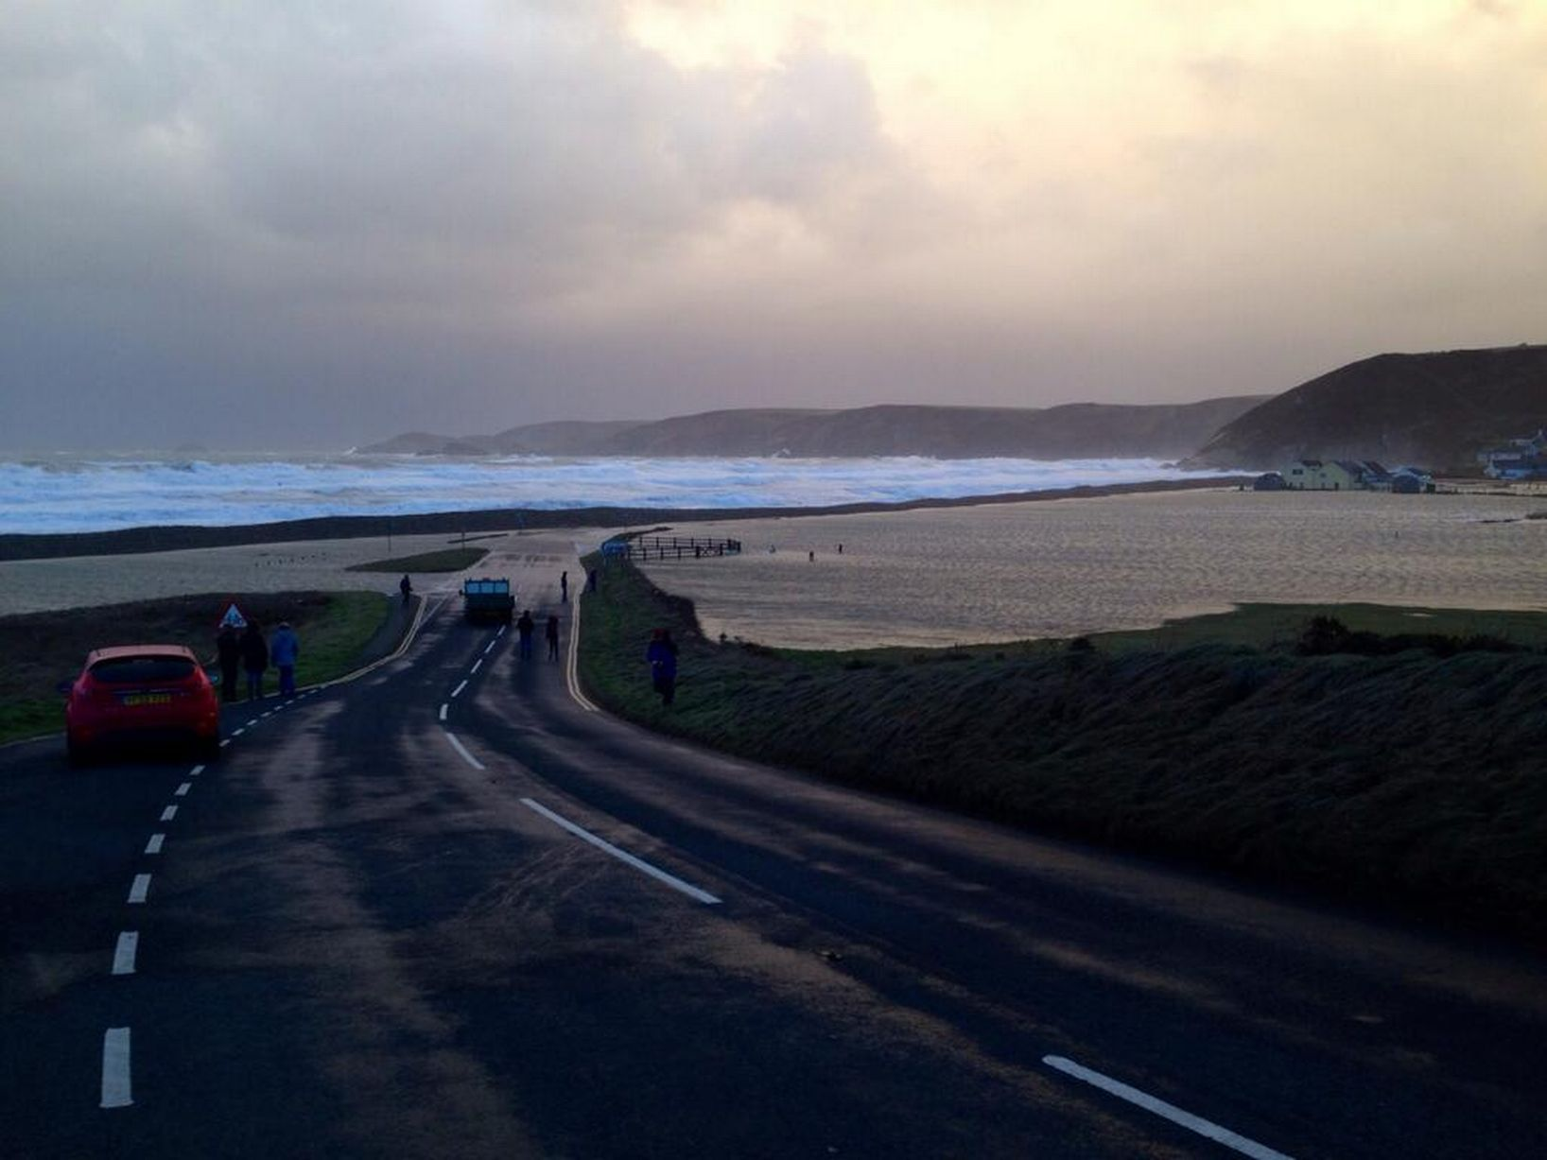
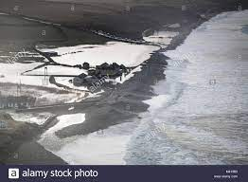
The Effects of Global Warming
Coastal Erosion
Rising Sea Levels
Sea Temperature Changes
Storm surges
Displacement of animals

Slide 5
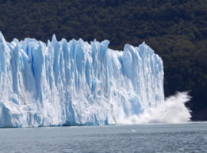
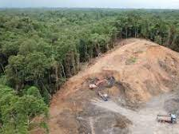
Reversing Global Warming
Reforestation
Cleaner Cars
Low Carbon Construction
Sustainable living
Renewable energy

Slide 6
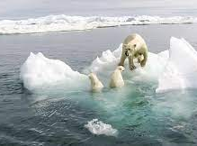
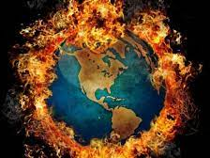
Reality
We are the last generation that can Reverse Global Warming/Climate Change in our lifetime
Prevention isn’t enough
1000 years to undo
Continue Efforts to Reduce Carbon Emissions
Begin Efforts to Protect against the effects

Slide 7
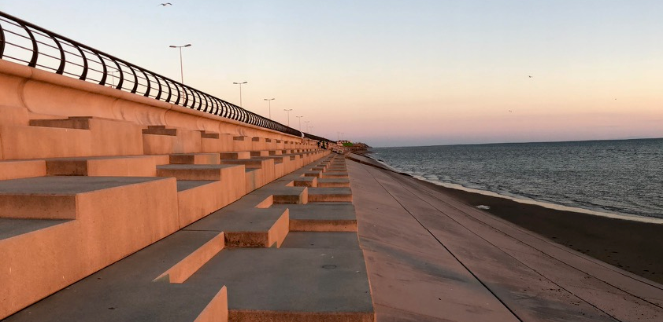
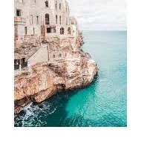
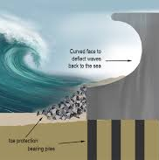
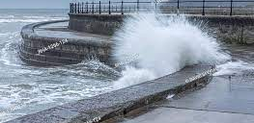
New Focus
Protection
Natural Flood Defenses
Man Made Flood Walls
Tidal Lagoons
Econcrete

Slide 8
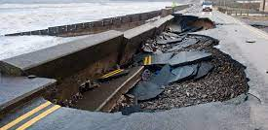
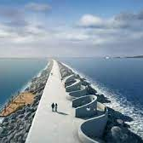
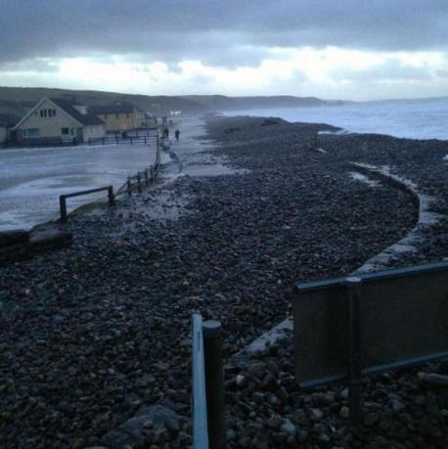
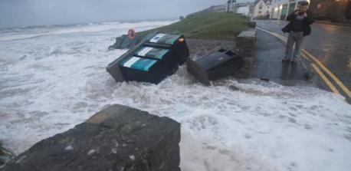
Purpose
Flood Defense
Delay Effects of Rising Sea Levels
Increased Housing
Increased Tourism
Improved Quality of Life, and Safety to residents
Renewable Power Source

Slide 9
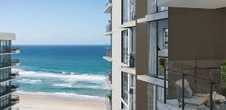


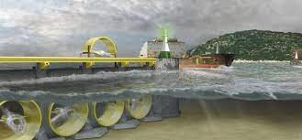
Methodology
Interview: Estate agents to gauge interest in beachfront residential and investment.
Interview national parks/local council to discuss limitations of building in National Parks, Coastal Parks
Case Study: Further explore the benefits of Tidal Lagoons as an energy source, develop that further to discover the potential coastal protection of them.

Slide 10
Adding to Existing Knowledge
The West Coast of Wales (the UK) is Highly Susceptible to Flooding for 6 Months every year.
Many Coastal Towns and Villages Could be Devoured by Rising Sea Levels.
Developing a Multipronged Approach to Global Warming. Using Flood Defense as a Barrier, Renewable Energy Source, and Residential/Tourism Income

Slide 11

Any Questions?

Slide 12
References
https://royalsocietypublishing.org/doi/abs/10.1098/rsta.2005.1570
https://www.nature.com/articles/s41586-019-1541-4
https://www.euractiv.com/section/climate-environment/news/we-are-last-generation-that-can-stop-climate-change-un-summit/
https://www.sciencedirect.com/science/article/pii/S0959378019307113
https://hess.copernicus.org/articles/23/3117/2019/
https://www.sciencedirect.com/science/article/pii/S026151771630262X

Slide 13

Figures.
https://www.alamy.com/stock-photo-flooding-over-the-sea-defence-at-newgale-beach-in-pembrokeshire-174591539.html
https://www.walesonline.co.uk/incoming/gallery/storms-hit-welsh-coastline-january-6464486
https://science.howstuffworks.com/environmental/green-science/reverse-global-warming.htm
https://www.livescience.com/27692-deforestation.html
https://www.greenmatters.com/p/global-warming-causes
https://qrius.com/didnt-start-fire-global-warming-climate-change/
https://www.newground.co.uk/blog/a-changing-coastline-the-impacts-and-how-we-can-adapt/
https://www.westerntelegraph.co.uk/news/10911974.updates-from-a-dramatic-day-as-flooding-hits-pembrokeshire/

