Slide 1

Module: Problem Solving and Decision Making
Module code: LCLM4004
Component 1: Green Haven Florists
Student Name: Janina Marinela Fira
Student ID:2435168
Lecturer name: Abdulah Sodiq

Slide 2

Title: Green Haven Florists: Business Challenges and Strategic Analysisbhhhu

Slide 3

Introduction
  This presentation will investigate Green Haven Florists, challenges, including sales decline, rising costs and competition.
  Founded in 2016 in Norwich, UK, Green Haven Florists is well-known for bespoke floral designs and its commitment to eco-friendly values.
  This presentation will assess the nature and scope of the problem.
  This will also investigate external factors and root causes.

Slide 4
Overview of Green Haven Florists
Green Haven Florists is an independent flower shop founded in 2016 in Norwich, UK, by Liam and Patel.
It is mainly well-known for bespoke arrangements, eco-friendly packaging, as well as strong community ties.
This business also faces declining revenue, increasing costs, and increased competition from online as well as local florists.

Slide 5
Problems of Green Haven Florists
Problem | Type | Contribution Factors | Level of Control
30% decline in in-store sales | Internal/External | Reduced foot traffic due to high street decline, change to online shopping (Venugopal and Akhila, 2023) | Medium- can also implement marketing, but cannot control broader shopping trends.
Rising operational costs | Internal | Enhanced flower prices, sustainable packaging expenses | High- can manage suppliers as well as costs strategically
Competition from online and local florists | External | National chains with discounts, boutique florists with strong social media | Low- can not control competitor actions
Outdated digital presence | Internal | Website is difficult to navigate, and has limited online marketing | High- can update website as well as develop digital strategy

Slide 6
Applying 5W2H Model
What | Where | When | Who | Why | How | How Much
What effect is it having? | Where is the problem occurring? | When was the problem first noticed? | Who is impacted by the problem? | Why is the problem happening | How serious is the problem? | How much money is being lost?
30% decline in 0n-store sales, rising expenses, slight online growth | Green Haven Florists, Norwich | Last 12 months | Owners, workers, and regular customers | Increased competition, reduced foot traffic, supply chain problems, and outdated digital presence. | Limited delivery options, weak digital marketing, and website problems | Significant revenue loss, profitability under threat.
Notes:
.

Slide 7
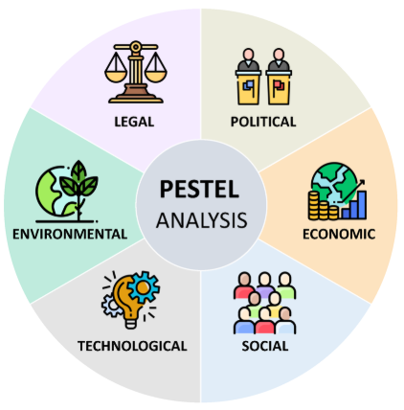
PESTEL Framework
  PESTEL analysis is mainly a framework for assessing and evaluating external factors that can affect an organisation’s strategic planning and decision-making (Buye, 2021).
  Used to identify the external business environment.
  Helps with strategic planning, risk identification, and market understanding.
  Benefits: Holistic insight, informed decisions.
  Criticism: May oversimplify, lacks prioritization.

Slide 8
External Factors: PESTEL Analysis
Political | Brexit has also led to increased import expenses for flowers, impacting pricing as well as supply chains.
Economic | The UK florist industry is also valued at £1.1 billion in the year 2025, with a modest annual growth rate of 0.4% from 2019 to 2024 (Beels, 2024). On the other hand, inflation has also raised the flower prices, specifically imported varieties, impacting profit margins.
Social | Customers highly prefer online purchasing for convenience as well as cost-effectiveness.
Technological | E-commerce as well as social media presence are essential for attracting new consumers (Khrais and Gabbori, 2023).
Environmental | Demand for eco-friendly packaging is increasing, though it also adds to operational expenses.
Legal | Also, compliance with the sustainability regulations, along with employment law, is mandatory.

Slide 9
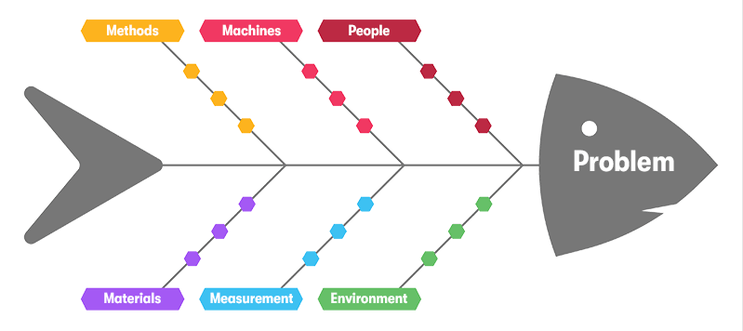
Critique of the Cause-and-Effect Model
The cause-and-effect Model identified root causes of issues (Kang et al., 2021).
Used to investigate issues systematically as well as find solutions.
Used in quality control, business problem-solving, and process improvement.
Benefits: Clarifies causes, supports decision-making.
Criticism: Can oversimplify complex issues.

Slide 10
Provide an application and discuss the Cause-and-Effect Diagram
Methods
Machines
People
Inefficient Workflows
Equipment
Breakdowns
Staff Errors
Problems:
Loss Customer base
Decrease in overall revenue
Outdated Procedures
Maintenance Issues
Inadequate training
Low-quality Supplies
Inaccurate data
Poor Lighting
Shortages
Poor Tracking systems
Noisy workplace
Materials
Measurement
Environment

Slide 11

Conclusion
  Green Haven Florists also faced declining sales and rising expenses.
  Customer preference changed toward online shopping and subscriptions.
  Competitors gained an advantage through pricing as well as digital presence.
  Market changes also reduced foot traffic and revenue.
  Moreover, internal and external factors also caused significant challenges.

Slide 12
Reference List
Amaldoss, W., Du, J. and Shin, W. (2024) ‘Pricing strategy of competing media platforms.’ Marketing Science, 43(3), pp.488-505. Available at: https://pubsonline.informs.org/doi/abs/10.1287/mksc.2021.0092
Andonova, Y., Anaza, N.A. and Bennett, D.H. (2021) ‘Riding the subscription box wave: Understanding the landscape, challenges, and critical success factors of the subscription box industry.’ Business Horizons, 64(5), pp.631-646. Available at: https://www.sciencedirect.com/science/article/pii/S0007681321000264
Beels, M. (2024) ‘United Kingdom Labour Market Enforcement Strategy 2024/25 Annexe B: Labour market and non-compliance risk analysis.’ Available at: https://assets.publishing.service.gov.uk/media/67336b0579e9143625613575/uk-labour-market-enforcement-strategy-2024-25-annex-b-print.pdf (Accessed by 27th September, 2025).
Buye, R. (2021) ‘Critical examination of the PESTEL Analysis Model.’ Project: Action Research for Development, pp.1-12. Available at: https://www.researchgate.net/profile/Ronald-Buye/publication/349506325_Critical_examination_of_the_PESTEL_Analysis_Model/links/6093f3fd92851c490fbd6e7e/Critical-examination-of-the-PESTEL-Analysis-Model
Kang, Y., Yang, S. and Patterson, P. (2021) ‘Modern cause and effect model by factors of root cause for accident prevention in small to medium-sized enterprises.’ Safety and health at work, 12(4), pp.505-510. Available at: https://doi.org/10.1016/j.shaw.2021.08.002
Sutinen, U.M., Saarijärvi, H. and Yrjölä, M. (2022) ‘Shop at your own risk? Consumer activities in fashion e‐commerce. International Journal of Consumer Studies, 46(4), pp.1299-1318. Available at: https://doi.org/10.1111/ijcs.12759
Venugopal, K. and Akhila, J. (2023) ‘Assessment of Physical Environmental attributes impacting the foot traffic at Retail Stores.’ International Journal of Innovative Research and Practices, 11(7), pp.10-17. Available at: https://www.forum4researchers.com/cw_admin/docs/IJIRP-JULY-23-02.pdf

