Slide 1

The future of work: artificial intelligence and human collaboration in hospitality. enhancing guest satisfaction and employee efficiency at Marriott hotels
Presented by:
Catalina Trasc
Student number: 2018162

Slide 2
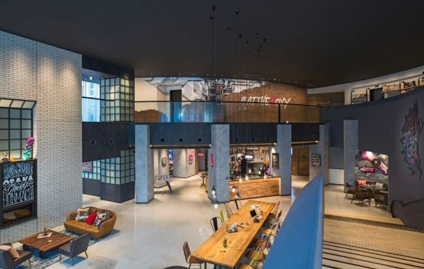
Structure:
Artificial Intelligence definition
Why AI and Human Collaboration is Crucial
Main Areas Where AI is implemented in hotels
Key Benefits of Using AI in Hotels
Impacts
Method
PEST analysis
Conclusion
Recommendations

Slide 3
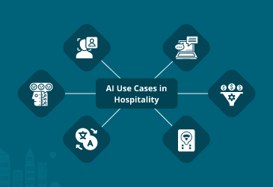
INTRODUCTION
FACIAL RECOGNITION
CHATBOTS & VIRTUAL ASSITANCE
SMART ROOM CONTROLS
LANGUAGE TRANSLATION
SENTIMENT ANALYSIS
REVENUE MANAGEMENT
What is AI?
AI in hospitality (Ivanov & Webster, 2019)
COVID-19 effects in hospitality
Digital transformation
AI and human collaboration:
1. Reshaping roles
2. Improving guest experiences
3. Optimizing operations

Slide 4
Main areas where ai is implemented
AI CHATBOTS AND VIRTUAL ASSISTANTS
VOICE ACTIVATED CONCIERGE SYSTEMS
AI RECOMMENDATIONS FOR MENU PERSONALIZATION
INVENTORY AND WASTE MANAGEMENT OPTIMIZATION
FACIAL RECOGNITION FOR CHECK-IN
AI POWERED DYNAMIC PRICING TOOLS TO ADJUST ROOM RATES BASED ON DEMAND
AI DRIVEN GUEST SEGMENTATION AND PERSONALIZED MARKETING EMAILS
PREDICTIVE MAINTENANCE
SMART SCHEDULING OF HOUSEKEEPING TASKS BASED ON OCCUPANCY AND GUST BEHAVIOR
FRONT DESK
REVENUE MANAGEMENT
HOUSEKEEPING & MAINTENANCE
MARKETING
FOOD & BEVERAGE
SECURITY & OPERATIONS

Slide 5
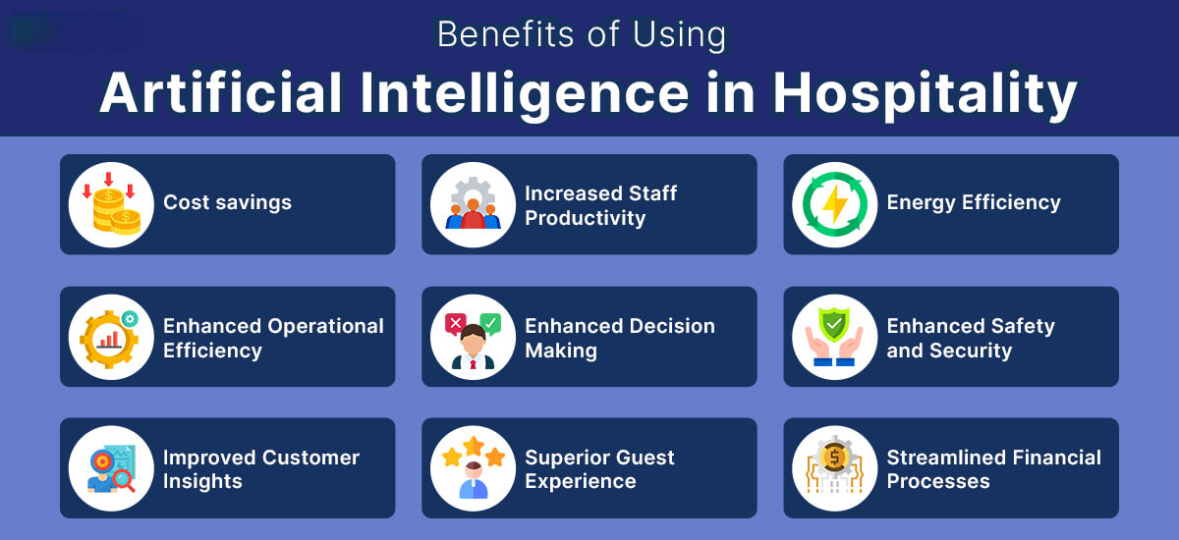
Key Benefits of Using AI in Hotels

Slide 6
LITERATURE REVIEW
OPERATIONAL EFFICIENCY & COST REDUCTION
Example: Marriott’s partnership with Winnow to reduce food waste. Data point: 25% reduction in food waste in 6 months (Winnow, 2023).
GUEST PERSONALISATION
Marriott’s use of RENAI (AI concierge) and Bonvoy App. Higher loyalty through personalized offers and Increased guest satisfaction.
REVENUE MANAGEMENT
AI helps Marriott forecast demand and set dynamic pricing. Improved RevPAR.

Slide 7

METHOD:
Official hotel website (Marriott International.com, 2023)
Social media platforms and customer feedback portals (Booking.com, 2025)
Academic journals and hospitality trade publications.

Slide 8
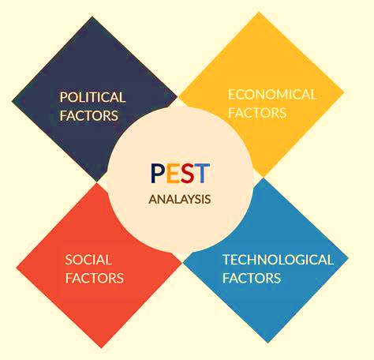
POLITICAL
Data Protection and Regulatory Compliance
RENAI virtual concierge
Labour Policies and Employment Rights
bias in AI algorithms
Tussyadiah (2020) emphasized that AI adoption must be accompanied by robust, transparent, and ethical data management practices to maintain guest trust.
concern from labour unions and political institutions about job displacement.
Ethical AI Frameworks and Accountability

Slide 9
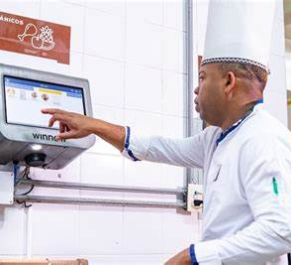

ECONOMICAL
Service robots in food and beverage operations or AI-powered systems in housekeeping scheduling significantly reduce reliance on manual processes.
The economic implications of AI adoption in hospitality are:
• Cost savings through automation
• Revenue growth via data-driven personalization
• Resilience through digital transformation post-pandemic

Slide 10
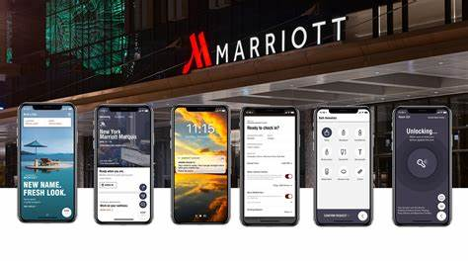
SOCIAL
1. Changing Guest Expectations: Marriott’s AI concierge system, RENAI.
2. Cultural and Demographic Acceptance of AI: adopt culturally sensitive AI strategies, offering guests flexible service channels depending on their comfort levels and preferences.
3. Staff Reskilling and the Human-AI Synergy: staff reskilling and training programs.
4. Maintaining the “Human Touch”
in a Digital World: balance AI-driven
efficiency with human warmth.
Notes:
Social factors—such as evolving guest expectations, demographic attitudes towards technology, and the need for human connection—significantly shape how AI is perceived and received in hotel environments like Marriott.
RENAI was created based on the understanding that Renaissance Hotel guests are “interested in emerging tech that is clever and has personality,” Marriott said in the announcement.
Guests can start a conversation requesting information on local experiences, dining and more. Then, the “virtual concierge” will respond with its recommendations, which are vetted by the brand’s human Navigators. The technology can also identify deals on restaurants, tours and more.
According to Jiwnani (2024), hyper-personalization—where AI systems tailor room settings, greetings, and loyalty offers—directly enhances guest satisfaction, increases brand engagement, and boosts repeat booking rates.

Slide 11
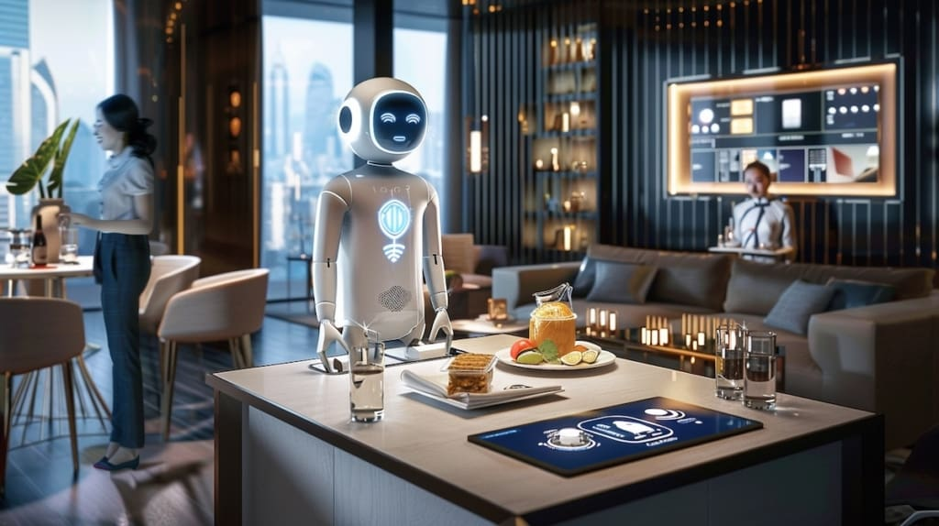
TECHNOLoGICAL
Benefits:
• Increased efficiency
• Enhanced service speed
• Predictive capabilities that prevent service disruptions

Slide 12


CONCLUSION :
AI is reshaping the UK hospitality sector by offering efficiency, personalization, and sustainability.
Marriott has been a frontrunner, particularly through Winnow AI and RENAI.
AI’s full integration must be balanced with human-centric hospitality values.

Slide 13
Recommendations:
1. Integrate AI to Enhance, Not Replace, Human Interaction.
2. Invest in Training and Upskilling Employee.
3. Invest in multilingual NLP systems to support diverse guest profiles.
4. Address Data Privacy and Ethical Concerns.
5. Segment AI Applications by Property Type.
6. Encourage Feedback and Continuous Improvement.

Slide 14
thank you for your attention!
REFERENCES:
EchoinnovateIT (2023) How AI Reduces Costs in Hospitality. Available at: https://echoinnovateit.com Accessed on 3rd June 2025.
Ivanov, S. & Webster, C. (2019) Robots, Artificial Intelligence, and Service Automation in Travel, Tourism and Hospitality. Emerald Publishing.
Jiwnani, S. (2024) Guest Personalisation in the Age of AI: A Human-Centric Approach. Journal of Hospitality Innovation, 12(1), pp. 45-58.
Kimes, S. (2021) Hotel Revenue Management in an Era of Data Science. Cornell Center for Hospitality Research.
Marriott International (2023) Sustainability and Social Impact Platform – Serve 360. Available at: https://serve360.marriott.com/ Accessed on 25th May 2025.
Marriott News Center (2023) AI Concierge RENAI Enhancing Guest Experience. Available at: https://news.marriott.com/2023/renai-ai-concierge Accessed: on 2nd June 2025.
Tussyadiah, I. (2020) A review of research into automation in travel and hospitality: Launching the Annals of Tourism Research Curated Collection on AI and Robotics in Tourism, Annals of Tourism Research.
Winnow (2023) Marriott Case Study: Reducing Food Waste with AI. Available at: https://blog.winnowsolutions.com/Accessed on 28th May 2025.

