Slide 1
Financial Overview
James Long

Slide 2
Introduction
I am James Long and I have been looking at the financial overview for the project
I will be talking about cash inflow and outflow and projected costs and profits for the company over the first year
I will also be talking about our start-up funds and where we would get them from

Slide 3
Start-Up Funding
Our original funding would come from investments from either our own pocket or from a third party
We’d be looking for around £5000-£10000 to buy the equipment
If unable to get a grant it would come from our own pocket and potentially a loan or a mixture of loan and grant
“Arwain Sir Benfro LEADER Programme” / Pembrokeshire Lottery
Notes:
Our original funding would come from investments from either our own pocket or from a third party
We’d be looking for around £5000-£10000 to buy the equipment and to get up and running
If we would not be able to get this from a third party then we would have to take £5000 out of our own pocket and then attempt to get a £5000 grant to make up the difference. If it was difficult to do either of these then potentially we would look into business loans. Barclays offer a £10000 loan paid back over 5 years with 6.8% APR.
One of the grants we would attempt to get is “Arwain Sir Benfro LEADER Programme” which is designed for the use of “Exploiting Digital Technology”, if we weren’t able to gain much from this we would then contact the Pembrokeshire Lottery and see what they are willing to contribute.

Slide 4
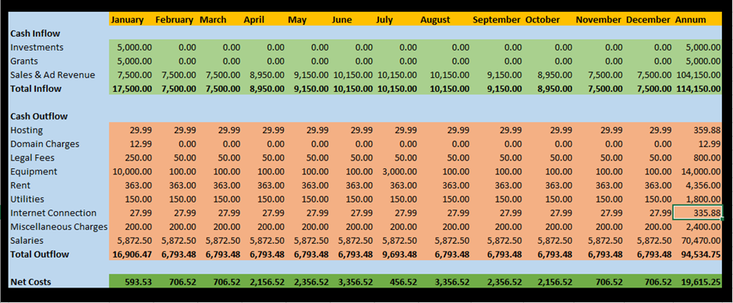
Cash Inflow
Assumption based off 25 businesses with 50 customers and us getting 1.50 from each customer
25 x 1.50 x 50 x 4 = Total Monthly Revenue
1.50 per customer based on average of £30 table
Looking to take around 5% per bill
Brings in around £7,500 per month but will increase during busier months (April-September)
Notes:
There is one assumption we have made with calculating the total cash inflow from our business and this is the amount of businesses and customers we would be getting each week along with the average cost of their bill.
Our monthly revenue is calculated by 25 businesses who will bring in tables booked per week with an average bill of £30, this is a conservative assumption as if they do not this target, the other tables will have likely purchased more than £30 worth of food and drink bringing us back onto our target.
We will be looking to take around 5% of the total bill as this won’t intrude on the customer by having them pay up front, and won’t hurt the business as it is a small contribution
This brings in around £7,500 per month as revenue intended to increase as the tourist season kicks in (April-September)

Slide 5
Cash Outflow
First month is most money spent
Only reoccurring chargers after that until summer as company doesn’t need to hold stock
First year profit £20000
Salaries brought beyond national living wage after first year
As business grows there are plans for a new office and increase in file storage etc.
Notes:
Our first month is where we would likely spend the most amount of money due to setting the system up, renting office space and buying all of our equipment
Once this is done there would mostly just be reoccurring charges and salaries to pay out as we don’t need to hold onto stock to sell. This is until the summer where we are expecting to upgrade the office or the machines we work on to produce higher quality advertising material such as small animated videos etc.
This gives us a total profit over the first year overall with almost £20000 being made
After the first year the wages would be brought up to a more respectable industry standard wage as opposed to paying employees from the national living wage.
As the business grows other charges may increase due to the amount of data we would store and if we upgraded office space etc but this should be covered by the increase in business bringing in more money overall meaning we don’t lose out on much, if any profit.

Slide 6
Overall Forecast
If the forecast is correct we would make £20000 profit in first year
If incorrect then we could make or lose more money than projected.
This would likely increase when moving outside of West Wales
In an area like London which has several high cost restaurants this could potentially make double or triple the profit.
More staff would be employed and other charges increase
Notes:
If the forecast is correct and we would be able to get 25 businesses on board before launching the app officially we would make around a £20000 profit in our first year
This would potentially go either way and could bring in much more money or lose money depending on how sales were and advertising for the app was.
After expanding to other areas around and beyond West Wales then the profit margin is likely to go up as there are more businesses involved and more people to advertise to.
In an area like London which has several high cost restaurants this could potentially make double or triple the profit as the cost of eating in those areas are much more than in west Wales.
Once expanded to these areas more staff would be employed and other charges will increase. This would be down to buying more office space, better website hosting, an increase in data storage etc.

Slide 7
Thanks for Listening

