Slide 1
John Muir Award
Scrapbook of Ellys Lyle
1904360

Slide 2

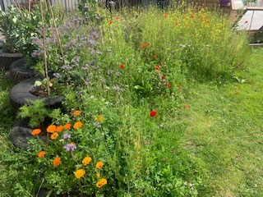
Wildlife garden, lots of flowers and plants to home bees and creatures.

Slide 3
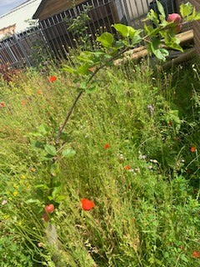
Fruit trees planted to harvest.

Slide 4
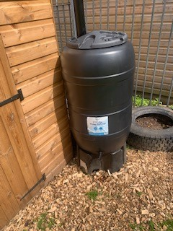
Water butt to reuse and recycle rainwater.

Slide 5
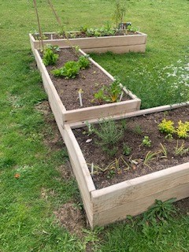
Planter with edible plants such as fruit, vegetables and salad.

Slide 6
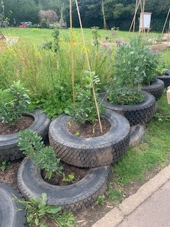
More plants that are edible such as sweet peas.

Slide 7
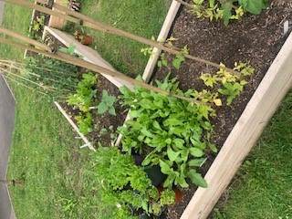
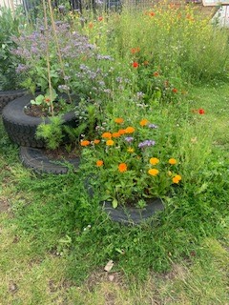
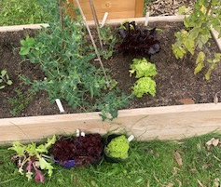

Slide 8
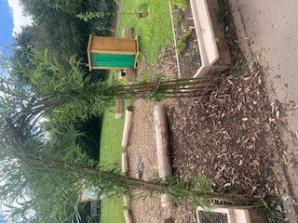
Entrance and sitting area inside the edible garden.

Slide 9
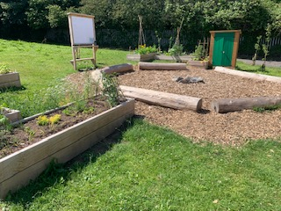
The edible Playground sitting area and planters.

Slide 10
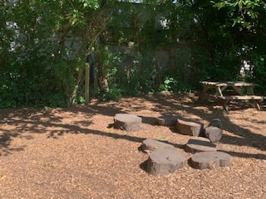
The entrance to the Willow Garden.

Slide 11
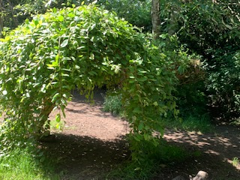
Lovely area to relax and play hide and seek.

Slide 12
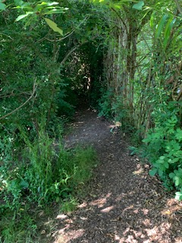
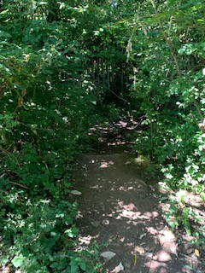
Pathways inside the willow garden. They are also great to run around and play hide and seek.

Slide 13
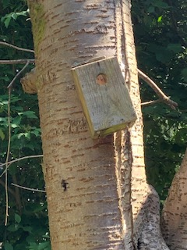
A big bird box nailed to a tree to help bird nest and find somewhere to rest and feed.

Slide 14
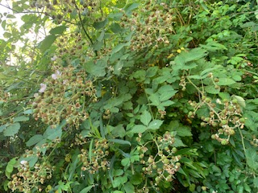
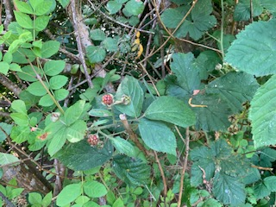
Wild raspberries growing, great source of food for wild animals.

Slide 15
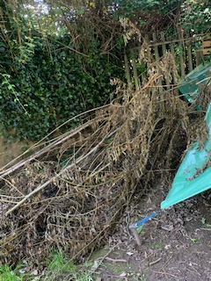
Pile of trees that got cut down and is now a messy area within the Willow garden. This is a great area for wildlife to hide and live but also, makes the area look messy. So next step is to tidy up the tress.

Slide 16
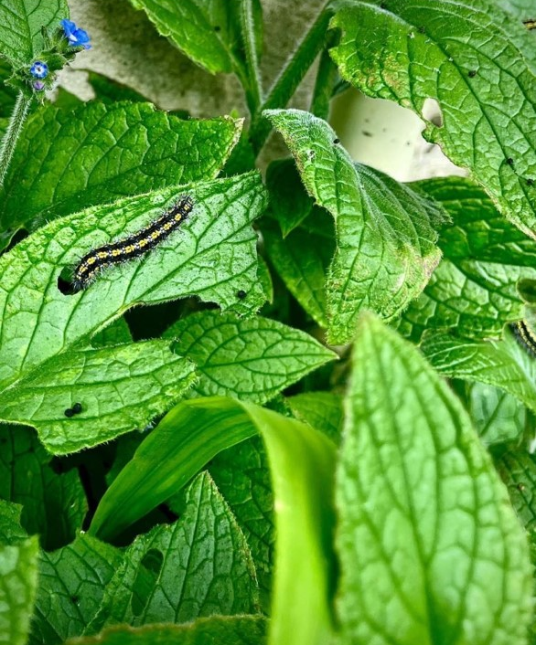
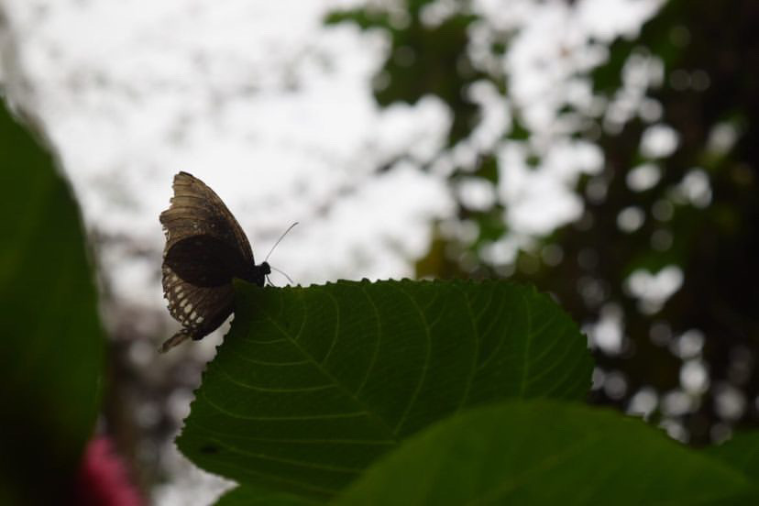
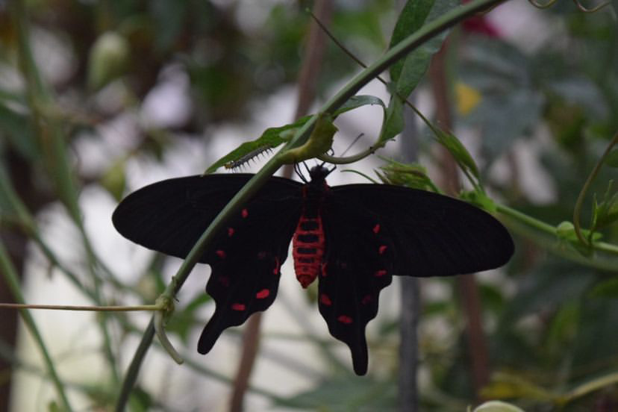
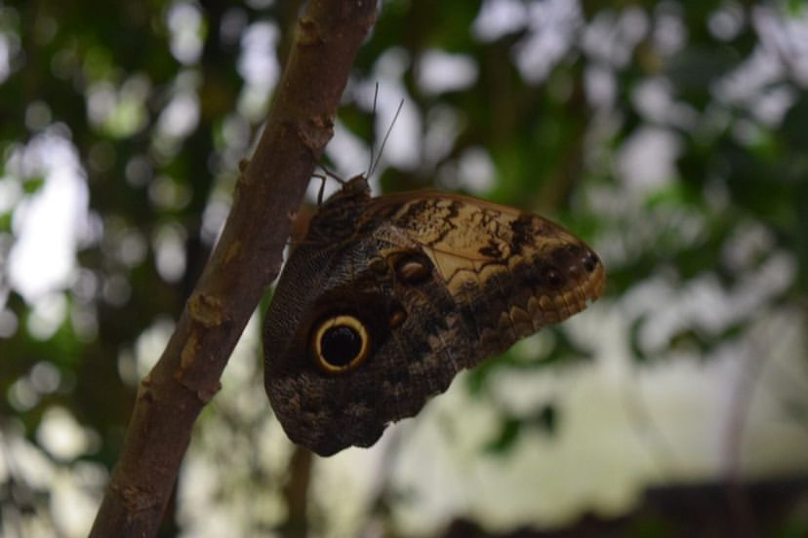
Wildlife captured within the Willow garden.

Slide 17
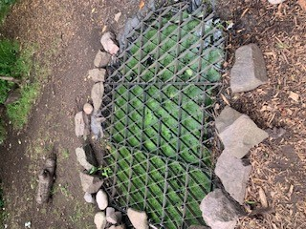
Wildlife Pond, every year we have tadpoles in here every year.

Slide 18
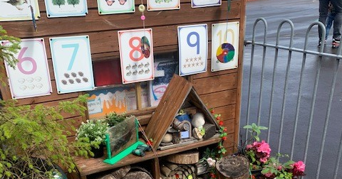



Bug hotel we made to home a variety of insects.

