Slide 1



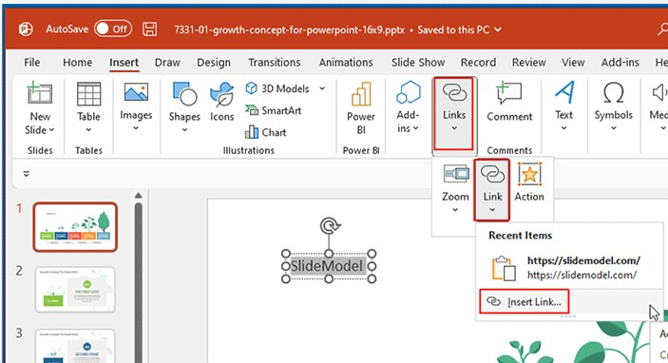





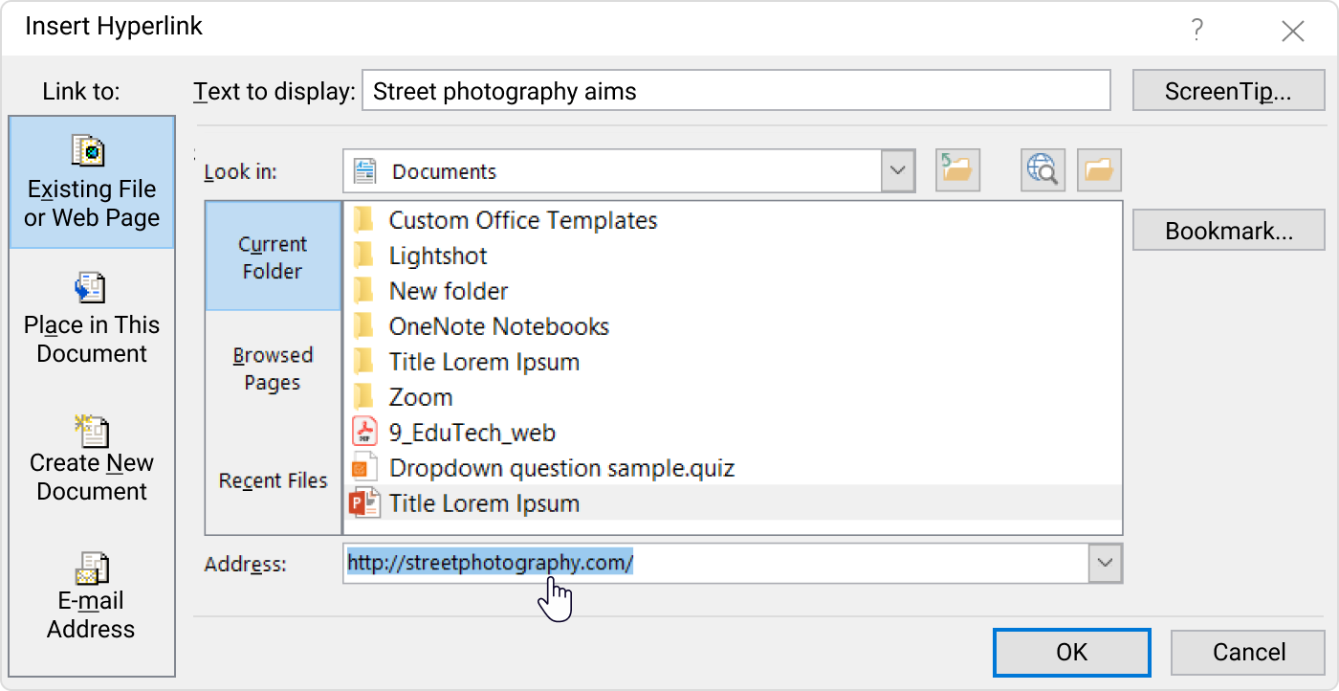


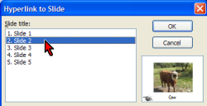



INSERT
HYPERLINK
POWERPOINT
How to Add a Hyperlink to a PowerPoint
To insert a hyperlink to text, shape, chart, or picture, select it and go to Insert -> Link -> Insert Link.
Go to the Insert tab
Click the Link button
Click Insert Link
Then Choose the type of Source
Below
Types of Sources
Hyperlink a Webpage or File
Hyperlink a Slide
Hyperlink a New Document
Hyperlink an Email Address

