Slide 1
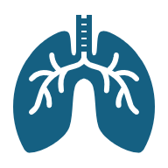
Emphysema:
Impact on the Respiratory System and Care Planning
Student name: Marie Andrews
Number: 2411716
Module code: (BMHP5023)
Lecturer: Robert Nartowski

Slide 2
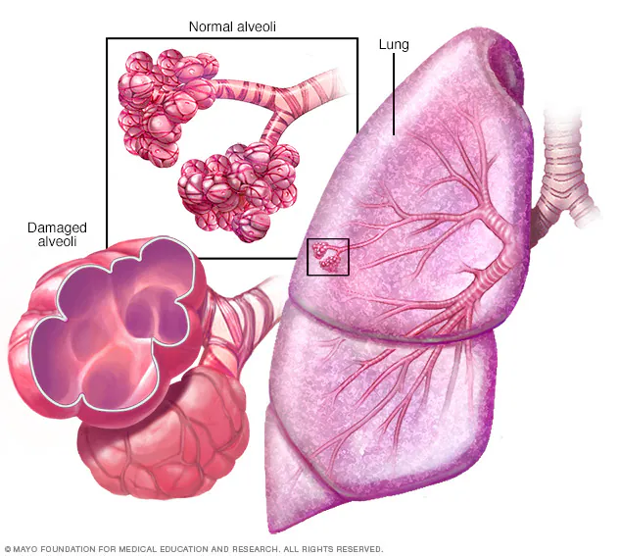
Introduction
Chronic Respiratory Diseases are a major health challenge in the UK, affecting quality of life and healthcare services (Kurpas et al, 2014).
Emphysema is a type of COPD that develops slowly and gets worse over time (PRASAD, 2020).
It occurs when the air sacs (alveoli) in the lungs are damaged, making breathing difficult.

Slide 3
Patient Case
Patient: Mr. Ahmed, 62 years old, Retired factory worker, lives in Manchester
History of smoking: 30 pack-years
BMI: 29 (overweight), limited physical activity
Risk factors: smoking, age, occupational dust/fumes, urban air pollution
Family history: cardiovascular disease

Slide 4
Anatomy of the Respiratory System
Main structures: nose, trachea, bronchi, bronchioles, alveoli, diaphragm
Function: moves air in and out of lungs (ventilation)
Alveoli = tiny air sacs where oxygen enters blood and carbon dioxide leaves (Comroe, 1966)
Diaphragm and intercostal muscles support breathing movements

Slide 5
Physiology of Gas Exchange
Alveoli: provide a large surface area for gas exchange
Oxygen diffuses into capillaries; carbon dioxide diffuses out (Clark, 1997)
Thin alveolar walls + rich blood supply make exchange efficient
Elasticity of lungs helps air move in and out smoothly

Slide 6
Pathophysiology of Emphysema
Alveolar walls are destroyed → fewer, larger air sacs
Reduced surface area → less oxygen enters blood
Loss of lung elasticity → air trapping, difficulty exhaling
Leads to chronic breathlessness, hypoxia, CO₂ retention

Slide 7
Symptoms & Complications
Main symptoms:
Shortness of breath (dyspnoea), especially on exertion (Coccia et al, 2016)
Chronic cough with sputum
Wheezing, chest tightness
Long-term effects:
Fatigue and weight loss
Frequent chest infections
Severe cases → pulmonary hypertension, right-sided heart failure (cor pulmonale) (Brill, 1939)

Slide 8
Care Plan (Lifestyle Management)
Smoking cessation: the most crucial step to slow disease progression (Tashkin, 2015)
Pulmonary rehabilitation: exercise training & breathing techniques
Healthy diet: balanced nutrition to maintain energy & muscle strength
Vaccinations: annual flu and pneumococcal to reduce infection risk
Environmental control: avoid dust, fumes, and air pollution exposure

Slide 9
Care Plan (Medical & Monitoring)
Bronchodilators: inhalers to relax airways and ease breathing (Diaz et al, 2008)
Inhaled corticosteroids: reduce airway inflammation
Oxygen therapy: for patients with chronic low oxygen levels
Regular monitoring: spirometry and check-ups with GP or respiratory nurse
Pulmonary rehabilitation referral: ongoing support for exercise and education

Slide 10
Communication & Ethical Considerations
Shared decision-making: involves the patient in treatment choices
Clear communication: explain inhaler use & treatment plans in simple terms
Confidentiality: protect the patient’s personal health information
Respect for autonomy: support lifestyle choices while encouraging healthy changes
Empathy & support: address emotional impact of living with chronic disease (Stev et al, 2025)

Slide 11
Prognosis & Future Outlook
Progressive condition: no cure, but symptoms can be managed
With management:
Improved quality of life
Reduced hospital admissions
Slower disease progression
Without management:
Worsening breathlessness and disability
Frequent infections and hospitalisations
Increased risk of respiratory failure and reduced life expectancy

Slide 12

Conclusion
Emphysema is a progressive lung disease that damages the alveoli and reduces gas exchange, leading to breathlessness and serious complications. Although it cannot be cured, lifestyle changes, medical treatment, and regular monitoring can slow progression and improve quality of life. Patient-centred, ethical care is essential to support better long-term outcomes.

Slide 13
References
Kurpas, D., Mroczek, B., Sitko, Z., Helicka, D. and Kuchar, E., 2014. Quality of life and health care utilization in patients with chronic respiratory diseases. In Environment Exposure to Pollutants (pp. 63-74). Cham: Springer International Publishing.
PRASAD, B., 2020. Chronic obstructive pulmonary disease (COPD). International Journal of Pharmacy Research & Technology (IJPRT), 10(1), pp.67-71.
Comroe, J.H., 1966. The lung. Scientific American, 214(2), pp.56-71.
Clark, S.A., 1997. Normal oxygen transport. Design of Pulse Oximeters, pp.13-20.
Coccia, C.B., Palkowski, G.H., Ntusi, N.A.B., Schweitzer, B. and Motsohi, T., 2016. Dyspnoea: Pathophysiology and a clinical approach. South African Medical Journal, 106(1), pp.32-36.
Tashkin, D.P., 2015, August. Smoking cessation in chronic obstructive pulmonary disease. In Seminars in respiratory and critical care medicine (Vol. 36, No. 04, pp. 491-507). Thieme Medical Publishers.
Diaz, P.T., Bruns, A.S., Ezzie, M.E., Marchetti, N. and Thomashow, B.M., 2008. Optimizing bronchodilator therapy in emphysema. Proceedings of the American Thoracic Society, 5(4), pp.501-505.
Stev, C.H., 2025. Analysis of the Influence of Psychosocial Support on the Quality of Life of Patients with Chronic Diseases. International Journal of Nursing and Midwifery Research, 3(2), pp.76-85.
Brill, I.C., 1939. The clinical manifestations of the various types of right sided heart failure (cor pulmonale). Annals of Internal Medicine, 13(3), pp.513-522.

