Slide 1
LCBB5003
Management Economics
Week - 7
Market Structures: Monopolies

Slide 2
Learning Objectives
Define a monopoly
Identify monopoly power
Discuss the assumptions of monopolies
Compare the advantages and disadvantages of monopolies
Identify natural monopolies
Discuss the efficiencies of monopolies
Discuss the characteristics of monopolies
Define price discrimination
Analyse the conditions necessary for price discrimination to occur
Compare the advantages and disadvantages of price discrimination

Slide 3

Watch the video clip on this slide and discuss your understanding of the term “Monopoly” (10 minutes)

Slide 4
Definition: Monopoly
Only one firm in the industry
There are barriers to entry - other firms are unable to enter the industry and compete
It is a short-run profit maximiser
Has market power
Legal definition - company with a market share in excess of 25%
A monopolist is the only firm in the industry – it is the industry.

Slide 5
Examples of monopolies
Can you think of any?

Slide 6
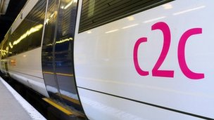
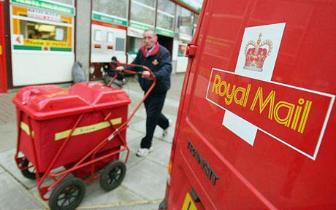
Examples of monopolies
C2C that serves Fenchurch Street
Royal mail

Slide 7
Assumptions of monopolies…
The neo-classical assumption of a monopoly assumes that there is only _____ firm in the market. That there are _____________ to ____________ preventing other firms from entering the market. The assumption is that the firm enjoys ____________ profits and is a profit __________________ in the short-run. We assume that the monopolist has market ____________. We also assume that in the long-run that one objective may be to ______________ unwanted entrants into the market. It carries out this action by the use of ____________ pricing strategies. It can also ensure it retains its abnormal profits by erecting barriers to __________.

Slide 8
Assumptions of monopolies…
The neo-classical assumption of a monopoly assumes that there is only one firm in the market. That there are barriers to entry preventing other firms from entering the market. The assumption is that the firm enjoys abnormal profits and is a profit maximiser in the short-run. We assume that the monopolist has market power. We also assume that in the long-run one objective may be to discourage unwanted entrants into the market. It carries out this action by the use of predatory pricing strategies. It can also ensure it retains its abnormal profits by erecting barriers to entry.

Slide 9
Where do monopolies come from? (5 minutes)
Origins of monopoly:
  discuss

Slide 10
Where do monopolies come from…answers
Origins of monopoly:
  Through growth of the firm, Economies of Scale
  Through amalgamation, merger or takeover
  Through acquiring patent or license
  Through legal means – Royal Charter, Nationalisation, wholly owned plc by the government
  Natural monopolies

Slide 11
What are the assumptions of monopolies?
Complete…
Number of sellers?
Number of buyers?
Firm position?
Existence of entry and exit barriers?
Motives?
Market power?
Information available?
Type of pricing?
Also:
Type of product?
Types of profits?

Slide 12
Assumptions of Monopolies
One seller
Large number of buyers
Firm is dominant
Entry and exit barriers
Firms are profit maximisers
Market power
Imperfect information
Destroyer or predatory pricing
Also:
Firms produce unique products, no close substitutes
The firm earns abnormal profits

Slide 13
Monopolies Conditions and Diagrams
Fill in the information on monopolies
Label the different points on the graph
What kind of profit will the firm be making?

Slide 14
Monopoly Profits
£
MC
A
B
AC
D
C
Area of abnormal profits ABCD
AR
MR
0
Q0
Quantity

Slide 15
Activity – comparing PC and monopoly – use side-by-side diagrams, same scales
Conditions of monopoly
Conditions of perfect competition
Draw MC
Show the output and price where MC=MR, label as Pm [price/monopoly] and Qm [quantity monopoly]
Indicate the gain in producer surplus
Indicate the loss of consumer surplus
Show the deadweight loss triangle
Show equilibrium (allocative efficiency)
Indicate the area of consumer surplus
Indicate the area of producer surplus

Slide 16
Perfect Competition
Monopoly
£
MC
£
Supply
Pm
p0
AE
Ppc
Demand
AR
MR
0
0
Qm
Qpc
Quantity
q0
Quantity

Slide 17


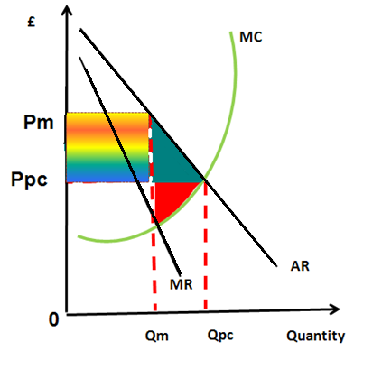
Perfect Competition
Monopoly
Loss of consumer surplus
Loss of producer
surplus
Gain in producer
Surplus and loss of consumer surplus (consumer surplus is appropriated) by the producer
£
Supply
p0
AE
0
q0
Quantity

Slide 18
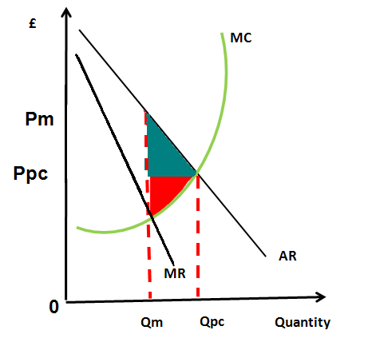
Monopoly – welfare loss
Deadweight loss triangle

Slide 19
Conditions of Monopolies
Condition | Relevance to real life monopolies
Room for only one firm in the industry
Barriers to entry
Unfair competition
Advertising on a massive scale
Natural Monopoly
Economies of scale

Slide 20
Conditions of Monopolies
Condition | Relevance to rail transport
Room for only one firm in the industry | Competing rail tracks serving the same area, there would be logistical and geographical constraints [natural monopoly argument] It would not be efficient to have more than one postman doing the same round
Barriers to entry | Existing suppliers can set a price higher than competition and still serve customers, lack of incentive to enter market and compete e.g. difficulty setting up firms and providing the sufficient infrastructure for the business
Unfair competition | Price wars erupt to bankrupt any possible competitor - where local monopoly suppliers will fight new entrants for services through predatory pricing
Advertising on a massive scale | Costly for any new entrant to enter to detract customers away
Natural Monopoly | The minimum efficient scale is so large that the advantages of the economies of scale are not exhausted at any foreseeable output, huge cost to build rail tracks. Cost of sorting offices and distributional mail network
Economies of scale | A new entrant would not be able to gain these e.g. capital costs to set up new rail routes

Slide 21
Price Discrimination
Price discrimination: charging a different price for the same good or service in different markets
Give examples of price discrimination in the following
contexts…
Rail
Museums
Fill in the boxes explaining the different types of price discrimination

Slide 22
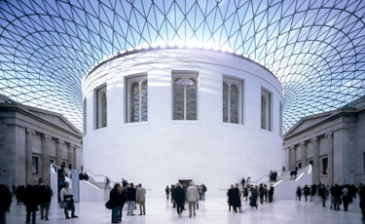
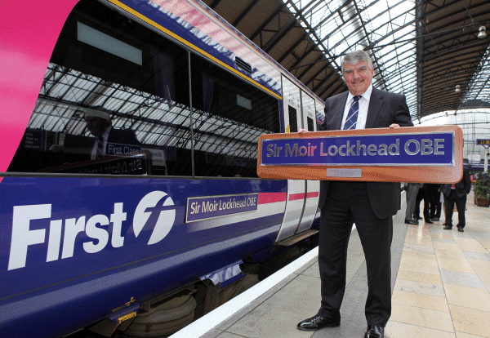
Methods of Price Discrimination
Can you identify ways of price discrimination in either Rail or Museum according to these methods?
Geographical
Branding
Time
Type of customer

Slide 23
Methods of Price Discrimination
Museums
Rail
Geographical – different zones
Branding – premium seats, class
Time – different times of the day
Type of customer – by age, income, status
Branding – different exhibits
Time – different times of the day
Type of customer – by age, income, status

Slide 24
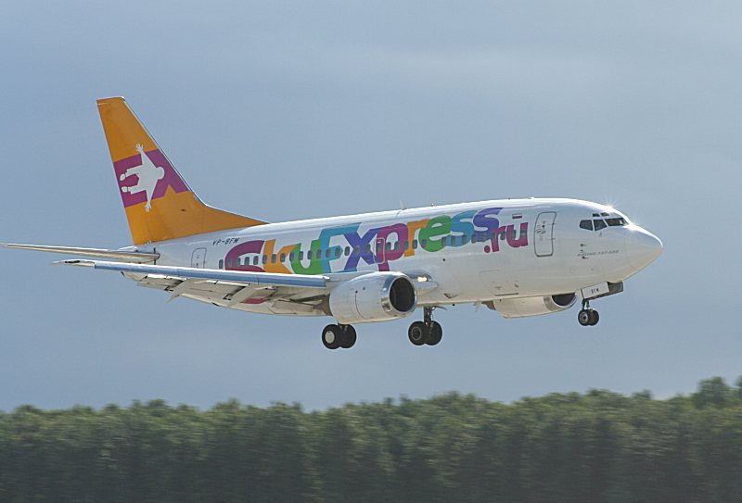
The Context of Air
Why are midweek fares usually cheaper?
Why are late flights cheaper?
Why are there extra discounts for booking on-line?
Why are bargain flights usually harder to obtain during the holidays?
How would you expect a Germany v. England football match in Munich to affect fares around the match date?
What might occur to pricing policy for the airline if flights to Munich were exclusive to one company?

Slide 25
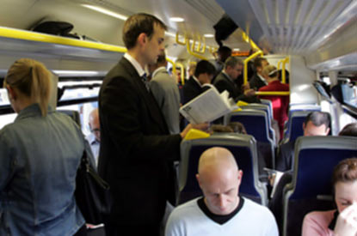
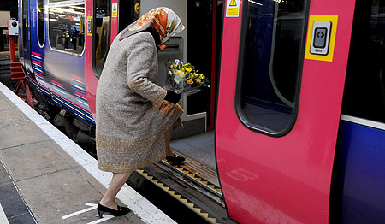
However…
You may be thinking that not all of those commuters would be paying full fare – and you would be right – this situation is called Price Discrimination

Slide 26
Price discrimination activity
Price discrimination: charging a different price for the same good or service in different markets
State the three conditions there must be for price discrimination to work (Please use your textbook for this activity)

Slide 27
Conditions Necessary for Price Discrimination
The market must face different demand curves i.e. there must be different elasticities of demand in different groups - some buyers must be prepared to pay more than others [and so the monopolist can charge different prices]
It must be possible to split the market into distinct groups [and therefore distinguish between them]
The monopolist must be able to separate the markets AT LOW COST and resale must be preventable from one buyer to another [market seepage]

Slide 28
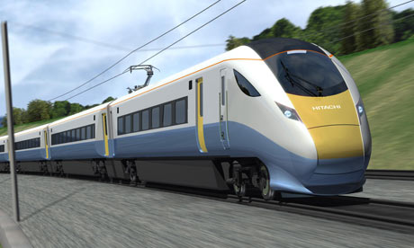
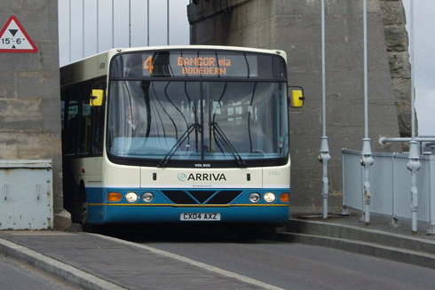
Examples
List all the examples of price discrimination you can think of; for trains and for bus travel

Slide 29
Price Discrimination
train
bus
Peak times
OAP
Child tickets
Group tickets
Including underground
Oyster
Annual tickets
OAP fares
Child fares
Return/single
Bus passes
Season tickets
Octopus

Slide 30
price discrimination – what occurs in these scenarios?
Where demand is price elastic…
Where demand is price inelastic

Slide 31
Price Discrimination – what occurs in these scenarios?
Where demand is price elastic…
Where demand is price inelastic
Offers discounts
Charges a range of prices
Prices vary according to criteria e.g. age, time of travel
Demand is more sensitive to price
Monopolist minimises prices
Charges high prices
Due to on-peak demand, commuters pay high prices
Demand is less sensitive to price
Monopolist maximises prices

Slide 32
Price Discrimination
Advantages
Disadvantages
Re-investment of profits - consumers might derive benefits in terms of increased efficiency and lower costs and prices, e.g. better buses
Fairer - consumers paying the lower price may not have been able to afford it if a single price was charged – half price for children on trains and buses - OAP’s and travel cards
Superior - those consumers wishing to pay more can receive a superior product – first and club class on airlines
Higher prices e.g. users of peak time public transport pay more for the service
Producer gain more of the consumer surplus - represents a transfer of welfare from consumers to producers and is a way in which producers gain at the expense of consumers
Unjustifiable redistribution of income in favour of profit takers with higher prices reducing consumers' real incomes

Slide 33
Types of Price Discrimination
1. First Degree Price Discrimination
Discrimination, alternatively known as perfect price discrimination, occurs when a firm charges a different price for every unit consumed. The firm is able to charge the maximum possible price for each unit which enables the firm to capture all available consumer surplus for itself. In practice, first-degree discrimination is rare.

Slide 34
2. Second Degree Price Discrimination
Second-degree price discrimination means charging a different price for different quantities, such as quantity discounts for bulk purchases.

Slide 35
3. Third Degree Price Discrimination
This is the most frequently found form of price
discrimination and involves charging different prices
for the same product in different segments of the
market. Third degree discrimination is linked directly
to consumers’ willingness and ability to pay for
a good or service. The market is usually separated in
two ways: by time or by geography.

Slide 36
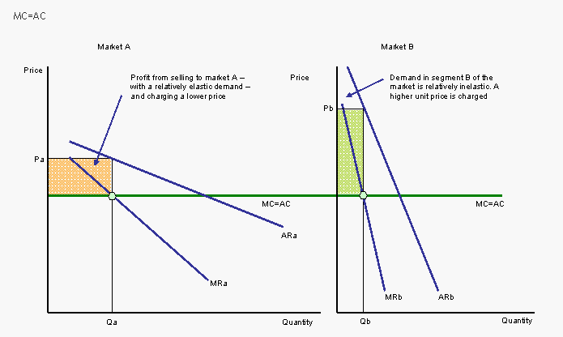
Demand Curves and Price Discrimination

Slide 37
review
What are the four main characteristics of monopolies?
What are the short-run objectives?
What are the long-run objectives?
Does the monopoly set price or output?
What is price discrimination?
State how price discrimination works

Slide 38
Draw a Natural Monopoly Diagram
Draw a downward sloping AR curve
Draw a LRAC curve with MES that has not yet been achieved
In a natural monopoly, the MC curve is below AC as diminishing returns have yet to set in, draw MC parallel and beneath ATC, for the entire length of the AC curve, AC are so large that MES has not yet been reached, economies of scale have not been reached
Draw MR as diverging from the AR curve [as usual]
Show what would be the monopolists level of output (Qm) and therefore price (Pm) and show abnormal profit (rectangle)
If the government chooses the point of allocative efficiency i.e. where AR=MC, show the Ppg and Qpg
Note the difference between the cost and the relative position of the AC curve
Indicate the area of subsidy required

Slide 39
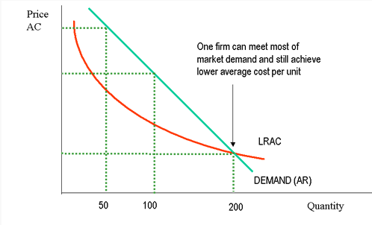
Natural Monopoly
Allocative efficiency

Slide 40
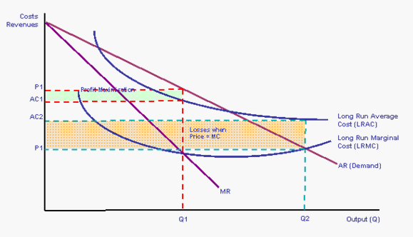
A natural monopoly

Slide 41
What is a natural monopoly?
What is the relationship between LRMC and LRAC?
Where would the monopoly produce?
What profits would it make here?
Where is the socially optimal point?
What is occurring at this point?
What are the solutions?
B
E
G
F
I
J
LRATC
D
=AR
LRMC
MR
0
A
H

Slide 42
What is a natural monopoly?
What is a ‘natural monopoly’?
When does this come about?
What is consistent in these cases?
What happens to economies of scale in the long-run?
Why is the MES very large?

Slide 43
What is a natural monopoly?
A ‘natural monopoly’ is a situation when one firm has an overwhelming cost advantage
A natural monopoly tends to come about when a monopoly has sole ownership of a resource and that it is extremely expensive for competitors to duplicate installations, competition is therefore inefficient, therefore the economies of scale act as a barrier to entry
In these cases there tends to be a very high % of fixed costs
Economies of scale in the long-run are regarded as continuous
The MES is very large due to high sunk costs of investment

Slide 44
What is a natural monopoly?
Long run marginal cost (LRMC) slopes down beneath the LRAC - costs are very gradually falling as output increases
Monopoly would produce at OA, where MR=MC and make abnormal profits of BEFG
Socially optimal point where LRMC = AR, yet LRATC are higher than MC at this point
The natural monopoly is therefore making a loss equivalent to AH x IJ
Possible under government control, if it were paying for the losses
Under private ownership a subsidy of AH x IJ would be required as ATC are higher than AR
B
E
G
F
I
J
LRATC
D
=AR
LRMC
MR
0
A
H

Slide 45
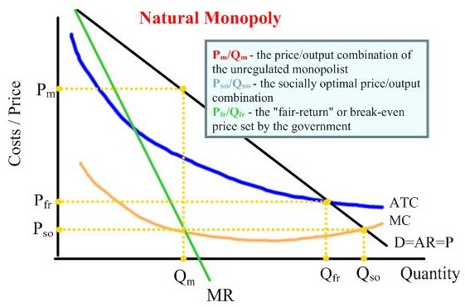
Regulated Monopoly

Slide 46
Monopolies
advantages
disadvantages

Slide 47
Monopolies
Advantages
Disadvantages
Achieves economies of scale, as average costs are falling
Earns profits to carry out R & D
Gains in economic welfare from R & D
Can be competitive in international markets
Profits distributed to shareholders in the form of dividends
Different prices to different groups of customers via price discrimination
Dynamically efficient; produces differentiated products to satisfy consumers’ desires
Maximises profits
Allocatively inefficient, prices are above socially optimal point
It is not productively efficient, as it is not operating at the lowest point of the AC curve
Produces at a low output to drive up price
Charges a high price, exploitation of consumer
Earns very high abnormal profits
Monopolises all the demand in the market
‘Leapfrogging’ – being in a powerful position to overtake all other firms in the market
Process of creative destruction
High barriers to entry for other firms
Needs to be regulated by government, involves costs to taxpayer
Lack of competition reduces the incentive to innovate

Slide 48
Are monopolies efficient?
List reasons why not….

Slide 49
Monopoly and Efficiency
Only firm in the industry so unlikely to be productively efficient
Can exploit consumer so is not allocatively efficient – high price, erodes consumer surplus; inferior service; shoddy vehicles
Does not operate at lowest unit cost, therefore not productively efficient

Slide 50
Monopoly and X - inefficiency
X-inefficiency - the difference between efficient behaviour of firms implied by economic theory and their observed behaviour in practice, the difference between attainable costs and actual costs. This is often observed in public sector firms where managers have no real incentive to reduce costs and complacency sets in.
Discuss why might monopolies

Slide 51
Monopoly and X - inefficiency
A monopoly tends to price at a point where price is greater than long-run average costs
X-inefficiency occurs: the difference between efficient behaviour of firms implied by economic theory and their observed behaviour in practice
Causes of X-inefficiency:
over-investment
managerial objectives
tends to increase average costs causing further inefficiencies
lack of motivation to reduce costs stemming from a lack of competition
over-reliance on subsidies
pressure by unions to pay higher (above market) wages

Slide 52

Any Questions?
Thank you!

