Slide 1
MODULE NAME: Problem Solving and Decision Making
MODULE CODE: LCLM4004
STUDENT NAME: Victoria-Alexandrina Chitoraga
STUDENT ID: 2417029
LECTURER: Faizu Edu
Assignment 1: Presentation

Slide 2
INTRODUCTION
Overview of Green Haven Florists case study
Problem: Nature and Scope
PESTLE ANALYSIS of external factors
Fishbone Diagram to identify causes
Conclusion/Key Findings
Reference List

Slide 3
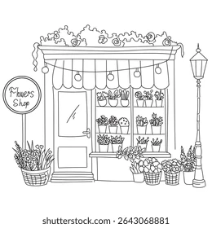
OVERVIEW
Independent flower shop in Norwich, Uk
Founded in 2016 by Liam and Priya Patel
Built reputation through personal service
Serves walk-in clients, corporate clients and weddings
Known for bespoke arrangements and eco-friendly packaging
Recently experiencing decline in revenue and foot traffic due to:
Rising costs
Competition from online and local florists
Shift towards online shopping

Slide 4

5W2H
What | In-store sales dropping
Why | Outdated website, rising costs, competition
Where | Green Haven Florists, Norwich, high street
When | Over the past 12 months
Who | Owners Liam and Priya
How | Customers shifting to online flower retailers and competitors with stronger social media presence
How Much | 30% decline in in-store sales

Slide 5






PESTLE ANALYSIS: Green Haven Florists
Political: Import regulations affecting flower supply, local council rules on high street businesses
Economic: Competition from cheaper online retailers, rising inflation increasing flower costs.
Social: Customers prefer online shopping, influence of social media
Technological: Outdated website, weak social media presence
Environmental: Weather and seasonal effects on flower supply, eco-friendly packaging
Legal: Employment laws affecting staff and wages, health and safety regulations

Slide 6
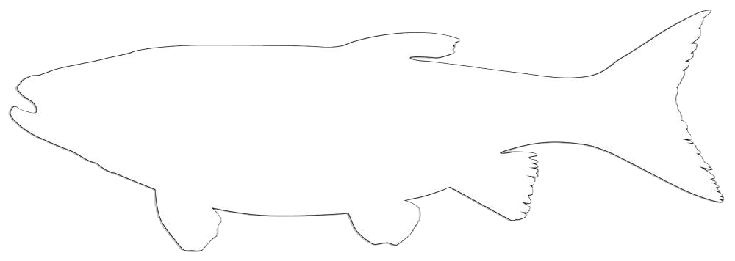


Cause and Effect analysis: Fishbone Diagram
Environment
Process
People
Owners lack marketing skills
Limited customer engagement
Reduced foot traffic
New competitors nearby
Outdated website
No subscriptions
Decline in in-store sales
Rising costs of flowers and eco packaging
Lack of delivery and subscription system
Not enough digital marketing tools
No system to track their top selling products
Not enough monitoring of competitor actions
Materials
Equipment
Measurement

Slide 7

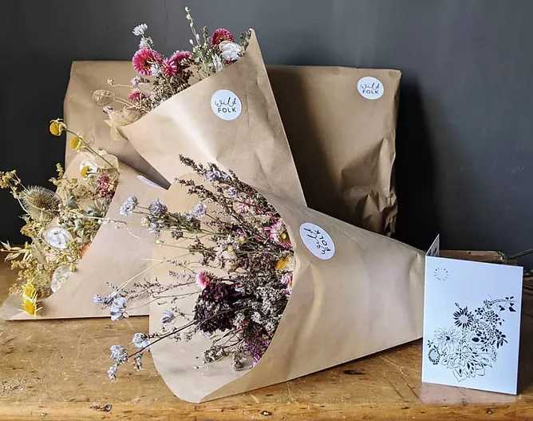
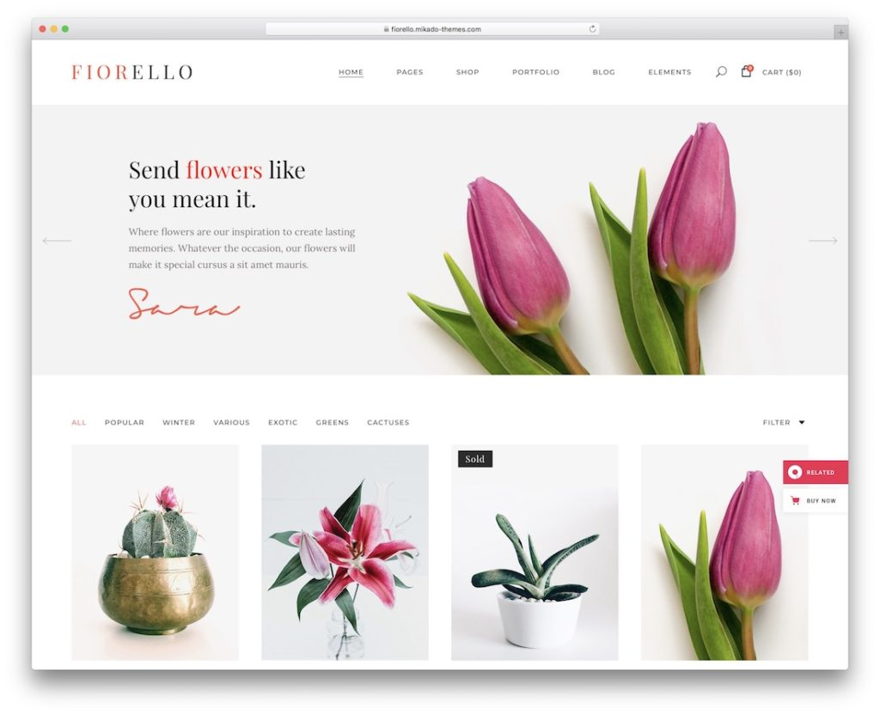
Conclusion
Key Findings:
Need stronger online presence- the website needs an update and better usage of social media
Introduce flexible delivery options- home delivery and subscriptions
Focus on marketing and promotions- attract local and online customers
Maintain the eco friendly option but manage the costs more efficiently
Monitor their sales and customer feedback- track the top selling products
Keep track and monitor competitors' actions

Slide 8
References
Case Study:
Green Haven Florists (2026)- provided by lecturer
Websites:
https://britishfloristassociation.org/for-the-industry/industry-brexit/the-statement-to-government/
https://flora.market/en/blog/post/how-to-increase-flower-shop-sales
Images:
Delivery guy image
Flower website image
Eco friendly packaging image

Slide 9
THANK YOU
Any questions?​

