Slide 1
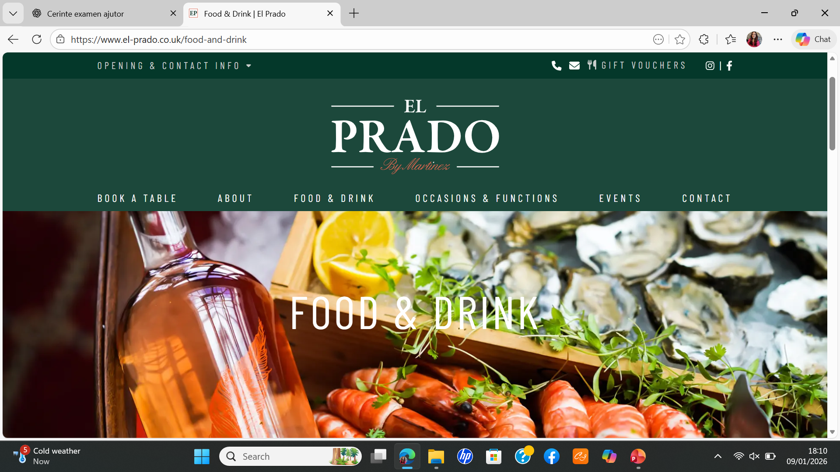
Restaurant Review El Prado (Bridgend)
Customer review-family dinner
Ionut Moldovan
Notes:
Today I will talk about my restaurant review of El Prado in Bridgend.
I visited this restaurant as a secret customer.
I went there with my family for dinner.
In this presentation, I will talk about the food, the service, the atmosphere and my opinion.

Slide 2
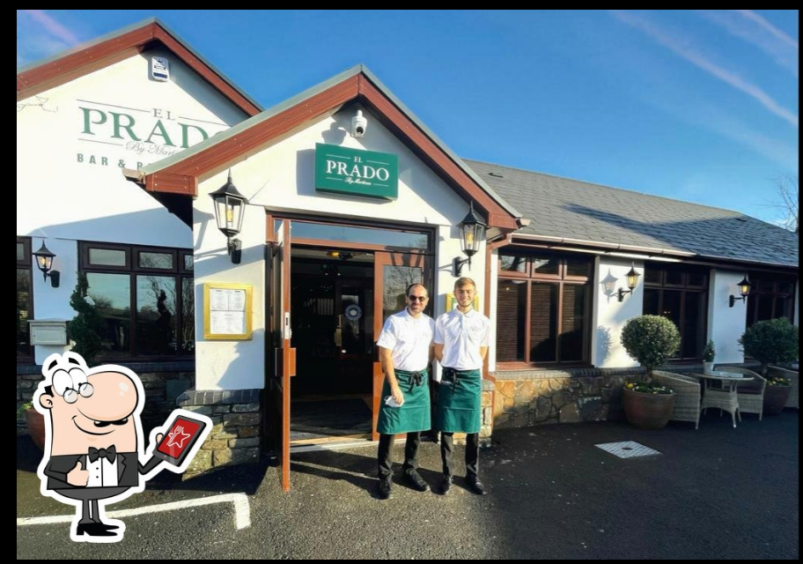
INTRODUCTION TO THE RESTAURANT
Location: Laleston, Bridgend
Type: Bar and restaurant
Notes:
El Prado is a bar and restaurant located in Laleston, near Bridgend.
It is not in the town centre, but it is easy to find by car.
The restaurant is a place where people can eat food and also enjoy drinks in a relaxed environment.

Slide 3
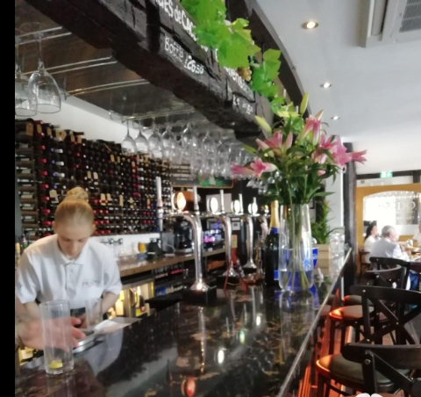
WHY I CHOSE THIS RESTAURANT
Why El Prado?
(Online reviews are important for customers – Qiu, 2024)
Notes:
I chose El Prado because I wanted a nice place for a family meal.
I also saw positive reviews online, especially on TripAdvisor.
Online reviews are important because many people check them before choosing a restaurant.
According to Qiu (2024), online reviews influence customer decisions.

Slide 4
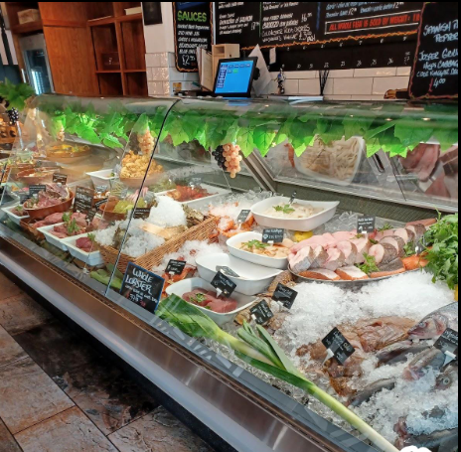
FIRST VISIT
First visit
Notes:
This was my first visit to El Prado.
Because it was my first time, I paid attention to many details.
I looked at how we were welcomed, how the food arrived, and how we felt inside the restaurant

Slide 5
HOW IS THE RESTAURANT MARKETED?
Website
Online reviews
Notes:
The restaurant is marketed mainly online.
People can find El Prado through its website and online reviews.
The website shows the menu, opening times and contact details.
TripAdvisor reviews help customers decide if they want to visit.

Slide 6
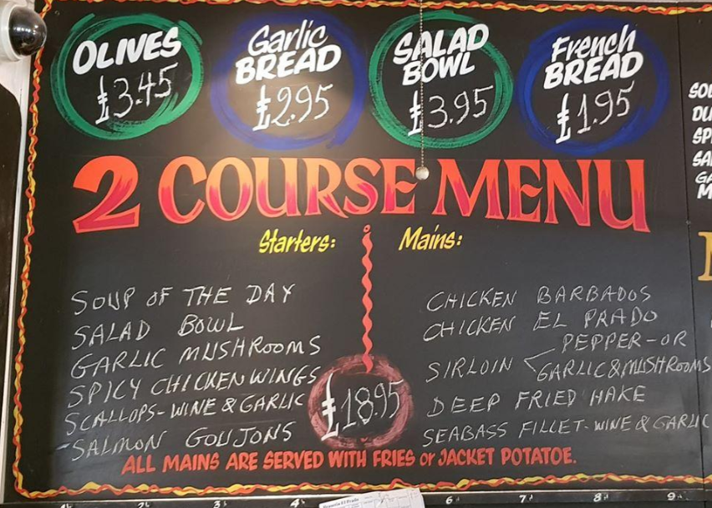
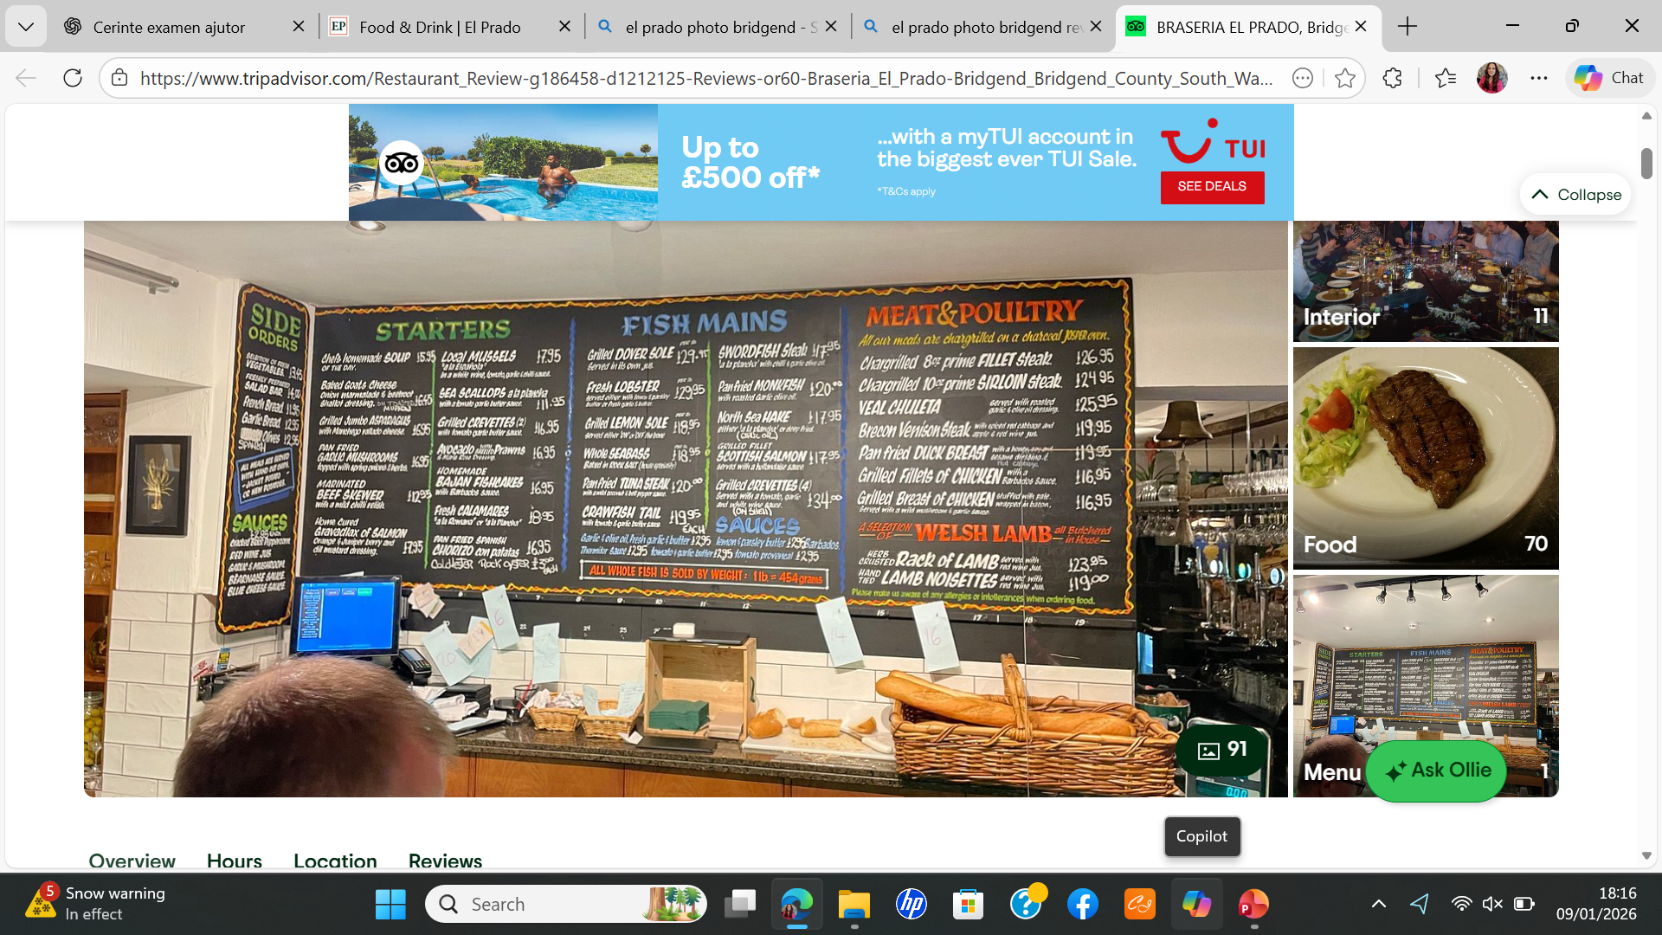
PRODUCT
1.
Food
2.
Drink
Notes:
El Prado offers different types of food, including starters and main courses.
They also offer drinks, so it works well as a bar and restaurant.
The menu is easy to read and understand.
The food looks fresh and well prepered

Slide 7
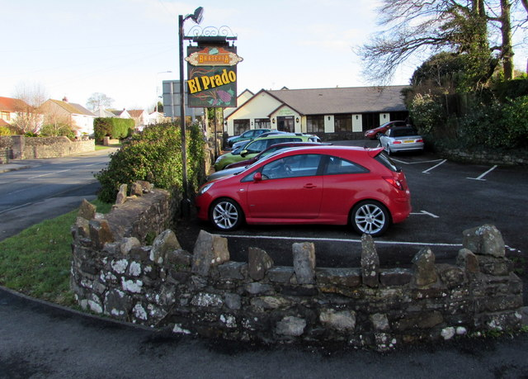
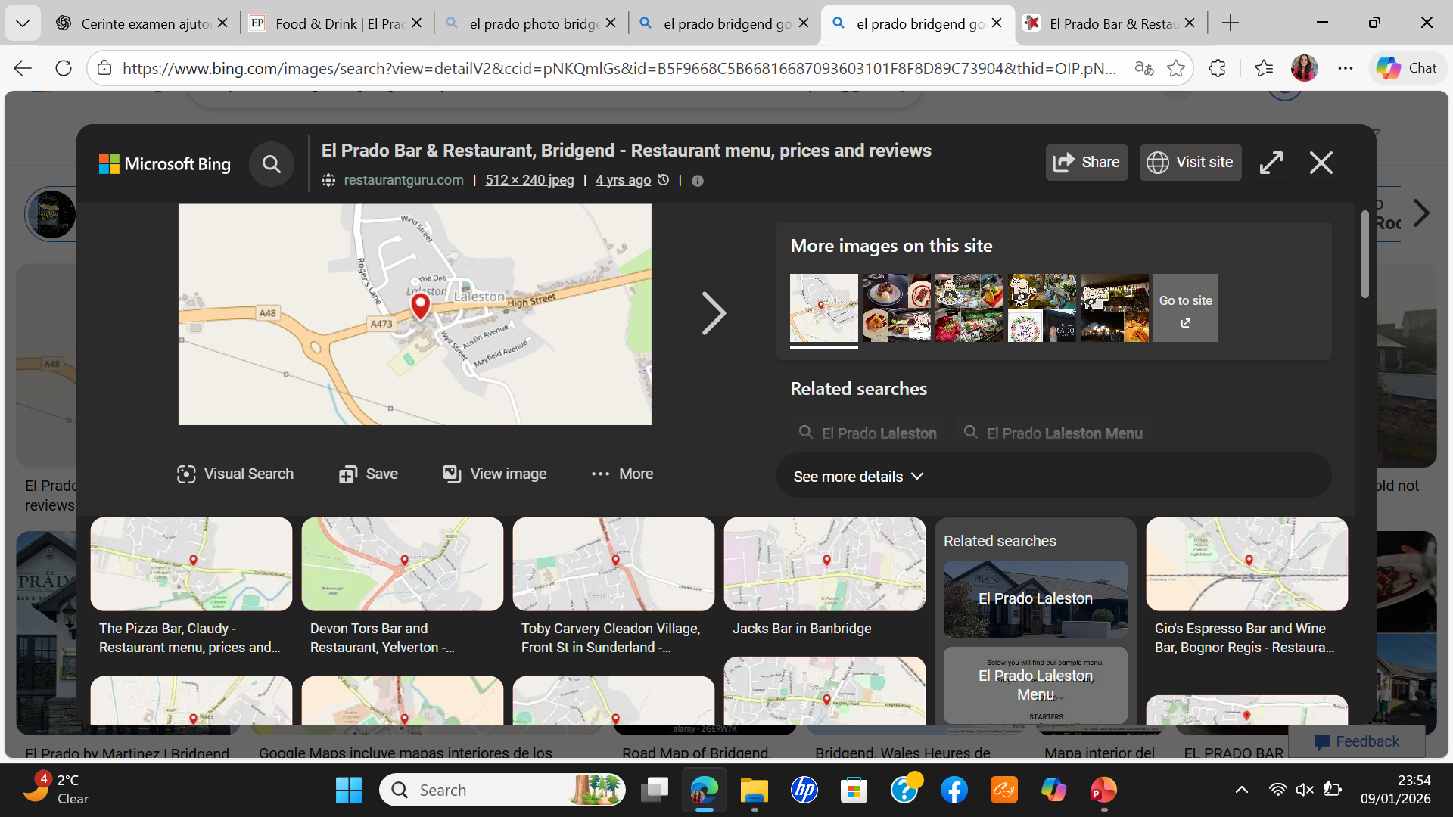
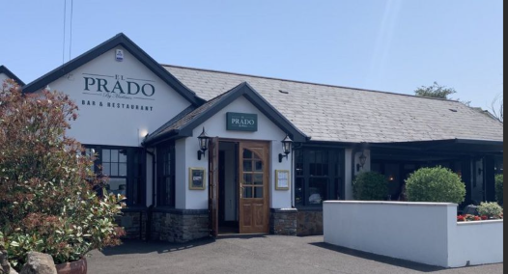
PLACE
Not in town centre
Parking available
Notes:
The restaurant is not in Bridgend town centre.
It is easier to reach by car.
Parking is available, which is good for families.

Slide 8
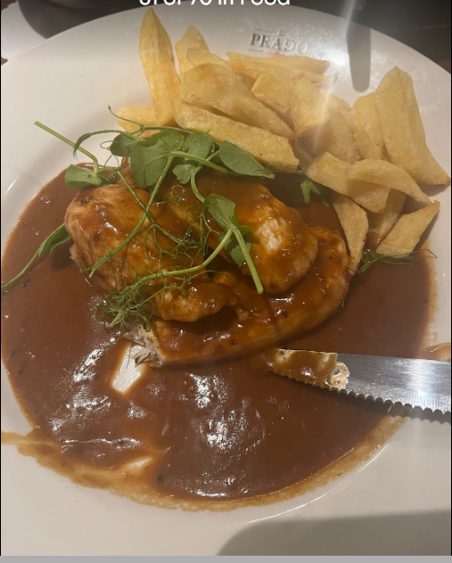
PRICE & TARGET CUSTOMERS
Mid-range prices
Families & couples
Notes:
The prices are mid-range for the Bridgend area.
It is not very cheap, but it is not very expensive.
I think the restaurant is suitable for families, couples and people celebrating special occasions.

Slide 9



Promotion
Online booking
Website information
Notes:
The restaurant promotes itself mainly online.
Customers can visit the website to see the menu and opening times.
They can also book a table online, which is very convenient.
Online promotion is important today because people search online before visiting restaurants.

Slide 10
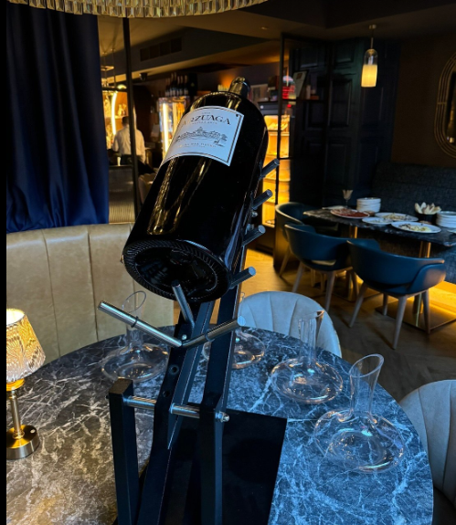
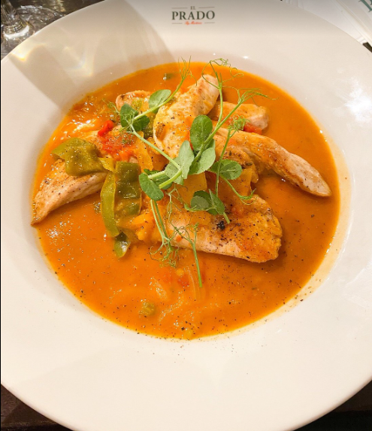
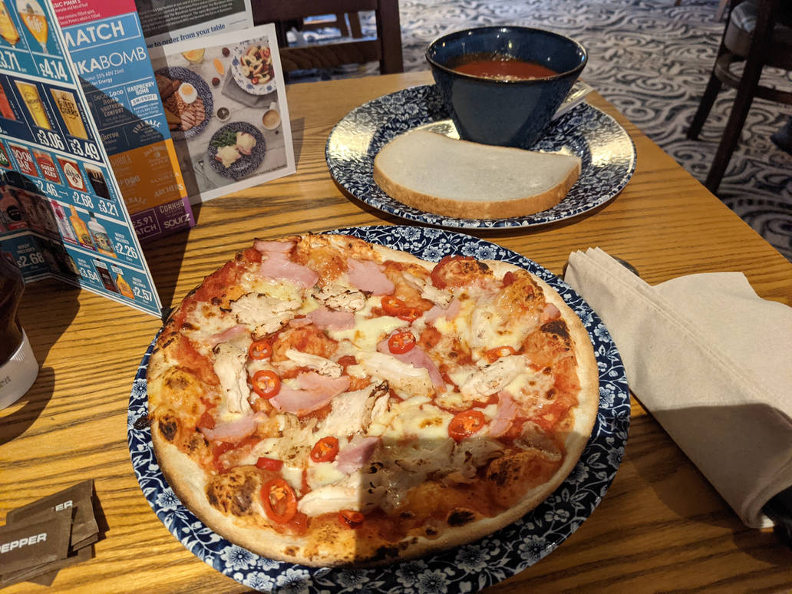
CUSTOMER VALUE & EXPERIENCE
Food
Service
Atmosphere
Pine and Gilmore (1998)
Notes:
El Prado creates customer value through food, service and atmosphere.
The food is important, but the experience is more than just eating.
The service was polite and friendly, which made us feel comfortable.
The atmosphere was calm and relaxing.
According to Pine and Gilmore (1998), customers remember experiences, not only products

Slide 11
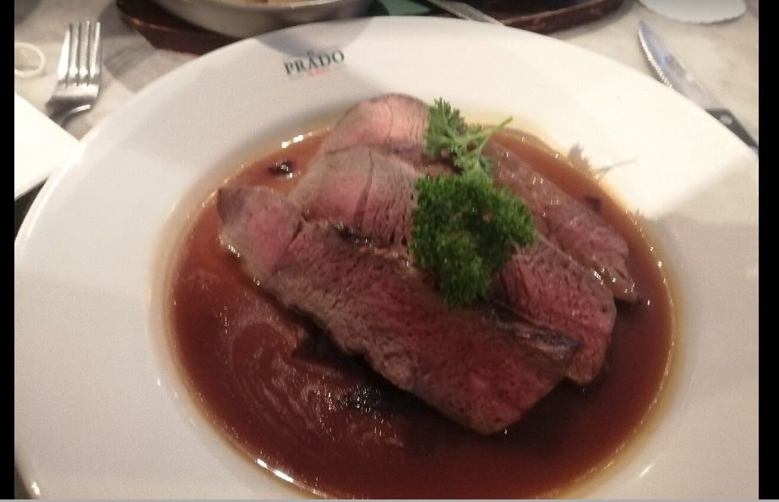
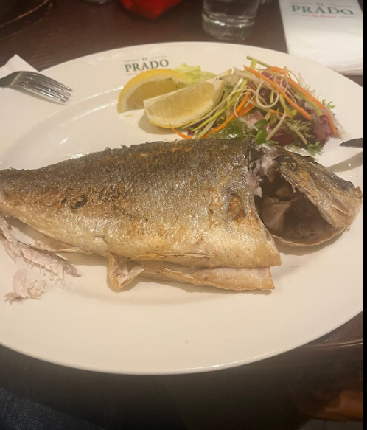
MY FAMILY VISIT EXPERIENCE
Family visit
Positive experience
Notes:
I visited El Prado with my family.
The atmosphere was calm and comfortable, and we felt relaxed.
We enjoyed spending time together and the food was good.
The staff were polite and friendly, which made the visit pleasant.
However, we waited quite a long time for the main course.
This was not a big problem, but it made the meal a little longer than expected.
Overall, the experience was positive, but the waiting time is something that could be improved.

Slide 12
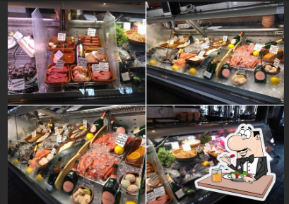

PROBLEMS NOTICED
Location
Waiting time
Notes:
There were two small problems.
First, the location is not very central.
Second, we waited quite a long time for the main course.
Some online reviews also mention waiting time

Slide 13
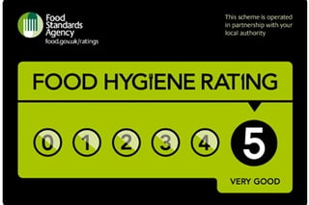
Food Hygiene Rating: 5
CLEANLINESS & FOOD HYGIENE
Notes:
Cleanliness is very important in restaurants.
El Prado has a Food Hygiene Rating of 5.
This is the highest rating in the UK.
It made me feel safe and confident about eating there.

Slide 14
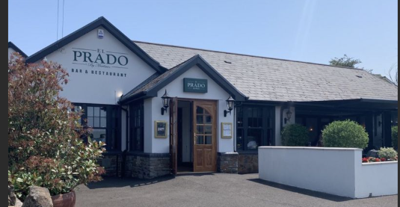
FINAL OPINION & INFLUENCE
Overall rating: 4/5
Would I recommend it?
Notes:
Overall, my experience at El Prado was positive.
I would give the restaurant a rating of 4 out of 5.
I would recommend it for family meals and special occasions.
I would suggest planning extra time because service can sometimes be slow.
This review could help other customers decide if they want to visit

Slide 15
REFERENCES
Bitner, M. J. (1992).
Servicescapes: The impact of physical surroundings on customers and employees. Journal of Marketing, 56(2), pp. 57–71.
Available at: https://journals.sagepub.com/doi/10.1177/002224299205600205
Chuang, Y. F. (2023).
Online travel reviews and consumer purchase intention. Journal of Travel & Tourism Marketing.
Available at: How do online travel reviews facilitate informed purchase decisions?: Asia Pacific Journal of Tourism Research: Vol 28, No 4
Food Standards Agency (2025).
How food hygiene ratings work.
Available at: How food hygiene ratings work | Food Standards Agency
Food Standards Agency (2025).
El Prado by Martinez – Food Hygiene Rating.
Available at: https://ratings.food.gov.uk/business/1351632/el-prado-by-martinez-bridgend
Food Standards Wales (2024).
Food hygiene ratings in Wales.
Available at: Food hygiene ratings | GOV.WALES
Parasuraman, A., Zeithaml, V. A. and Berry, L. L. (1985).
A conceptual model of service quality and its implications for future research. Journal of Marketing, 49(4), pp. 41–50.
Available at: A Conceptual Model of Service Quality and Its Implications for Future Research on JSTOR

Slide 16
REFERENCES
Pine, B. J. and Gilmore, J. H. (1998).
Welcome to the experience economy. Harvard Business Review.
Available at: https://hbr.org/1998/07/welcome-to-the-experience-economy
The impact of online customer reviews on purchase intention. Journal of Business Research.
Available at: How online reviews affect purchase intention: A meta-analysis across contextual and cultural factors - ScienceDirect
TripAdvisor (2025).
El Prado Restaurant – Customer Reviews.
Available at: https://www.tripadvisor.co.uk/Restaurant_Review-g186458-d1212125-Reviews-Braseria_El_Prado-Bridgend_Bridgend_County_South_Wales_Wales.html
Qiu, H. (2024).
The impact of online customer reviews on purchase intention. Journal of Business Research.
Available at: https://www.sciencedirect.com/science/article/pii/S2543925123000323
Google Maps (2025).
El Prado Restaurant – location and accessibility.
Available at: https://www.google.com/maps
British Hospitality Association (2023).
Customer experience in hospitality.
Available at: https://www.ukhospitality.org.uk

Slide 17
REFERENCES
Visit Wales (2024).
Food and drink experiences in Wales.
Available at: https://www.visitwales.com/things-do/food-and-drink
El Prado Restaurant (2025).
Official restaurant website.
Available at: https://www.el-prado.co.uk/

