Slide 1
Injuries Presentation
Hannah Hoffman 0951194

Slide 2
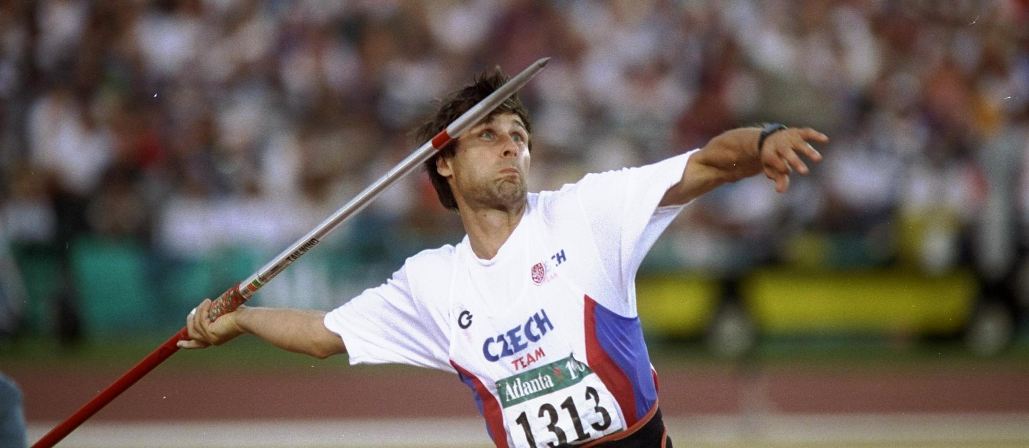
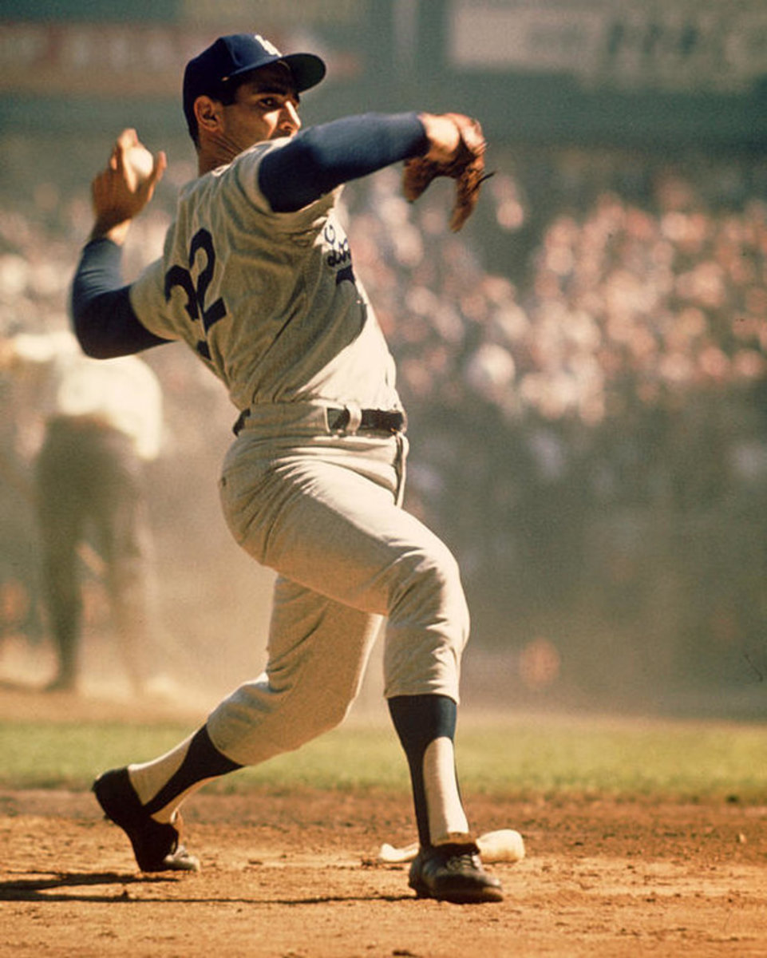
Golfers Elbow (Medial Epicondylitis): Causative Factors
“Inflammation of the tendons that attach the forearm flexor muscles onto the medial epicondyles of the humerus, on the inside of the elbow.” (Kent, 2007).
Image 1 (Top Athletics, 2023)
Image 2 (HubPages, 2025)

Slide 3
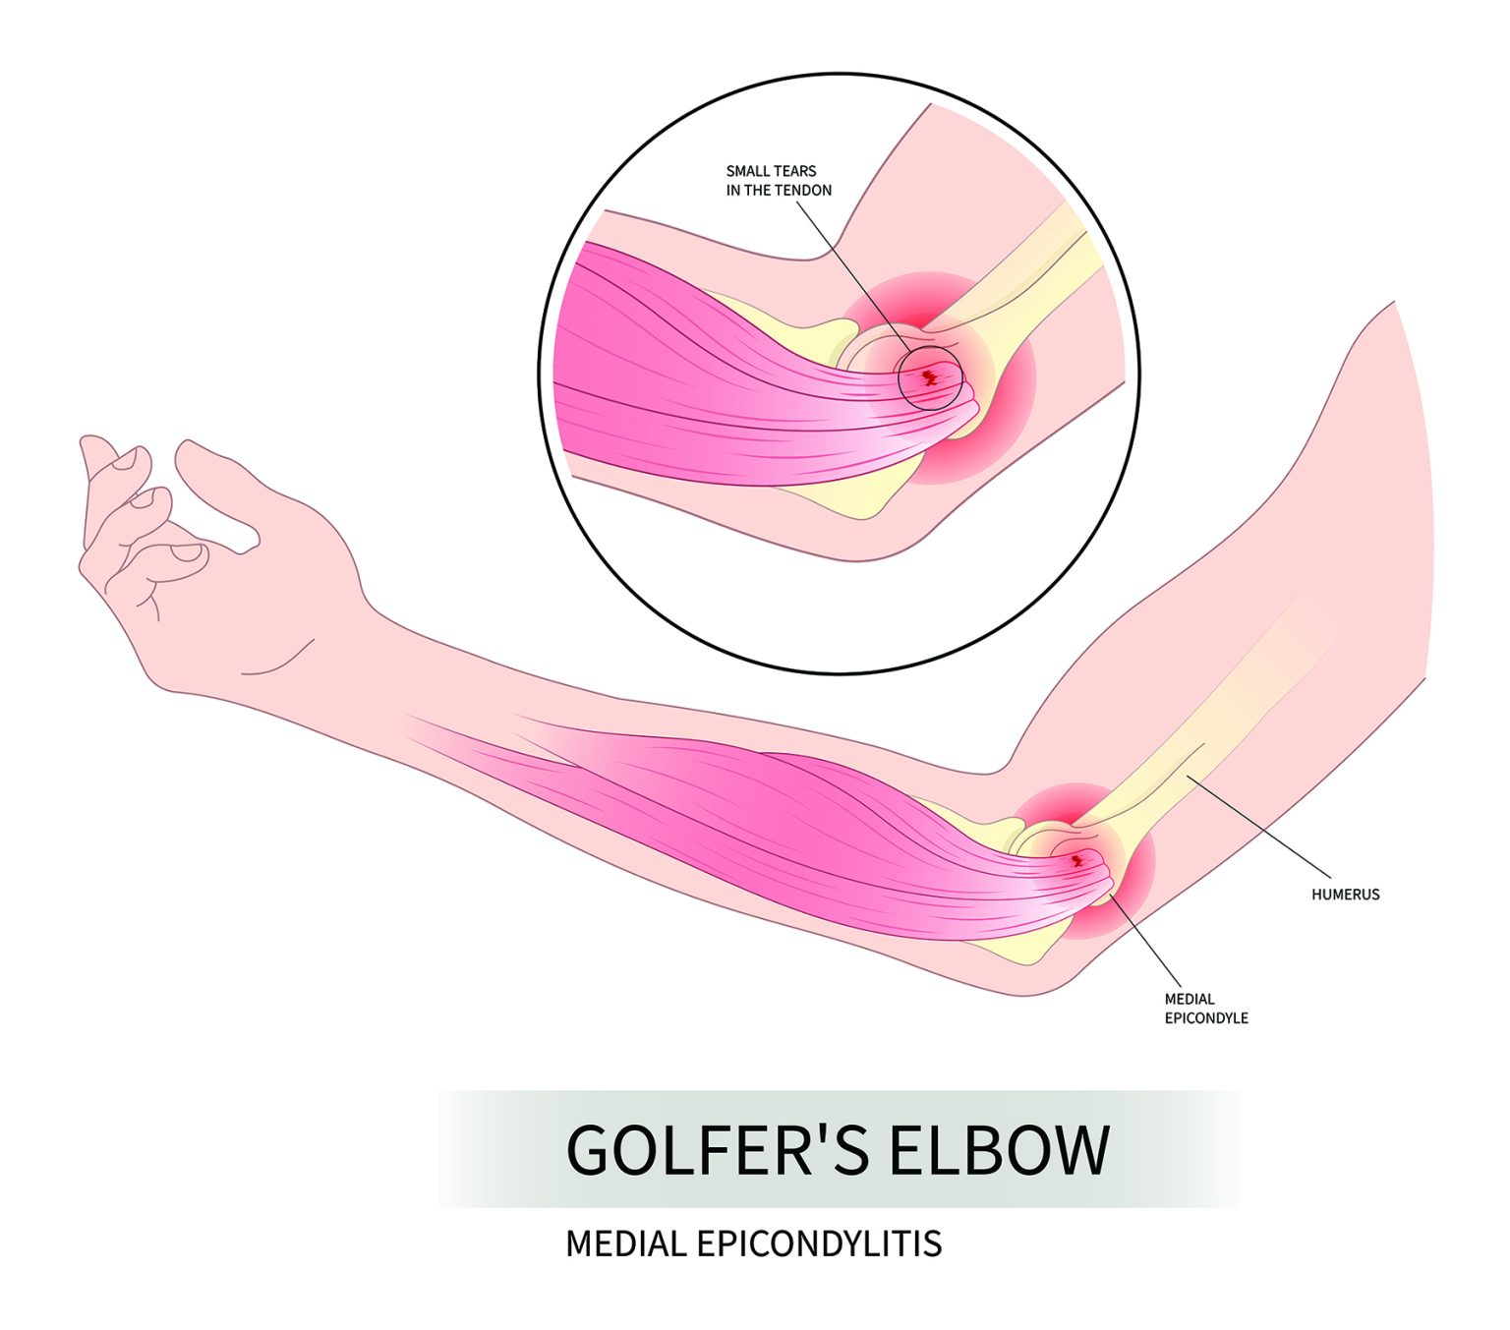
Golfers and throwing athletes
Weightlifters
(Kent, 2007)
Carpenters
(McMurtrie and Watts, 2012)
(Kiel and Kaiser, 2023)
Older adults
(Kwan et al., 2023)
Image 3 (NHS Inform Scotland, 2025)

Slide 4
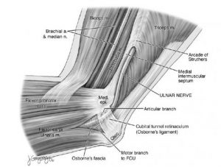
Mechanism of Injury;
“Medial epicondylosis, or ‘Golfer's elbow’, is a tendinosis which affects the origins of the flexor carpi radialis (FCR) and pronator teres muscles.” (McMurtrie and Watts, 2012).
Affects the inside of the elbow
Tendons in forearm get damaged
Repeated strain causes tendons to weaken
Break down or develop tough, scar-like tissue, calcium deposits – difficult to fix
(Nirav et al., 2015)
Image 4 (Sport Med School, 2017)

Slide 5
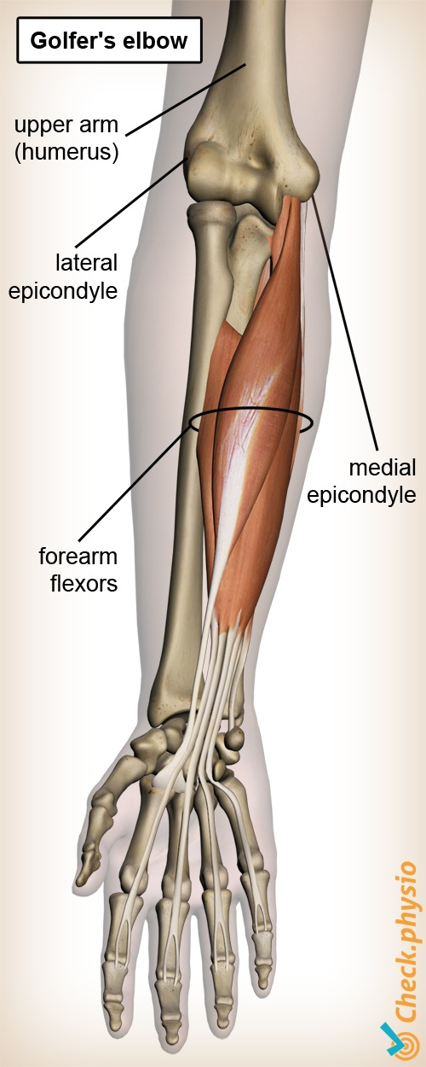
Mechanism of Injury;
Repetitive overuse
Excessive force during impact
(McMurtrie and Watts, 2012)
Reduced flexibility
Grip and equipment issues
Poor biomechanics and technique
(Kiel and Kaiser, 2023)
Tendon degeneration
(Rees et al., 2009)
Muscle imbalances
(Kamalden et al., 2009)
Inadequate recovery
(Leong et al., 2019)
Image 5 (PhysioCheck, 2025)

Slide 6
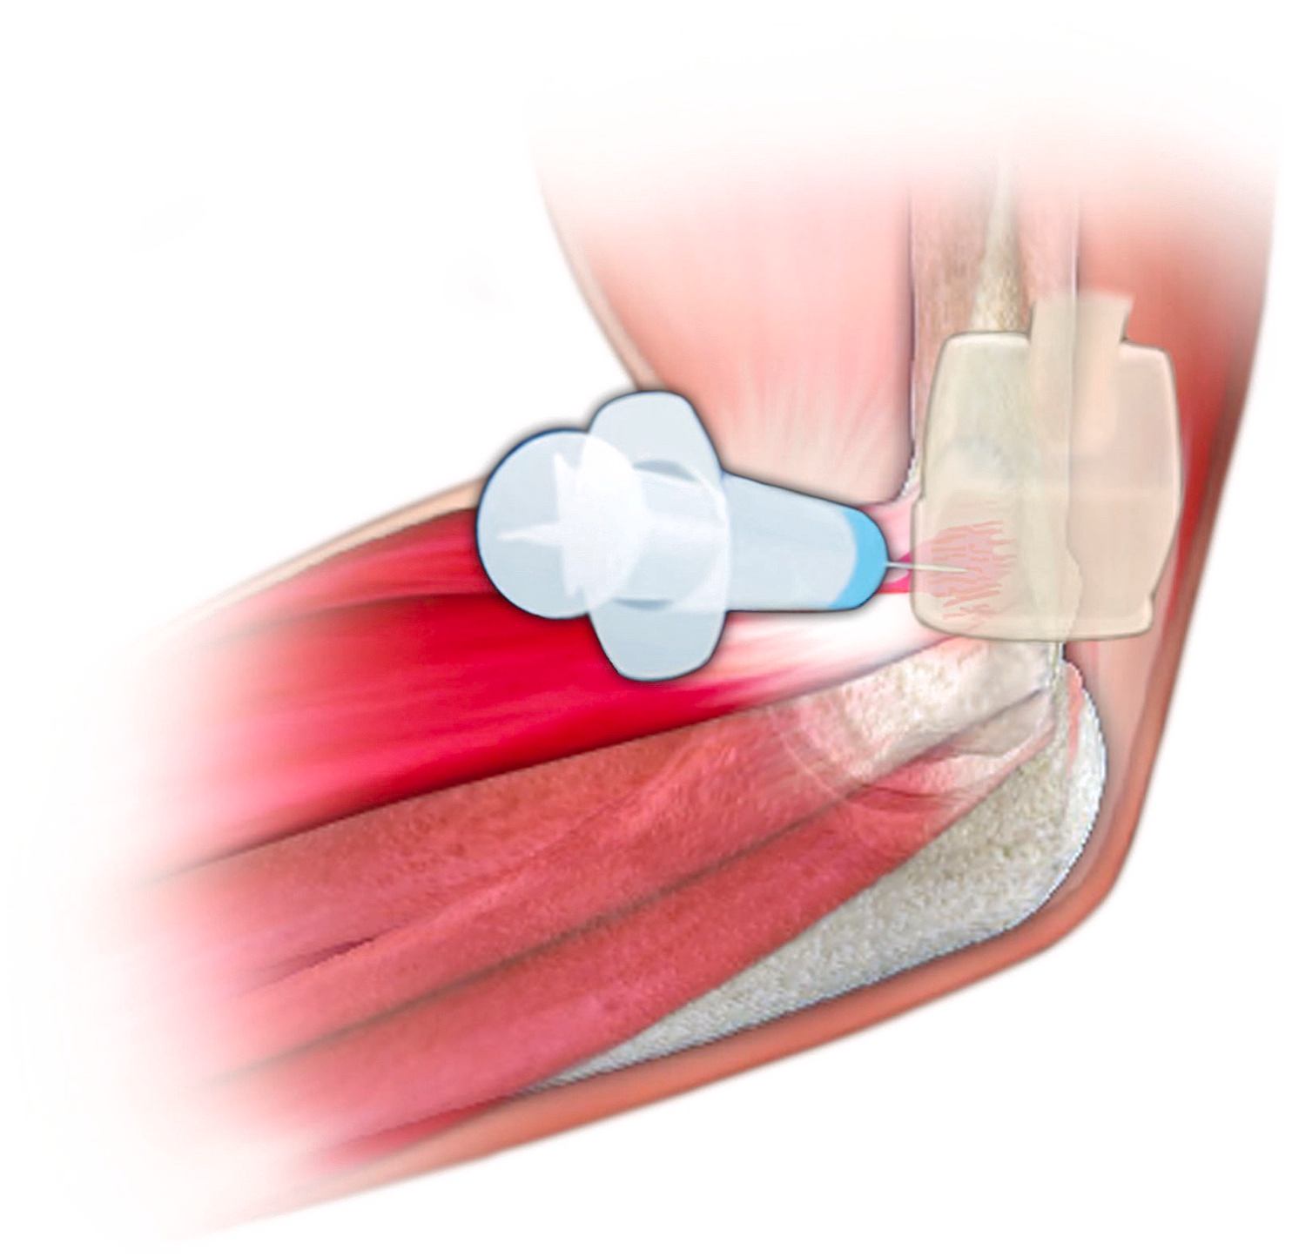
Signs & symptoms and timeframe;
Pain
Difficulty gripping
Restriction in movement
Tenderness when touching the area
(NHS Inform Scotland, 2025)
Non-operative
Activity modification
Physical therapy
Soft tissue and manipulation techniques
Topical and/or oral non-steroidal anti-inflammatories
Corticosteroid injection
Electrical stimulation/shock wave
Bracing
K-tape
(Meridith et al., 2023)
(Kiel and Kaiser, 2023)
Image 6 – Corticosteroid injection
(Meridith et al., 2023)

Slide 7
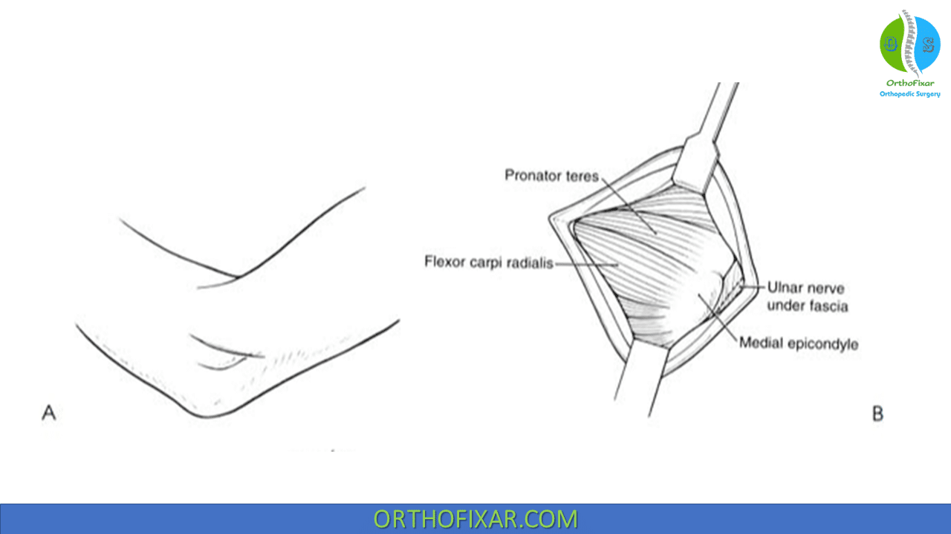
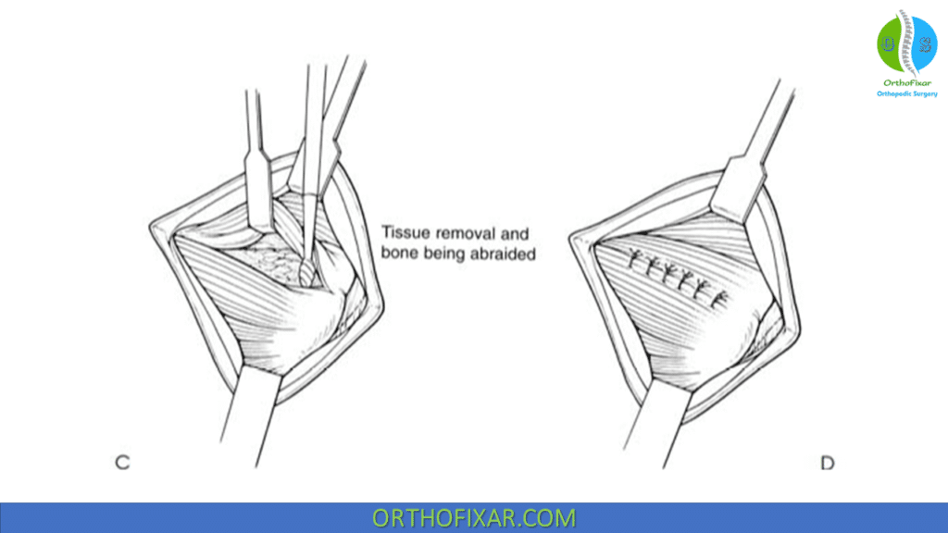
Signs & symptoms and timeframe;
Operative
6-12 months
Percutaneous epicondylar muscle release
(Baumgard and Schwartz, 1982)
Debridement and reattachment
(Gabel and Morrey, 1995)
Resection of the angio-fibroblastic tissue and drilling
(Ollivierre et al., 1995)
Incision and debridement without reattachment
(Kurvers and Verhaar, 1995)
Image 7 and 8 - Percutaneous epicondylar muscle release (Orthofix, 2024)

Slide 8

Summary & questions

Slide 9
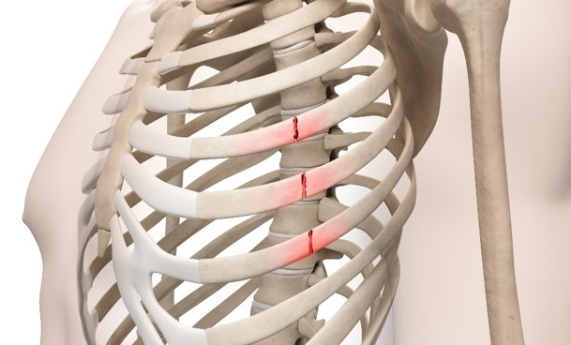
Fractured Rib: Causative Factors
“A break in bone usually resulting from a more or less instantaneous application of excessive load”. (Kent, 2007).
Image 9 (Care Company, 2023)

Slide 10
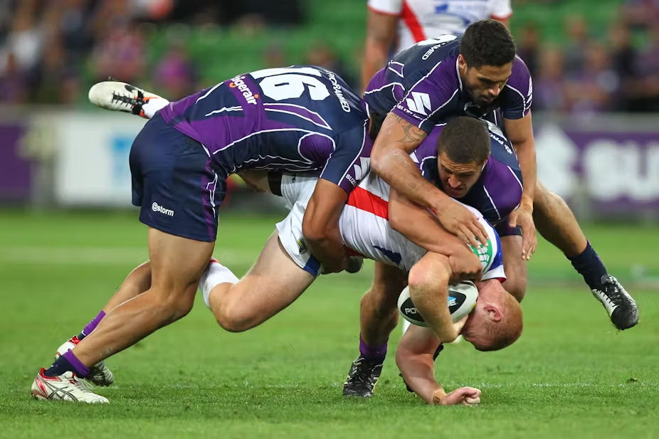
Older adults
Osteoporosis
(Mai et al., 2018)
Cancer patients
High impact trauma
Coughing
Contact sport athletes
Image 10 (The Conversation, 2025)

Slide 11
Image 11
Mechanism of Injury;
Break in rib
Single/non-displaced – hairline/simple
Point of impact
Back – structurally weakest
Most common – blunt force trauma
Exerting direct pressure
(Serfin M.D.W. et al., n.d.)

Slide 12
Mechanism of Injury;
Direct blunt trauma
Compression or crushing force
Twisting or rotational force
Repetitive stress or overuse
Severe coughing or sneezing
Bone weakening conditions
Image 12

Slide 13
Signs & symptoms and timeframe;
Simple fracture
Pain – breathing/coughing
X-ray (CT scan for underlying lung injuries)
Additional damage
4-6 weeks healing time
No specific treatment
Pain management
Breathing exercises
(NHS, 2023)
Image 13

Slide 14
Signs & symptoms and timeframe;
Surgery and complications
3 or more displaced ribs
Segments of broken ribs interfering with chest movement
Chest wall deformity
Unmanageable pain
Chest infection
Pneumathorax
Hemothorax
Surgical emphysema
Abdominal injuries
Varied timeframe
(NHS, 2023)
Image 13

Slide 15
Summary & questions

Slide 16
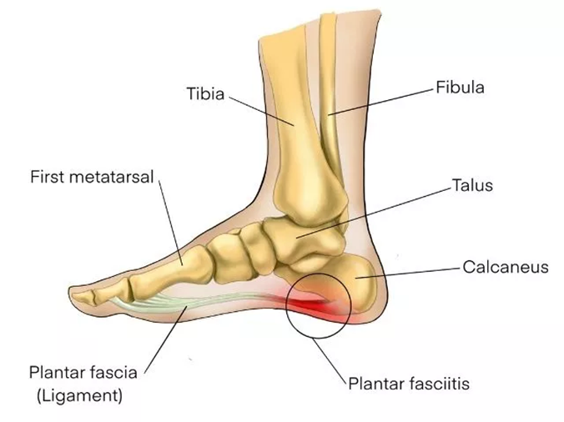
Plantar Fasciitis: Causative Factors
“Inflammation of the plantar fascia at it’s attachment to the heel-bone” (Kent, 2007)
Illustration 2 (Peterson Physical Therapy, 2023)

Slide 17

Runners
Older population
People with a high BMI
People with low arches or flat feet
(Brukner & Khan, 2012, p. 844)
People with abnormal posture and gait
(Rabadi et al., 2022)
Image 1 (The Runners Mark, 2016)

Slide 18
Mechanism of Injury;
Talk about mechanism of injury for plantar fascia
Image 11

Slide 19
Mechanism of Injury;
Talk about mechanism of injury for plantar fascia
Image 11

Slide 20
Signs & symptoms and timeframe;
For fractured rib
Image 13

Slide 21
Signs & symptoms and timeframe;
For fractured rib
Image 13

Slide 22
Summary & questions

Slide 23
Peterson Physical Therapy (2023). Available at: https://petersenpt.com/plantar-fasciitis-stretches-for-quick-relief (Accessed: 23 February 2025).
The Runners Mark (2016). People running on a bridge. Available at: https://therunnersmark.com/10-ways-to-change-up-your-running-routine/ (Accessed: 23 February 2025).
Kent, M (2007). The Oxford Dictionary of Sports Science & Medicine. 3rd edn. Oxford: Oxford University Press.
Rabadi et al., (2022) ‘Immunopathogenesis, early detection, current therapies and prevention of plantar fasciitis: A concise review’, International Immunopharmacology, 110 (September) article 109023. Available at: https://doi.org/10.1016/j.intimp.2022.109023
Brukner, P. and Khan, K. (2012). Clinical Sports Medicine. 4th edn. Australia: McGraw-Hill Australia Pty Ltd.
Top Athletics (2023). Jan Zelenzny. Available at: https://www.topathletics.org/legends/ (Accessed: 23 February 2025).
HubPages (2025). Sandy Koufax. Available at:https://discover.hubpages.com/sports/25-Greatest-Players-in-Major-League-Baseball-History (Accessed: 23 February 2025).
Peterson Physical Therapy (2023). Available at: https://petersenpt.com/plantar-fasciitis-stretches-for-quick-relief (Accessed: 23 February 2025).
The Runners Mark (2016). People running on a bridge. Available at: https://therunnersmark.com/10-ways-to-change-up-your-running-routine/ (Accessed: 23 February 2025).
Kent, M (2007). The Oxford Dictionary of Sports Science & Medicine. 3rd edn. Oxford: Oxford University Press.
Rabadi et al., (2022) ‘Immunopathogenesis, early detection, current therapies and prevention of plantar fasciitis: A concise review’, International Immunopharmacology, 110 (September) article 109023. Available at: https://doi.org/10.1016/j.intimp.2022.109023
Brukner, P. and Khan, K. (2012). Clinical Sports Medicine. 4th edn. Australia: McGraw-Hill Australia Pty Ltd.
Top Athletics (2023). Jan Zelenzny. Available at: https://www.topathletics.org/legends/ (Accessed: 23 February 2025).
HubPages (2025). Sandy Koufax. Available at:https://discover.hubpages.com/sports/25-Greatest-Players-in-Major-League-Baseball-History (Accessed: 23 February 2025).

