Slide 1

Working in an Inclusive World
Agility & Flexibility

Slide 2
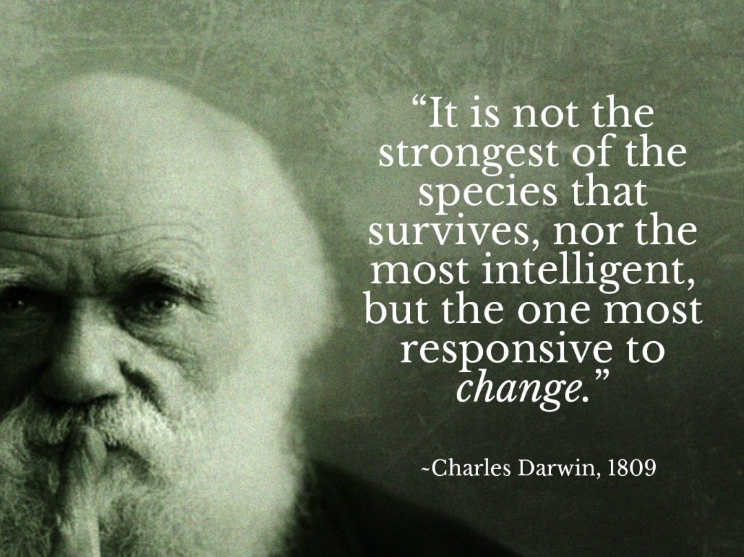

Slide 3
Session Objectives
Introduce the concept of Agile and Flexible working
Ascertain what is Agile Working
Define what Flexibility is
Establish what is the flexible firm
Differentiate Between different form of contracts
Determine criticisms of Flexibility & Agility

Slide 4
Discussion Question
Whilst workers on temporary contracts may offer advantages in terms of cost savings and flexibility, do they add other costs for the employer (in terms of quality, productivity or commitment, for example)?
What do temporary workers gain from this form of employment, if anything?

Slide 5
Flexibility of What?
Flexibility for Whom?
Labour:
  Wider range of tasks, jobs or skills;
  Variability in the amount of labour force.
Technology:
  access to know-how, new ideas or different types of machinery
Organizations:
  general ability to adapt
Systems and processes:
  national economy, regions, industries, global economy
FOR employers – OF employees
FOR employees – in their interest

Slide 6
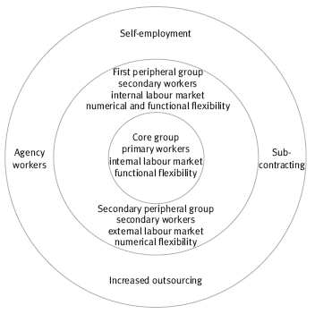
Defining Flexibility
Much derives from John Atkinson’s model of the ‘flexible firm’ which suggests a workforce composed of three basic groups:
  core workers
  peripheral workers
  subcontracted workers.

Slide 7

Defining Flexibility
Central to the model are two types of flexibility:
  Functional
  Numerical

Slide 8
Functional Flexibility
Numerical Flexibility
Functional flexibility is applied specifically to the core workers (permanent, full-time staff) and means that instead of working to rigid job descriptions, individuals are capable of undertaking a broad range of duties, at different levels.
Numerical flexibility is applied to the peripheral group (part-time/temporary staff) and subcontracted staff.

Slide 9
Activity
What are the Advantages & Disadvantages:
  A) Functional Flexibility
  B) Numerical Flexibility

Slide 10

Activity
Make a list of as many different forms of employment contracts as you can!

Slide 11
Numerical Flexibility
People are employed on different forms of ‘different contracts’ so they can be deployed where they are most needed at the times they are needed.
  part-time contracts
  temporary contracts
  temporal flexibility
  subcontractors
  homeworking
  outsourcing

Slide 12
Activity
Provide a definition of what each type of contract is.
Provide a reason / justification for such a contract.
Outline the ‘Pros’ & ‘Cons’ for each type of contract.

Slide 13
Flexibility Rights
30th June 2014 all employees were given the statutory right to request flexible working conditions
Flexible working hours are increasingly considered a necessity as work becomes more central in our lives, taking up more and more time outside of traditional office hours, particularly since the introduction of mobile technology.
Employers must begin to consider allowing employees the ability to manage their time spent working, as long as they achieve their targets and meet expectations
CIPD surveys reveal 43% would like to change start/finish time & half of employees admitted taking phone calls and responding to emails outside of their contracted hours, which reinforces this notion that the traditional working hours are no longer meeting business needs

Slide 14
Criticisms of Flexibility
What are they?
  The main criticisms are characterised by a tendency to equate the concept of ‘flexibility’ with that of ‘employment insecurity’. There is a supposed incompatibility between the principles of the flexible firm and high-commitment P&D practices.
  Such employers tend to seek staff who are already trained, rather than developing people themselves. This would ultimately result in chronic skills shortages and thus damage the health of the national economy.

Slide 15
Criticisms of Flexibility
  Ethical considerations.
    Developing a peripheral workforce allows employers to exercise a greater degree of power – exploiting these individuals’ desire for greater stability.
    Widespread adoption of the flexible firm model would result in an unequal society.

Slide 16
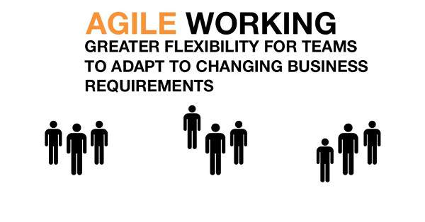

Slide 17
Agility
Holbeche (2005) and (2011):
“the ability to manage continuous, rapid and sustainable change, is becoming a key organisational differentiator in a fast-changing complex environment”

Slide 18

Discussion Question
Is Flexibility the Same as Agility?

Slide 19
Agility V Flexibility
It would appear that these are one and the same, but flexible working has usually been working to the advantage of the employee’s lifestyle, whereas agile working benefits the business needs.

Slide 20

Discussion Question
How can an Agile culture be reflected within an organisation?
Notes:
Intense customer and market focus with internal systems, structures and processes facilitating this
Anticipation of need, risk and opportunity
Speed of decision making and implementation
Flexibility
Climate conducive to experimentation, innovation and shared learning
Empowerment and participation
Team/partnership working across boundaries
Continuous improvement and risk management
Efficiency and effectiveness

Slide 21

Discussion Question
How do you implement organisational agility?
Notes:
Requires managers to regard all areas of the business as potentially subject to change
Recognise change as coming from the external world of customer demands, competitor influences, technical advances, legislative changes, macro-economic shifts and so on, and not simply as an internal activity.
Use available resources in a timely, flexible, affordable and relevant manner, in order to respond to those changes effectively.
Organisations who understand how to manage constant, integrated change are far more effective and profitable / cost-efficient than those who treat change as a series of disconnected projects.
Have focused professionals with specific skills that can be drawn on throughout the organisation and they have flatter, decentralised organisational structures with fewer people formally designated as ‘leading’ or ‘directing’.
Along with distributed leadership at all levels, the style of top leadership, its alignment to strategy, strength and speed of decision-making, clarity of communication and the degree to which leadership is trusted - is key to agility.

Slide 22

Discussion Question
Why is agility and flexibility important in today’s ‘Inter-Cultural Workplace’?

