Slide 1

Operating Hotel Facilities
-Housekeeping

Slide 2
Contents table
Contents | Slide
Introduction | 3
Health and safety guide in hotels | 4,5
Cleaning procedure | 6,7
Injury prevention | 8,9
Emergency procedures | 10,11
Conclusion | 12
Reference list | 13
Thank You | 14

Slide 3
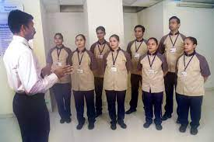
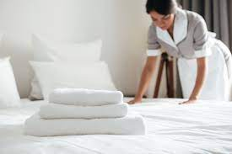
Introduction
The following presentation is based on the topic “Operating Hotel Facilities”.
It presents a basic training module
The purpose of the presentation is to make employees aware of the basic standards of health and safety
Notes:
The following presentation is based on the topic “Operating Hotel Facilities”. It presents a basic training module for ensuring health and safety among the employees. The purpose of the presentation is to make employees aware of the basic standards of health and safety which they need to comply with and be aware of as well.

Slide 4
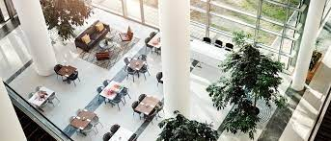
Health and safety guide in hotels
Identification of risks
Some of the potential risks associated with housekeeping are faulty equipment, damaged flooring, slippery floors or not mopped up properly, slippery guest bathrooms, broken or cracked glass and chemical exposure from the cleaning
Agents.
Moreover, employee feedback and regular audits can contribute to the organisation to foster a safe housekeeping environment.
Importance
Safety measures for injuries and accidents during the time of cleaning the room are important as it require various types of precautions.
Notes:
Identification of risks
Some of the potential risks associated with housekeeping are faulty equipment, damaged flooring, slippery floors or not mopped up properly, slippery guest bathrooms, broken or cracked glass and chemical exposure from the cleaning agents. All these can lead to danger and injuries which can harm or hurt the guest and can make the guest unsatisfied towards the services provided by the organisation. These risks can also result in infectious diseases, chemical exposure, overexertion injuries, tissue injuries, and fall and slip accidents from cluttered or wet surfaces. Some of the best industrial practices generally involve effective cleaning protocols and fostering the use of protective equipment (CCOH, 2023). In addition, some of the regulations can be followed in terms of OSHA standards, proper cleaning chemical storage, and providing adequate ventilation. Moreover, employee feedback and regular audits can contribute to the organisation to foster a safe housekeeping environment.
Importance
Safety measures for injuries and accidents during the time of cleaning the room are important as it require various types of precautions. Wearing proper protective tools which involve goggles and safety gloves for protecting against sharp objects or chemical exposure. It is very important to ensure good ventilation in terms of cleaning surfaces to reduce the respiratory risk from the agents of cleaning. It is very important to ensure that the wet floors need to be dry with proper signs and appropriate addresses to mitigate the issue of falls (Aurosiksha, 2023).
Taking proper questions by utilising the electrical tools ensures that the sockets need to be entirely dry before connecting with the plugs to reduce the risk from electricity. Continuous checking is essential in terms of cleaning the equipment based on any hazards which need to be appropriately repaired when required. Taking heavy objects or utilising techniques can lead to injury in the back or skeleton issues. Developing surfaces from Waste and exploring the recycling of waste is essential to secure the trash bags and maintain an eco-friendly environment. Moreover, it is very important to keep a first aid kit for emergencies.

Slide 5
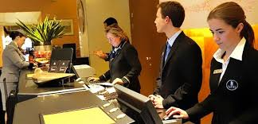
Health and safety guide in hotels
Precaution
The safety manual hard copy will be distributed to every employee
A session for discussing the manual will be conducted which will be recorded for later access as well
Waste disposition will be made mandatory for better hygiene practices
Any signs of hazards must be identified and immediately reported to the supervisor
Notes:
Precaution
For the implementation of the health and safety guide, the following will be ensured:
The safety manual’s hard copy will be distributed to every employee
A session for discussing the manual will be conducted which will be recorded for later access as well
Waste disposition will be made mandatory for better hygiene practise
Any signs of hazards must be identified and immediately reported to the supervisor

Slide 6
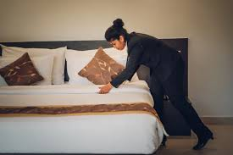
Cleaning procedure
Cleaning procedure in hotels involves activities such as dusting, sweeping,
mopping, polishing, disinfecting, spot cleaning, making the bed and so on.
There are certain areas which need to be cleaned every day such as the waiting hall, reception and toilets.
Notes:
Cleaning procedure in hotels involves activities such as sanitising, water disposal as well as dry and wet cleaning. All of these activities are proceeded in order to maintain a healthy and safe environment in the hotel (Leiter and Bakker, 2010). There are certain areas which need to be cleaned every day such as the waiting hall, reception and toilets. On the other hand, certain areas can be cleaned occasionally where people’s entry is minimal or no engagement is there. Personal Protective Equipment should be used during the cleaning procedure.

Slide 7
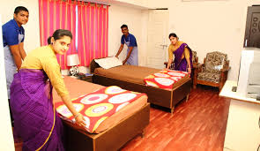
Cleaning procedure
Sanitisation
Waste disposal
Dry and wet cleaning
Notes:
Some of the procedures for room cleaning which incorporate safety measures are
Sanitisation: This includes wiping and cleaning all the surfaces which are touched such as electronics and surfaces with the support of disinfectant. Cleaning all these areas can support making huge differences which can also make the guest more satisfied. This factor can prevent bacteria and viruses from spreading from person to person or other elements to objects (CCOH, 2023). This can also include disinfecting most commonly touched surfaces in terms of remote controls, light switches and doorknobs utilising EPA-approved disinfection.
Waste disposal: This includes the disposal of waste properly and effectively by segregating hazardous materials and recyclable materials appropriately. This can also include removing or eliminating unnecessary elements from the rooms or other spaces to lower the risk of tripping and clear workplaces.
Dry and wet cleaning: Housekeeping must ensure the cleaning of spaces and objects in a neat and clean manner through both wet and dry cleaning methods. Utilising quality vacuum methods of cleaners consisting of HEPA filters by maintaining more cleaning towards edges and corners can help to ensure deep cleaning (Patricia, 2023).

Slide 8
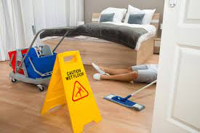
Injury prevention
Injuries often happen in hotels if the employees or staff are not careful. The most happening incidents are trips and falls which are very common in hotels.
The risk increases on hard surfaces such as tile or concrete.
Importance
It is very important to measure the wet floors because falls and slips lead towards major accidents.
Notes:
Discussion
Injuries often happen in hotels if the employees or staff are not careful. The most happening incidents are trips and falls which are very common in hotels. Sprains, back injuries and head trauma may occur due to such incidents and injuries (Quick, 2020). The risk increases on hard surfaces such as tile or concrete. This often happens on a freshly mopped floor or while moving away furniture and other heavy objects.
Importance
It is important to be aware of the expected injuries to avoid any unfortunate incidents in the hotel. Being aware of the expected spots where such injuries can happen will reduce the risk of such incidents and injuries.

Slide 9
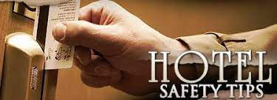
Injury prevention
Precautions
Bend your knees while lifting any heavy object or unloading items
● Make a full turnaround on the bed while making the bed
● Do not stand on one side of a bedsheet while removing it
● Move the small furniture that is placed in the way where you often go
● Read the instructions before using any cleaning products and chemicals
Keep the signboards after mopping the floor to make people aware of it
Notes:
The staff in housekeeping should follow the following procedures to prevent injuries:
Bend your knees while lifting any heavy object or unloading items
Make a full turnaround on the bed while making the bed
Do not stand on one side of a bedsheet while removing it
Move the small furniture that is placed in the way where you often go
Read the instructions before using any cleaning products and chemicals
Do not mix the chemicals while cleaning which may result in an explosion or any injuries
Keep the signboards after mopping the floor to make people aware of it
Read the signboards while walking in the areas which are cleaned daily

Slide 10
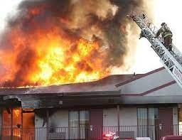
Emergency procedures
Emergency procedures are a plan of action which are conducted in a manner to foresee an emergency which may pose an immediate risk to health, property or life (Fallon and Rutherford, 2010).
Importance
Knowing the exact location can assist staff in making a quick and instant response to the emergency
Notes:
Emergency procedures are a plan of action which are conducted in a manner to foresee an emergency which may pose an immediate risk to health, property or life (Fallon and Rutherford, 2010). The emergency in hotels may arise at the e times of fire breakout, earthquake and others.
Importance
For the staff in the hotel, it is very significant to know the locations where the equipment for emergencies is kept. The equipment may include fire extinguishers and others. Knowing the exact location can assist staff in making a quick and instant response to the emergency (Quick, 2020). It will ensure the overall well-being of employees, the hotel as well as the customers. The emergency exists should also be accounted for by the employees.

Slide 11
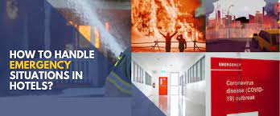
Emergency procedures Continued
Precautions
● Stay calm and alert when an emergency breaks out
● Be familiar with the procedures and ponder upon them
● If there is time, quickly notify the front desk
Notes:
Precautions
The following should be kept in mind during emergency procedures by the staff:
Stay calm and alert when an emergency breaks out
Be familiar with the procedures and ponder upon them
If there is time, quickly notify the front desk

Slide 12
Emergency procedures Continued
Be alert about the emergency gates and evacuate the hotel as quickly as
possible
● Always keep the customers first when such an emergency breaks out
● Use emergency equipment such as first aid kits, fire extinguishers and
others if needed
Notes:
Be alert about the emergency gates and evacuate the hotel as quickly as possible
Always keep the customers first when such an emergency breaks out
Use emergency equipment such as first aid kits, fire extinguishers and others if needed
Stay updated and listen to the announcements if there is any

Slide 13
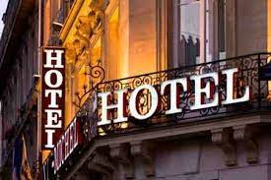
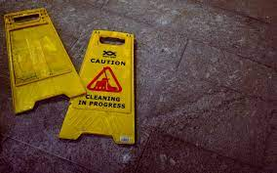
Conclusion
The above presentation discussed the various health and safety standards
Being careful while reading the training module is very significant
The purpose of the training module was to educate the employees
Notes:
The above presentation discussed the various health and safety standards such as careful use of chemicals while cleaning, alertness about emergency equipment and so on. Being careful while reading the training module is very significant for the overall well-being of the hotel and the people associated with it. The purpose of the training module was to educate the employees about a basic set of rules and regulations.

Slide 14
Reference list
Bridger, E. (2018) Employee engagement: a practical introduction. 2nd ed. HR Fundamentals. London: CIPD and Kogan Page.
Leiter, M. P. and Bakker, A. B. (2010) Work Engagement: A Handbook of Essential Theory and Research. Hove [England]: Psychology Press.
Quick, L. (2020) Managing Events. Real Challenges, Real Outcomes. London: SAGE Publications Ltd.
Fallon, M. & Rutherford, D. (2010) Hotel Management and Operations. London: Pearson.
Johnston, R., Clark, G. & Shulver, M. (2012) Service Operations Management. London: Pearson.
Sharma, N., Chaudhary, N. and Singh, V. (2019) Management Techniques For Employee Engagement In Contemporary Organizations. Hershey, Pennsylvania: IGI Global.
Tesone, D. (2010) Principles Of Management For The Hospitality Industry. 1st ed. London: Routledge.
Wood, R. (2013) Key Concepts in Hospitality Management.London: Sage.
Cottrell, S. (2019) The Study Skills Handbook. 5th ed. London:Red Globe Press.
Mullins, L. and Dossor, P. (2013) Hospitality Management and Organisational Behaviour. 5th ed. Harlow: Pearson.

Slide 15


