Slide 1
Media Representations: Disability
ECAY5005
2023

Slide 2
Clips from Channel 4’s ‘The Undateables’
Please watch the following clips

Slide 3
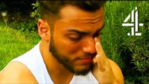

Slide 4
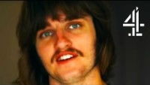

Slide 5
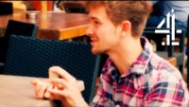
V

Slide 6
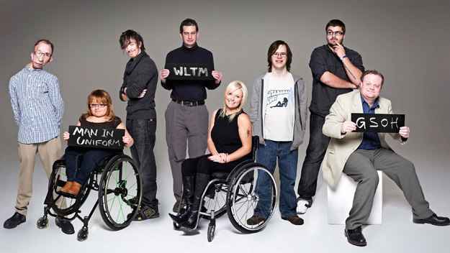
How does the Channel 4 show ‘The Undateables’ encourage us to view the disabled?

Slide 7
Two Views of Disability- Recap
Medical Model - Disabled by physical/mental impairment and need caring for, they are dependent on the able bodied
Social Model (Disablism) - Disabled people are disabled by society through prejudice and discrimination reinforcing the belief they are dependent on the able bodied

Slide 8
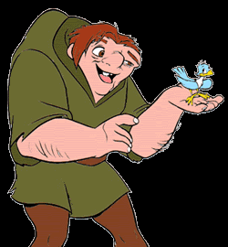
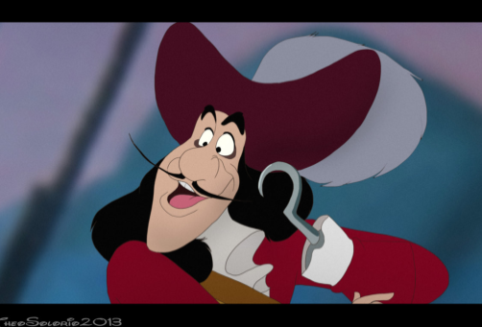
Disablism
The social barriers that arise when an able-bodied person views someone with an impairment with prejudice and treats them in a discriminatory way.
Shakespeare (2000) found that the media representations of disabled people still relied on old stereotypes of twisted villains, plucky heroes and weak victims.
He argues that the mass media encourages the able – bodied population to view people with disabilities as ‘other’ – an abnormal group that is not part of mainstream society.

Slide 9
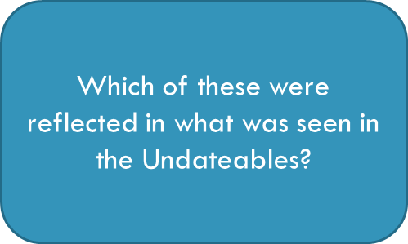
Content Analysis
According to Barnes (1992), there are a range of images of the disabled.
Content analysis of electronic and print media identified ‘the disabled person as……’
  pitiable and pathetic
  an object of violence
  sinister and evil
  atmosphere or curio
  ‘super cripple’
  an object of ridicule
  their own worst enemy
  a burden
  sexually abnormal
  incapable of participating n community life

Slide 10

The Effect of Telethons
(Charity fundraising)
Roper (2003) – mass media representations of people with disabilities on telethons can create problems for the disabled
Rely on ‘cute’ children which are not representative of the population
Implies that charities, not governments, should be responsible for providing for the disabled, doesn’t ask why these people are disadvantaged
Roper (2003) argues that media representations end up creating beggars
Telethons are aimed at allowing the public to alleviate guilt and relief that they’re not disabled, not informing on the facts
(Roper, 2003 cited in Paton, 2007)

Slide 11
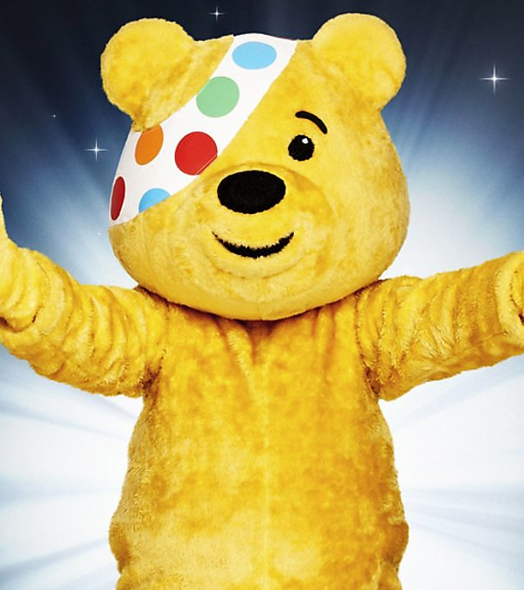
The Effect of Telethons (Charity fundraising)
Karpf (1988) – there is a need for charities, but telethons act to keep audience as givers, whereas recipients are kept in place as grateful etc
Telethons entertain the public not inform them about disability
Therefore, representations confirm prejudices, e.g., people with disabilities being dependent

Slide 12
The views of people with disabilities
(Ross, 1997)
Carried out a qualitative study of 384 disabled viewers’ attitudes towards media representations of the disabled
Found these disabled viewers were overwhelmingly critical of way disabled characters featured on mainstream television. They objected to:
  Infantilization of disabled characters
  Unrealistic and sanitized portrayal of disability
  Persistent use of wheelchairs, white sticks and guide dogs to denote disability
  Associations with disabled roles such as anger and bitterness
  Restricted repertoire of character types
  Lack of first-hand experience by media practitioners
  Failure to present disabled people as able to have an ordinary life

Slide 13
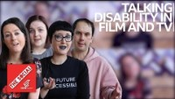

Slide 14

Zu is newly sober when she receives news that she is to become the sole guardian of her half-sister named Music, a young girl on the autism spectrum.
The film explores two of Sia's favourite themes: finding your voice and creating family

Slide 15
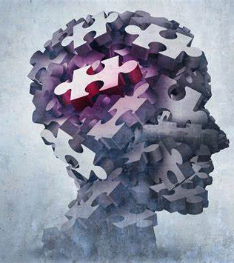
Representations of people with mental disabilities
Glasgow University Media Group (Philo, 1996): television and press reporting often focuses on violent incidents
Concluded that a high proportion of able-bodied people felt fear and anxiety when in proximity of those with mental health problems, because media coverage associates mental illness with violent behaviour
Also claimed this could supersede personal experience

Slide 16
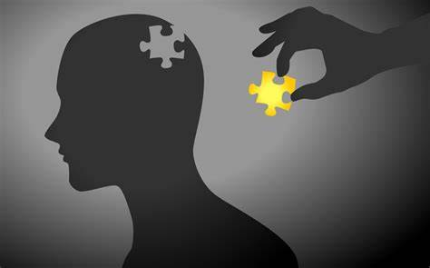
“depictions of persons with experience of mental illness draw upon archetypes of the mad man or woman. Those depictions fuel fears of unpredictable violence, social incompetence and contagion that position persons with a mental illness as unlike us: ‘strange, unpredictable, shocking and frightening’” (Nairn, 2007, p .144)
Consequently, media representation undermines people’s attempts to live ordinary lives by perpetuating ignorance and prejudice (Nairn, 2007)

Slide 17
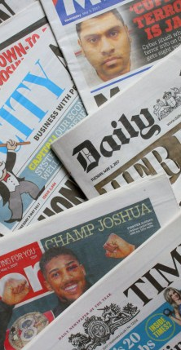
Newspapers
Content analysis of the Guardian and The Times between 1989 and 2009.
Decline in stereotypical words such as ‘brave’.
However, stereotypical representations were still present in 2009. Journalist assume disability is tragic.
Disability is not regarded as newsworthy.
(Williams-Findlay, 2009)

Slide 18
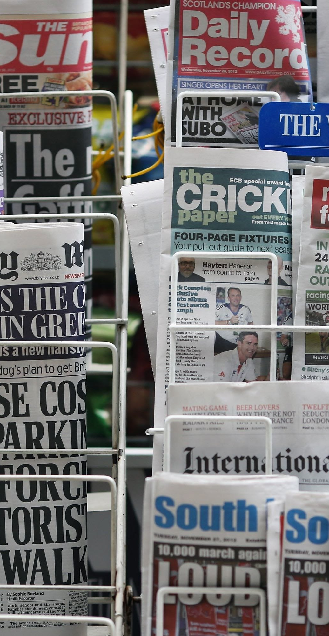
Newspapers
Compared tabloid media coverage in 5 British newspapers in 2010-2011 and 2004-5.
There had been an increase in reporting on disability. However, some groups (those with ‘hidden’ impairments and mental health conditions) were presented as ‘undeserving’
Disabled portrayed as welfare scroungers undeserving of benefits with the focus groups believing that 70% of benefit claims were fraudulent
(Watson, Philo and Briant, 2011, p. 4)

Slide 19
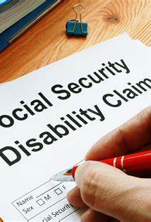
“Disabled people are feeling threatened by the changes in the way disability is being reported and by the proposed changes to their benefits and benefit entitlements. These two are combining and reinforcing each other”
(Watson, Philo and Briant, 2011, p. 5)

Slide 20
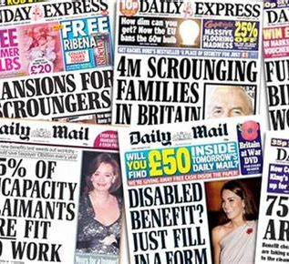
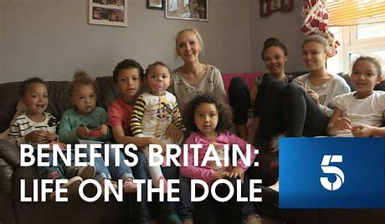
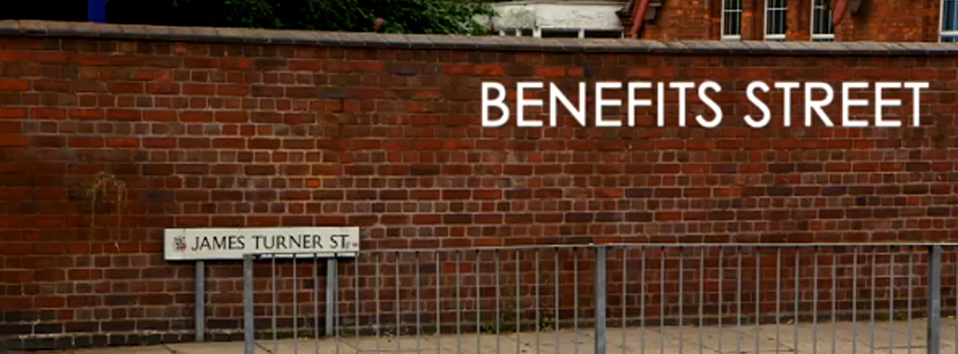

Slide 21
References
Barnes, C. (1992) Disabling Imagery and the Media: An Exploration of the Principles for Media Representations of Disabled People. Halifax: Ryburn Publishing
Karpf, A. (1988) Doctoring the Media: Reporting of Health and Medicine. London : Routledge
Nairn, Raymond G. , 'Media portrayals of mental illness, or is it madness? A review', Australian Psychologist, 42 (2), pp. 138 – 146 DOI: 10.1080/00050060701280623
Paton, R. (2007) Fundraising as Marketing: Half A Truth is Better Than None, in Mordaunt, J. and Paton, R. (Eds.) Thoughtful Fundraising: Concepts, Issues and Perspectives. London: Routledge
Philo, G. (1996) Media and Mental Distress. London: Longman
Ross, K. (1997). But where's me in it? Disability, broadcasting and the audience. Media, Culture & Society, 19(4), pp. 669–677.
Shakespeare, T. (2000) Help (Imagining Welfare). London: Venture Press
Williams-Findlay, R. (2009) Is there evidence to support the view that the language and subject matter selected by the Times and the Guardian in relation to disabled people has changed over the last twenty years? Available at: https://disability-studies.leeds.ac.uk/wp-content/uploads/sites/40/library/williams-findlay-RWilliams-DisabilityDissertation-200372855-3.pdf (Accessed 21st February 2021)
Briant, E., Watson, N. and Philo, G. (2011) Bad News for Disabled People: How the Newspapers are Reporting Disability. Available at: http://eprints.gla.ac.uk/57499/1/57499.pdf (Accessed 21st February 2021)

