Slide 1
PRESENTATION
THE RITZ CARLTON
Student Name: STELUTA MARINA HANEA
Student ID: 2212027
Course Name: HOSPITALITY AND GUEST SERVICE MANAGEMENT
BMIH4003
LECTURER: MUHAMMAD CASAMO

Slide 2
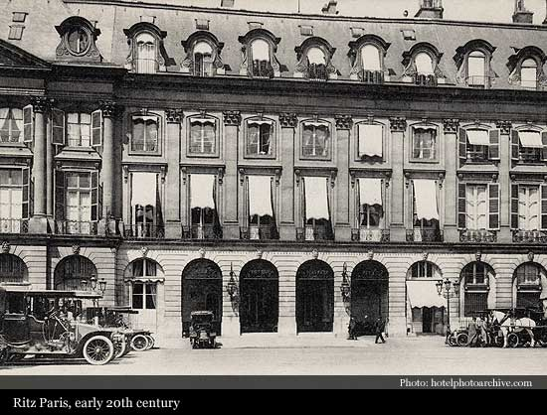
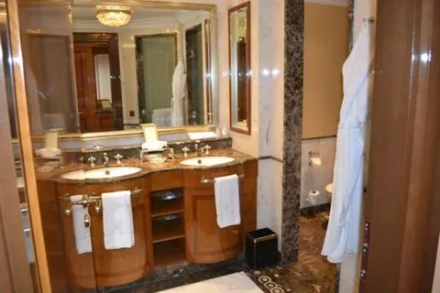
1. Introduction
The Ritz-Carlton is one of the luxury brands owned by Marriott International and a symbol of elegance, luxury, and the highest quality services provided in the Hospitality Industry.
The brand was founded by Cesar Ritz in 1906, a pioneer in the Hospitality Industry, the first hotelier who creates the concept of “grand hotel” and the standards of high-quality services.
Notes:
Madrid has scored the highest number of recognition for its sustainability as well as in providing its travellers with comfortable accommodations globally (Statista. 2022). Therefore, due to the vast geographical area of the hotel, Swansea Marriott Hotel is focusing on developing its marketing plan within that particular area.
Purpose of marketing plan
The main objective of this marketing plan is to attract a huge amount of new customers that are located within the new market area. This marketing plan is determined to be focusing on improving, changing as well as introducing the latest ideas that are effective for developing the customer base of the hotel within Spain.
The main reason for the marketing plan
The main reason behind the marketing plan is to focus on attracting new customers through developing the imagination as well as improving, and analysing both the micro & macro environment. This marketing plan is mainly being developed for the citizens of Spain and also foreign travellers.

Slide 3
2.History
Ritz-Carlton is one of the luxury brands owned by Marriott International and a symbol of elegance, luxury, and the highest quality services provided in the Hospitality Industry. The brand was founded by Cesar Ritz in 1898, a Swiss hotelier and a pioneer in the Hospitality Industry, the first hotelier who creates the concepts of a “grand hotel” and “grand cuisine” and creates the standards of high-quality services. The first Ritz Hotel was Ritz Parsi opened in 1898 by Cesar and his best friend chef Auguste Escoffier. | Ritz Paris was the first hotel in Europe that provided a bathroom, electricity, and a telephone in each room. Due to its innovative concepts, luxury standards, and high-quality services, Ritz Paris becomes famous quickly among the important personality of that period The most famous guest of Ritz Paris was Coco Chanel who lived at Ritz for 34 years.
Notes:
Place
The place that has been chosen by the organisation to build up the high focus of the company is Spain, Madrid. This place is suitable for organisational development as well as improving the product development and market share of the company. This place could be helping the organisation in building up the standards as well as in maintaining the accommodations comfortable for the travellers from a global perspective (Lilien et al., 2022). Furthermore, it has been noticed that this destination has been topping the list of the tourism sector and for its high recognition; the Hotel company is concentrating on having high growth factors of the marketing plan. The developed product of the company would be distributed through internet services. The website that would be used by the company is the organisation’s company website.
Price
The Hotel has estimated an amount for the usage of this kit included within the total package. The pricing strategy used by the hotel is a competitive strategy to focus on the new customer market area that could focus on having stable competition concerning its competitors (Alzoubi et al., 2022, p. 459). The market research that would be effective for the company before establishing their product within the new market is to have research in the market. Spain has been identified to aim towards addressing effective rank first in protecting the ecosystem vitality furthermore the country is also having strong dependence upon renewable energy resources.
Promotion
The Hotel company has been identified to be using effective marketing campaigns that would be providing its customers with better impactful views upon reacting positively as well as in resulting towards developing constant customer engagement growth facilities. The campaign hashtag of the company is #GoldenRule. This idea is projected to showcase the meaning and the purpose of the classic selection of brands. Furthermore, the hotel could be using the social media platform for forming an effective high amount of recognition while focusing on a new market area (Bar-Zeev et al., 2022, p. 101). This procedure is also determined to be involved focusing on maintaining the best connections that would be helpful for the company to attract new customers towards themselves. Moreover, the company is required to be focusing more on making attractive features that would be helpful for the company.

Slide 4

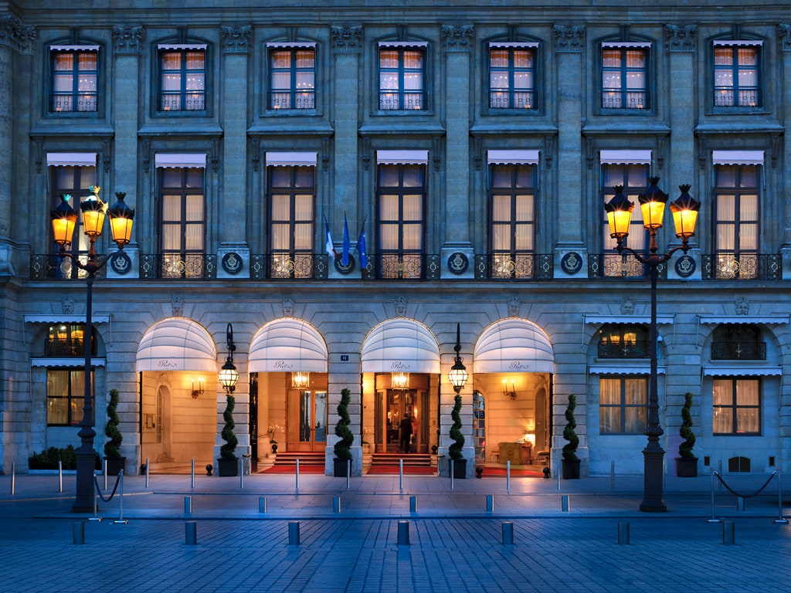
 | Weakness
RITZ PARIS | Whether the guests are choosing Ritz-Carlton for a business trip, whether for events or a relaxing trip, Ritz is providing the same exquisite travel experience.
Notes:
SWOT analysis
From the above idea, it has been recognised that the company has been having high access to shifting demographics as there has been high involvement of millennial as well as Gen-Z within the consumer market. The Hotel Company has been getting this opportunity as its strong point is based on having an excellent global presence that not just increases the revenues but also has the access to reduce the risk factors of the company. Furthermore, a high global presence allows the company to operate across 127 countries across the globe. Moreover, this also stimulates the Hotel to be one of the largest hotel chains in the global market. This is because over 30 brands, 81 hotels as well as $25.1 billion as these are determined to assert within impressive portfolios (bstrategyhub. 2020). Furthermore, the company has also evolved within accessing high focus on the emerging economies within the area it is present currently. Swansea Marriott Hotel is effectively based upon demand for high-end opportunities for hospitality services that would be based in developing countries. This also projects in focusing on increasing rapid changes and also in processing access in presenting lucrative opportunities for the hotel chains. As this Hotel organisation has been projected in getting high access within diversification therefore they mostly concentrate on customer satisfaction procedures whether it is through digital marketing. Swansea Marriott Hotel is evident in processing demands for best-personalised services as these are considered to be satisfying for the customers who are focusing on processing their needs. As the company is having vast diversity to be offering high effectiveness of the reputation. Swansea Marriott Hotel is determined to be ranked 44 across the diversity; moreover, the company is ranked 100 among its competitors (bstrategyhub. 2020). It has also been stated that the Hotel Company is 84 among the top similar companies. In contrast to these strengths and opportunities, the organisation has been determined to have certain issues whilst maintaining its sustainability and stability within the UK market space. Some consumers cannot be trusted and therefore need to avoid organisations that fail in protecting their data. Swansea Marriott Hotel is evident in getting acquainted with the issue of not being active in protecting their data properly and due to this reason they fail in keeping the data of customers or staff very often. On the other hand due to the lack of positioning it has also been identified that due to poor positioning strategies of the company they suffer a lot in maintaining the future of the hospitality sector. These are also the results of the increase in threats within the company. The weaknesses of the company have been indicated to face issues within the global pandemic with a loss of 92% of profits that stimulates permanent decline due to the Covid-19 issue (bstrategyhub. 2020). Furthermore, the company has also seen a high amount of stuff competition level within the UK marketplace. The competitors of the company are Hilton as well as Novotel and many more that are determined to be having renowned hotel chains and facilities. However, on the other hand, the market of the Swansea Marriott Hotel has been drastically changing.

Slide 5
3. The main consumers of Ritz- Carlton
RITZ-CARLTON owns over 100 hotels and 50 properties in more than 30 countries. Each hotel and resort keep the same opulent, elegant, and extravagant decoration according to its destination aesthetic and provides more than high-quality services, it provides the finest luxury experience for guests perfected over a century.
Its main consumers are people willing to pay for this fancy and classy unique experience and include business people, and leisure travelers, mostly people from an upper and upper-middle-class section of society.
Whether the guests are choosing Ritz-Carlton for a business trip, whether for events or a relaxing trip, Ritz is providing the same exquisite travel experience.
The motto that defined the brand is “We are ladies and gentlemen serving ladies and gentlemen” and reflects the high standard of their services.
Notes:
Socio-cultural
Demographics as well as the skill level of the population
Good involvement in cultural diversity
The demographics of Spain are estimated to have highly developed within the social market of the economy. Europe is estimated as the sixth largest according to the GDP (Miranda and Ruiz-Moreno, 2022, p. 1901). Swansea Marriott Hotel is also needed to acquire the need of making their staff members skilled in acknowledging digital skills, cognitive skills and educational skills.
On the other hand, as Spain is in comparison to the UK is the largest tourism destination; therefore it has to have access to vast cultural diversity. Swansea Marriott Hotel is needed to get access to high cultural diversity within the productivity of the company.
Technological
AI technology advances
Impact of value chain structure
In comparison to the UK, Spain is not so developed in building technological; factors, therefore the Swansea Marriott Hotel is needed to focus more on utilising AI technology advances that are processed in building high-rise of promotional facilities for the Hotel Company.
On the other hand, in comparison to the UK, Spain does not carry high productivity within the value chain with effective design, production, and distribution. Swansea Marriott Hotel, the company is required to maintain its technological procedures within Spain's market area and this would bring high productivity scope within a new marketplace.
Environmental
The law regulating the environmental pollution
Air as well as water pollution regulations in the lodging industry
In comparison to the UK, Spain is much more into maintaining sustainability therefore, the Swansea Marriott Hotel, is needed to maintain the air as well as water pollution regulations within getting into the new market area with the new product launch (Xu et al., 2022).
On the other hand, being involved in Spain's marketplace, the company is required to obtain the law regulating environmental pollution.
Legal
Anti-trust law in the lodging industry
Taxation law
In comparison to the UK, Spain is evident in using prohibitions in maintaining anticompetitive restraints on those who are involved in maintaining the licence agreements of the company.
On the other hand, Spain uses the Beckam special tax regime that helps the company establishing or are established within Spain can lay less amount of taxes in Spain. Swansea Marriott Hotel would be able to income allocation regime for income generated through business entities without having separate legal personalities.
PESTLE analysis
Through the above impact study, it has been seen that as political stability is good within Spain, therefore the Swansea Marriott Hotel can take effective measures on political stability and regulations. As the company can take a positive role as the inflation rate is low and the Hotel would be able to obtain high-yield facilities. The hotel may capitalise on positive impacts by using political, economic factors, social factors as well as environmental factors. The hotel may address its negative sides, by developing the technological factors as well as legal norms within the Hotel (Zhong et al., 2022, p. 482). It has been seen that due to the good involvement of the company in cultural diversity, they are being able to address their issues using digital skills, cognitive skills as well as educational skills of the company. Furthermore, the company is needed to maintain the best technological affairs that they have gained within the UK, as this is evident to be affecting the company with a high amount of production. The company could be able to gain the best factors and elements for maintaining the air as well as water pollution facilities within the lodging industry. This is therefore the state that the company is effective in forming a high amount of legal facilities within the organisation. The company is also needed to be based on anti-trust facilities as well as taxation laws that would help the company in gaining maximum benefits and social media security.

Slide 6
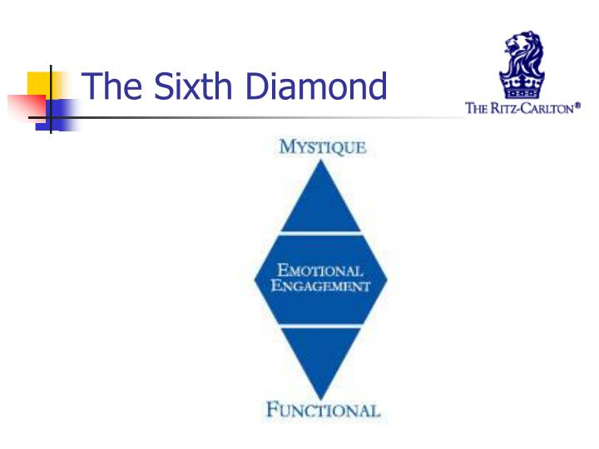
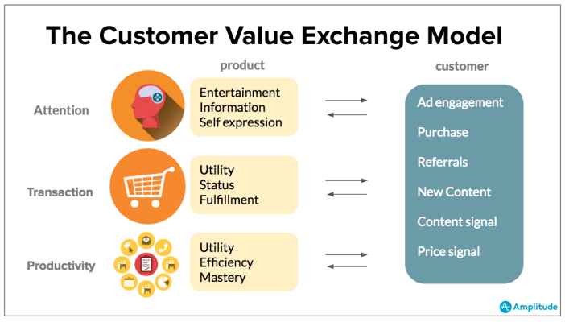
3. Business Values
According to the introduction The Ritz-Carlton started as a new concept dedicated to the luxury sector of the Hospitality Industry, the organization is required to focus on details, on seeking opportunities to innovate and improve the Ritz experience in order to provide the finest personal services, memorable experiences and on exceeding highest customers’ expectations.
The company values and gold standards attracted a loyal following of customers who are choosing their destination whether there is a Ritz Carlton in their desired city.
Notes:
The simple equation of this process is customer value benefitting- cost (CV = B-C). Moreover, with the utilisation of the four types of customer value, the company could be able to focus on the functions such as sales, marketing, as well as advertising for selling the product in a new product (functional value) (Zhang et al., 2022, p. 180). On the other hand, the monetary value of the company is concentrated to focus on the economy or the profits gained by the company within a new market segment. With the initiation of social value, the organisation could indicate by highlighting the environmental or trending factors within the market the company is radically being concentrated. Furthermore, the psychological value could focus on the customer's thinking ability and the customers interests with the help of which the company could gain a high amount of success within diversification.
Benefits of offering present and potential visitors
With the utilisation of the creation of customer value, the company can focus on increasing the customer satisfaction procedure as well as maintaining the customer experience. Furthermore, the reverse of this is also stated to be true, as a good customer experience is stated to create effective value for the customers (Bu et al., 2022). Therefore the creation of customer value is stated to have better benefits versus price to perform an increase in loyalty, and market share as well as in maintaining the price through the reduction of maximum errors of the company. These benefits are considered to be provided to potential travellers. Furthermore, the benefits provided to their present travellers are high customer loyalty, an increase in profits as well as in having increased conversion procedures.
Develop visitor engagement
For increasing the engagement facilities in Swansea Marriott Hotel in Spain, the hotel Company is evident in providing attractive offers as well as high-quality services and products that would attract the travellers to get accommodated within the Hotel (Maciejewski and Krowicki, 2022, p. 70). The company is effectively based on providing their customers with boasting as well as attracting the evolution of customer engagement procedure. Social media platforms are also considered one of the productive platforms that increase the revenue sales of the company.
Marketing channels
The company is stated to provide their customers with a direct marketing channel consisting of a producer and a consumer (Hadjielias et al., 2022). The company may also use digital or social media marketing channels that could help them with a high amount of effectiveness and easy working ability within the Spain market. Social media are nowadays having high power over their customers which also help in bringing effective productivity.

Slide 7
SERVICES AND FACILITIES
In The Ritz Hotel chain, all the rooms are extremely elegant and timeless decorations, no matter the type of accommodations chosen by the customer and the services are gold standards and is offering :
Accommodations in suits and villas – for traveling with friends and families
Sky-high penthouses with spectacular views
Lounge and bars, in some locations have sky lounge and bar with a panoramic view over the city
Voyages with luxury cruise ships
Some of The Ritz-Carlton restaurants are providing dining experience at Michelin-starred, one of these restaurants is situated in The Ritz London
Conference hall and meeting facilities
Spa and sauna
Special facilities for families with babies called Itzy Bitzy Baby service where it can be found essentials including a baby bathtub, changing table
Airport transfers
Overall, The Ritz Hotel chain is offering the highest quality services in Hospitality Industry, is offering an experience .
Notes:
These are stated to be focusing on bringing the most essential advents as these are playing the most essential role within the industry. Digital marketing such as social media marketing and influencer marketing has been stated to contain huge amounts of productivity nowadays (Shin and Perdue, 2022, p. 1100). Therefore, the Swansea Marriott Hotel could use this to help them increase their marketing effectiveness. These are also concentrated to be measured by short-term as well as long-term sustainability based on the revenue those are being generated with the help of a campaign.
The message that would be delivered in attracting new customers
The message that the company is stated to be having while attracting new customers within Spain is health and safety matters. Moreover, the company could show the advances of technological factors by promoting its hotel facilities through social media platforms such as Instagram, Twitter, Pinterest, Facebook and YouTube. The Swansea Marriott Hotel is also seen to use productive customer discounts as well as promotions that would help the company retain productivity within the Spain marketplace.

Slide 8
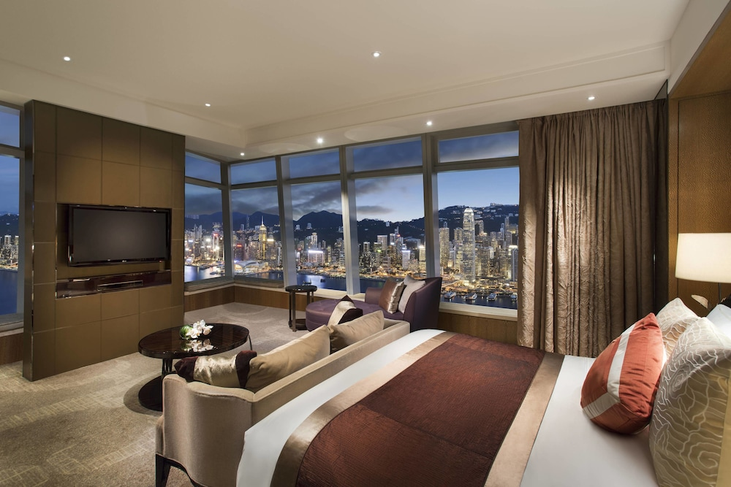
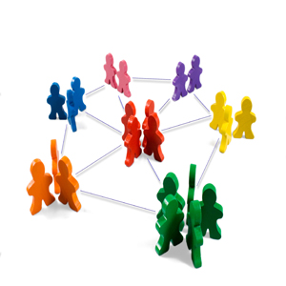
7. Conclusion
The completion of the above study observed the marketing plan challenges in determining the sustainable market strategy against the competitors of the company.
Issues in presenting a sustainable market strategy for launching new products within new markets are due to the selection of Spain as the geographical area.
Notes:
As Spain is having a high amount of strategies as well as the hospitality sector has observed high competitive levels within the area. Therefore, while establishing a new product the company is required to reflect upon their strengths and also improve the weaknesses and threats that may reduce the sustainability factor within the company.
Recommendations
While focusing on providing their new customers with Covid-19 precaution kits in Spain's hospitality sector, the organisation is required to focus on consumer-oriented marketing as well as customer value marketing. These would be focusing on building up the Swansea Marriott Hotel company's marketing strategy. The company is also recommended to focus on innovative marketing as well as social media marketing platforms that would help the company in being able to build the determination and sustainability of the marketing segments.

Slide 9

References
Maciejewski, G. and Krowicki, P., 2022. Brand as a Customer Value Driver: Relationships with Customer Engagement. Marketing of Scientific and Research Organizations, 43(1), pp.53-74. https://www.researchgate.net/profile/Grzegorz-Maciejewski/publication/360217829_Brand_as_a_Customer_Value_Driver_Relationships_with_Customer_Engagement/links/6268fa86ee24725b3ecae61d/Brand-as-a-Customer-Value-Driver-Relationships-with-Customer-Engagement.pdf
Miranda, J.A. and Ruiz-Moreno, F., 2022. Selling the past. The use of history as a marketing strategy in Spain, 1900-1980. Business History, 64(3), pp.491-510. https://www.tandfonline.com/doi/abs/10.1080/00076791.2020.1717473
Piranda, D.R., Sinaga, D.Z. and Putri, E.E., 2022. Online Marketing Strategy In Facebook Marketplace As A Digital Marketing Tool. Journal of Humanities, Social Sciences and Business (JHSSB), 1(3), pp.1-8. http://ojs.transpublika.com/index.php/JHSSB/article/download/123/114
Shin, H. and Perdue, R.R., 2022. Customer nontransactional value cocreation in an online hotel Brand community: driving motivation, engagement behavior, and value beneficiary. Journal of Travel Research, 61(5), pp.1088-1104. https://journals.sagepub.com/doi/pdf/10.1177/00472875211024752
Xu, Z., Zhu, G., Metawa, N. and Zhou, Q., 2022. Machine learning based customer meta-combination brand equity analysis for marketing behavior evaluation. Information Processing & Management, 59(1), p.102800. https://www.sciencedirect.com/science/article/pii/S0306457321002788
Zhang, J.Z., Chang, C.W. and Neslin, S.A., 2022. How physical stores enhance customer value: The importance of product inspection depth. Journal of Marketing, 86(2), pp.166-185. https://www.researchgate.net/profile/Jonathan-Zhang-4/publication/350714741_EXPRESS_How_Physical_Stores_Enhance_Customer_Value_The_Importance_of_Product_Inspection_Depth/links/6312f9961ddd4470212f3c1f/EXPRESS-How-Physical-Stores-Enhance-Customer-Value-The-Importance-of-Product-Inspection-Depth.pdf
Website
bstrategyhub (2020). Marriott SWOT Analysis. [online] Business Strategy Hub. Available at: https://bstrategyhub.com/marriot-swot-analysis/ [Accessed 3 Nov. 2022].
festival, P. management (2018). Defining the Future of Product Management. [online] Product Management Festival. Available at: https://productmanagementfestival.com/three-games-customer-engagement-strategy-guest-post/ [Accessed 3 Dec. 2022].
Statista. (2022). International tourist numbers Madrid Spain. [online] Available at: https://www.statista.com/statistics/449249/yearly-number-of-international-tourists-visiting-madrid/ [Accessed 3 Nov. 2022].
Luxury Hotel Accommodations | The Ritz-Carlton (ritzcarlton.com)
Meet Three-Michelin Starred Chef Sven Elverfeld | Journey Into The Ritz-Carlton (ritzcarlton.com)

Slide 10


