Slide 1

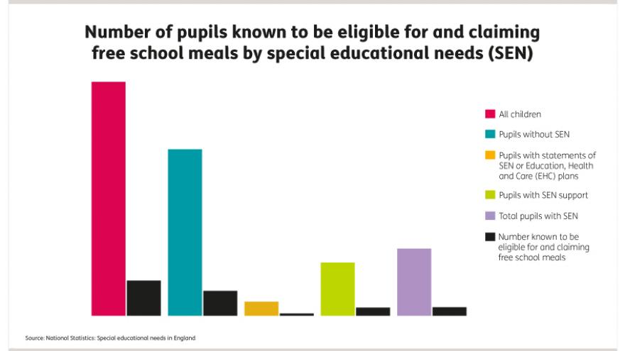

Impending Changes to Additional Learning Needs (ALN) Legislation in Wales
Implications
There are many implications to consider when regarding the new changes in Wales to the ALN legislations. Such as what if there is not enough funding for children who have a IDP? Afterall, this is a statement they have which is a legal entitlement. So for example, if a child’s statement says they need to have a 1:1, then they will have to have one but what if there is no money to pay for that member of staff. A child who is entitled to the 1:1, is then being let down by the government and will fall behind in their education because they haven’t received what is rightfully theirs. How time consuming is it going to be to get a statement in the first place. Whilst an IDP is reviewed annually, what if a child is not diagnosed with an ALN until they are 5, when the first three crucial years of their life are when an ALN should be identified but if it is missed, then the child is the one who suffers from this because they then are not meeting the educational targets that they should be meeting. Home, A. (2013) states in her ‘Chapter 3: Advocating for children with disabilities’ video looks at how parents find it hard that there is a constant need to advocate for their child with an ALN because their child is constantly being scrutinised because of their disability and it seems that staff are sometimes unprepared with how to deal with the behaviour of a child with an ALN because they may be untrained. Staff themselves may feel unprepared when dealing with children with ALN because they have no qualifications or experiences where they have worked with children with an ALN before. Therefore, should all staff who work with children have some expertise when it comes to additional learning needs because we are being taught now on how we need to be aware of being advocates for children and we have some expertise of children’s rights after this course, but those who work with children already, should be provided with the same learning opportunities as we are and go on on courses that advise them on how to cope with working with children with ALN. Then again, will there be funding for all of these courses. If a practitioner feels unprepared to work with a child with an ALN, this is what the role of ALENco is for because they are a senior member of staff with previous experience of working alongside children with ALN and they are usually the advocates for these children.
Poverty could be another implication in regards to ALN legislation because you can come across a new parent who lives in poverty, who is not aware of the norms of development that a child should be reaching and what milestones/targets they should have met by a certain age. Therefore, their child could have an undiagnosed ALN and this then puts them in a position where they are behind their peers, but also late at being diagnosed may mean they have to wait longer until solutions are put into place to help support the ALN. Another implication could be, if a child living in poverty has an ALN, they may need to go to different professionals to help maintain the progress of them working towards goals set out in their IDP’s, but what if their parents do not drive our live in a rural area where there is not much transport, this then effects the child’s progression. After all, one of the aims set out in the seven core aims by the Welsh assembly government were to not de disadvantaged by poverty.
Introduction
In Wales, seven core aims have been developed to ensure all Welsh children have a flying start in life, have a range of educational/learning opportunities, enjoy the best possible health, have access to play and leisure, are listened to and treated with respect, have a safe home and not be disadvantaged by poverty. Children with an Additional Learning Need (ALN) have been described as ‘’one of the most vulnerable groups in our society’’ (Children in Wales, 2014). Within the education sector in Wales, we are amongst impending changes in regards to ALN legislation. The impending changes are going to be discussed in regards to the implications of these changes for early years practitioners and children with ALN. The United Nations Convention on the Rights of the Child ((UNCRC, 1989) Article 12 states that all children have the right for their views to be expressed and anything that affects them, must be taken seriously. Jones and Walker (2011) would support this statement because they believed that ‘’children are agents in their own lives’’ and that ‘’children are able to contribute and participate in decision-making’’. Therefore, early years practitioners must see these changes as positive, because after all, the child is the main priority and their needs are being put first. As these changes are not officially in effect yet, the information spoken of today could be changed depending on the outcome of the proposed changes.
Advocacy
However, Jones and Walker (2011) discuss how there are implications in practice such as involving children in decisions that relate to them, giving them opportunities to communicate needs and how they need to be active agents in their own lives and not active responders. This then leads to early years practitioners being advocates for children because practitioners should be putting children at the centre of their role because we live in a world where we say children have rights, yet we do not let them express these rights or listen to them if they do express these rights. Mickelson (1995) defines advocacy as ‘’representing, defending, intervening, supporting or recommending a course of action on behalf of one or more individuals, groups, or communities, with the goal of securing or retaining social justice’’. This is especially true for children with an ALN, because often it is these children who feel left behind in society or let down by society as stated by The United Nations on the Rights of Persons with Disabilities (2006). Practitioners are the most important advocates for children in general but especially those children with an ALN because children have no political power whatsoever. Child Law Advice (no date) states that advocates ensure the child’s feelings are heard, attend meetings with the Local Authority (LA) on behalf of the child, ensure they are treated fairly and their legal rights are upheld, have meetings with social workers and ask questions on behalf of the child. Children need advocates because children are reliant on adults for their needs to be met as they are unable to protect themselves. Practitioners being advocated can be supported by Hoofer’s unified model of advocacy (2016) which shows the stages of advocacy. Step number one is getting involved, then understanding the issue, then planning on what outcomes the child wants and then advocating is how you can help them by speaking for them, then evaluating the outcomes and finally ongoing monitoring includes monitoring the progress and how it benefits the child and to see if it is working or if changes need to be made.
Impending changes
For example, the Additional Learning Needs and Education Tribunal (Wales) Act 2018 has set out in their framework that it will now be a statutory requirement to support children and young adults from 0 to 25 with an ALN, therefore replacing the current Special Educational Needs (SEN) framework requirement which only aims to support children and young people with an ALN from 0 – 18. The new framework aims to support young people with an ALN who wish to pursue post compulsory education such as higher education and further education. They want to ensure the process of assessment and planning helps to facilitate interventions that are early and effective whilst the information and advice resolving concerns and possible appeals are fair. Eleven core aims have been developed for this Act’s provision. Some of these include: replacing the term SEN which can be seen as a derogatory term towards children with an ALN because of the term ‘special’ with the term ALN instead. The age range as spoken about will be for children and young people between the ages of 0-25 instead of 0-18, an increased participation of children and young people. Improving the child’s aspirations and outcomes, increased collaboration and a clear and consistent rights of appeal (Welsh Assembly Government, 2018). These impending changes with regards to ALN legislation also mean that some terms will be replaced such as an IEP (individual educational plan) will be replaced with an Individual Development Plan (IDP) and a SENDCO (Special Educational Needs and Disabilities Coordinator) will now be known as an ALENCO (Additional Learning Educational Needs Coordinator). The changes are being made because an IDP puts the child’s needs first rather than just their educational needs whilst providing an action plan with evidence to support them from birth to 25. It also benefits early years practitioners as it encourages them to work alongside multi-agencies if need be and they will have better access to services that will support them. An IDP will be easier to access and update which benefits the child or young person and the practitioner because if the child’s needs have changed or have been met, then new goals can be set and they will be reviewed annually (Snap Cymru, 2014). The IDP will also combine education, health and social services. All queries that parents or carers have will be listened to and contribute towards factors in the IDP and there will be a Parent Partnership Service to advise parents through all stages of the IDP process. To ensure that an IDP remains effective, the needs of the child should be identified, the outcomes for the child or young person should be agreed on by everyone involved including their parents, ALENco and the practitioner who is in charge of that child. Any additional provision required to meet those needs such as key workers or multi-agency staff and the success criteria of the IDP will be reviewed annually (Snap Cymru, 2018). These changes are supported by the UNCRC’s children’s rights such as article 23 which states children have the right to ‘’a full life and active participation in the community for disabled children and young people’’.
Statistics
Government funding is a huge implication in regards to ALN because the Welsh Assembly Government (WAG, 2016) state that whilst Local authorities use money frim the revenue support grant to fund for children with ALN, the amount each LA gets depends on how it is distributed through the local government settlement. Between 2016-2017, the local authorities were given a total of £4.102 billion through the RSG to deliver the services needed such as 1:1 support, courses for practitioners and even to help cut out barriers in the setting such as no disabled access to certain buildings etc. However, this is a 1.3% decrease from 2015-2016 because they were provided with £54 million less between 2016-2017. All the money that they are provided, does not necessarily mean it will all be spent on ALN education because as long as they meet the statutory requirements needed, they can spend the money on other things for the setting. You could say that this is a barrier in itself because shouldn’t the government provide separate amounts of money by setting aside separate pots of money for ALN and other needs in the setting because what if one year you needed to spend more money hiring 1:1 staff because there was an increase in the number of children admitted to your setting. Do those children just go without because the funding has been spent elsewhere as we know that ALN education is exempt from receiving any specific grants from the government. (WAG, 2016).
Conclusion
To conclude, the impending changes to the ALN legislation in Wales are effective for children if they fulfil the statements that they have made. However, there are implications which effect the early years practitioner and possibly the child if the government do not follow through with their statements. Practitioners are advocates for children with ALN and must always remember to put the child first. Parents and carers are also advocating for their child and should be involved in every part of the process via the Parent Partnership Service. There are many positives to the changes implemented but only the future can tell if they will be as beneficial as we hope to provide children with an ALN a better education; an education they deserve by being taught by qualified and confident practitioners.
References
Child Law Advice.org (no date) ‘Advocacy’ https://childlawadvice.org.uk/information-pages/advocacy/ [Accessed 12th January 2019].
Children in Wales (2014) ‘Looked After Children,’ http://www.childreninwales.org.uk/our-work/looked-children-2/ [Accsessed 12th January 2019].
Donaldson, L.P and Shields, J. (2008) ‘Development of the Policy Advocacy Behaviour Scale: Initial Reliability and Validity’, Research on Social Work Practice, Volume 19, Issue 1, 2009.
Hoefer, R. (2016) Advocacy Practice for Social Justice. (3rd ed.). New York: Oxford University Press.
Home, A. (2013) ‘Chapter 3: Advocating for Children with Disabilities’, https://www.youtube.com/watch?v=cgJaK9AfzS8 [Accessed 12th January 2019].
Jones, P. and Walker, G. (eds.) (2011) Children’s rights in practice. London: Sage Publications Ltd.
Snap Cymru (2014) ‘Individual Development Plan IDP’ http://www.snapcymru.org/wp-content/uploads/2014/09/IDP-Booklet.pdf [Accessed 12th January 2019].
Snap Cymru (2018) ‘ALN/SEN Reform,’ http://www.snapcymru.org/help-for-families/aln-reform/ [Accsessed 12th January 2019].
UNICEF (2016) ‘A Summary of the UN Convention on the Rights of the Child,’ https://www.unicef.org.uk/child-rights-partners/wp-content/uploads/sites/3/2016/08/CRC_summary_leaflet_Child_Rights_Partners_web_final.pdf [Accsessed 12th January 2019].
Welsh Assembly Government (2018) ‘Equality Impact Assessment’ https://beta.gov.wales/sites/default/files/publications/2018-06/alnet-wales-act-equality-impact-assessment.pdf [Accessed 12th January 2019].
Welsh Assembly Government (WAG) (2016) ‘’Research Briefing: Additional Leaning Needs (ALN) in Wales’ http://www.assembly.wales/Research%20Documents/16-059%20SEN/16-059-Web-%20English.pdf [Accessed 12th January 2019].

