Slide 1
Name: Milan Melissa Pratt
Student ID: 2116217
Module Code : BMSW4004
Module: Problem solving and decision making
Lecture: Abdi Rehman

Slide 2
- Complex problems on employees and organisations!
Complex problems for employees
Segregation.
Tormenting or provocation.
Execution issues.
Awful work fit or absence of preparing.
No work fulfilment.
Unmotivated.
Independent representatives.
Meddling representatives.
Complex problems for
organisations
Monitoring performance.
- Regulation and compliance
Competencies and recruiting - Technology.
Exploding data
Customer service.
Guideline and consistence.
Abilities and enlisting the right ability.
Innovation.
Detonating information.
Complex issues have numerous aspects, causes, interdependencies, and input circles that make the conduct we notice. They don't have a remarkable arrangement, so the best way to advance the circumstance is to make the circumstances in which the issue can't exist.
In this specific situation, regarding the NHS complex issues are issues that are past the extent of any single association to comprehend and answer regarding a single problem, there is conflict much of the time about the reason for the issues and how to address them and the issues must be tended to, not totally settled this is were decisions have to be made to illuminate the problems as a whole.

Slide 3
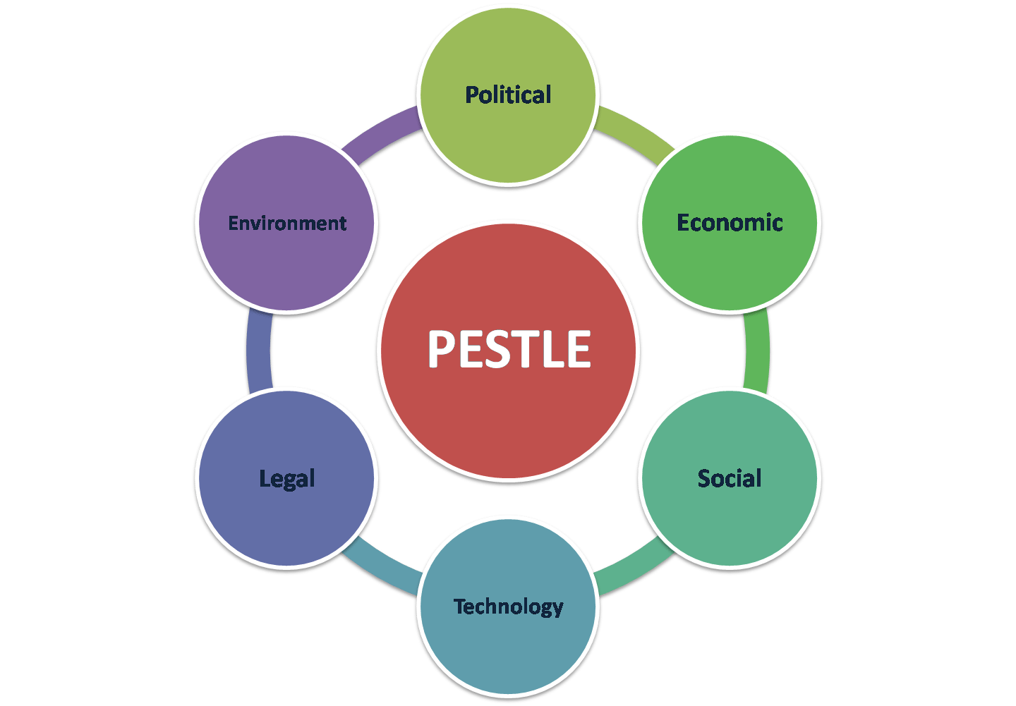
- PESTLE analysis of the Marco-environmental factors contributing to the complex problem!
PESTLE - Macro Environmental Analysis. The PESTLE Analysis is a structure used to filter the NHS outer large scale climate. The letters represent Political, Economic, Socio-social, Technological, Legal and Environmental as shown on the diagram on the left hand side of the slideshow. A few methodologies will include additional variables, like International, or eliminate some to decrease it to PEST.
Political
The real NHS crisis is political not humanitarian. Politicians of all parties have failed to provide sufficient funding for health and social care. This is in-fact an complex political argument.
Economical
A tax-funded NHS depends on a well-performing UK economy.
Social
Lack of social care causes problems for the NHS There is a knock-on effect for the health service if the care system is supporting fewer people
Technological
growing burden of long-term conditions, could be solved in part by medical technology
Notes:
The real NHS crisis is political not humanitarian. Politicians of all parties have failed to provide sufficient funding for health and social care
https://www.kingsfund.org.uk › publications › articles › political-crisis-nhs
a tax-funded NHS depends on a well-performing UK economy
NHS England » Funding and efficiency
growing burden of long-term conditions, could be solved in part by medical technology
www.buildingbetterhealthcare.com

Slide 4
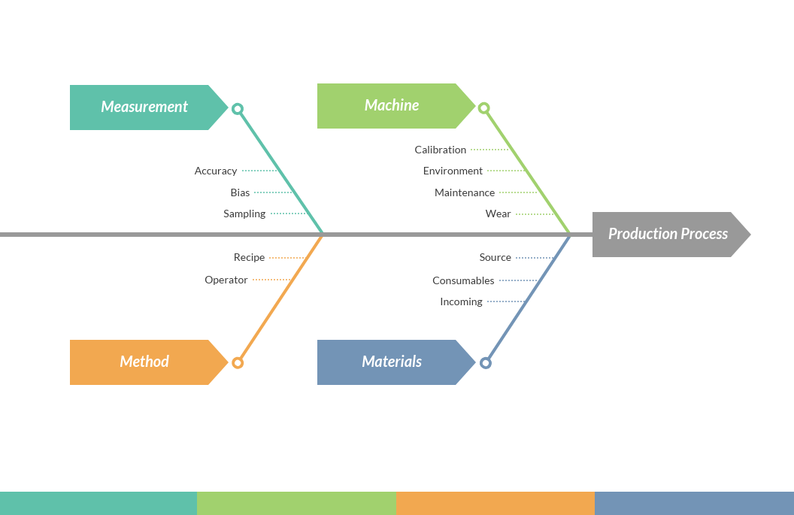
- RESEARCH-INFORMED caused-and-effect analysis, Using Fishbone Diagram, of the complex problem
The cause-and-effect analysis allows problem solvers to broaden their thinking and look at the overall picture of a problem. Cause-and-effect diagrams can reflect either cause that blocks the way to the desired state or helpful factors needed to reach the desired state.
Fishbone Diagram (otherwise called Cause and Effect Diagram or Ishikawa Diagram) It outwardly shows numerous reasons for an issue and assists us with distinguishing partner thoughts regarding the reasons for issues which Allows us to quickly classify thoughts into subjects for investigation or further information gathering. Individuals frequently utilize the 5-whys strategy related to the fishbone graph like the one on the left hand side of my presentation.

Slide 5

- An evaluation of alternative solutions of staff shortages and appropriate solutions among these alternatives
Preparing or retraining to fill positions is an expected answer for deficiencies, despite the fact that there are inquiries concerning whether this is a suitable answer for bosses on account of occupations with medium (or longer) preparing prerequisites. For instance, apprenticeships might be a medium-term recommendation for tending to deficiencies.
Normally, one of the simplest ways of filling an abilities lack is by recruiting contingent laborers. With specialists, experts, project workers and then some, you can fill enormous holes in your activity rapidly and in a practical way.
In any case, in the event that we can fundamentally remediate medical care labour force deficiencies - and the progress of organizations like AMN recommends we can - there will be not a good reason for inaction. The option is the medical services rendition of an unnatural weather change - too couple of assets for a maturing populace.

