Slide 1

Student : Waqar Ali
Student ID number: 2027054
BA Leadership and Management Skills for the Workplace
Developing Innovation and Creativity for Business Advantage
Module code BMSW 6102
Dr Sanjeewa Herath
Innovative Service Plan
(The Body Shop)

Slide 2
About Us
The Body Shop is a worldwide beauty brand that offers skincare, body care, hair care and makeup products. They are known for their dedication to ethical and sustainable business practices and are advocates for social and environmental causes through campaigns and initiatives they run. The company also offers regular sales and has a robust loyalty program.

Slide 3

Problem
‘’The Body Shop has in many ways been the victim of its own success. Being a unique proposition, and having effectively created its own retail category, it has appeared slow to evolve its brand identity. The strong association between the company and its campaigning founder, increasing competition and changing consumer attitudes, have been significant factors in the company's struggle to re‐align and update its brand.’’ (1)

Slide 4
Solution
TO CREAT BRAND STABILITY UTILISE ALL AVAILABLE STREAMS OF COMMUNICATION
‘’Business can drive positive change in the world. When Anita threw open the doors of The Body Shop, this was her belief. The products we create, the campaigns we run and the communities we support drive purpose as well as profit. We’re change-makers and we always have been. These days, more and more businesses are waking up to the idea of business as a force for good, and we’re glad to hear it. It’s going to take all of us.’’

Slide 5
FINAL STATEMENT
The Body Shop's strategic focus on innovation,
sustainability, and customer engagement
has enabled them to not only survive but
thrive in a competitive industry, setting a positive
example for other businesses looking to stay
relevant and successful in today's market.

Slide 6
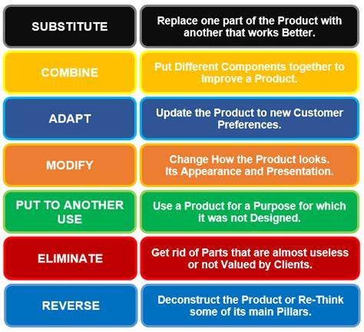

Slide 7
ACADEMIC REFERENCES
The Body Shop and the role of design in retail branding | Emerald Insight
Our Brand Purpose | Our Manifesto | The Body Shop®

Slide 8
Thank you!
I WELCOME ANY QUESTIONS YOU MAY HAVE TO ASK ME
ABOUT MY PRESENTATION
WAQAR ALI
Phone number:
07306425110

