Slide 1
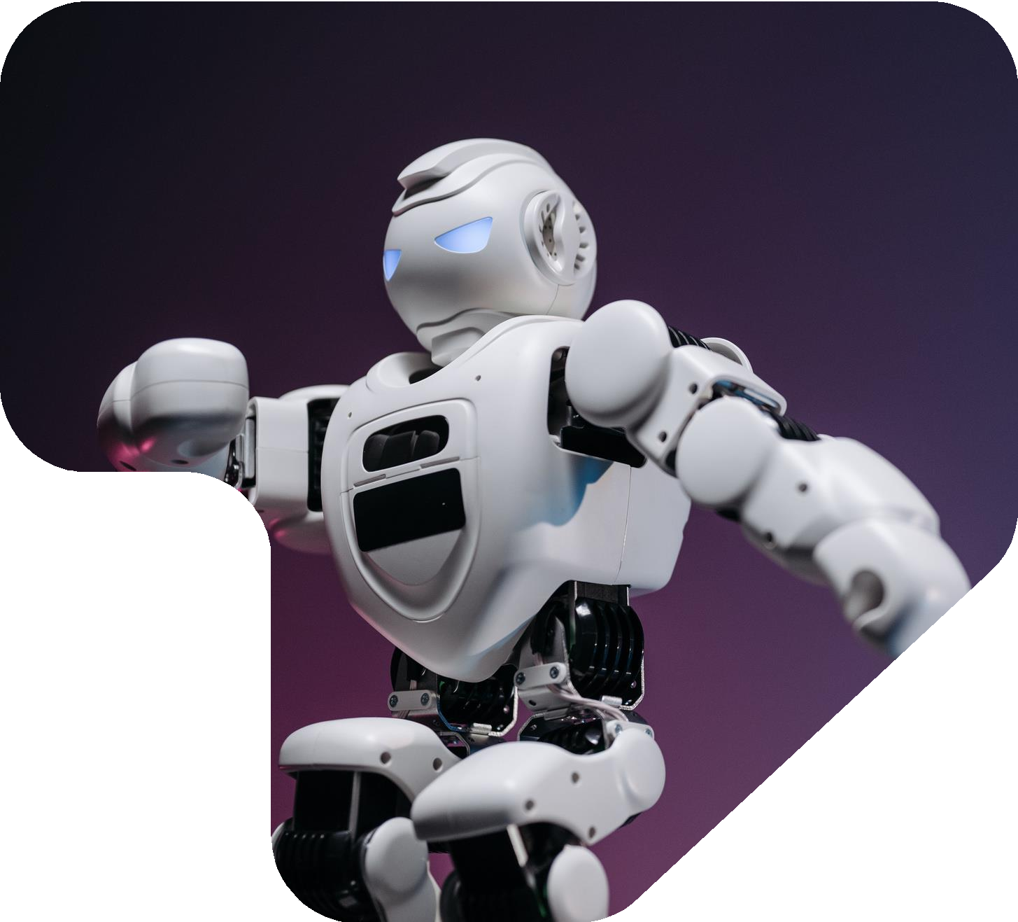
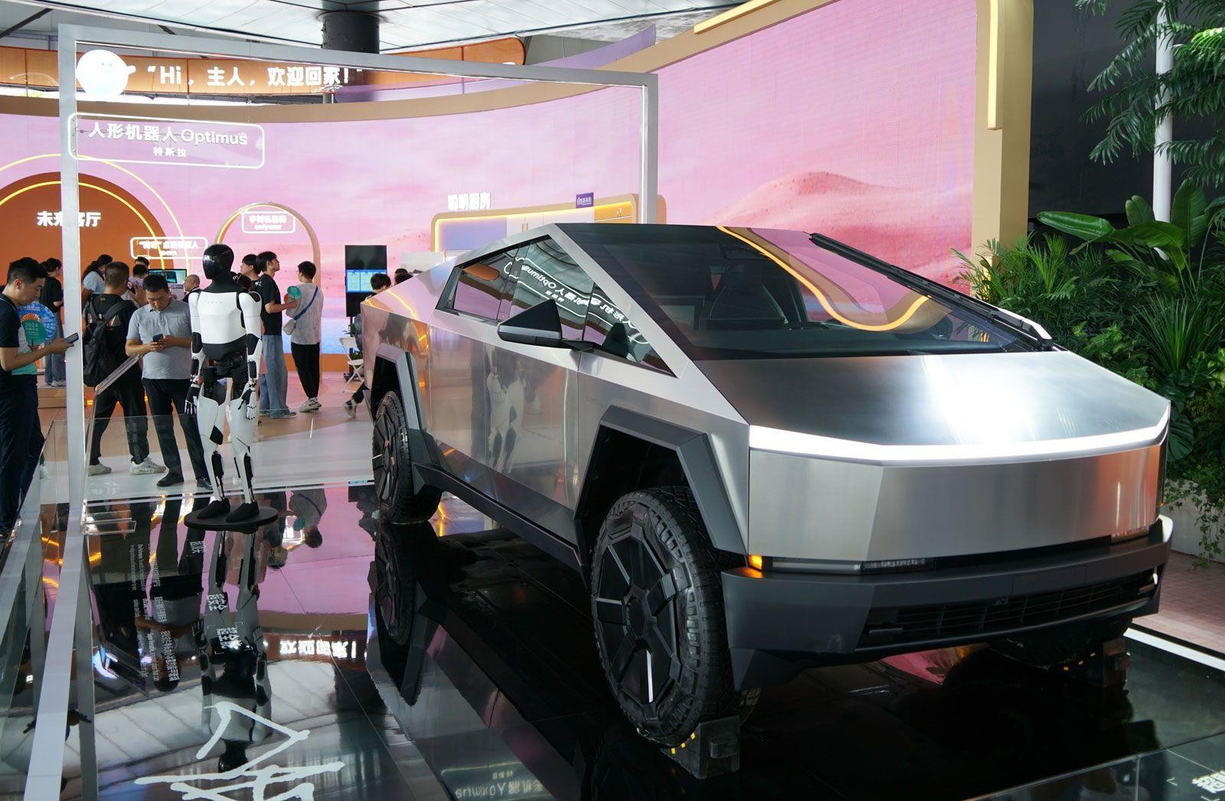

Tesla, Inc.: AI, Automation and Workforce Transformation – Strategic Implications for Human Capital Management
STUDENT NAME & ID:
SHREMAN MANKAD-2537843,
DARSHIL DODIYA- 2522995,
NIRMAL TRIVEDI-2534890,
LAKMI SINGH- 2534405,
KIRTI PATEL- 2537200,
JAINIL BAROT-2537840
Programme: Master of Business Administration Module Name: Human Capital Management Module Code: LCMB7023
Module Lecturer: Eno Maycock

Slide 2
Table of Contents
Organisation Overview
What is Workforce Transformation
Current Tesla Policies and Practices
Current AI Technologies Used
Opportunities for Tesla
Current Challenges
Impact on Employee Experience
AI SWOT Analysis
Root Cause Analysis
Evidence-Based Recommendation 1
Evidence-Based Recommendation 2
Evidence-Based Recommendation 3
Future of Work Implications
Tesla Workforce Transformation Roadmap
Strategic HRM Model
Overall Group Conclusion

Slide 3
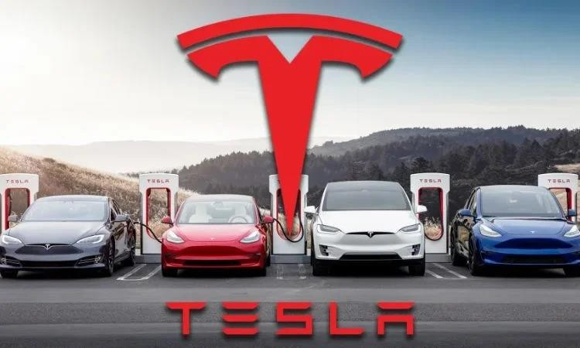
Organisation Overview
Tesla, Inc. is a well-known automotive and clean energy technology firm and its foundation year is 2003.
Nearly 125000 employees work at this Austin-based American multinational firm.
Tesla Inc.’s priority is for AI, robotics and extensive vehicle automation as these supports in making the capability for innovation autonomous mobility stronger (Tesla, 2026).
(Source: https://www.businessoutreach.in/tesla-success-story/)

Slide 4
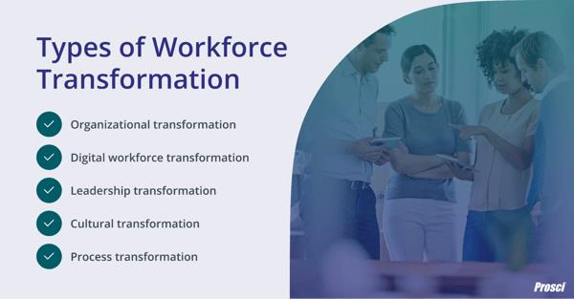
What is Workforce Transformation
Organisational restricting is essential as the trends in the market changes supported with technological advancement.
There is a requirement for phase-based automation and AI at the time of redesigning the workforce including human capabilities optimisation (Babashahi et al., 2024).
Digitalisation framework and growth in automotive industry poses the need of transition at like Tesla Inc. for market relevance.
(Source: https://www.prosci.com/blog/workforce-transformation /)

Slide 5
Current Tesla Policies and Practices
Area | Current Policies and Practices
Manufacturing | Tesla, in its manufacturing plants, currently uses robotics and automation for its operations
Recruitment | For faster, efficient and accurate candidate screening, the use of an AI system
Training | Flexible learning opportunities for employees with digital learning and upskilling platforms
Performance | The performance of employees is tracked using an advanced data tracking system
Innovation | Agile and cross-functional teams accelerate innovation capabilities
Strengths:
Tesla Inc.'s current policies and practices support optimum operational efficiency and productivity. Capabilities related to innovation and scalability are optimised (Nezhadkian and Zho, 2025).
Weaknesses:
High-pressure culture encourages employees to constantly adapt but lead to higher stress level.
Excessive use of AI highlights the concern for data privacy and security (Miller et al., 2024).

Slide 6
Current AI Technologies Used
Tesla Inc. for performing repetitive and dangerous Tesla uses the Optimus robot in its manufacturing plants (Tesla, 2026).
Operation efficiency, speed and capacity of production at Tesla are optimised with the use of excessive automation (Forbes, 2026).
Technical failure and interruption in the workplace are minimised with the use of machine learning and predictive analytics.
Operational decision, safety control and performance tracking are optimised with the use of AI-driven visual systems and workforce analytics.

Slide 7
Opportunities for Tesla
Valuable resource is AI for Tesla when it is used effectively as of RBV as it supports better problem-solving and strengthens innovation capabilities.
Efficiency and productivity level is enhanced profoundly at Tesla when there is effective use of AI and automation.
HR planning and decision-making with the use talent analytics become better (Madhuri and Kumar, 2025).
Competency of employees enhanced personalised learning opportunities that are run by AI.

Slide 8
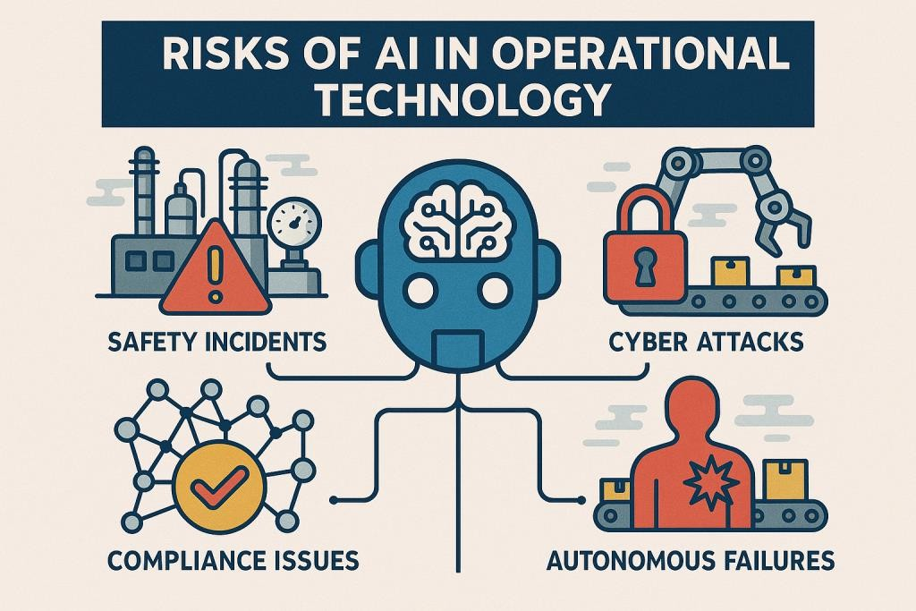
Current Challenges
Challenge 1: When there is higher level of automation use there is the possibility in generating the fear of job displacement among employees.
Challenge 2: Advancement of technologies generates the concern for skill shortages (Moch and Oberdieck, 2024).
Challenge 3: Lack of digital competitions generates employees' resistance towards change.
Challenge 4: AI decision-making brings ethical
concerns.
Challenge 5: Over-reliance on technologies
presents the risk and security (Dowthwaite et al., 2024).
Challenge 6: The stress and burnout level of
employees increases with excessive work pressure.
(Source: https://cybertlabs.com/risks-of-ai-in-operational-technology/)

Slide 9
Impact on Employee Experience
AI-driven work environments, lack of alignment with expectations that are shown by employees it leads to a lack of trust, engagement and higher burnout rate among employees (Saranya et al., 2025).
Expectations of employees around the workplace environment and job changes completely with the excessive use of technologies.
Digital transformation at Tesla Inc. brings the opportunity of upskilling and receiving optimum growth at career.
Robust planning and systematic implementation of AI and automation lead to positive experiences and outcomes.

Slide 10
AI SWOT Analysis
Strengths: Operational efficiency and innovation capabilities of organisations are enhanced with the use of AI. | Weaknesses: There is the possibility of security threats in job including change press which are key reasons for anxiety levels and turnover rate.
Opportunities: Employees receiving personalised training, skill development opportunities perform better. | Threats: There is a need to follow strict rules for avoiding data privacy concerns.

Slide 11
Root Cause Analysis
Culture: High pressure is faced by Tesla’s employees, as there is a strong priority for an innovative culture (Provitera and Sayyadi, 2024).
Technology: Internal resistance among employees arises with the quick deployment of technologies (McCall, 2025).
Processes: Tesla’s HR planning is not robust enough to support quick scaling and transition towards digital technologies
.
External: Digital transformati on has become increasingly important due to high-intense competition in the automotive sector.
Leadership: Aggressive expansion and fast-paced innovation are key priorities of Tesla’s leadership
Skills: Shortages of employees having strong modern digital competencie s.

Slide 12

Evidence-Based Recommendation 1: AI-Human Collaboration Strategy
Tesla Inc. priority for AI-assisted collaboration makes work better.
This approach optimises the AI acceptance level of employees and improves decisions that boost overall organisational performance.
Hiring or performance evaluation must be looked over by employees besides the decision made by an AI system.
Effective AI–human collaboration at Tesla comprehensive knowledge is gained with Socio-Technical Systems Theory (Weiss, 2026).

Slide 13
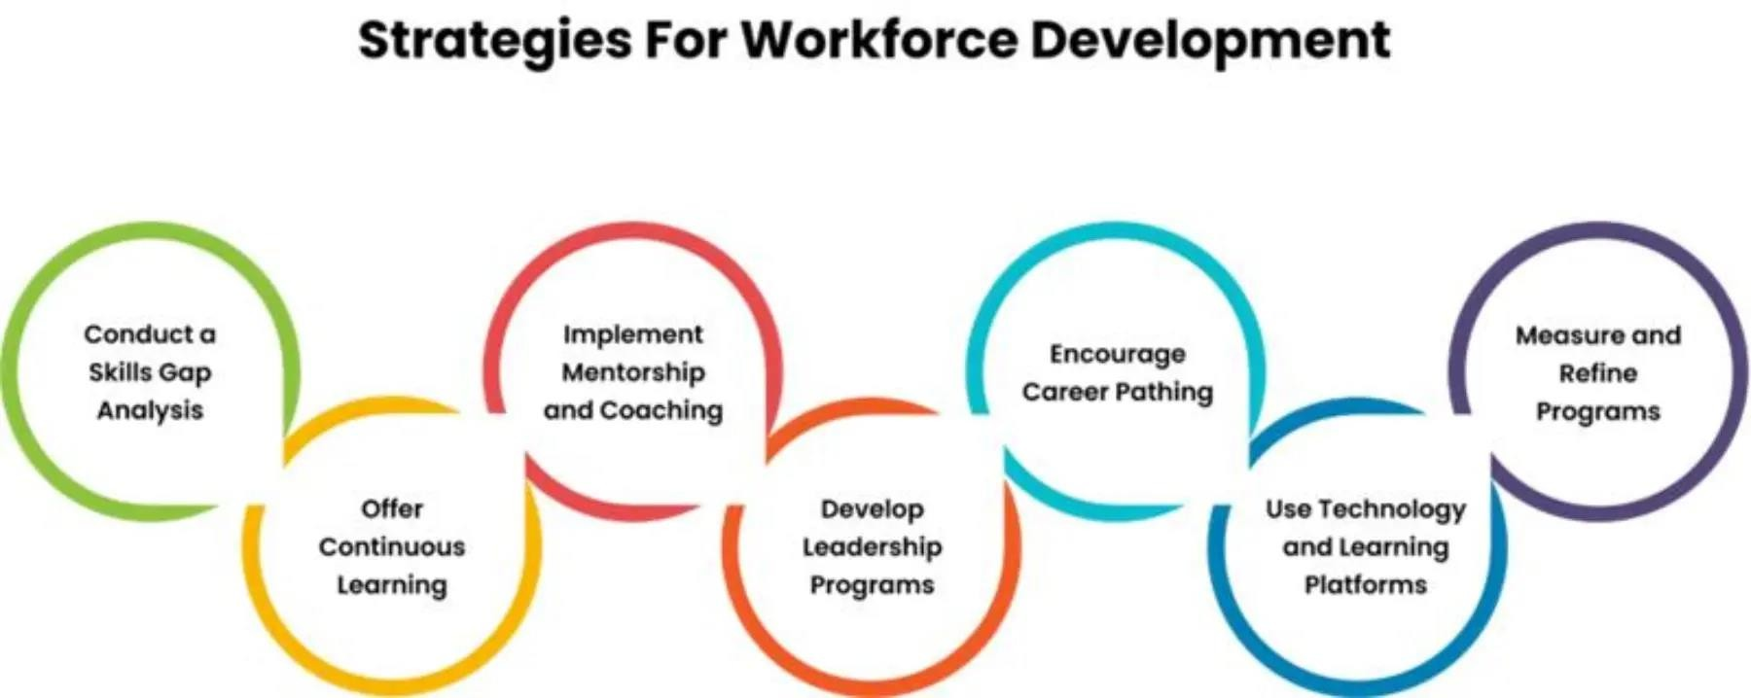
Evidence-Based Recommendation 2: Strategic Upskilling Programme
From the viewpoint of Human Capital Theory, a strategic workforce skills development programme must be introduced at Tesla Inc.
Training that are for AI use giving each employee decrease resistance (Oyekunle and Boohene, 2024).
Tesla needs to ensure skill development in the
areas of robotics technologies and data analytics.
Regular training and development programs need to be provided for employees for further skill enhancement.
(Source: https://www.timechamp.io/blogs/workforce-development/)

Slide 14

Evidence-Based Recommendation 3: Ethical AI Governance Framework
The AI decision-making procedure which have been incorporated at Tesla Inc. have to be clear.
Governance at Tesla must ensure that the adoption of recruitment and management approaches is fair.
Strict compliance with data privacy laws for avoiding data breaches condition.
Accountability present the result including ethical use of the system (Farinu, 2025).

Slide 15
Future of Work Implications
Tesla Inc., in its manufacturing sites need to deploy collaborative robotics for optimising efficiency and safety level.
Decision-making and task allocation need to be done by an AI manager to speed up the operation (Akeiber, 2025).
Better organisational planning can be done through digital twins.
Predictive workforce analytics presents real-time needs and supports adaptation in approaches for better organisational outcomes.

Slide 16
Tesla Workforce Transformation Roadmap
Year | Initiative
2026 | AI literacy training for employes
2027 | For continuous learning, the digital skill centre development
2028 | Successful implementation of an AI governance framework
2029 | Internal talent platform introduction for better career advancement opportunity
2030 | Human–AI collaboration model adoption
2031 | Competent future workforce development for the organisation

Slide 17
Strategic HRM Model
The skills and competencies of employees are strengthened within Tesla through workforce transition.
Successful digital transformation at Tesla is ensured with a strong AI strategy.
Active engagement and innovation capabilities of employees optimises with improved skills.
Tesla Inc.'s competitive positioning strengths with continuous focus on innovation.

Slide 18

Overall Group Conclusion
Under stronger leadership, Tesla is able to successfully use AI and automation for its operations.
This change become successful with human-AI collaboration upskilling program investment and AI application ethical based
Skill and competence development through training optimises overall organisational productivity.
Job displacement, skill gaps and privacy concerns are the key reasons which creates internal employee resistance.

Slide 19
References
Tesla, (2026) Available at: AI & Robotics https://www.tesla.com/en_in/AI (Accessed: 6 th June 2026)
Babashahi, L., Barbosa, C.E., Lima, Y., Lyra, A., Salazar, H., Argôlo, M., Almeida, M.A.D. and Souza, J.M.D., (2024). ‘AI in the workplace: A systematic review of skill transformation in the industry’. Administrative Sciences, 14(6), p.127. https://www.mdpi.com/2076-3387/14/6/127
Nezhadkian, M. and Zho, W., (2025). ‘Leveraging AI and IoT for Industry Transformation: A Case Study of Tesla's Technological Integration and Strategic Innovation’. Information sciences
and technological innovations, 2(1), pp.24-34. https://isti.reapress.com/journal/article/download/29/24
Miller, T., Durlik, I., Kostecka, E., Borkowski, P. and Łobodzińska, A., (2024). ‘A critical AI view on autonomous vehicle navigation: the growing danger’. Electronics, 13(18), p.3660.
https://www.mdpi.com/2079-9292/13/18/3660
Forbes, (2026) Elon Musk Cops To Overpromising On Automation, Then Hikes Targets For Model 3 And Profits Available at: https://www.forbes.com/sites/joannmuller/2018/04/13/elon-
musk-scraps-automation-that-slowed-tesla-output-then-hikes-targets-for-model-3-and-profits/(Accessed: 6 th June 2026)
Madhuri, A. and Kumar, B.R., (2025).’ HR analytics and decision-making: A data-driven approach to employee performance management’. Journal of Neonatal Surgery, 14(7s). https://www.researchgate.net/profile/Br-Kumar/publication/390477819_HR_Analytics_and_Decision-Making_A_Data-Driven_Approach_to_Employee_Performance_Management/links/67fcfa7cbd3f1930dd5d8dd2/HR-Analytics-and-Decision-Making-A-Data-Driven-Approach-to-Employee-Performance-Management.pdf
Moch, E. and Oberdieck, T., (2024). ‘Strategies for securing and further developing AI expertise: measures to avoid a shortage of skilled workers in the artificial intelligence industry’. Int J Acad Res Reflect, 12. https://www.researchgate.net/profile/Tobias-
Oberdieck/publication/378182785_Strategies_for_Securing_and_Further_Developing_AI_Expertise_Measures_to_Avoid_a_Shortage_of_Skilled_Workers_in_the_Artificial_Intelligence_Ind ustry/links/65cc65fc1e1ec12eff8e5d3f/Strategies-for-Securing-and-Further-Developing-AI-Expertise-Measures-to-Avoid-a-Shortage-of-Skilled-Workers-in-the-Artificial-Intelligence-
Industry.pdf
Dowthwaite, A., Cook, D. and Cox, A.L.,( 2024). ‘Privacy preferences in automotive data collection’. Transportation research interdisciplinary perspectives, 24, p.101022.
https://www.sciencedirect.com/science/article/pii/S2590198224000083
Saranya, T.S., Ashalatha, T.L. and Gupta, S.K., (2025), November. ‘AI-Driven Sustainable Management Practices for Employee Engagement’. In International Conference on Artificial
Intelligence in Management for Business and Industrial Growth (AIMBIG 2025) (pp. 391-411). Atlantis Press. https://www.atlantis-press.com/article/126018200.pdf
McCall, A., (2025). ‘Technology acceptance and resistance: understanding employee adaptation to digital tools’. https://www.researchgate.net/profile/Andrei-Mccall-2/publication/388753938_Technology_Acceptance_and_Resistance_Understanding_Employee_Adaptation_to_Digital_Tools/links/67a4bf4596e7fb48b9b960fc/Technology-Acceptance-and-Resistance-Understanding-Employee-Adaptation-to-Digital-Tools.pdf
Provitera, M. and Sayyadi, M., (2024). ‘Tesla’s approach to innovation culture’. Rutgers Business Review, 9(1), pp.22-30. https://rbr.business.rutgers.edu/sites/default/files/documents/rbr-
090103.pdf
Weiss, L.M., (2026). ‘Intelligent Hyperautomation and Responsible Artificial Intelligence Across Socio-Technical Systems: A Unified Theoretical and Applied Framework’. International
Journal of Modern Medicine, 5(01), pp.7-13. https://intjmm.com/index.php/ijmm/article/download/91/90
Oyekunle, D. and Boohene, D., (2024). ‘Digital transformation potential: The role of artificial intelligence in business’. International Journal of Professional Business Review: Int. J. Prof. Bus. Rev., 9(3), p.1. https://dialnet.unirioja.es/descarga/articulo/9426469.pdf
Farinu, U., (2025). ‘Fairness, accountability, and transparency in AI: Ethical challenges in data-driven decision-making’. Available at SSRN 5128174.
https://papers.ssrn.com/sol3/Delivery.cfm?abstractid=5128174
Akeiber, H.J., (2025). ‘Artificial intelligence in engineering management: revolutionizing decision-making and automation’. Al-Rafidain Journal of Engineering Sciences, pp.317-349. https://rjes.iq/index.php/rjes/article/download/167/142

Slide 20
Thank You

