Slide 1

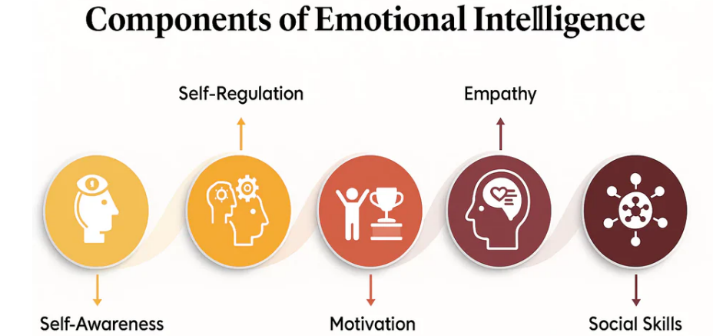
Name and surname: Leila Zougui
Student’s number: 2321811
LCLM 5006
Developing Emotional Intelligence Skills
Lecturer: Dr Abdallah Naser
Assignment Title: C1- Poster Presentation
"If you are tuned out of your own emotions,
you will be poor at reading them
in other people.“
Daniel Goleman
The relationship between emotional intelligence and generational differences
According to Strauss and Howe( 1991, people born in the same era share similar values and behaviours as they are influenced by the same social, cultural and historical environment. There are significant differences between the generations, which impact their emotional intelligence and awareness.
Baby Boomers (1945-1964): High interpersonal EI; empathy, conflict resolution, hierarchical workplaces
Impact: emotional stability, teamwork
Gen X (1965-1980): independent, adaptable, balance between emotional control and empathy
Impact: act as mediators between the generations
Millennials (1981-1996): freely discuss emotions and mental health, self-awareness, cannot manage stress.
Impact: foster collaboration and openness, experience fatigue.
Gen Z (1997-2012): Highly empathetic, emotionally expressive, can’t regulate emotions
Impact: promote inclusivity, comfortable discussing emotions publicly, rely on reduced face-to-face interactions.
Introduction
Reflection and mindfulness development
What is emotional intelligence?
The term emotional intelligence (EI) is described as “the ability to perceive and express emotion, assimilate emotion in thought, understand and reason with emotion, and regulate emotion in the self and others” (Mayer, Salovey and Caruso, 2000, as cited in Cherniss, 2010). According to Goleman (1995), cognitive intelligence alone is insufficient to achieve success without the support of emotional awareness, self-regulation, empathy and interpersonal skills, with studies conducted by Goleman indicating that “emotional competencies account for two out of three essential skills for effective performance” (Cherniss, 2010).
By reflecting on my experience as a student, I have come to understand that controlling my emotions and developing mindfulness requires self-awareness and preparations.. Applying the advice of my lecturers, I used some strategies to overcome this problem including preparing and submitting the tasks earlier before the deadline, to rehearse for oral exams .Also, I use journaling as a tool to manage my emotions and increase my self-awareness. Also, I have practiced mindfulness by using breathing method, and meditation. The technique of cognitive reappraisal has helped me reduce negative emotions and improve my focus by changing the way I interpret the stressful situation. This is supported by Gross(1998) who found that it helps manage emotions and build resilience..
.
Key factors to succeed as a student The knowledge of EI to work
Conclusion
The key factors to succeed in the studies
are as follow:
1- Effective time management
2- Active learning strategies
3- Academic skills
4- Networking support from peers and mentors
5- Good mental and physical health and less stress
6- Emotional Intelligence and Self-regulation
7- Self-motivation and goal setting
I will learn all the key EI skills to improve my own EI to be fit for the workplace:
1- Self-awareness
2- Empathy
3- Self-regulation
4- Accepting feedback
5- Building positive and respectful team relationship.
At the beginning of this poster, I
introduced briefly the theory of emotional Intelligence. It is important for recognising ones’ emotions and the others. Handling emotions is very important for workers and students as well. It helps increase productivity and success. A section of research method was provided as well. After, a personal reflection
Shed light on the way to develop EI and mindfulness, key to success, how to prepare the self for work. At the end, I explored the different generational cohorts their impact on EI.
mmm
Methodology
References
To prepare this poster presentation, the source of information a range of credible and reliable academic sources, which included platforms such as Google Scholar for peer-reviewed literature, ResearchGate for journal articles, as well as the university library, which provided access to various scholarly texts. In addition, Google was useful in locating additional material from reputable university websites. Through the use of a variety of accredited sources deepened and enhanced my knowledge of EI and allowed me to develop this poster.
Cherniss. (2010) Emotional intelligence: Towards clarification of a concept. Industrial and Organizational Psychology,3(2),pp110-126.
Filice, L. and Weese, W.J., 2024. Developing emotional intelligence. Encyclopedia, 4(1), pp.583-599.
Gross,JJ.,1998. The emerging field of emotion regulation: An integrative review. Review of General Psychology, 2(3), pp. 271-299
Goleman, D., 1995. Emotional Intelligence: Why It Can Matter More Than IQ. New York: Bantam Books.
Gross,JJ.,1998. The emerging field of emotion regulation: An integrative review. Review of General Psychology, 2(3), pp. 271-299
Strauss, W., & Howe, N. (1991). Generations: The history of America's future, 1584 to 2069. New York, NY: William Morrow and Company
How to develop Emotional Intelligence?
Felice and Weese(2024) explain that Emotional Intelligence can be developed by reflecting, practicing, and applying the Goleman’s four core components:
1- To develop Self-awareness
2- Self-management
3- Developing social awareness
4- Developing relationship management

