Slide 1
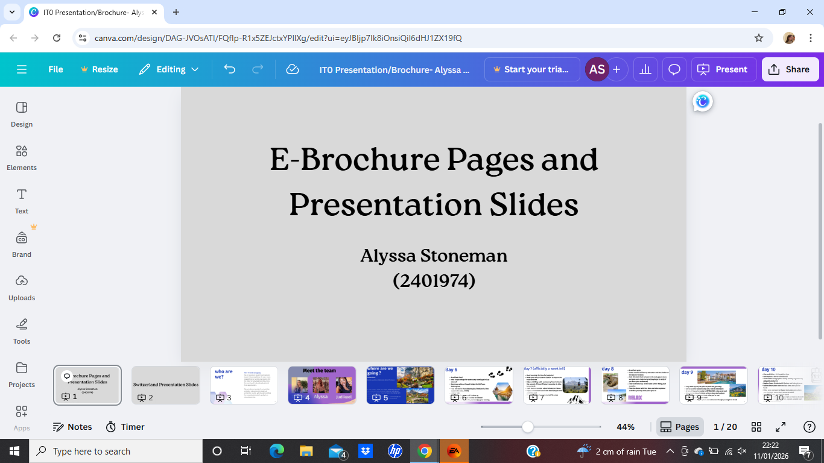

Slide 2
Within this PowerPoint Presentation, you will find screenshots of my work for the E-Brochure and our Team Presentation that has been produced on Canva, I have had to upload it this way as Canva is extremely faulty with allowing me to upload documents. Thank you for your time and patience. - Alyssa Stoneman

Slide 3
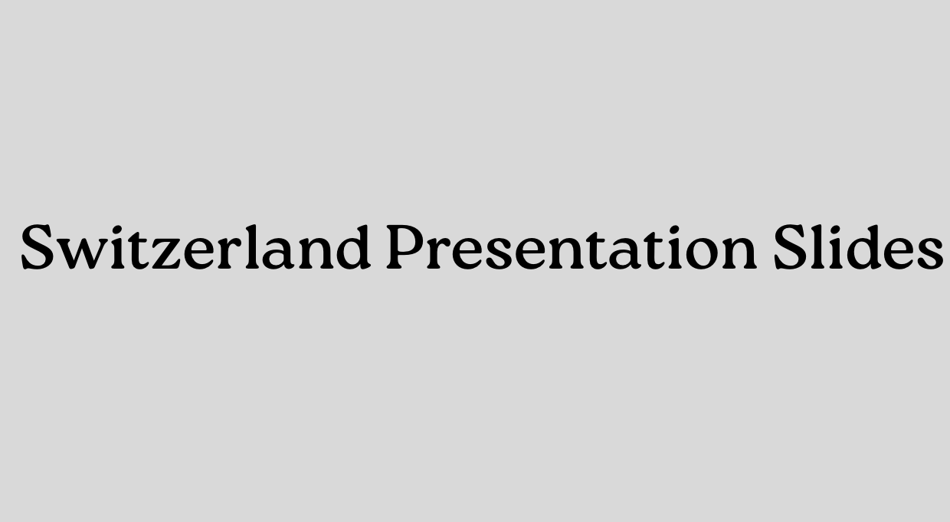

Slide 4


Slide 5
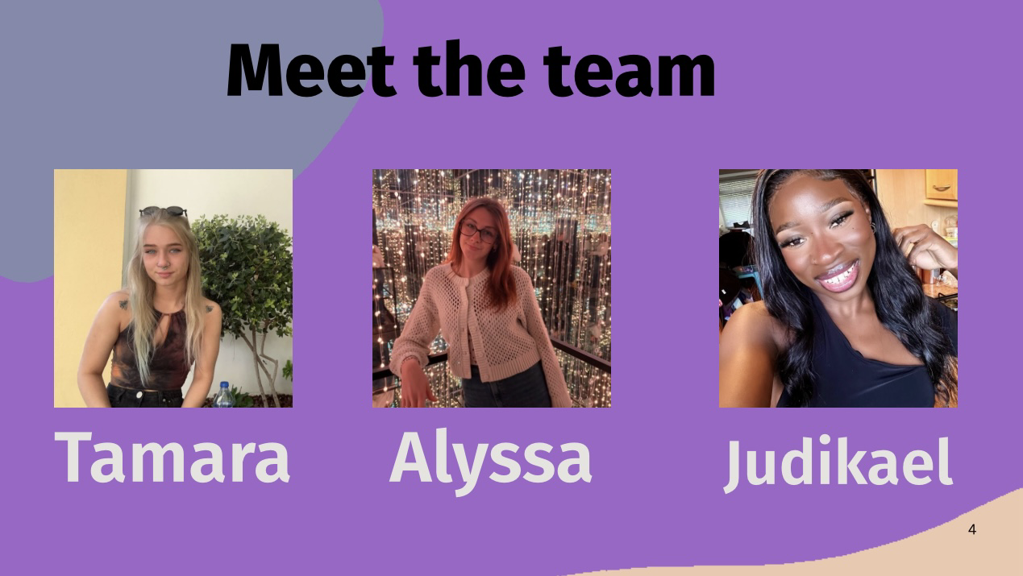

Slide 6
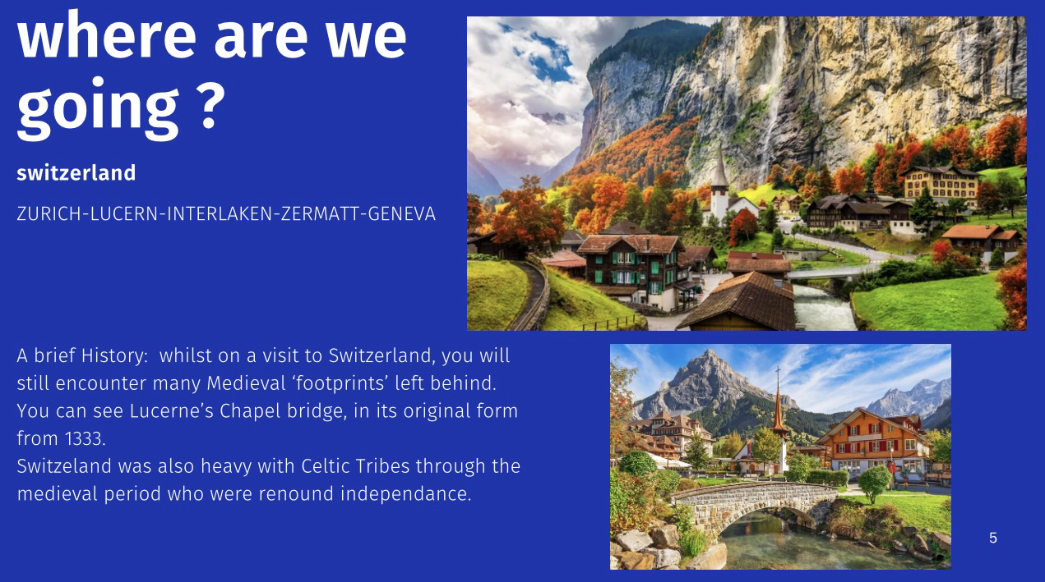

Slide 7
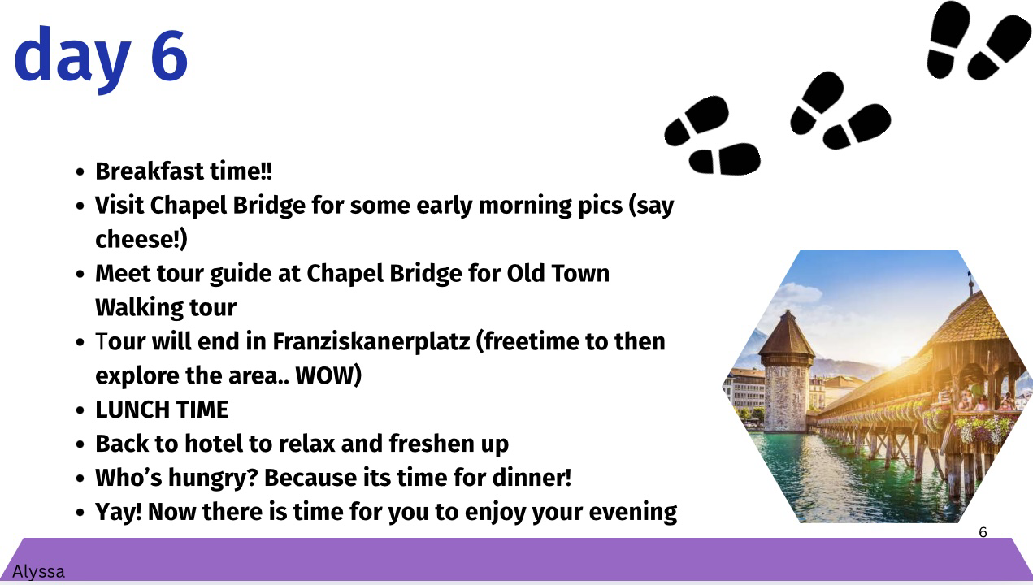

Slide 8
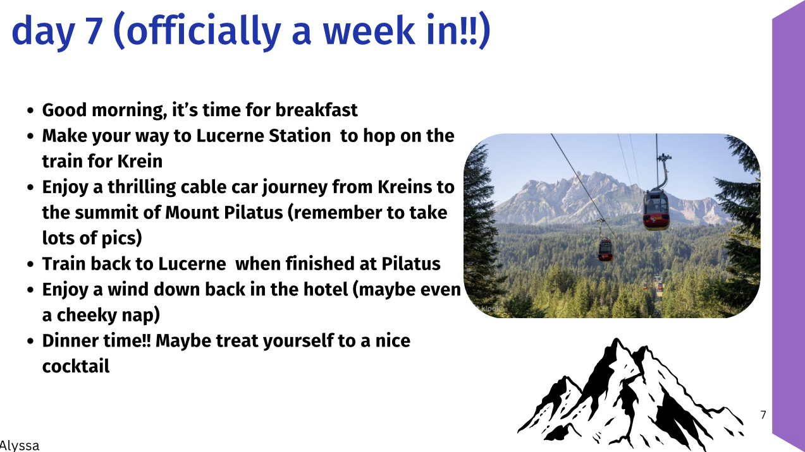

Slide 9


Slide 10
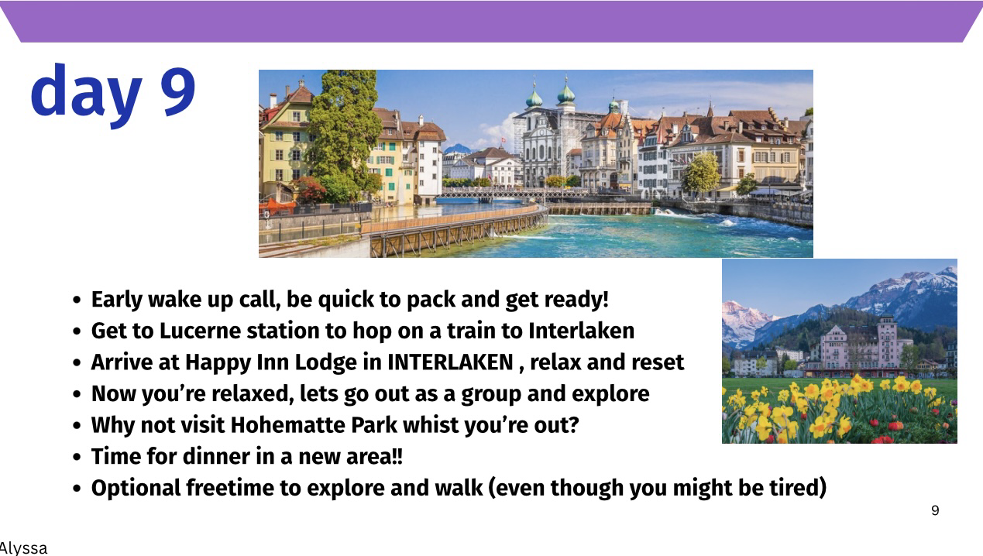

Slide 11
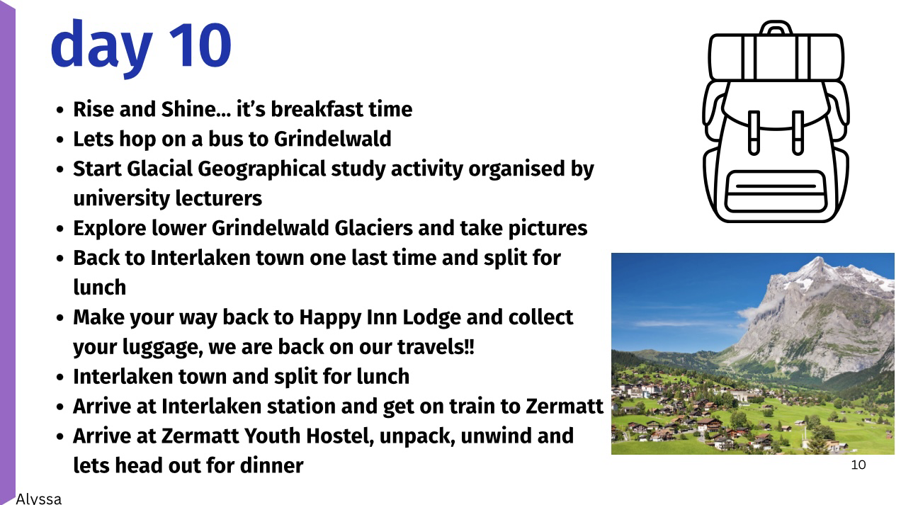

Slide 12
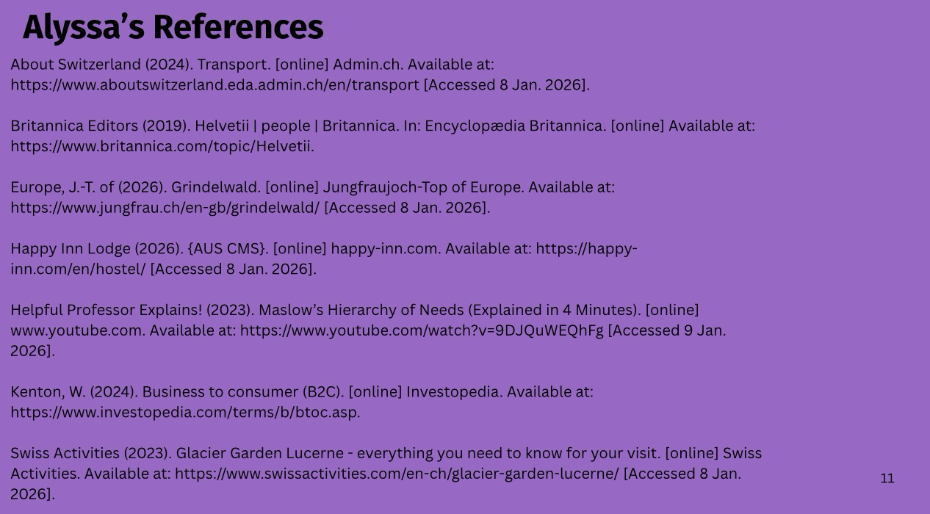

Slide 13


Slide 14


Slide 15
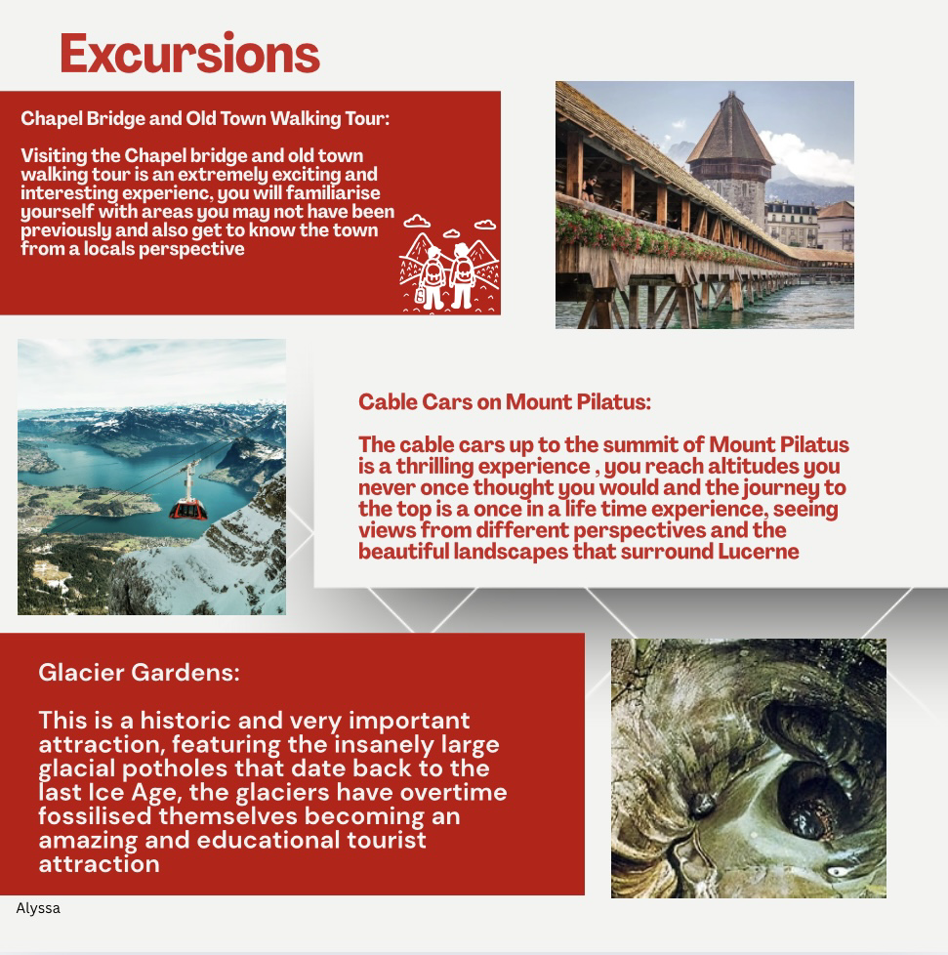

Slide 16


Slide 17
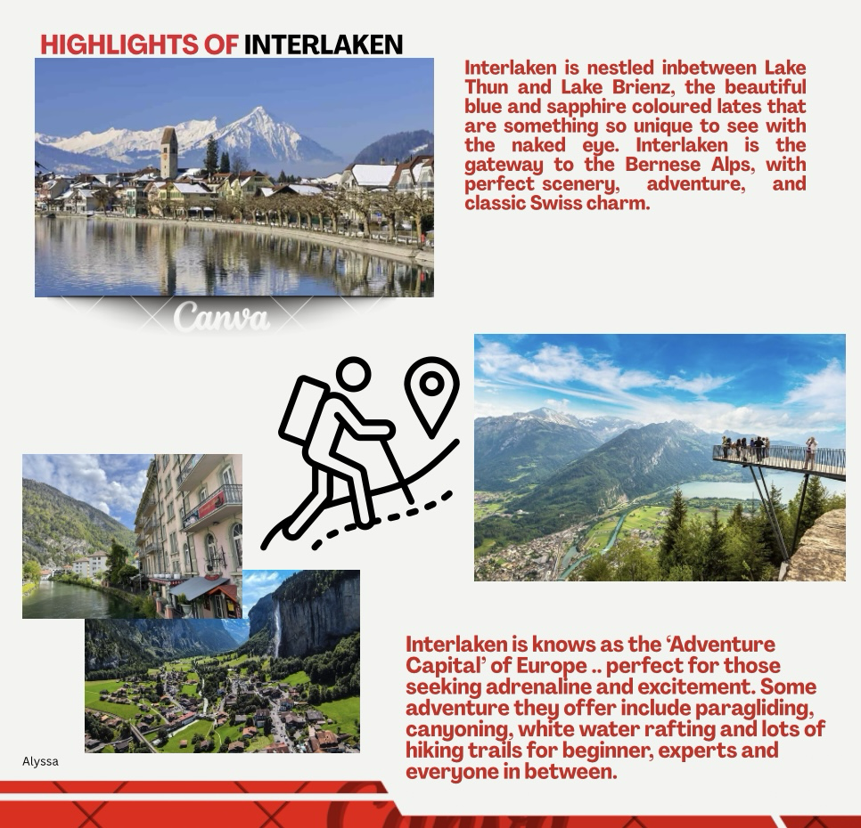

Slide 18
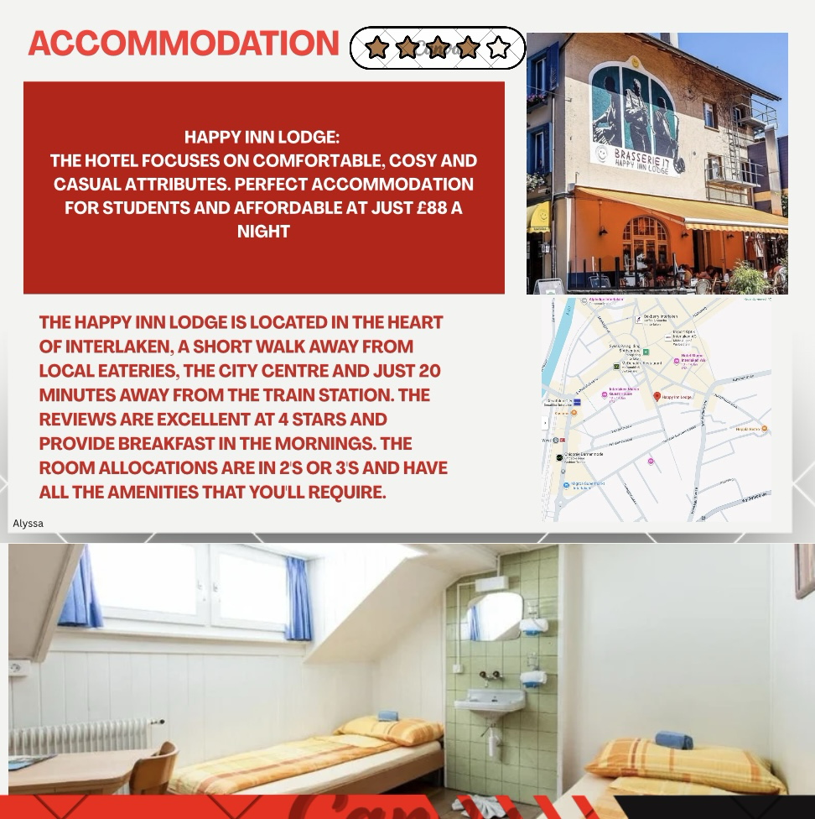

Slide 19
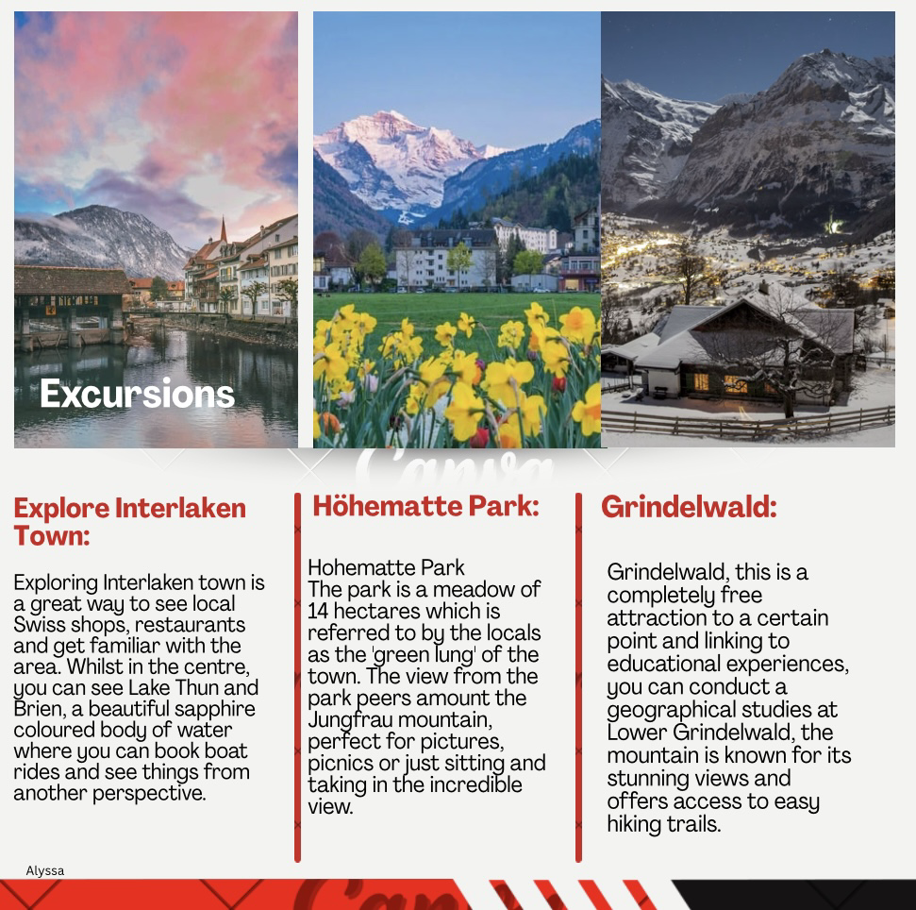

Slide 20


Slide 21


