Slide 1
Using an Array in VB

Slide 2
Arrays
An array stores a fixed-size sequential collection of elements of the same type. An array is used to store a collection of data, but it is often more useful to think of an array as a collection of variables of the same type.
All arrays consist of contiguous memory locations. The lowest address corresponds to the first element and the highest address to the last element.
Lists of variables
  Same name, index to distinguish individual elements
  Used along with loops
  Upper and lower bounds, individual elements listed within those bounds

Slide 3
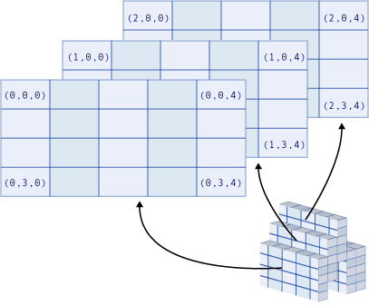
Arrays

Slide 4
Using Arrays
Visual Basic allocates space for each index number, so avoid making an array larger than needed
All the elements in an array have the same data type (eg. Integer)
Two ways to create an array:
      Arrays of objects are set up on your form
      Declare as variable arrays in your code

Slide 5
Example
Dim intCounters(14) As Integer ' 15 elements
Array of 15 elements, with index numbers running from 0 to 14
Dim dblSums(20) As Double ' 21 elements
array of 21 elements, with index numbers running from 0 to 20

Slide 6
default lower bound for an array is 0
different lower bound - use the To keyword
Dim intCounters(1 To 15) As Integer
Dim strSums(100 To 120) As String

Slide 7
Question
Dim intMonth(11) As Integer
  Write VB code to set the Integer elements with the numbers 1-12

Slide 8
2D arrays
To declare a two-dimensional 10-by-10 array:
Dim dblMatrixA(9, 9) As Double
Or
Dim dblMatrixA(1 To 10, 1 To 10) As Double

Slide 9
3D arrays
Dim MultiD(3, 1 To 10, 1 To 15)
creates an array that has three dimensions with sizes 4 by 10 by 15
How many elements in total?
Note the large amount of storage needed by a 3D array, especially with Variant data types

Slide 10
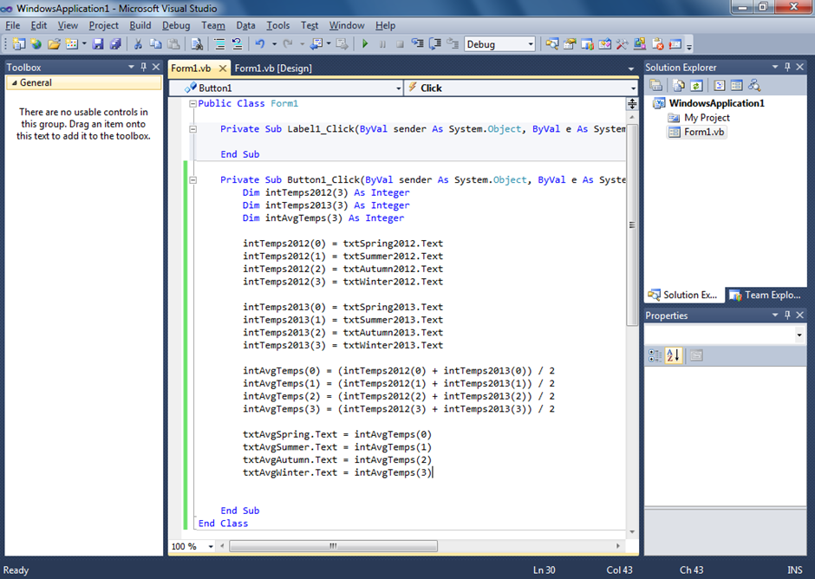

Slide 11
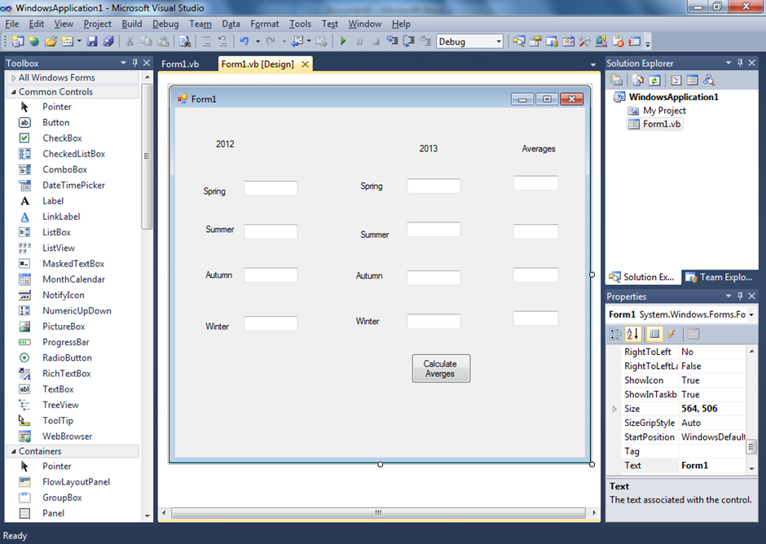
Use arrays to solve the following problem

