Slide 1
Converting Research into Practice
LCDB 7010
Week 1 - Introduction, Key Topics &
Assessment Review
Delivered by: Dr Eno Maycock
Notes:
Fill in the relevant information for the cohort

Slide 2
Module Aims
Aims of the module on Converting Research into Practice are:
1. To develop advanced scholarships skills to a high level to create new knowledge through empirical research in the field of business and management and write academic papers to a standard requisite for publication.
2. To develop a critical and systematic understanding of the current state of knowledge concerning how to translate research into practice.
In Week 9, you will be required to do a class presentation with ppt slides on the key components of your research article

Slide 3
Delivery Schedule for the term
Teaching Weeks | Topics
Week 1 | Module Introduction & Foundations of Social Research
Week 2 | Research Proposals
Week 3 | Ethics In Research
Week 4 | Conducting Pilot Studies
Week 5 | Qualitative Analysis & Analysis
Week 6 | Qualitative Analysis And Academic Publishing
Week 7 | Planning and Writing
Week 8 | Finalising the Research Article
Week 9 | Presenting the Research Article
Week 10 | Presentation Week

Slide 4
Module Assessments
Part 1 - 6000 words Conduct a pilot study of the topic you have identified to write the article - gather and analyse original empirical data and develop the findings and write a paper in the format of an academic journal article.
Part 2 - 1500 words Write a reflective account of the process that you have followed. Briefly describe and justify the interesting and/or challenging aspects of this task including what you did, why you did it, how you handled the challenge and what exactly you learnt from the process
BEGIN TODAY ( we will finalise topics next week)

Slide 5
CLASS FORMAT
Reflection/presentation based on previous week’s reading
Lecture Discussion on Topic of the Week
Reading and summarising relevant article for the week
Feedback

Slide 6
Topics and Readings
1. Foundations of Social Science Research
Introduction to the research process (Micheal Crotty)
Reflection and Summarisation – Key points and relevance to your topic
2. Research Proposals (producing good research proposals)
What is a Good Research Proposal (Part 1) by Martyn Denscombe (chapters 1 to 3)
Reflection and Summarisation with relevance to your topic
3. Overview of qualitative research
Historical overview of qualitative research in the social sciences (Chapter2) - Oxford Handbook of Qualitative Research
Qualitative analysis using Focus Group method
How do I produce a good research proposal by Martyn Denscombe (Chapters 4-10)

Slide 7

Topics and readings- continued
4. Conducting Pilot Studies
A Tutorial of Pilot Studies
Conducting the Pilot Studies
5. Academic Publishing
Academic Publishing – Oxford Handbook of Publishing 2019
Workshop on getting your article published
6. Planning and Writing
Writing up qualitative research – Oxford handbook of qualitative research
Writing through theoretical frameworks in the doctoral classroom
Planning and Writing by Derricour, Robin

Slide 8
FORUM Discussions
Weekly topic will be uploaded on Moodle
Your engagement will be reflected when you actively participate in this exercise (engagement is monitored by the Student Engagement Team)
A new topic will be uploaded over the weekend each week
TOPIC FOR NEXT WEEK
Discuss using examples the difference between survey research, ethnography, phenomenological research, grounded theory and action research.

Slide 9
What Is Social Research
Social research is the systematic investigation of social phenomena, such as human behaviour, social interactions, and societal structures, using empirical methods to gather and analyse data. It aims to understand, explain, and sometimes predict social behaviours, attitudes, and structures within societies. Why is Social Research Important? 1. It helps us understand how individuals, groups, and societies interact and function. 2. Social research provides evidence for decision-making in areas like public policy, business, education, and healthcare. 3. It can address social problems, inform interventions, and contribute to positive change.

Slide 10
Why Social Research Matters for DBA
Social research matters for DBA because it ensures that doctoral-level inquiry is grounded in real organisational needs, produces knowledge that is both rigorous and relevant, and ultimately drives positive change in business and management practice.
DBA as applied doctoral research - DBA candidates are encouraged to adopt a dual identity as both researchers and practitioners, reflecting on their own position and context to produce embedded, reflexive research.
Bridging theory and practice - DBA research often starts with a real organisational problem, engages stakeholders, and aims to produce practical insights.
Research for impact, not abstraction - The process involves identifying a practice issue, exploring tensions in the literature, and formulating research questions that address gaps between theory and practice.

Slide 11
Foundations of social science research
Positionality: researcher’s own background, identity, beliefs, and experiences, and how these influence every stage of the research process. It involves how their worldview, values, and social identities (such as gender, ethnicity, class, etc.) shape what they study, how they interpret data, and how they interact with participants.
Scaffolding: This is the structured support that would be provides stability and direction.
What methodologies and methods will be employed?
How do we justify the choice made? Answer lies in the Purpose of research
What methods do we propose to use?
What methodology governs our choice and use of methods?
What theoretical perspective lies behind the methodology in question?
What epistemology informs this theoretical perspective?

Slide 12
Typical Steps in Social Research
Defining the Research Problem: Identifying a focused question or issue to investigate.
Reviewing Literature: Understanding what is already known about the topic.
Choosing a Research Design: Selecting appropriate methods (quantitative, qualitative, or mixed).
Collecting Data: Using surveys, interviews, observations, or document analysis.
Analysing Data: Interpreting findings to answer the research question.
Reporting Results: Sharing conclusions and implications.

Slide 13

Break Time – 15 minutes

Slide 14

Workshop Activity 1 – 30 minutes
Scan the internet to identify a research piece that interests you
Read and reflect and make notes on the following
  Purpose/aim of the research
  General context or background to the study
  Why was it important for the author
  Was data/information collected?
  How was data collected?
  What were the findings presented by the author?
  What is your take on the research ?
Present in class

Slide 15
Break Time – 15 minutes

Slide 16
What is Research Methodology
A research methodology encompasses the way in which you intend to carry out your research project.
You can think of your research methodology as being a formula.
One part will be how you plan on putting your research project into practice and another will be why you feel this is the best way to approach it.
Your research methodology is ultimately a methodological and systematic plan to resolve your research/project problem.
In short, you are explaining how you will take your idea and turn it into a study, which in turn will produce valid and reliable results that are in accordance with the aims and objectives of your research/project.
Think of it like writing a plan or an outline for you what you intend to do.

Slide 17
What needs to be included
Your research method. You need to state whether you plan to use quantitative analysis, qualitative analysis, or mixed-method research method.
Explain your reasoning. Why is this particular methodology the best way to answer your research problem and achieve your objectives?
Explain your instruments. This will mainly be about your collection methods e.g. interviews, industry or government reports, questionnaires, documents (budgets, organizational charts, policies/procedures, monitoring reports). Your methodology will need to detail your reasoning in choosing a particular instrument for your research.
What will you do with your results? How are you going to analyze the data?
How will your sampling process go?
Any practical limitations? You should discuss any limitations you foresee being an issue when you’re carrying out your research.
Your ethics process

Slide 18
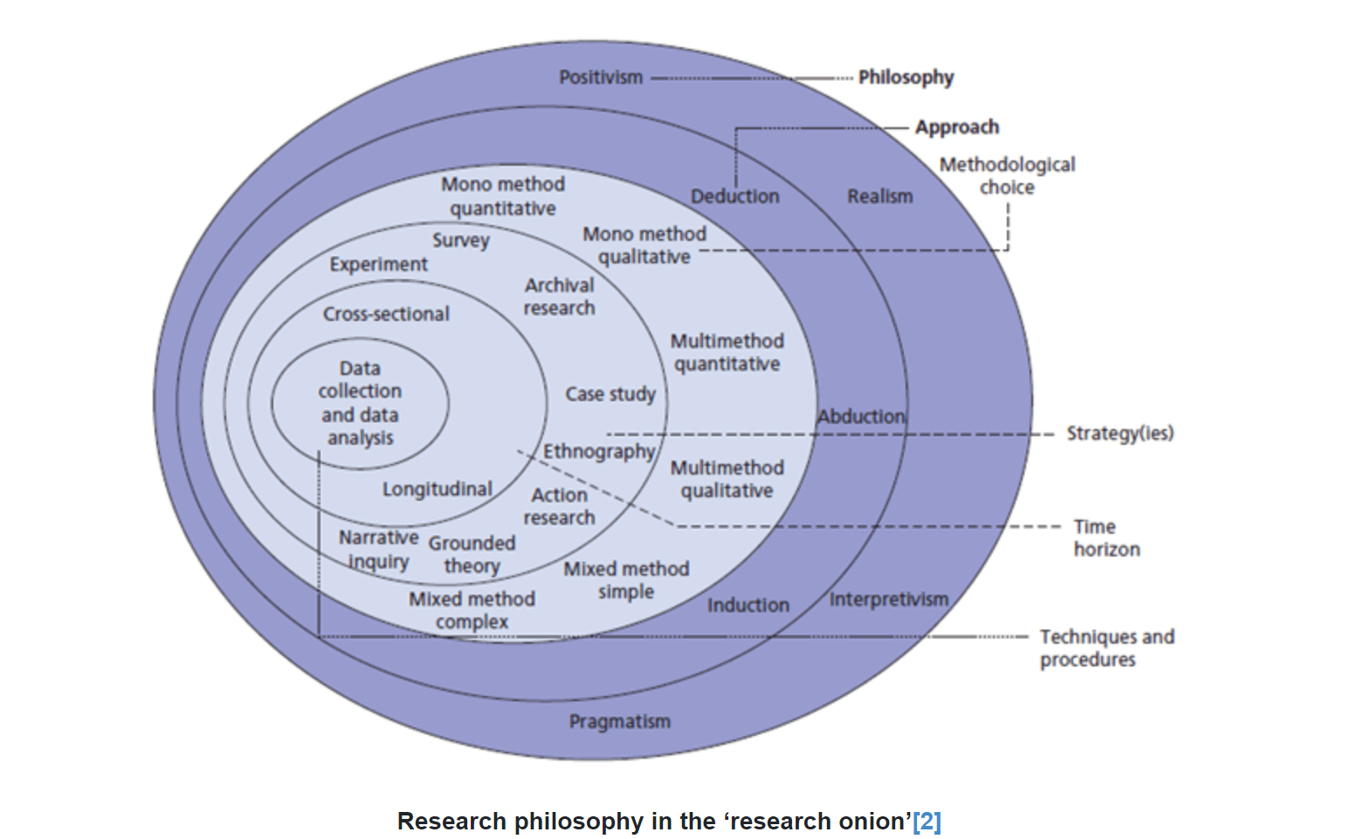
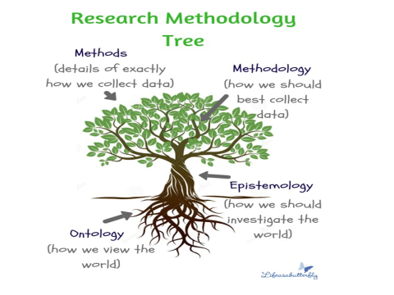
Research Design and Tactics
The research onion (Saunders, 2009)
Saunders et al, (2009)

Slide 19
Understanding your research philosophy
‘Research philosophy is an over-arching term relating to the development of knowledge & the nature of that knowledge’ (Saunders et al, 2009).
It contains important assumptions about the way in which you view the world (Anderson, 2012).
Aspects of philosophy
Positivism - importance of an objective scientific method.
Realism - what the senses show us as reality is the truth.
Interpretivism – more concerned with understanding peoples perception of the world.
Pragmatism – The research question is the most important determinant of Knowledge.

Slide 20
Research Paradigms Overview
 | Positivism | Interpretivism
Ontology (what is reality) | Assumes reality is objective and can be measured | Reality is socially constructed and subjective
Epistemology (how we know) | Knowledge is gained through observation and experiment; facts are discovered by testing hypotheses | Knowledge is developed through understanding meanings and experiences from the perspective of participants.
Methodology (How we study) | Uses quantitative methods such as surveys, experiments, and statistical analysis. | Uses qualitative methods such as interviews, ethnography, and case studies.
Summary | Positivism seeks to uncover universal laws by studying observable phenomena. It is common in natural sciences & some social sciences. | Interpretivism focuses on understanding the complexity of human experience & the meanings people attach to their actions.

Slide 21
Research Paradigms Overview
 | Critical Realism | Pragmatism
Ontology (what is reality) | Reality exists independently of our perceptions, but our understanding of it is always partial and influenced by social, cultural, and historical contexts. | Reality is viewed as dynamic and shaped by practical consequences and problem-solving.
Epistemology (how we know) | Knowledge is a result of both observable phenomena and underlying structures that may not be directly visible. | Knowledge is judged by its usefulness and applicability to real-world problems.
Methodology (How we study ) | Employs both qualitative & quantitative methods to uncover deeper mechanisms & causes. | Flexible, any methods (quantitative, qualitative, or mixed) that best address the research question
Summary | Critical realism bridges the gap between positivism and interpretivism, recognising both the existence of an objective reality and the importance of context in understanding it. | Pragmatism is especially relevant for DBA research, as it prioritises actionable knowledge and methodological flexibility to solve practical problems.

Slide 22
Research Paradigms Overview Summary
Positivism seeks objective truths through measurement.
Interpretivism explores subjective meanings and experiences.
Critical Realism acknowledges both objective reality and the influence of context.
Pragmatism focuses on practical solutions and uses whatever methods work best.
Focus on:
Ontology (what is reality?)
Epistemology (how we know)
Methodology (how we study)

Slide 23
Pragmatism for DBA Research
Practice-Based Research
Scholar–Practitioner Model
From Practice Problem to Research Gap
Starts with a real organisational problem
Engages stakeholders
Produces practical insights
Dual identity: researcher & practitioner
Reflexivity
Embedded research contexts
Framework:
Practice Issue
Literature Tension
Research Question
Problem-driven research
Methodological flexibility
Focus on actionable knowledge

Slide 24

Workshop Activity 2: Topic Clarification (30 minutes)
Task: In the next 45 minutes, spend some time
Identify a practice-based problem.
Describe your practice problem
Why does it matter? Your positionality.
Who is affected?

Slide 25
Break Time – 15 minutes

Slide 26
Workshop Activity 3: Mapping the Gap (45 minutes)
Task: Pick 3 to 5 articles to scan through within your topic and subject area
Identify what literature says about the topic you have identified
Identify what is missing from the literature
Draft a provisional research focus

Slide 27

Peer Critique Session
Present topic (5 mins each)
Receive structured feedback

Slide 28
Break Time – 15 minutes

Slide 29
Exploring Reflection and its Practice
Reflection is a purposeful activity in which you analyse experiences, or your own practical skills/responses in order to learn and improve (Gibbs, 1988).
Reflective writing requires a clear line of thought, use of evidence or examples, to illustrate your reflections, and an analytical approach.
Reflective practice is the ability to reflect on one's actions so as to engage in a process of continuous learning (Schon, 1983).

Slide 30
How to Reflect
There is no one magic formula to follow and you will find that what works for your peers might not work for you.
It's important to try and build time into your schedule for reflection (especially as it is part of your assessment) but exactly how you do this will depend on your circumstances.
Some people are able to find time every day whilst others set aside time each week.
You can be really organised and regularly write your reflections down or you can do it as and when you can.
It's best if you can reflect regularly as this will help you get into the habit & you will be able to build on what you learn.
The easiest way to get started with reflection is to ask yourself some of the following questions about the experience you want to reflect on. As you look at the questions think about how you might record your answers.

Slide 31
Models of reflection ….
There are frameworks that you can use to aid your reflective process. It needs to be a set of questions that you can ask yourself about an experience. For example here are a few question that can help you begin the reflective process.
What have you learnt about yourself as a result of the experience?
Have you developed because of it? How?
Why do you think you made the particular choices that you did? Did you think these were the right choices?
What are your thoughts on the experience in general?
Was it a useful learning experience?
What specific skills or perspective did you acquire as a result?
Looking back, what would you have done differently?

Slide 32
In class Activity - Reflection & Scholar Identity
Based on the topic that you have selected, please reflect on:
Your positionality
Access to data
Ethical sensitivities

Slide 33
Break Time – 15 minutes

Slide 34
Classification of the research purpose
Exploratory research
Explanatory Research
Descriptive Research
– is a valuable means of finding out ‘what is happening to seek new insights; To ask questions and to assess phenomena in a new light’. It is particularly useful if you wish to clarify your understanding of a problem, such as if you are unsure of precise nature of the problem. (An explorer)
involves studies that establish causal relationships between variables. The emphasis here is on studying a situation or a problem in order to explain the relationship between variables. (A doctor)
There are 3 principal ways of conducting explanatory research:
A search of the literature;
Interviewing ‘experts’ in the subject;
Conducting focus group interviews.
The object of descriptive research is ‘ to ‘portray an accurate profile of persons, events or situations’. This may be an extension of, or a forerunner to a piece of exploratory research or, more often, a piece of explanatory research. ((A detective)
It is necessary to have a clear picture of the phenomena on which you wish to collect data prior to collection of data.

Slide 35
Research Strategies
Experiment
Action Research
Survey
Grounded theory
Ethnography
Archival/Desk Research
Case-study

Slide 36
Research Strategies
An Experiment will involve a definition of a theoretical hypothesis, selection & random allocation of samples from know populations, introduction of planned intervention, measurement & control of all other variables.
Survey - Popular in business research, perceived as authoritative, allows collection of quantitative data, but can be analysed quantitatively. Structured observation & interviews can be used.
Case-study provides a rich understanding of a real life context and uses & triangulates multiple sources of data (Yin, 2003).
Action research involves practitioners in the research & the researcher becomes part of the organisation & promotes change within the organisation (Schein, 1999).
(Source: Anderson, 2012)

Slide 37
Research Strategies
Grounded theory is built through induction & deduction & helps to predict & explain behaviour. It develops theory from data generated by observations. It is an interpretative process (Suddaby, 2006).
Ethnography - Aims to describe & explain the social world inhabited by the researcher. Takes place over an extended time period. Involves extended participant observation.
Archival or desk research: Uses administrative records & documents as the principal sources of data. Allows research questions focused on the past. Is constrained by the nature of the records & documents.
(Source: Anderson, 2012)

Slide 38
Break Time – 15 minutes

Slide 39

Reflective writing and presentation
Take a moment to read and summarise the reading (article uploaded on foundations of social research)
Focus your summary on what each of the components in epistemology, theoretical perspectives, methodologies, and methods mean according to Crotty.
Place it in the perspective of the research question you have chosen and present in class next week.

Slide 40
Article by Micheal Crotty on Introduction to Research
In preparation for next week, please read
Week 1 – Michael Crotty _1998_ 1. Introduction To Research. _The Foundations Of Social Research.pdf
Present your understanding of the article next week in class

Slide 41
Making the Links
Introduction
Literature review
Research Methods
Findings/Results
Conclusions
Recommendations

Slide 42
Journals to Explore
• Journal of Management Studies
• Academy of Management Learning & Education
• Management Learning

Slide 43
Reference List
Bryman, A. and Bell, E. (2003) Business Research Methods, Oxford: Oxford University Press. Chapters 1 & 2.
Creswell, J.W. and Poth, C.N. (2018) Qualitative inquiry and research design: choosing among five approaches. 4th edn. Thousand Oaks, CA: Sage.
Crotty, M. (1998) The foundations of social research: meaning and perspective in the research process. London: SAGE Publications.
Flyvbjerg, B. (2006) ‘Five misunderstandings about case-study research’, Qualitative Inquiry, 12(2), pp. 219–245.
Nicolai, A. and Seidl, D. (2010) ‘From communication barriers to practical relevance: the relevance gap from a system-theoretic perspective’, Theory, Culture & Society, 27(6), pp. 125–142.
Saunders, M., Lewis, P. and Thornhill, A. (2019) Research methods for business students. 8th edn. Harlow: Pearson Education.
Van de Ven, A.H. (2007) Engaged scholarship: a guide for organizational and social research. Oxford: Oxford University Press.

Slide 44
ANY QUESTIONS?

Slide 45
THE END

Slide 46
Between-Session Tasks
Before Week 2:
• Finalise topic
• Draft research aim
• Identify 5–7 key academic sources

Slide 47
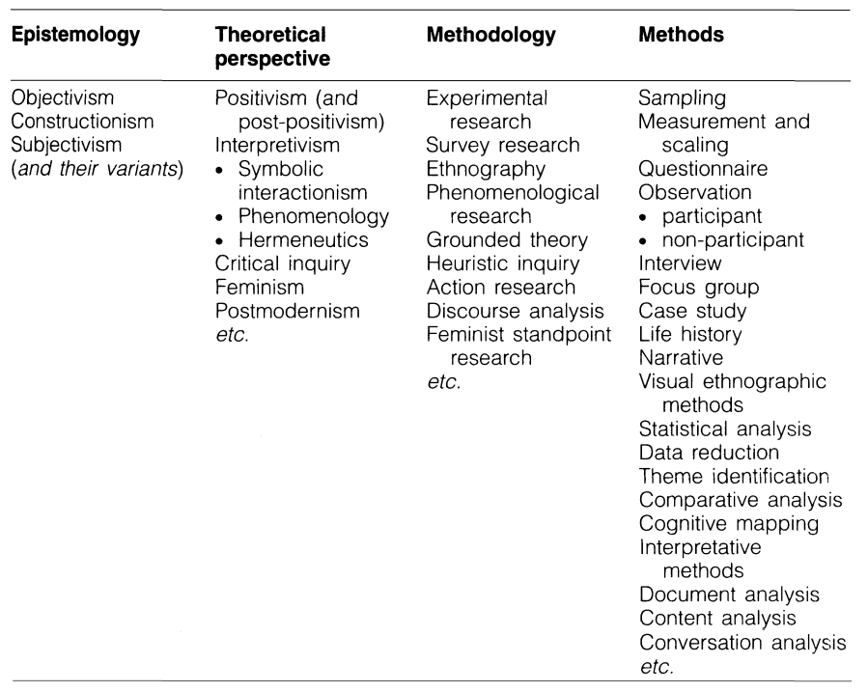

Slide 48
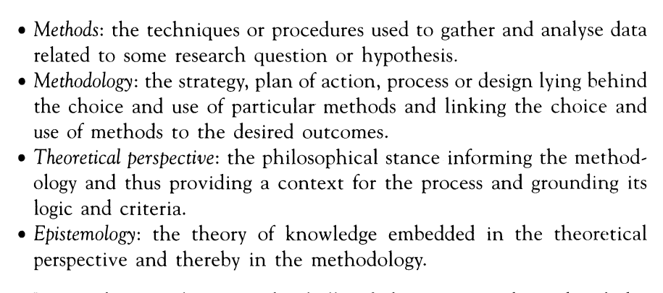

Slide 49
HOW DO WE CHOOSE A METHODOLOGY?
Causal relationships - What is the relationship between A and B? | Experiment
Meaning - What is the meaning of this experience? | Phenomenology
Patterns, descriptions -What is the culture of this group of people? | Ethnography
Single phenomenon - What are characteristics of the phenomenon? | Case study
Partly based on Richards & Morse, 2007

Slide 50
WHAT KINDS OF DATA DO WE COLLECT?
Experiment (causal relationship) | Tests, behavioural measurement, etc.
Phenomenology (meaning) | In-depth conversations, phenomenological literature, etc.
Ethnography (patterns, descriptions) | Observations, field notes, interviews, focus groups, documents, artefacts, etc.
Case study (phenomenon) | Interviews, observations, focus groups, documents, evidences, etc.
Partly based on Richards & Morse, 2007

