Slide 1
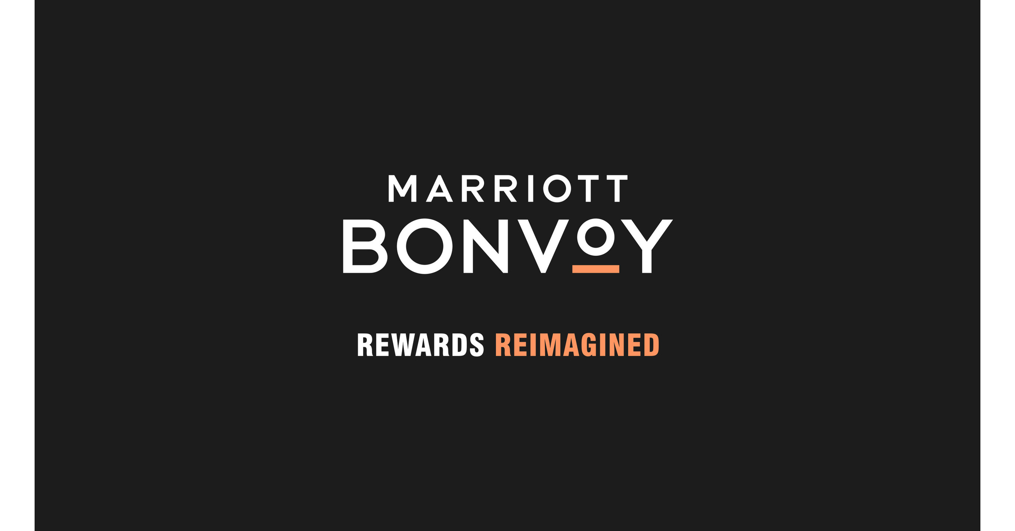

Slide 2
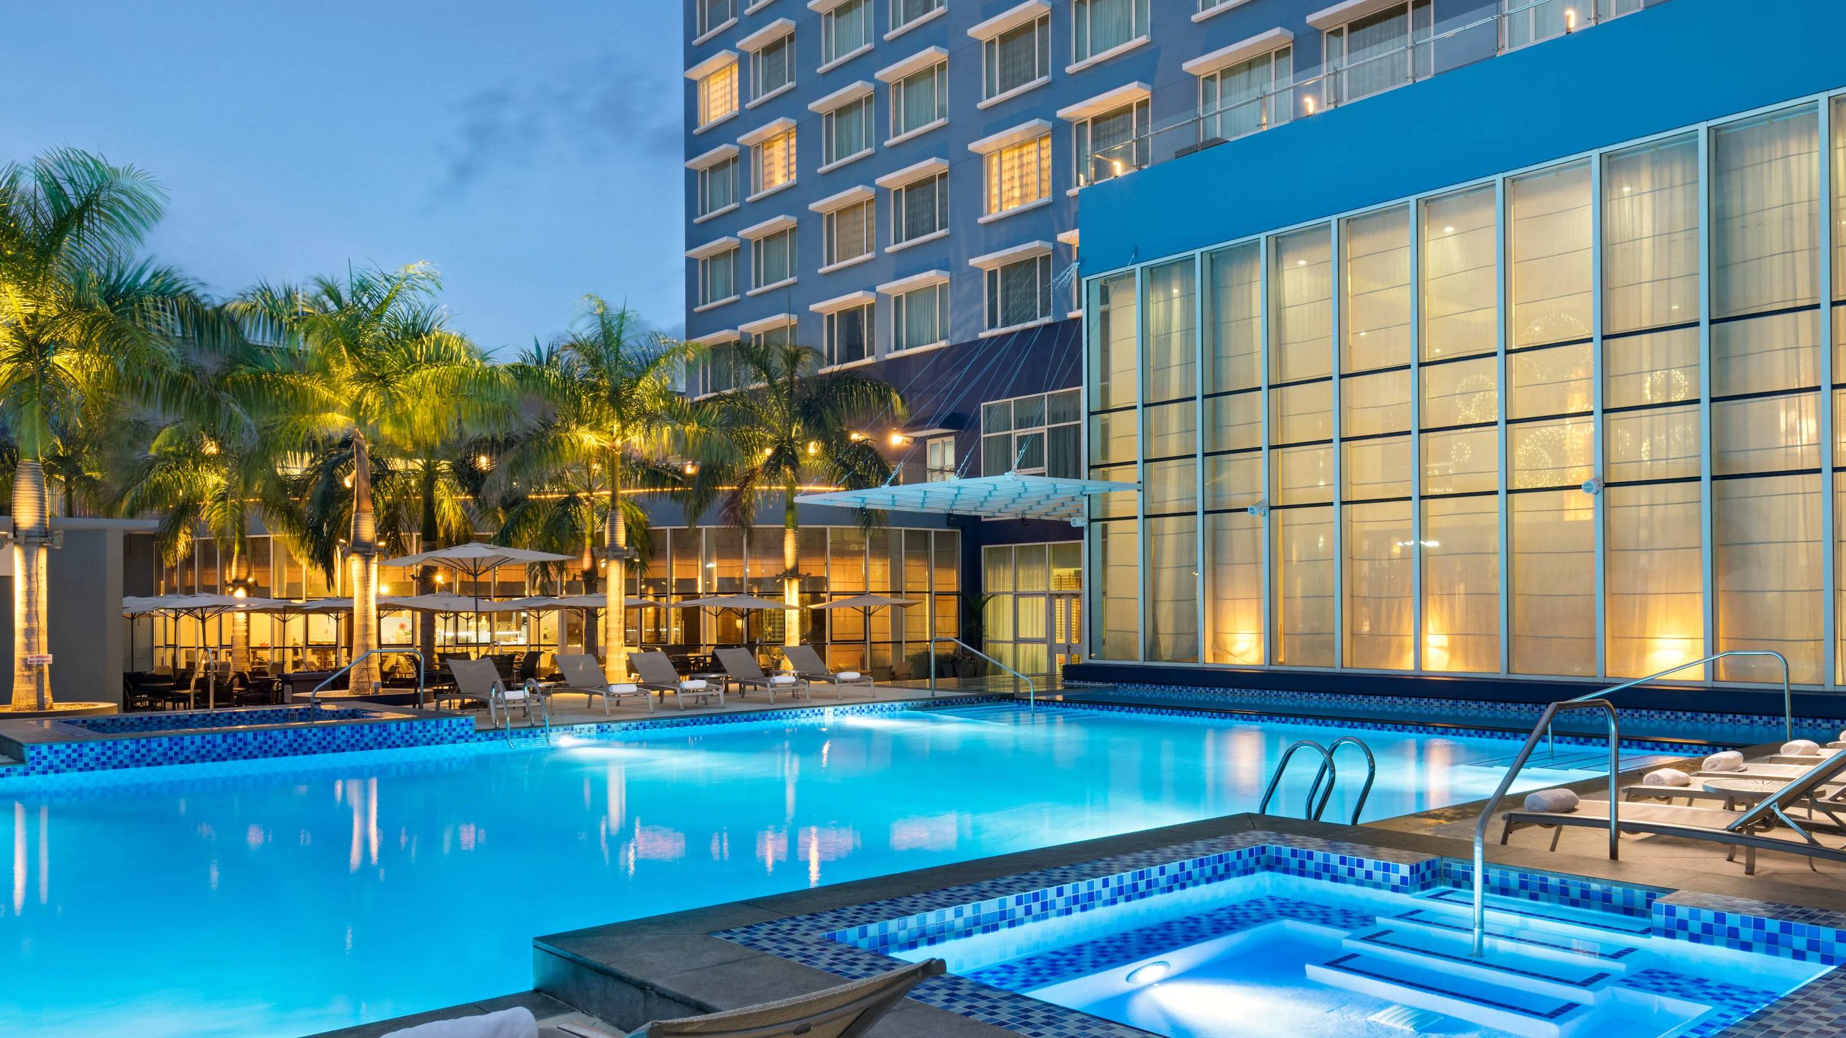

Slide 3
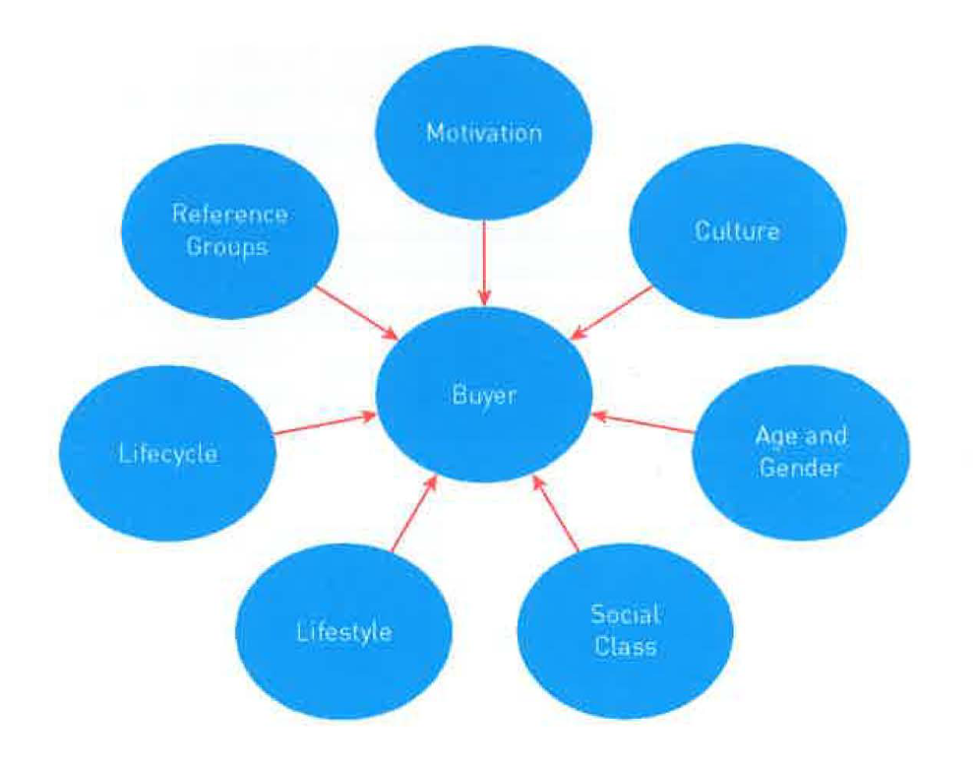
Behavioral motivations are an incentive to see what can attract new customers and in the current climate any offers are an incentive to gain potential new clients, offering a choice of gift be it a free massage or a luxury free hamper or a discount on a guided tour of the area these are all an incentive when looking to book a hotel. ( Hudson, 2017, pg6)
(Hudson Simon, 2017, pg6)

Slide 4
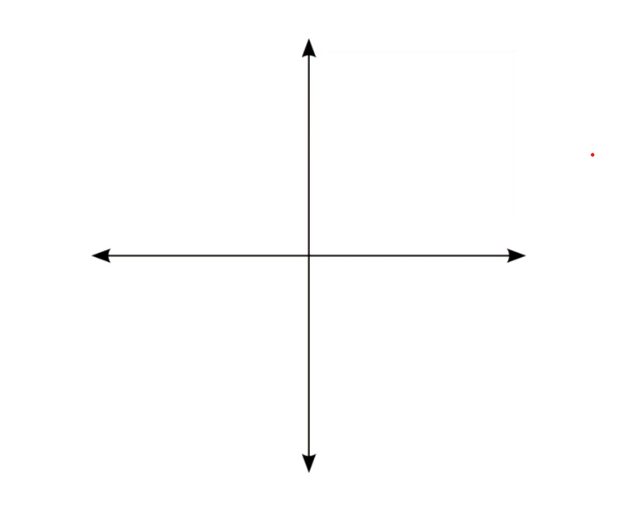
Comfort
Massage
Massage oils
Towels
Soaps
Scented candles
Low Quality
High Quality
Guided tours
Free hamper
Entertainment
(Toy house, 2020)

Slide 5
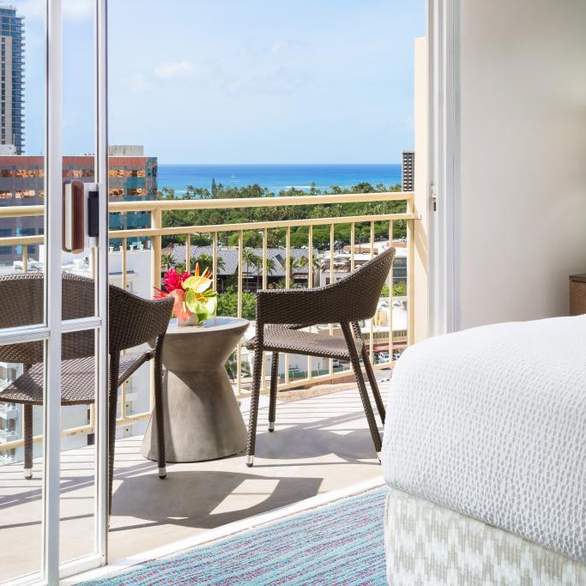
A product for Marriott hotels and resorts: Come and enjoy a getaway and take advantage of our complimentary offers or a discount on a tour with us all for new customers.
You can choose a complimentary gift hamper with luxurious toiletries and highly scented candles to remind you of that perfect stay.
Or a complimentary massage helps you destress giving you time to unwind and relax offering the perfect start to your time away.
We also have a special offer for new customers a discount on our guided tours helping you enjoy our setting and offering you a personalized tour of the local area and sights.
Whatever offer you go for we know you'll have the perfect experience in our zen-like rooms and spectaculor locations with the best service we offer.
(Courtyard Marriott 2022)

Slide 6
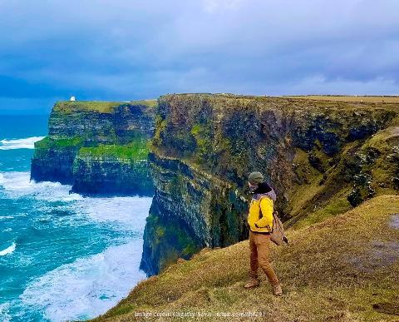
(Marriott hotels and resorts 2022)
Marriott private tours offer a large selection of tour activities so whether it’s a walking tour your up for a scenic drive or local landmarks you would like to explore we have a 20% discount on for our new customers, were waiting to show you the sights (Marriott 2022).

Slide 7
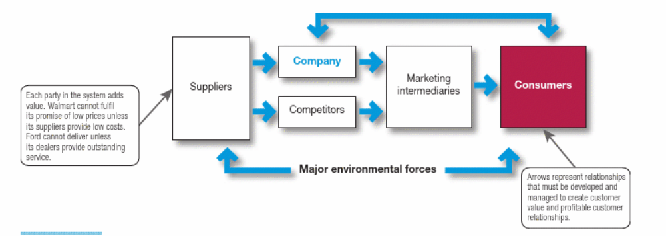
Markets exist to thrive by creating a relationship with their clients through the exchange of service a marketplace to clients is an orchestra to its audience, and creating these relationships takes work recognising customer needs and wants coming up with a product then promoting and pricing it, but this in the digital era is a two-way affair buyers also research companies their products and services they offer giving marketers the advantage of influencing its clients (Kotler, 2020, pg9)
(Kotler, 2020, pg9)

Slide 8
L. Hudson (ed.) (2017) Understanding Today’s Customer. In: Marketing for tourism, hospitality & events : a global & digital approach . First edition. London :, Sage Publications Limited. p. xii, 370 pages :
Kotler, P. (2020) Principles of marketing . Eighth European edition. Harlow, England :, Pearson.
Courtyard Marriott Rooms - Bing images
The Cliffs of Moher from Dublin: Private Full Day Trip | Marriott
Marriott_Bonvoy_Logo.jpg (2699×1414) (prnewswire.com)
marriott hotels and resorts - Bing
Private Tours with Handpicked Guides | Marriott
https:toyhou.se/~forums/207.character-discussion.share-your-oc-alignment-charts-

Slide 9
Gannt Chart (2).xlsx

Slide 10
Gannt Chart.xlsx

