Slide 1
Independent project
Element 1

Slide 2
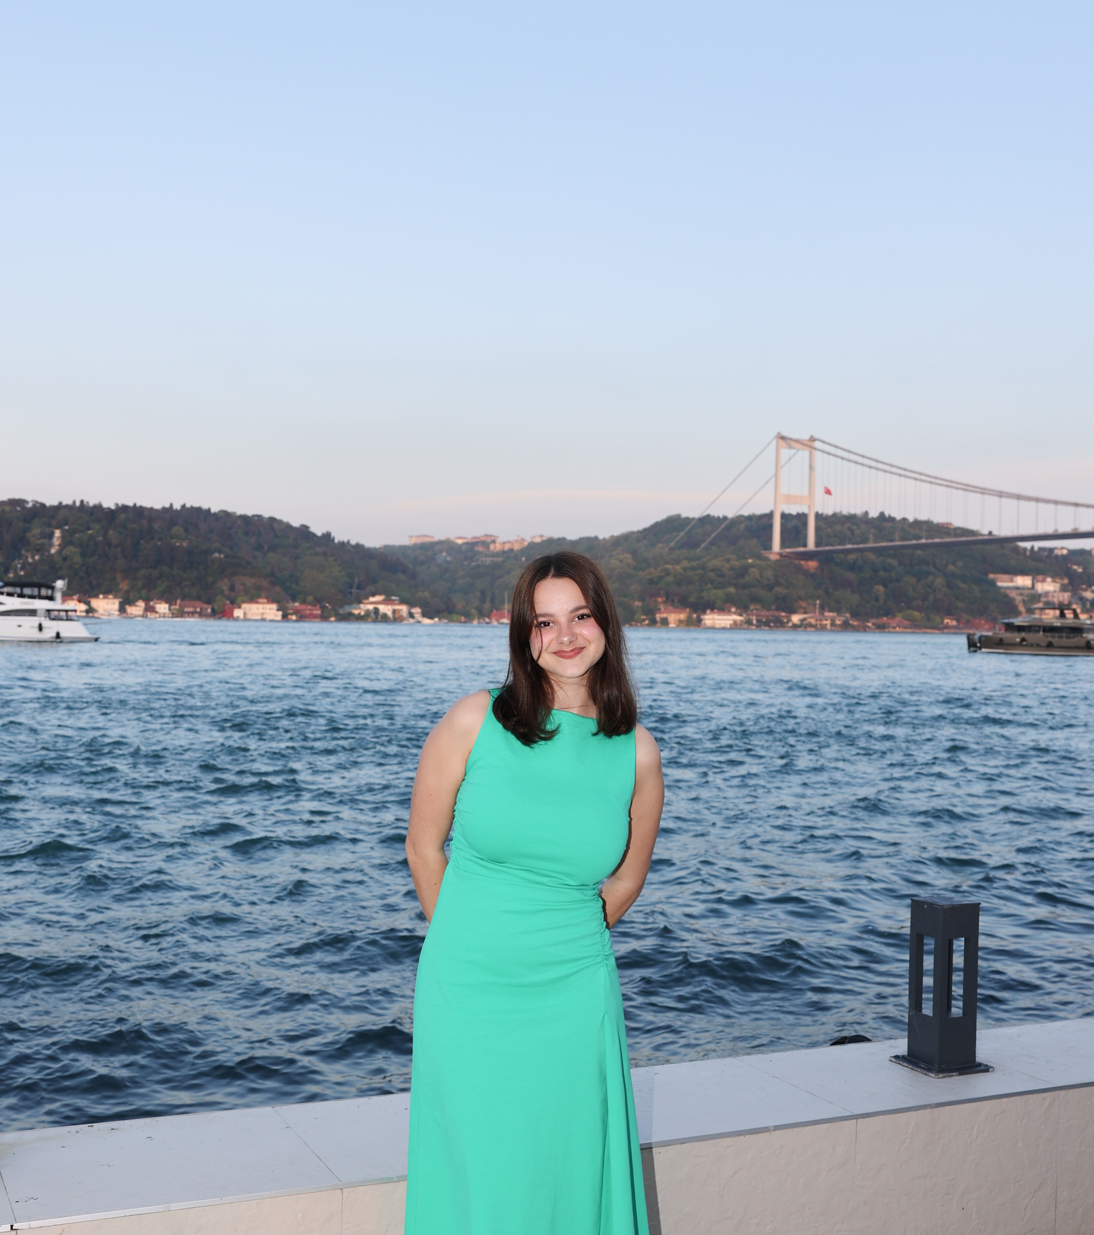
A bit about me
I am a third-year Event Management student with two years of experience working in the Food and Beverage department at Swansea Arena. This role has given me valuable insight into venue's operations and inspired my interest in pursuing a career in event and venue management.

Slide 3
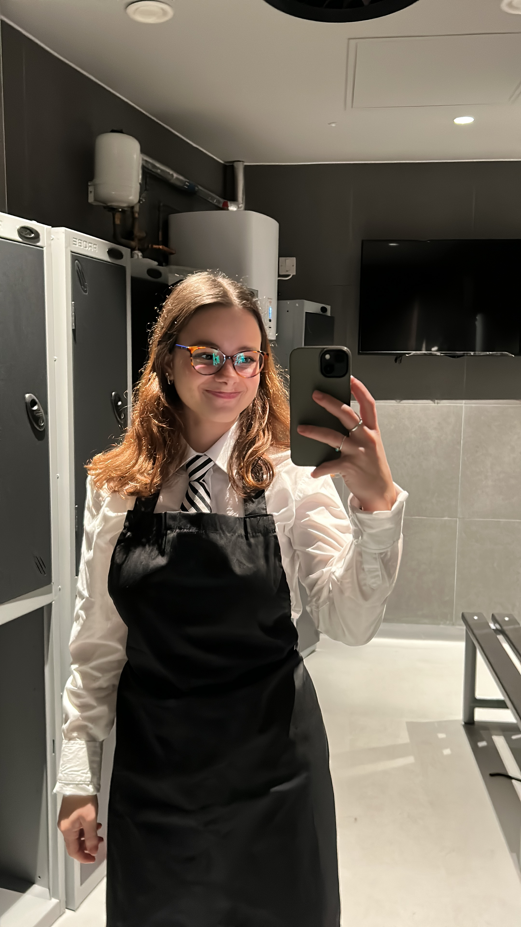
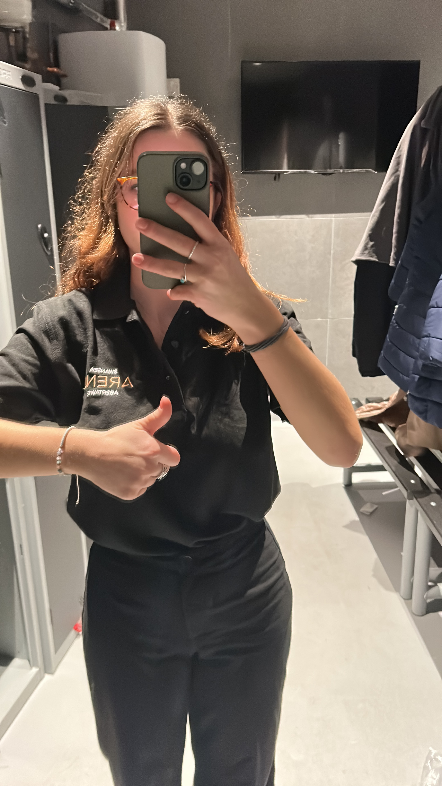

About Swansea Arena

Slide 4
Aims & Objectives
Aims:
To develop a value-driven loyalty program for Swansea Arena VIP lounge customers that boosts retention, enhances experience and encourages repeat visits through targeted rewards. The program will explore partnerships with local businesses to offer collaborative benefits, adding customer value and strengthening community and commercial ties.
Objectives:
Analyse current VIP lounge customer engagement and retention strategies at Swansea Arena.
Identify customer preferences and behaviours to align the loyalty program with their needs.
Ensure the program’s operational and financial feasibility, including timelines, costs, and resources.

Slide 5
Project Scope
This project will develop a tailored loyalty and rewards program for regular VIP lounge customers at Swansea Arena, evaluating current engagement strategies, identifying improvement opportunities and proposing a practical, implementable loyalty scheme.
TASK1:
Analysing customer attendance data and existing marketing initiatives
TASK 2:
Designing a structured, tier- based rewards program
TASK 3:
Outlining operational requirements, cost implications and expected benefits
TASK 4:
Exploring sponsorships or collaboration opportunities with local restaurants, hotels or service providers

Slide 6
Final Outcomes
Short-term (0-6 months after implementation):
Increased VIP customer engagement
Positive customer feedback
Established local partnerships
Long-term (6-24 months after implementation):
Improved customer retention and loyalty
Revenue growth
Enhanced brand image and competitive advantage

Slide 7
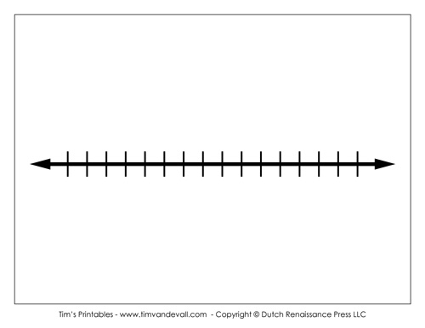
Timeline
Key deliverables
Project proposal
Research summary and current practice analysis
Customer insight report
Benchmarking report
Loyalty program proposal document
Partnership opportunities list
Feasibility and cost analysis
Implementation and evaluation plan
Final consultancy
Presentation

Slide 8
Potential key milestones
Milestones | Duration
Project approval and finalization | 1st-15th November
Customer insight collection | December 2025
Partnership exploration | December 2025
Drafting of implementation plan | January- 1st week of February 2026
Completion of final report | January- March 2026
Submission and presentation | March 2026

Slide 9
Work Plan Activities
Define project scope and objectives
Conduct organizational research
Benchmark industry best practices
Design loyalty program structure
Develop final recommendations and report

Slide 10
Resources
To complete this project successfully, the following resources will be required:
Support from Swansea Arena
Non-sensitive customer data
Permission to distribute surveys
Research tools
Online survey platforms
Access to case studies and industry reports
Communication and feedback
Supervisor guidance and academic support
Stakeholder engagement

Slide 11
Methodology
Secondary research: researching existing loyalty programs in similar venues and reviewing industry trends to understand best practises
Primary research: conducting surveys with VIP customers gathering preferences, short interviews with staff understanding current operations
Comparative analysis: comparing Swansea Arena’s current approach with other venues identifying gaps and improvement opportunities
Feasibility assessment: Reviewing costs, resources and potential challenges to ensure the loyalty program is practical and sustainable

Slide 12

Execution
The project will be executed in collaboration with Swansea Arena staff and under supervisor guidance to ensure all objectives are met. Data will be gathered from staff, stakeholders and secondary sources such as industry reports and online research. Insights from this analysis will inform the design of a loyalty program, which will be reviewed with arena management for feasibility and alignment with organizational goals.

Slide 13
Collaboration
The project will involve close collaboration with colleagues, supervisors and Swansea Arena stakeholders. Regular meetings, emails and updates will keep everyone informed and aligned. Feedback will be actively sought to improve the project and engaging with arena teams will help build partnerships essential for the loyalty program's success. Open communication and teamwork will ensure challenges are addressed quickly and objectives are met.

Slide 14
References
Swansea Building Society Arena (n.d.) Welcome to Swansea building Society. Available at:https://www.swansea-arena.co.uk/ (Accessed date: 23 October 2025).
Houston, M., & McDonagh, M., Houston, M. (Ed.), (2023). Writing Effective Research Aims and Objectives. Sage Research Methods: Business. Available at:https://methods.sagepub.com/how-to-guide/writing-effective-research-aims-and-objectives#:~:text=It%20is%20important%20to%20differentiate,to%20meet%20the%20research%20aim.(Accessed date: 23 October 2025).
Atlassian (2025) How to define & write a project scope: The Workstream. Available at: https://www.atlassian.com/work-management/project-management/project-scope (Accessed: 23 October 2025).
Brennan, M. (2025) ‘Project timeline: How to create, manage, optimise & more’. Teamwork Blog. Available at: https://www.teamwork.com/blog/project-timeline/ (Accessed: 23 October 2025).
Indeed (2025) 10 Reasons Why Collaboration is Important in the Workplace. Available at: https://www.indeed.com/career-advice/career-development/why-is-collaboration-important. (Accessed date: 24 October 2025)
Thom., M (2025) Project Execution: Steps, Challenges, Gaps and Strategies. Available at: https://galorath.com/project/execution/#:~:text=The%20importance%20of%20project%20execution%20lies%20in%20its%20ability%20to,planned%20projects%20can%20fall%20short. (Accessed date: 24 October 2025)

