Slide 1
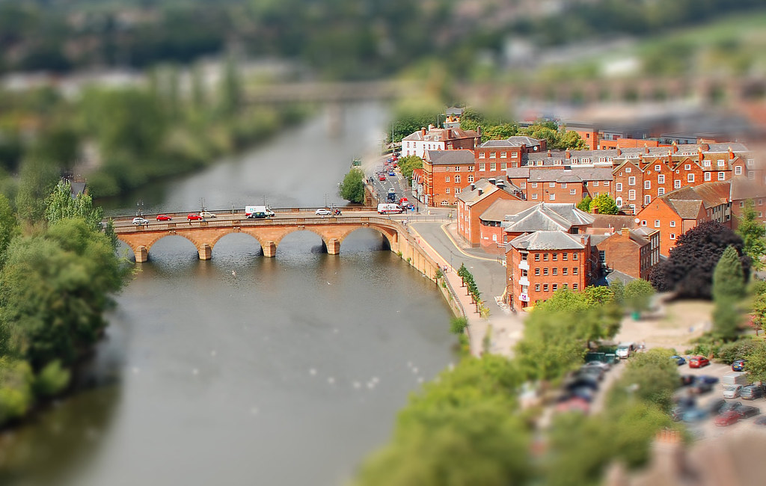
Project Management Plan for Worcester Bridge construction
Nargas Ahmadzai 2106756
Vasilka Sarandalieva 2113113
Julia Mansell 2110746
Module Code: BMSW5104
Module: Managing Project in the Organisation
Lectures by: Abel Agoba

Slide 2
Introduction
Project Management
Effective Plan
Requirements of the project

Slide 3

Project Description and Management Scope
Design and construction of the bridge will take into account factors such as traffic volume, load capacity, environmental impact, and safety regulations
Project Initiation
Project Planning
Design and Engineering
Procurement and Logistics
Construction and Implementation
Post-construction

Slide 4

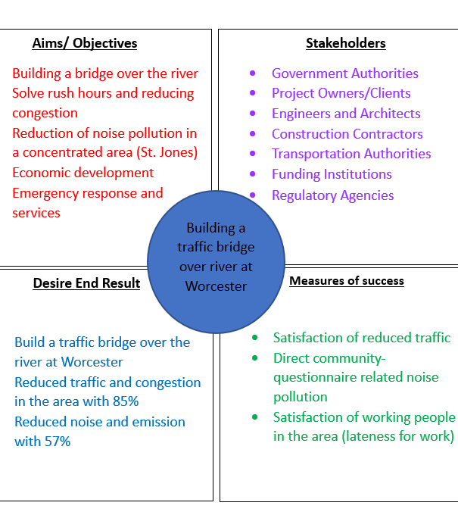
Quad Chart
Source: (Agoba, 2023).

Slide 5

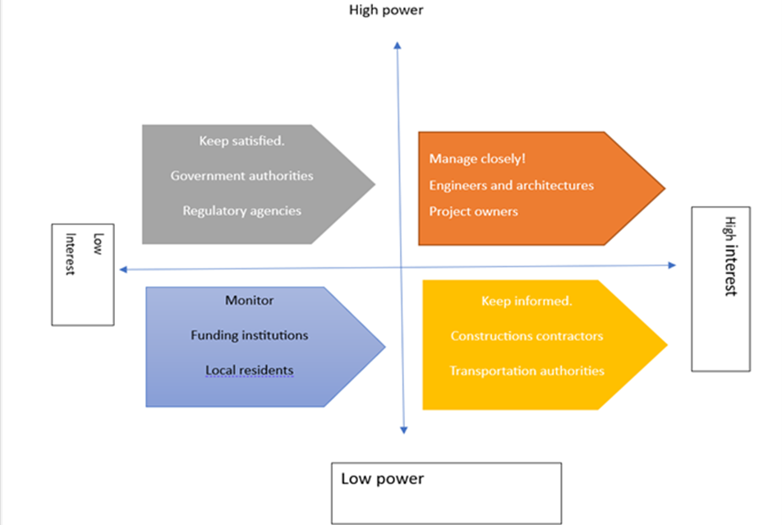
Stakeholder Analysis
Source: (Peachyessay, 2021).

Slide 6

SWOT Analysis
Strength
Weaknesses
Threats
Opportunities

Slide 7
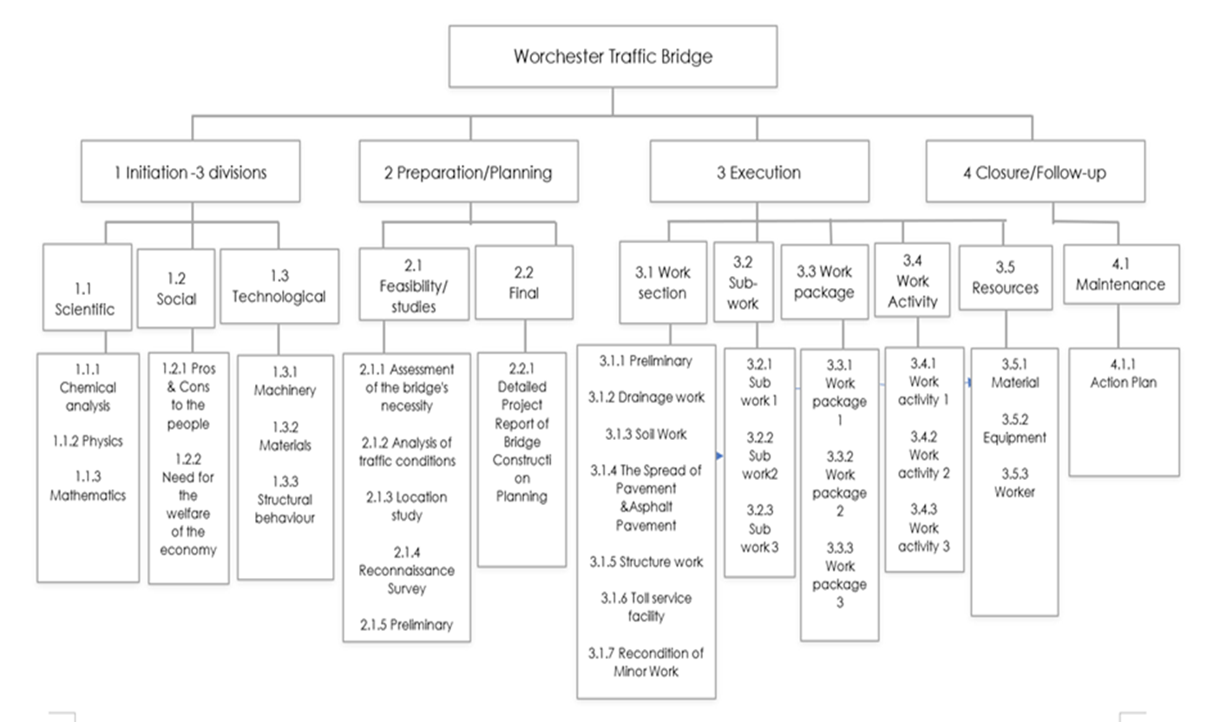
Work Breakdown Structure
Source:( Bridge Construction Planning, 2017).
And (Kurnia, Latief & Riantini, 2018).

Slide 8
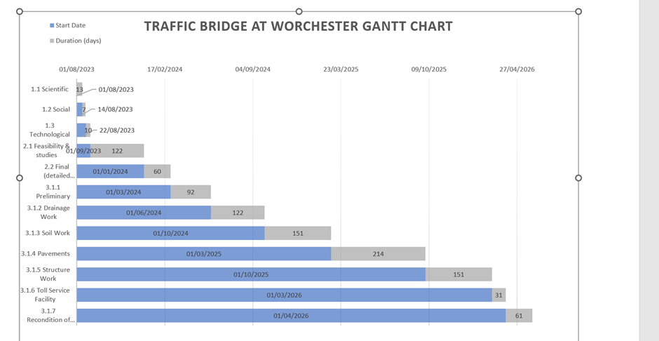
Source: (Agoba, 2023)

Slide 9
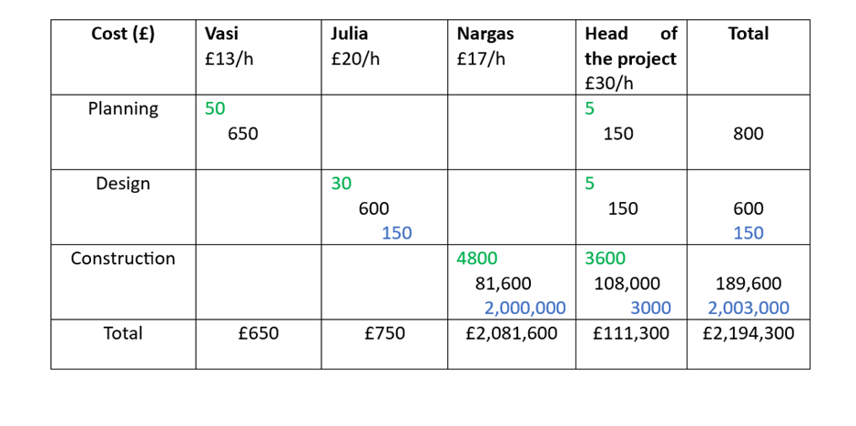
Allocation of resources
Source: (Agoba, 2023)

Slide 10

Risk Identification
1. Design and Engineering Risks
2. Construction Risks
3. Environmental Risks
4. Cost and Budget Risks
5. Stakeholder Risks
6. Safety and Security Risks

Slide 11
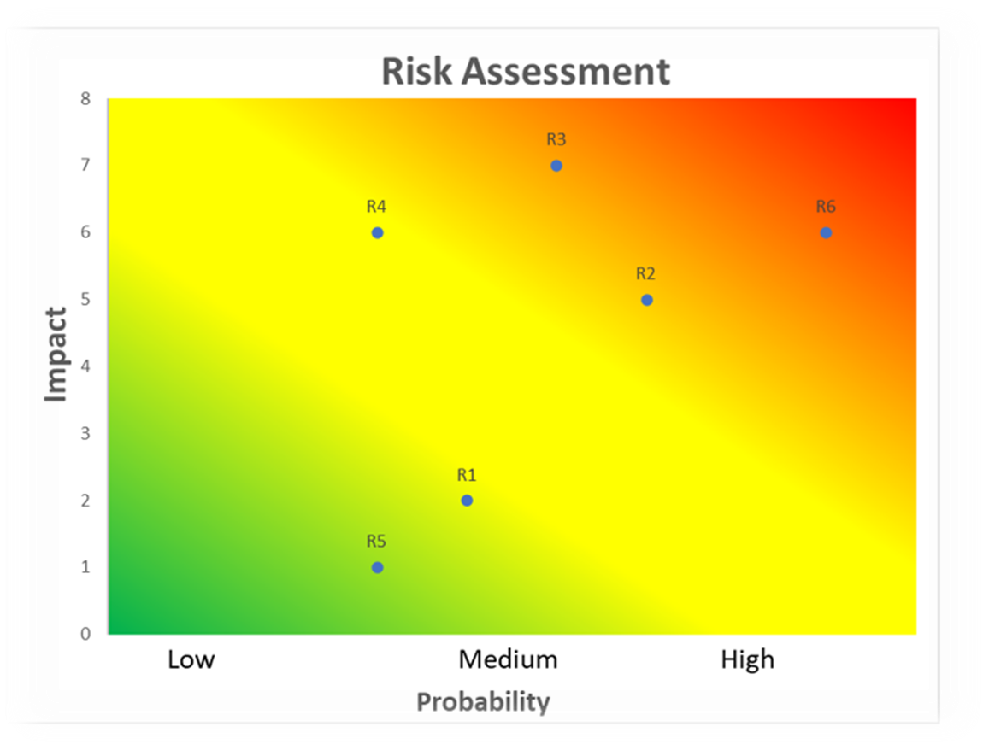
Safety and Security Risks (R6) - Risk Mitigation
Developing a comprehensive safety plan that includes safety protocols, guidelines, and training for all project personnel. Conducting regular safety inspections and audits to identify potential hazards and ensure compliance with safety regulations.
Contingency Plan
Designating responsible individuals or teams for managing emergencies and ensuring their readiness through regular drills and training. Developing alternative project schedules or resource plans that can accommodate potential safety-related delays or disruptions.
Source: (Munawar, H.S. et al. (2022)

Slide 12

Conclusion

Slide 13

Reference list
Agoba, A. (2023)’ Week three Quad chart and stakeholder analysis’ [ PowerPoint presentation]. BMSW5104: Managing projects in organizations. Available at: UWTSD (Accessed: 2023)
Agoba, A. (2023)’ Week four project management scope, [ PowerPoint presentation]. BMSW5104: Managing projects in organisations. Available at: UWTSD (Accessed:2023)
Bridge Construction Planning (2017). Available at: https://theconstructor.org/structures/bridge-construction-planning/15656/ (Accessed: 23 June 2023)
Kurnia, RF, Latief, Y & Riantini, LS 2018, The development of risk-based standardized WBS (Work Breakdown Structure) for cost estimation of concrete Precast bridge construction. in Proceedings of the International Conference on Industrial Engineering and Operations Management, IEOM 2018. Proceedings of the International Conference on Industrial Engineering and Operations Management, vol. 2018-March, IEOM Society, pp. 731-739, 8th International Conference on Industrial Engineering and Operations Management, IEOM 2018, Bandung, Indonesia, 6/03/18.
Munawar, H.S. et al. (2022) ‘Disruptive Technologies as a Solution for Disaster Risk Management: A Review’, Science of The Total Environment, 806, p. 151351. doi: 10.1016/j.scitotenv.2021.151351. Available from https://doi.org/10.1016/j.scitotenv.2021.151351 [Accessed: 20/06/2023]
Peachyessay (2021) Constructing a bridge: Development of a city, Peachy Essay. Available at: https://peachyessay.com/sample-essay/constructing-a-bridge-development-of-a-city/ (Accessed: 20 June 2023).

