Slide 1
BSc (Hons) Cloud Computing
Module Code : ACCA5019 – Business and Web Management
Week 04 : Introduction to Inkscape
Dr Mobolanle Bello

Slide 2

INKSCAPE
Inkscape is an open-source and cross-platform application for creating graphics.

Slide 3
Inkscape
The Inkscape interface is similar to other graphics editors.

Slide 4
Inkscape
The toolbar contains buttons for common tasks, such as :
creating shapes
filling objects, and
adding text.

Slide 5
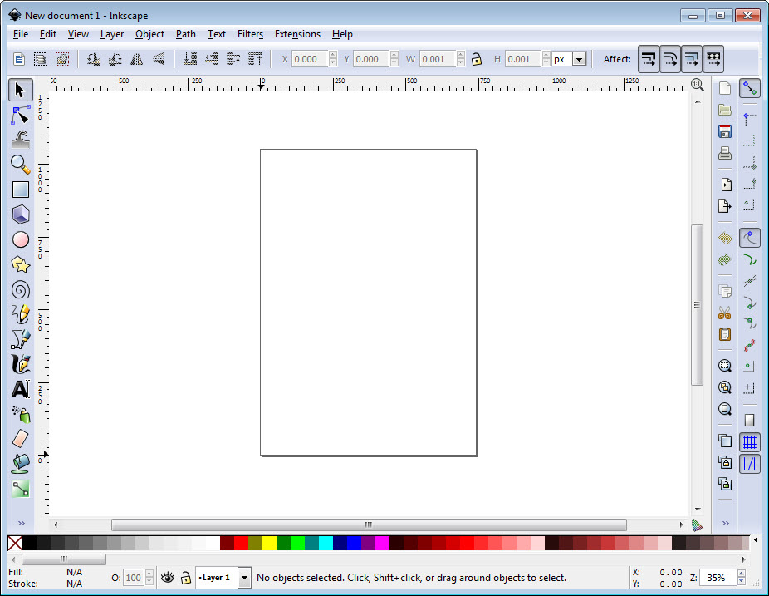
Inkscape Interface
The toolbox contains tools for drawing and editing shapes.
The document window is where you create your vector graphic.

Slide 6
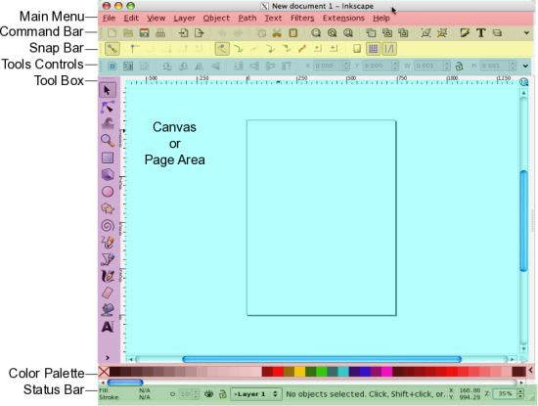
Inkscape Interface
The status bar displays information about the selected object.

Slide 7
Inkscape Interface
Main Components:
Toolbox
Canvas
Properties
Layers
Status Bar

Slide 8
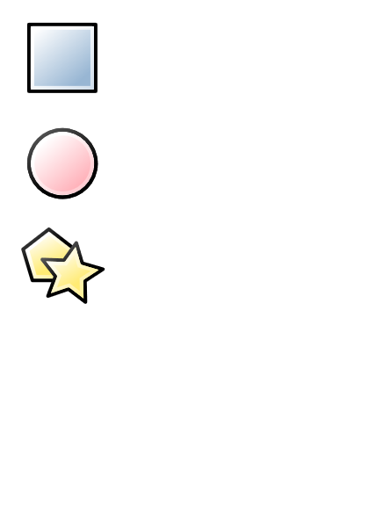
Drawing Shapes
Inkscape has tools for drawing a variety of different shapes:
Rectangles
Squares
Circles
Ellipses
Arcs
Polygons
Stars

Slide 9
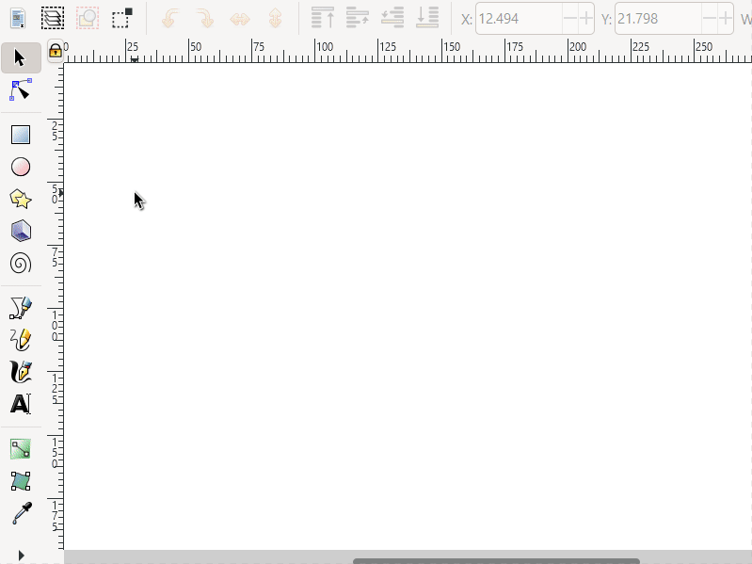
Drawing Rectangles and Eclipses
Choose a shape tool
Drag a shape out on the page
To create circles or squares hold ctrl as you drag.

Slide 10
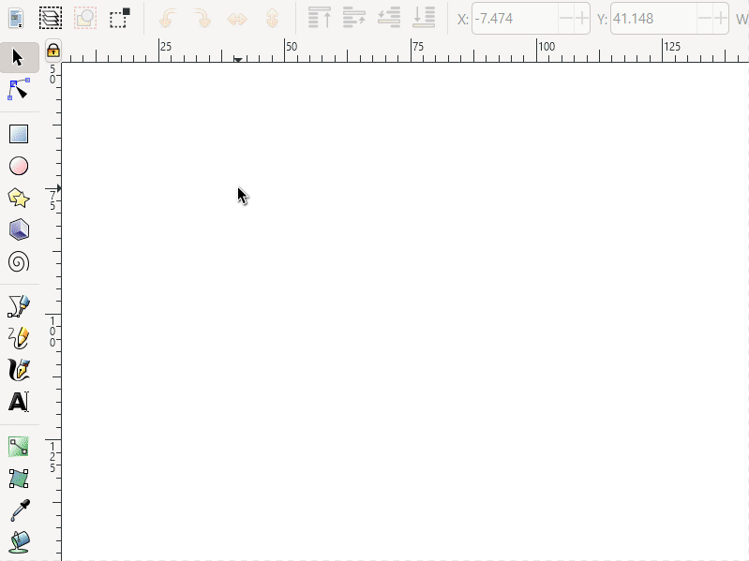
Drawing Polygons and Stars
Choose the polygon or star shape tool
Drag a shape out on the page
Change the options at the top of the screen:
Polygon or star
Number of corners

Slide 11
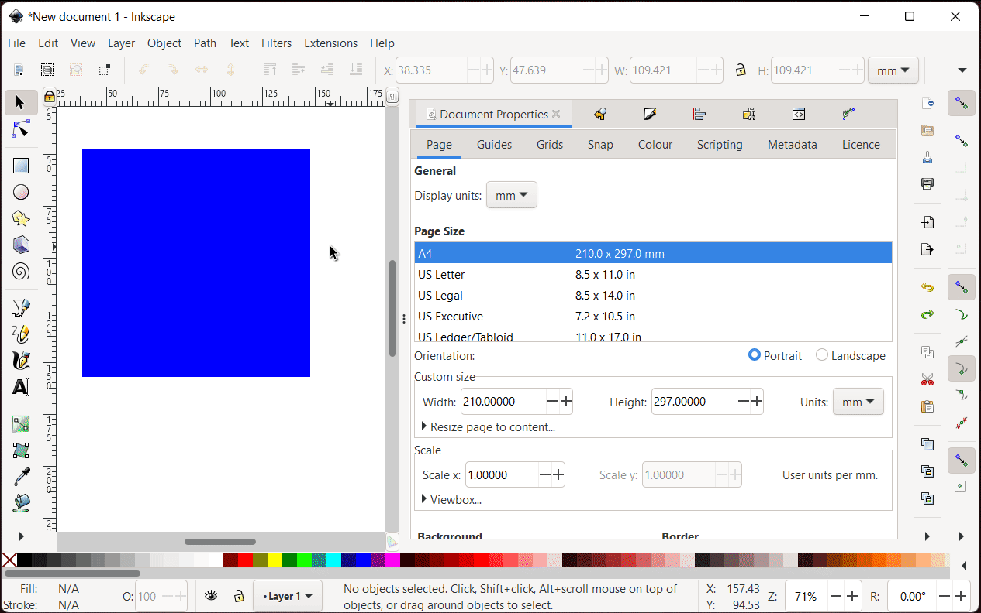
Change Shape Fill and Outline
You can change the fill and outline (stroke) of a shape as you create it or after you have created it.
Note: Inkscape will keep your settings for the next shape you create.

Slide 12
Questions & Answers

