Slide 1
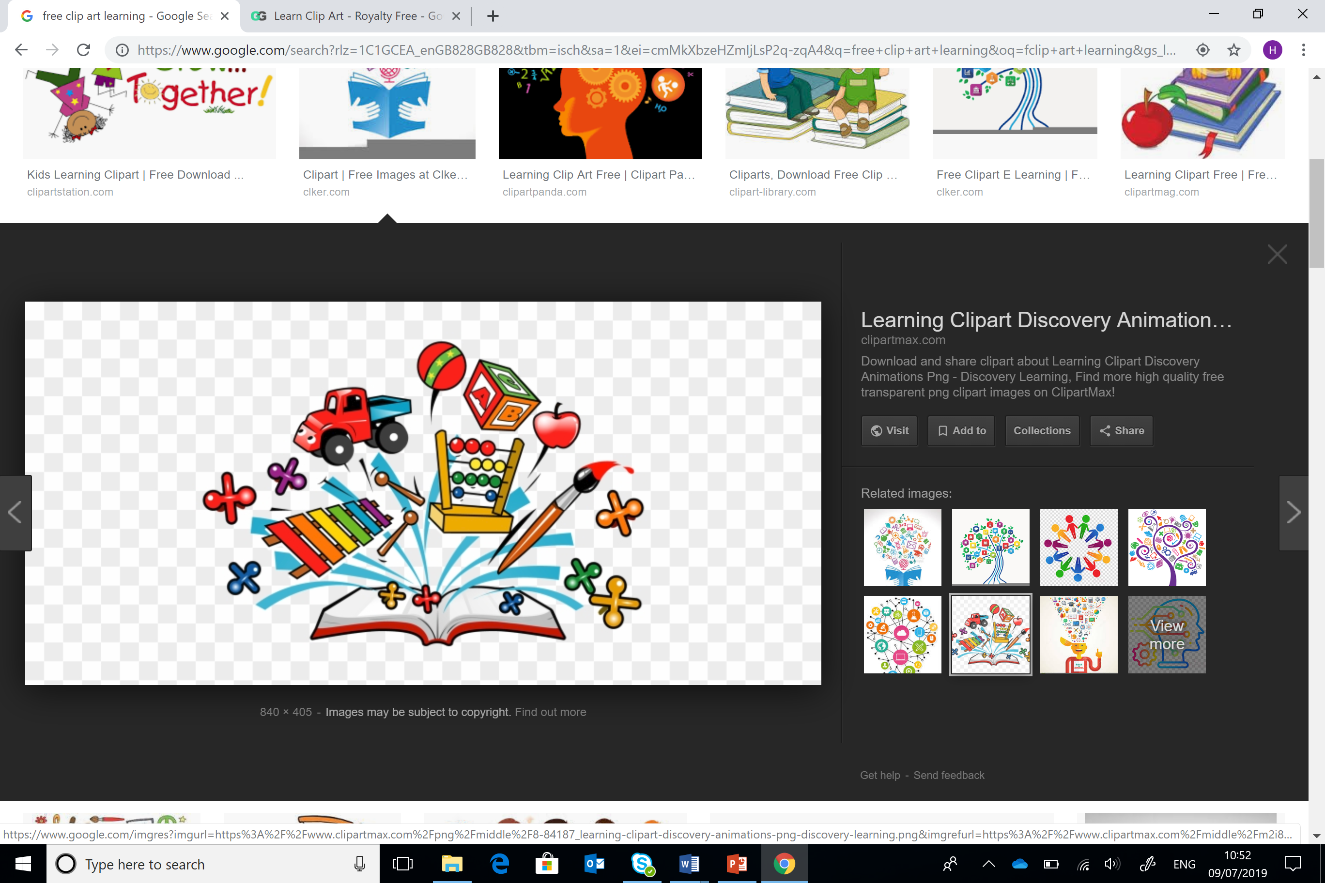
Damcaniaeth Dysgu ac Ymarfer
Learning Theory and Practice
ECES4010/C
Wythnos 1 Sesiwn 3
Week 1 Session 3
Vygotsky

Slide 2

Gorolwg Sesiwn / Session Overview
Vygotsky
Deilliant dysgu perthnasol
Perthnasedd i’r aseiniad
Vygotsky
Relevant learning outcome
Relevance to assignment

Slide 3

Adnoddau modiwl benodol
Module specific resources
Sleidiau darlith
Ymchwil
Tutalen Moodle
Llyfrgell ac Adnoddau Dysgu:
Rhestrau darllen ar-lein
Rhaglen Infoskills
Hanfodion Myfyrywr
Google Scholar
Lecture slides
Research
Moodle page
Library and Learning Resources:
Online resource lists
Infoskills programme
Student Essentials
Google Scholar

Slide 4

Sgiliau Cyflogadwyedd / Trosgwlyddadwy
Employability / Transferable Skills
Cynllunio
Trefnu
Datrys Problemau
Cydweithio
Ymchwilio
Cymryd nodiadau
Cyfathrebu
Hyblygrwydd
Planning
Organising
Problem Solving
Collaborating
Researching
Note taking
Communication
Adaptability
#OAstudiaethiGyflogaeth
#FromHigherEdToHired

Slide 5
Deilliannau Dysgu
Learning Outcomes
Dangos dealltwriaeth o ddysgu ac addysgu effeithiol.
Demonstrate an understanding of effective teaching and learning.

Slide 6
Deilliannau Dysgu
Learning Outcomes
Dangos gwybodaeth o ystod o ddamcaniaethau dysgu a deall sut mae’r ysgolion meddwl hyn yn dylanwadu ar fodelau cyfredol o arfer addysgol effeithiol.
Demonstrate knowledge of a range of learning theories and understand how these schools of thought influence current models of effective educational practice.

Slide 7
Deilliannau Dysgu
Learning Outcomes
Gwerthuso cyd-destunau dysgu gwahanol.
Evaluate different learning contexts.

Slide 8
Deilliannau Dysgu
Learning Outcomes
Deall sut mae cyd-destunau gwahanol yn hyrwyddo dysgu.
Understand how different contexts promote learning.

Slide 9
Aseiniad
Assignment
Group presentation (10 minutes each)
04/03/24 23:59
Demonstrate how learning theories can support effective teaching and learning
Cyflwyniad grwp (10 munud yr un)
04/03/24 23:59
Dangoswch sut y gall damcaniaethau dysgu gefnogi addysgu a dysgu effeithiol.

Slide 10

Atgoffa/Recap…
Work in pairs.
List as many of Piaget’s ideas as you can.
2. Share your recollections with another pair
3. Feedback
Gweithiwch mewn parau a rhestrwch cymaint o syniadau Piaget a phosibl.
Rhannwch eich meddyliau gyda phâr arall
Adborth

Slide 11

Datblygiad Gwybyddol
Cognitive Development
Canolbwyntio ar y prosesau sylfaenol sydd yn cyfrannu at sut mae plant yn dechrau...
Prosesu gwybodaeth
Datblygu dealltwriaeth cysyniadol
Rhesymu a datrys problemau
Focuses on underlying processes that contribute to how children begin to…
Process information
Develop conceptual understanding
Reason and problem solve

Slide 12
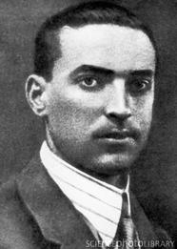
Vygotsky
Lev Vygotsky
1896-1934
1913 gorffen ysgol
1917 – graddiodd –arbenigo mewn llenyddiaeth
1917-1923- addysgu llenyddiaeth a seicoleg
1924 Institute of Psychology a dechrau Institute of Defectology ym Moscow
Bu farw o TB in 1934
Lev Vygotsky
1896-1934
1913 completed school
1917 – graduated – specialized in literature
1917-1923- taught literature and psychology
1924 Institute of Psychology & founded Institute of Defectology in Moscow
Died of TB in 1934

Slide 13

Ffactorau Cymdeithasol
Social factors
Damaniaeth Piaget yn anwybyddu rôl ffactorau cymdeithasol mewn datblygiad gwybyddol
Gweld y plentyn fel ‘gwyddonydd’ datblygol- yn datblygu’n unigol o’i fyd cymdeithasol
Damcaniaeth Vygotsky yn canolbwyntio ar ddatblygiad plant fel proses cymdeithasol
Piaget’s theory ignores the role of social factors in learning and cognitive development
Saw child as a developing “scientist” – developing independently from its social world
Vygotsky’s theory in contrast focuses on child development as a social process

Slide 14
Vygotsky
Herio’r pwyslais ar ddysgu unigol
Eraill yn gwneud mwy na chynnig cyfleoedd i ddysgu
Angen rhyngweithio cymdeithasol ar gyfer dysgu gwybyddol
Challenged emphasis on solitary learning
Others do more than provide opportunities to learn
Social interaction is required for cognitive learning

Slide 15
Diwylliant Culture
Mae babis yn dod i fyd sydd wedi ei drefnu gan eu gofalwyr yn ôl eu treftadaeth diwylliannol, hanesyddol ac esblygiadol
Mae plant yn elwa o wybodaeth a sgiliau cenedlaethau cynt
Mae rhannu gweithgareddau yn galluogi plant i fewnoli ffyrdd o feddwl ac ymddwyn
    Babies enter a social world organized by caregivers in accordance with their evolutionary, cultural and historical heritage
    Children benefit from the knowledge and skills of previous generations
    Shared activities allow child to internalize ways of thinking and behaving

Slide 16
Iaith Language
Iaith yw’r offeryn diwylliannol mwyaf pwysig
  Yr allwedd i ddysgu cydweithredol
  Drwy storiau a sgyrsiau mae plant yn amsugno confensiynau eu hiaith
  Language is the most important cultural tool
    The key to “collaborative learning”
    Through story-telling and conversations, children absorb the convention of their language

Slide 17

Chwarae Play
Chwarae yw y prif lwybr datblygiad
  Chwarae esgus ar y cyd - plant yn dysgu cydlynu syniadau a chynlluniau
  Play is the main avenue of development
    Collaborative pretend play – children learn to co-ordinate ideas and plans

Slide 18

Lefel rhyngbersonol Interpersonal level
Y plentyn fel prentis yn hytrach na gwyddonydd Piaget
Y gallu i feddwl a rhesymu yn ganlyniad i brosesau cymdeithasol
Yn dechrau gyda fawr ddim gallu i feddwl neu wneud pethau yn annibynnol
    The child as an apprentice rather than as Piaget’s scientist
    Ability to think and reason is the result of social processes
    Start off with little ability to think or do things by ourselves

Slide 19
Rhyngweithio cymdeithasol
Social interaction
Symudiad graddol tuag at fod yn hunan-ddigonol ac annibynnol drwy gymryd rhan mewn gweithgareddau cymdeithasol
Datblygiad gwybyddol yn digwydd drwy fewnoli gweithgareddau datrys problemau a ddatblygir trwy rhyngweithio cymdeithasol.
Gradual move toward self-sufficiency and independence through participating in social activities
Cognitive development occurs through internalization of problem-solving activities developed through social interaction

Slide 20
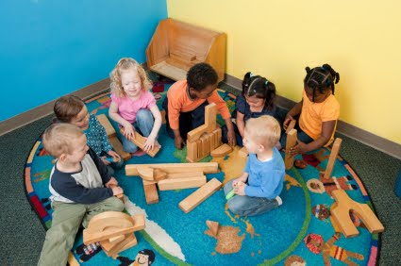
Parth Datblygiad Procsimol Vygotsky
Vygotsky's Zone of Proximal Development (ZPD)
Dysgu yw’r trosglwyddiad cymdeithasol o wybodaeth
Dysgwyr yn gweithredu ar ddwy lefel
1- lefel perfformiad
2- lefel datblygiad posibl
Bwlch – parth datblygiad procsimol
Learning is the social transmission of knowledge
Learners operate at two levels
1- performance level
2- potential development level
Gap – zone of proximal development
(Smidt 2013)

Slide 21

PDP – Parth Datblygiad Procsimol ZPD – Zone of Proximal Development
Plentyn arall neu oedolyn yn arwain y dysgu (sgaffaldio) o fewn parth datblygiad procsimol y plentyn (ystod o dasgau na fedrant ei wneud heb gymorth)
Gyda datblygiad mae’r PDP yn symud
  Another child or adult will guide learning (scaffolding) within the child’s zone of proximal development (range of tasks they cannot do without help)
  With development the zone of proximal development shifts

Slide 22

What the child can do with assistance today (s)he will be able to do by herself tomorrow
(Vygotsky, 1978:87 cited in Smidt 2013)

Slide 23
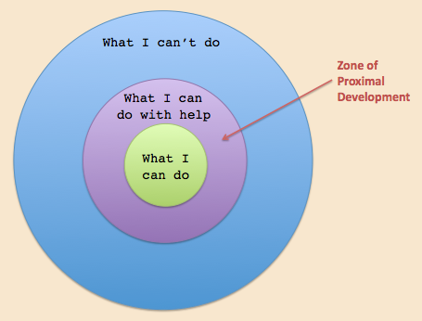

Slide 24
Task/ Tasg
Yn eich grwpiau, adlewyrchwch ar y clip
Ystyriwch enghreifftiau pellach o weithgareddau sydd yn medru datblygu iaith yn y dosbarth
Defnyddiwch y ddolen yma (tudalennau 132 – 140) am syniadau
In your group, reflect on the clip
Consider further examples of activities designed to develop language in the classroom
Use the following link (pages 132 – 140) to help

Slide 25
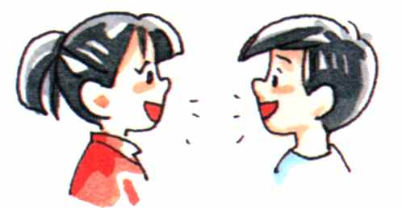
Iaith sydd yn darparu’r ddeialog y mae’r plentyn yn medru ei fewnoli i arwain ei ymchwiliad ei hunan i’r broblem
  Language provides dialogue which the child can internalize to guide their own exploration of the problem

Slide 26
4 cam / 4 stages
Cyfnod cyntefig
Cyfnod seicolegol naif
Cyfnod lleferydd egosentrig
Cyfnod tyfiant mewnol
Primitive stage
Naïve psychology stage
Egocentric speech stage
Ingrowth stage
( Bee & Boyd 2012)

Slide 27

Cyfnod cyntefig
  Dysgu drwy brofiad
Cyfnod seicolegol naif
  Dysgu defnyddio iaith i gyfathrebu ond ddim yn deall ei natur symbolaidd
Primitive stage
  Learns through experience
Naïve psychology stage
  Learns to use language to communicate but does not understand its symbolic character

Slide 28

Cyfnod lleferydd egosentrig
  Siarad egosentrig yn cael ei fewnoli yn gyfangwbl erbyn 6 neu 7 oed
Cyfnod tyfu mewnol
  Y cyfnod olaf o ddatblygiad gwybyddol
Egocentric speech stage
  Egocentric speech becomes completely internalized at age 6 or 7
Ingrowth stage
  Final period of cognitive development

Slide 29

Meddwl rhesymegol / Logical thinking
Logical thinking (Piaget ascribed to older children) resulted from internalization of speech routines that they had acquired from older children and adults in the social world rather than from schemes they had constructed for themselves through interaction in the physical world
( Boyd & Bee 2012, p. 149)

Slide 30
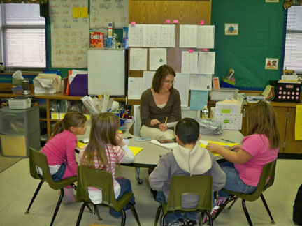
Tasg / Task
Teaching is good only when it ‘awakens and rouses to life those functions which are in a stage of maturing, which lie in the zone of proximal development’
(Wertsch and Stone, 1985:65 cited in Smidt, 2013, p. 38)
Sut mae hyn yn esiampl o'r PDP?
How is the following an example of the ZPD?

Slide 31
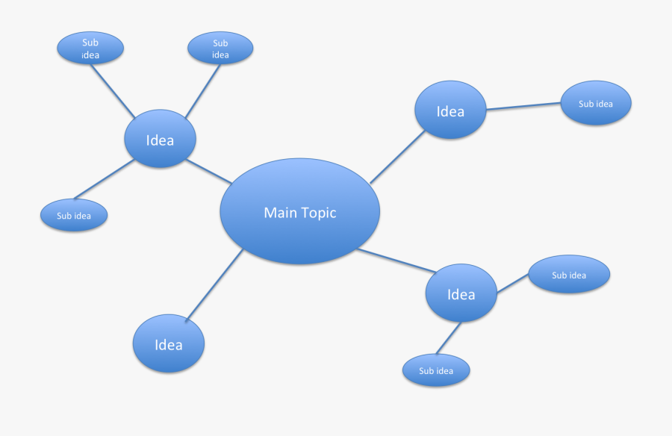
Tasg / Task
Mewn grwpiau ystyriwch brif nodweddion damcaniaeth ddatblygiad gwybyddol Vygotsky. Cofnodwch fel diagram corryn.
Casglwch enghreifftiau o’r ddolen isod i ddangos y nodweddion hyn yn y dosbarth
Estyn (2009) Chwarae a Dysgu Gweithredol
In groups consider the main features of Vygotsky’s cognitive development theory. Set out as a spider diagram.
Collect examples from the following link of where these features are present in classroom activities
Estyn (2009) Play and active learning

Slide 32
iaith
language
chwarae
play
damcaniaeth
Vygotsky
theory
diwylliantculture
rhyngweithio cymdiethasol
social interaction

Slide 33
Enghreifftiau o ddamcaniaeth Vygotsky
Examples of Vygotsky’s theory
Addysg yn Awstralia a Seland Newydd
Gweledigaeth Te Whāriki wedi tynnu ar agwedd cymdeithasol/ diwylliannol o’r cwricwlwm a phlentyndod a ddaeth o Vygotsky
Cwricwlwm a gymeradwyir yn eang
Yn ymwneud â phlant nawr a nid fel paratoad at gam yn y dyfodol
Education in Australia and New Zealand
The vision of Te Whāriki has drawn on a sociocultural view of curriculum and childhood derived from Vygotsky
Widely acclaimed curriculum
Concerned with children now and not preparing them for a future stage
(Brown & White, 2014,p. 138)

Slide 34
CYSYNIAD / CONCEPT | PIAGET | VYGOTSKY
Diwylliant / Culture
Y byd cymdeithasol: datblygiad gwybyddol / The social world: cognitive development
Datblyiad cymdeithasol / Social development
Iaith / Language
Datrys problemau / Problem solving

Slide 35
CONCEPT | PIAGET | VYGOTSKY
Culture | One influence on development | The main focus of development
The social world: cognitive development | The main development is within child | Led by the social world
Social development | Hierarchical stages | Complex roles in interactive activities
Language | Very little consideration of language | One of the main developmental tools
Problem solving | An individual independent process | Interactive process

Slide 36
Oes tebygrwydd rhwng damcaniaethau Piaget a Vygotsky?
Do Piaget and Vygotsky’s theories have anything in common?
Both theories see a role for maturation
Both interested in changes in cognitive abilities
  Piaget – stages;
  Vygotsky – ZPD
Y ddau yn gweld bod rôl gan aeddfediant
Y ddau â diddordeb mewn galluoedd gwybyddol
  Piaget – cyfnodau
  Vygostsky - PDP

Slide 37
Piaget v Vygotsky
Y ddau yn cydnabod pwysigrwydd rhyngweithio
  Piaget - rhyngweithio rhwng plentyn â’r amgylchedd
  Vygotsky - rhyngweithio cymdeithasol rhwng unigolion a’r byd cymdeithasol
Y ddau yn cytuno fod y plentyn yn ceisio gwneud synnwyr o’r byd, sydd yn datblygu’r meddwl
Both acknowledge importance of interaction
  Piaget – interaction between child and environment
  Vygotsky – social interaction between individuals and social world
Both agree that that the child tries to make sense of the world, which develops the mind.

Slide 38
Rhestr gyfeirnodi
Reference list
Bee, H. And Boyd, D. ( 2012) The developing child ( 12th edition. London: Allyn and Bacon
Brown, M.A. & White, J. (eds) (2014) Exploring Childhood in a Comparative Context. Oxon: Routledge
Estyn (2009) Chwarae a Dygu Gweithredol. Ar gael ar-lein: https://www.estyn.llyw.cymru/system/files/2020-07/Chwarae%2520a%2520dysgu%2520gweithredol%253A%2520Pecyn%2520cymorth%2520ar%2520gyfer%2520ymarferwyr%2520y%2520Cyfnod%2520Sylfaen%2520-%2520Medi%25202009.pdf (darllenwyd 01/11/21)
Estyn (2009)Play and Active Learning. Available online: https://www.estyn.gov.wales/thematic-report/play-and-active-learning-toolkit-foundation-phase-practitioners-september-2009 (accessed 01/11/21)
Smidt, S. ( 2013) The Developing Child in the 21st Century: A global perspective on child development . Oxon: Routledge

