Slide 1
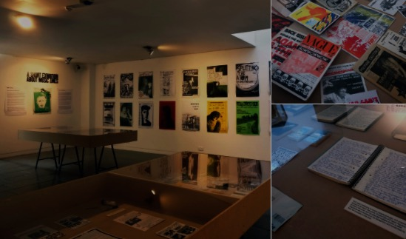
Ways of Perceiving
Curation, Commentaries and Compositions.

Slide 2
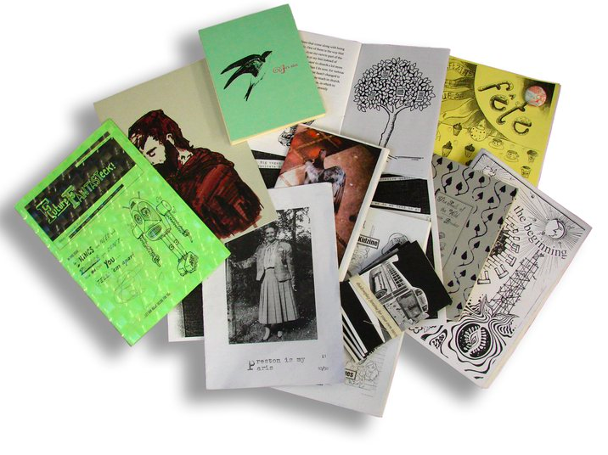
Module outline
In semester 2 you will work individually,
and will present in small teams, to curate ideas
and conceptualise them into a written composition or commentary.
This will involve research practices and approaches applied to deconstruct art, design and sound histories. This is a playful way to get you to think about the re-imagining of the history of ideas, by putting on an imagined exhibition, or music concert, fashion show, film festival etc?

Slide 3
Module outline
The research practices and approaches are those that you learned over last semester. You need to reapply them for this project.
In semester 2 you will work individually,
and will present in small teams, to curate ideas
and conceptualise them into a written composition or commentary.
This will involve research practices and approaches applied to deconstruct art, design and sound histories. This is a playful way to get you to think about the re-imagining of the history of ideas, by putting on an imagined exhibition, or music concert, fashion show, film festival etc?
You can draw on the histories that you learned last semester, and those that you learn in your discipline area.

Slide 4
Module outline
What is Curation?
Curation is the process of gathering information relevant to a particular topic or area of interest. Services or people that implement content curation are called curators.

Slide 5
Module outline
What is Curation?
Curation is the process of gathering information relevant to a particular topic or area of interest. Services or people that implement content curation are called curators.
- Your task is to gather information relevant to a particular topic or area of interest.

Slide 6
Module outline
- Your task is to gather information relevant to a particular topic or area of interest
What might a topic or area of interest be?
Spend three minutes writing some example topics or area of interest. This is what is called a ‘context’.

Slide 7
Module outline
Applying this ‘context’…
Now find works of art (in the broadest sense), that relate to this topic (context).

Slide 8
Module outline
Think broadly about the artists you have researched over the past semester. The artists/ works you choose to exhibit do not have to be within your subject area. One of the most important aspects of curating an exhibition is how the selected works speak to each other. Consider the importance of positioning.

Slide 9
Module outline
Think broadly about the artists you have researched over the past year. The artists/ works you choose to exhibit do not have to be within your subject area.
One of the most important aspects of curating an exhibition is how the selected works speak to each other. Consider the importance of positioning.

Slide 12
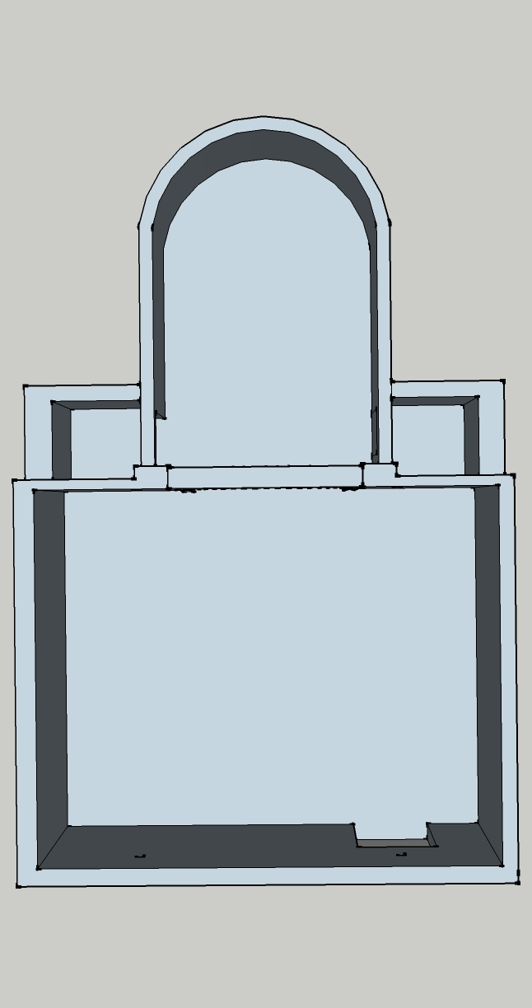
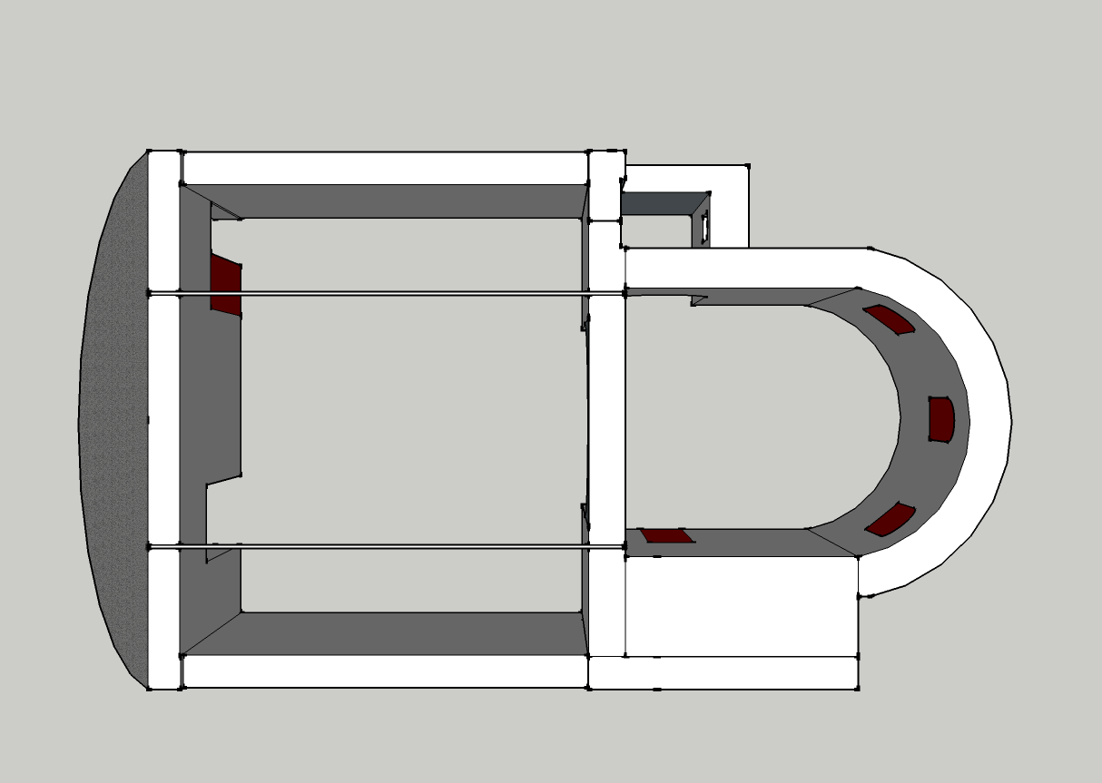

Slide 13
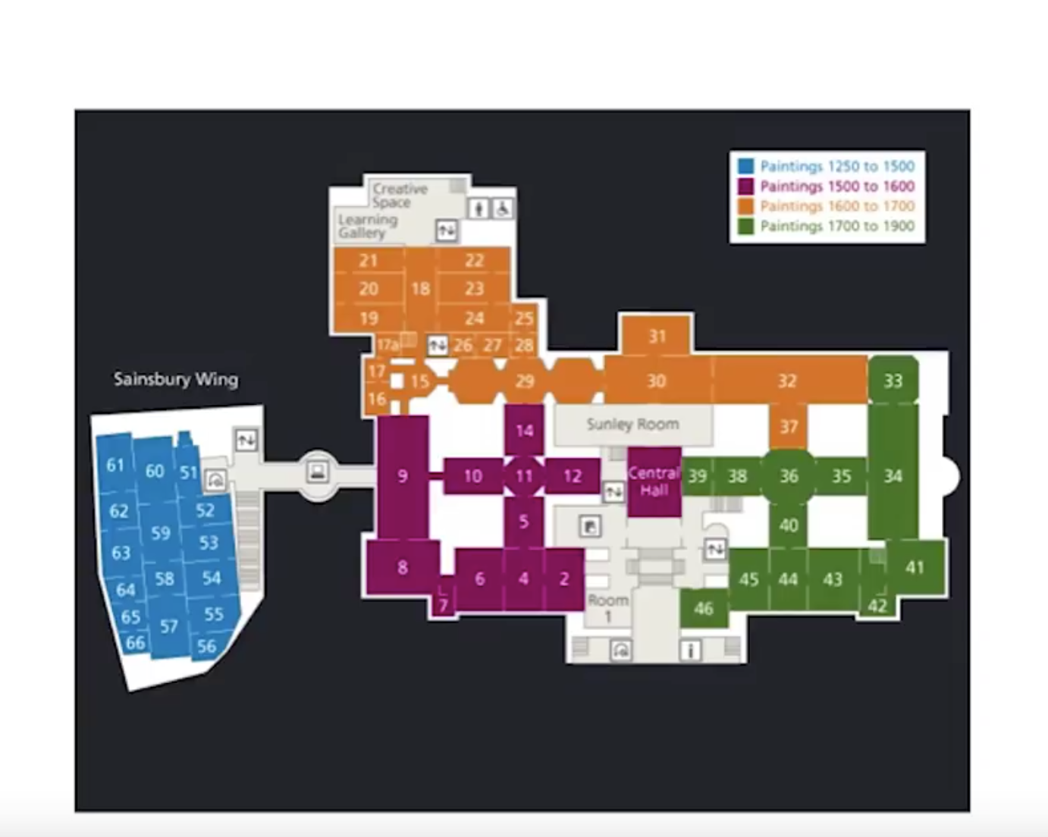

Slide 14
Module outline
Composition:
1. The act or art of composing.
2. The arrangement of parts
3. Combination

Slide 15
Module outline
How might your writing be designed to reflect your subject area and your outcome/curated project?

Slide 16
Module outline
Commentary:
A series of comments on a subject
A series of critical notes on a subject
A critical review of a subject

Slide 17
Module outline
Deconstruct:
To break an idea, history or situation down into its component parts

Slide 18
Assessment
You will be assessed for your individual writing which will be 1200 words (80% of the overall mark), and before uploading to moodle, will present a 'Collaborative Zine'.
Your 'Collaborative Zine' will consist of, for example, 2 slides each in a group presentation (5 team members) (20% marks)

Slide 19
Module Brief:
Key instructions - Choose any combination of the following (A-E):
A - up to 5 artists, designers, practitioners, influencers, etc.
B - a physical (existing) or metaphorical (imagined or idealised) space,
C - theoretical and/or historical perspective.
D - exhibition format and structure.
E - writing structure - narrative, report, composition, commentary.
Note: all structures require academic writing conventions such as referencing and bibliography, and must engage with relevant images.

Slide 20
Assessment
Group presentations takes place on
24th April, 1st of May and 8th of May,
For parity, all students hand in their group presentations on the 24th of April, so no one in the later weeks has an unfair advantage.

Slide 21
Assessment
Hand-in Deadline: Tuesday 8th May 2018 (by 10am)
Please note: in case of issues with moodle, you will not be penalised. If you have issues with moodle, do not panic – send the final draft to your seminar tutor and upload as soon as moodle is again available. In such cases the deadline will extend to 5pm.
Feedback available from Tuesday 29th May 2018

