Slide 1

Deglobalisation
14th February 2025

Slide 2
Agenda
Are we in a period of deglobalisation?
Torsten Bell MP
Measuring economies

Slide 3
Deglobalisation
A less connected world, characterised by:
Powerful nation states
Local solutions
Border controls

Slide 4
Are we in a period of deglobalisation?
Brexit?
Trumpism
War in Ukraine
Supply chain problems
Global energy crisis
Decline in FDI

Slide 5
A question of balance between globalising and deglobalising forces?
International collaboration still relevant and important
COVID 19
International crime
Climate change

Slide 6
Characteristics
Erosion of international treaties
Backsliding of democracy
Erosion of the International Criminal Court
Cooperation on arms control
International order post WWII under pressure

Slide 7
Implications for business?
Trade protectionism
Economic complexity
Need for strategies
Risk of trade wars
Global organisations not structured in a way that is fit for purpose
"Splinternet"
Global supply chains
Increased complexity (finance, taxation, environmental)
Data risk
Diminished global talent pool

Slide 8
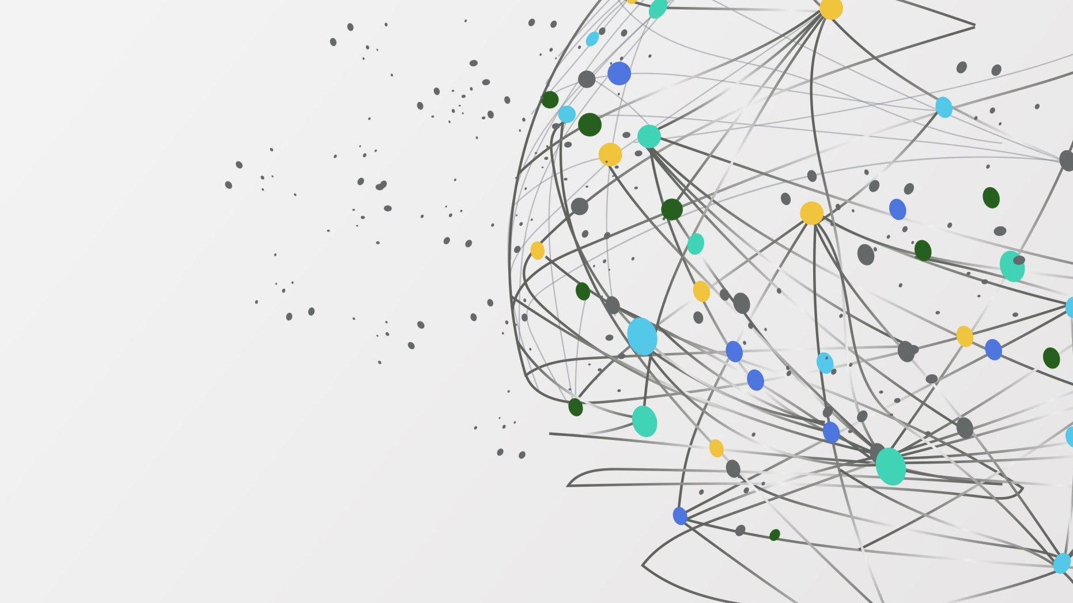
Splinternet the idea that the open, globally connected Internet we all use splinters into a collection of fragmented networks controlled by governments or corporations

Slide 9
Risks
Fragmented marketplace
Increased compliance complexity
Economic uncertainty
Cybersecurity threats
Supply chain disruptions
Barriers to entry
Increased costs
Data transfer restrictions
Technology incompatibility
Limited access to information

