Slide 1

wearable sensor-based digital health promotion intervention for monitoring Parkinson's disease in elderly population in the uk

Slide 2
Group member 1 : (slide 3-7)
Student name : Gorji Fatma Yusuf
Student id: 2526418
Group member 2 : (slide 8-10 )
Student name :
Student id:
Group member 3 : (slide 11-13 )
Student name : Disha Nasit
Student id: 2528386
Group member 4 : (slide 14-16 )
Student name :
Student id:
Module Code: LCHS7009
Module Name: Population Health and Digital Health Promotion
Lecturer Name: Dr. Raheela Shaikh

Slide 3
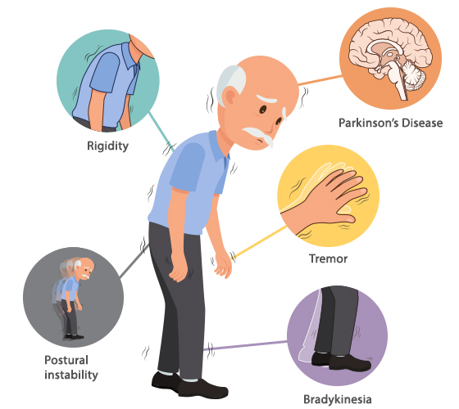
Parkinson’s disease
  Parkinson's disease is an ongoing, degenerative disorder of the nervous system that first affects people's movement, balance, coordination, and motor function, mostly with individuals over age 65 (Bacanoiu et al., 2025).
  Higher disease prevalence rates in older people are partly due to age-related neuronal degeneration, presence of multiple chronic diseases, diminished mobility and dependency on medical services (Qian and Siau, 2025).
  Around 153,000 people in the United Kingdom have Parkinson's disease, and because of population ageing trends, there are likely to be more people diagnosed with Parkinson's disease in the future (Mbue et al., 2025).
  Parkinson's disease represents significant physical, psychological, social and economic burden on the NHS, to families and care-givers, with a reduction in quality of life (Li et al., 2025).

Slide 4
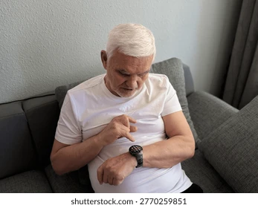
Aim And Overview Of The Intervention
  Enhance the continuous monitoring of Parkinson's disease symptoms and enable earlier intervention in the disease in the clinic, which will prevent avoidable complications in health in the elderly (Sun et al., 2025).
  Encourage early detection of symptom deterioration by monitoring, which will lead to timely treatment adjustments and minimize emergency hospital admissions in health services (Mughal et al., 2022).
  Promote self management and self execution of elderly people, encouraging active management of the progress of their disease and enhancing confidence, independence and quality of daily living (Almohammadi, 2026).
  Share reliable digital health information with clinicians that facilitates personalised care planning, virtual consultations and evidence-based clinical decision making in the NHS (Gu et al., 2026).

Slide 5

National Guidelines Supporting Intervention
NICE has conditionally recommended wearable devices for remote monitoring of Parkinson's disease (NICE, 2024).
The NHS Long Term Plan promotes digital solutions for managing long-term neurological diseases (NICE, 2024).
  NHS Long Term Plan focuses on remote monitoring technology and the use of technology to transform the care and management of chronic diseases, as well as the accessibility of health and wellness and community-based care (Branco, 2026).
  WHO Healthy Ageing framework promotes interventions to improve functional ability and independence, including through technology, to support healthy ageing and enhance quality of life for older people globally (Boyle et al., 2025).

Slide 6

Possible consequences
Delayed detection of motor fluctuations leads to poor medication adjustment in elderly patients (Moreau et al., 2023).
Delayed detection of motor fluctuations leads to poor medication adjustment in elderly patients (Moreau et al., 2023).
Lack of continuous monitoring contributes to higher rates of hospital admissions among Parkinson's patients (NICE, 2024).
Unmanaged symptoms significantly reduce quality of life for elderly individuals with Parkinson's disease (Tam et al., 2023).

Slide 7
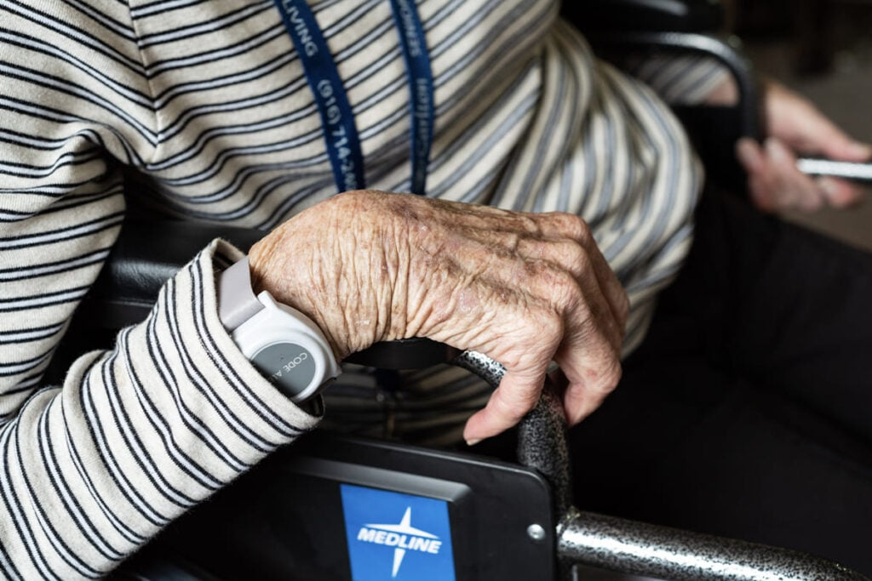
Chosen Digital Health Technology
wearable sensor | primary function
Wrist band | Continuous monitoring on movement while resting and physical activity and their walking pattern.
Wearable sensors provide continuous, objective monitoring of motor symptoms in Parkinson's disease (Polvorinos-Fernández et al., 2024).
Continuous data collection enables earlier intervention and reduces preventable complications in older adults (Moreau et al., 2023).
  When effective monitoring is not in place, elderly patients with Parkinson's disease experience an increase in falls, disability, hospital admissions, burden of care, health care costs, and loss of independence (Jin et al., 2026).

Slide 8

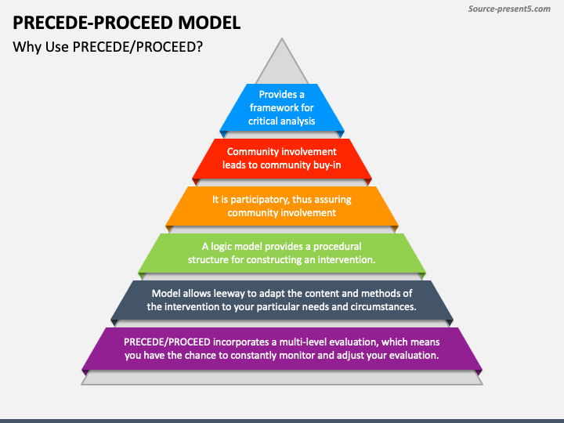
SELECTED PLANNING MODEL (PRECEDE–PROCEED MODEL)
  The PRECEED – PROCEED Model is a holistic health promotion planning model in the form of a framework that generates tools to effectively plan, assess, implement, evaluate, and continually improve the effectiveness of public health actions (Virameteekul et al., 2026).
  This model is appropriate because it:
1. Assess the health needs of older adults with Parkinson’s Disease
2. Identifies factors affecting the adoption of wearable sensor technology
3. Supports systemic implementation within NHS services
4. Enables continue monitoring and evaluation to improve patient outcomes and programme effectiveness (Yuzhou and Leng, 2025; Moreau et al., 2023).

Slide 9

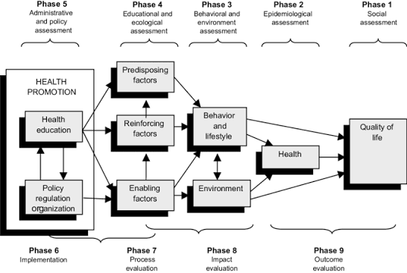
APPLYING THE PRECEDE–PROCEED MODEL
1. PRECEDE Phase
Social Assessment: Examine the impact of Parkinson’s disease on independence and quality of life (Sun et al., 2025)
Epidemiological Assessment: Analyse disease prevalence, falls and hospital admissions (Sun et al., 2025).
Behavioural & Environmental Assessment: Assess technology acceptance, digital literacy, medication adherence and caregiver support (Mughal et al., 2022).
Educational & Ecological Assessment: Identify training needs and factors influencing behaviour change (Mughal et al., 2022).
Administrative & Policy Assessment: Evaluate NHS resources, workforce capacity, funding and policy support (Almohammadi, 2026).
2. PROCEED Phase
Implement wearable sensor monitoring.
Evaluate programme delivery, patient engagement, clinical outcomes and cost-effectiveness to support continuous improvement (Gu et al., 2026).

Slide 10
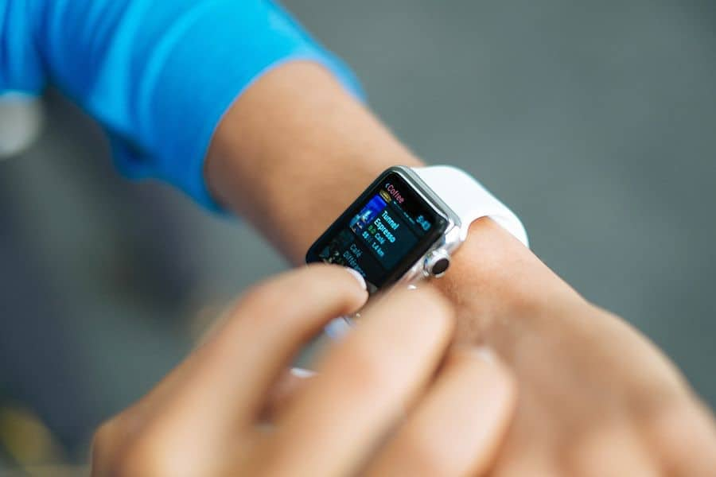

Implementation Strategy
The intervention will be implemented through a structured community-based approach.
Patient Recruitment: Identify eligible patients through GP practices, neurology clinics and community healthcare teams (Bacanoiu et al., 2025).
Training & Education: Provide training for patients, carers and healthcare professionals on wearable devices and digital platforms (Qian and Siau, 2025).
Remote Monitoring: Use wearable sensors to collect real-time symptom data and support early clinical intervention (Mbue et al., 2025).
Clinical Review: Healthcare professionals review patient data and personalise treatment when necessary (Bougea, 2025).
Evaluation: Measure patient adherence, symptom progression, falls, hospital admissions, quality of life, user satisfaction and cost-effectiveness (Li et al., 2025).

Slide 11
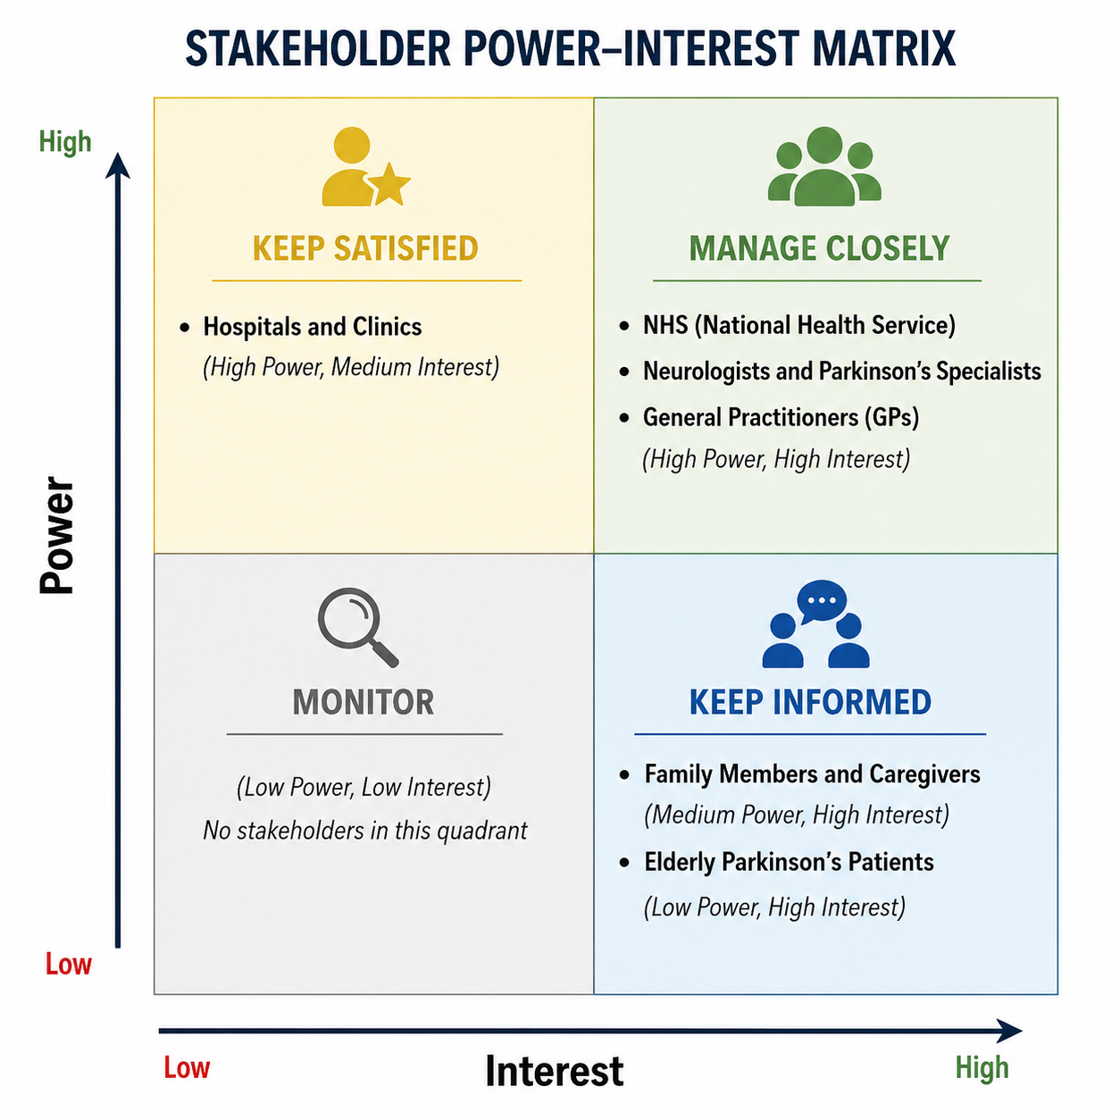
Stakeholders
Stakeholder | Role in the Intervention | Power | Interest | Management Strategy
Elderly Parkinson's Patients | Primary users of wearable sensors for continuous monitoring of symptoms and health status. | Low | High | Provide training, simple device interfaces, ongoing technical support, and involve patients in feedback sessions.
Family Members and Caregivers | Support patients in using wearable devices, monitoring alerts, and encouraging adherence Bloem et al., 2021). | Medium | High | Engage through education programmes, regular communication, and caregiver support resources.
Neurologists and Parkinson's Specialists | Analyse wearable-generated clinical data, monitor disease progression, and adjust treatment plans. | High | High | Involve in planning, clinical decision-making, protocol development, and evaluation of intervention outcomes.
General Practitioners (GPs) | Provide primary care, review patient data, coordinate referrals, and support long-term disease management (Bloem et al., 2021). | High | High | Maintain continuous communication, provide digital health training, and integrate wearable data into routine consultations.
NHS (National Health Service) | Provide funding, policy support, digital infrastructure, and integration within healthcare services. | High | High | Maintain close collaboration, demonstrate cost-effectiveness, comply with NHS Digital and NICE guidance, and report outcomes.
Hospitals and Clinics | Implement wearable technology within clinical pathways, monitor patients, and coordinate multidisciplinary care. | High | Medium | Provide staff training, establish implementation protocols, and ensure interoperability with electronic health records.
Notes:
The elderly patients from the UK currently suffering from Parkinson's disease can be categorised as a major Stakeholder for the wearable digital devices, such as Smart Watch for performing continuous health monitoring. On the other hand, the families of British caregivers have been identified as key stakeholders for British patients with advanced Parkinson's cases for delivering moral support to family members while interpreting healthcare information. In the British healthcare industry, the NHS and general practitioners of Great Britain also serve as critical stakeholders for delivering adequate financial assistance towards Parkinson's patients and their families.

Slide 12
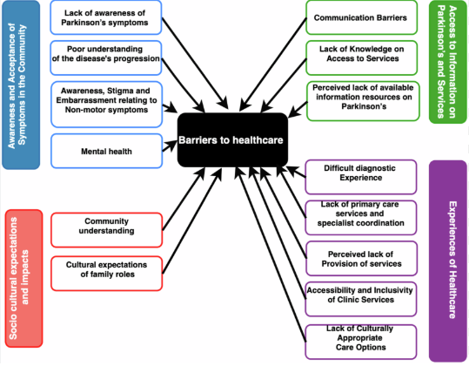
BARRIERS TO IMPLEMENTATION
Potential Barrier | Proposed Solution
Limited Digital Literacy Among Elderly Patients | Provide user-friendly device interfaces, hands-on training sessions, instructional videos, and continuous technical support to improve confidence and digital skills.
Resistance to Technology Adoption | Conduct awareness campaigns, demonstrate the benefits through pilot studies, involve patients in the design process, and encourage healthcare professionals to promote device adoption (De Miranda et al., 2022).
Data Privacy and Security Concerns | Ensure compliance with the UK GDPR by implementing data encryption, secure cloud storage, multi-factor authentication, and transparent privacy policies.
High Initial Implementation Costs | Secure NHS funding, apply for research grants, establish public–private partnerships, and implement the programme in phases to reduce financial burden.
Technical Failures and Device Malfunctions | Establish regular device maintenance schedules, provide prompt device replacement services, ensure continuous software updates, and maintain dedicated technical support (Del Din et al., 2021).
Notes:
The lack of digital awareness in the British marketplace can prove to be a major barrier towards utilising innovative smart devices for monitoring Parkinson's patients' healthcare vitals. The current UK healthcare professionals with low digital literacy are unable to interpret medical information from smart devices to make informed decisions to adjust the current level of medicine among British elderly patients. The patients over the age of 60 have showcased their current aversion level towards using digital solutions such as smart devices that can help UK doctors to attend to possible healthcare emergencies.

Slide 13

LEGAL AND ETHICAL ISSUES
The British marketplace has been experiencing increased data security issues that have exposed patients' confidential information and compromised care standards.
In the year 2018, the British government introduced the General Data Protection Regulation for safeguarding UK customer information (GOV UK, 2018)
The main part of the UK GDPR revolves around maintaining transparency across different British organisations to prevent potential data breach issues (ICO, 2026).
Notes:
The manufacturers involved in smart device manufacturing for British Parkinson's patients can employ the GDPR regulations to prevent future theft of confidential patient information. On the other hand, British doctors can also utilise the GDPR Act to gradually increase the transparency level of future treatment for Parkinson's patients to overcome data theft issues.

Slide 14

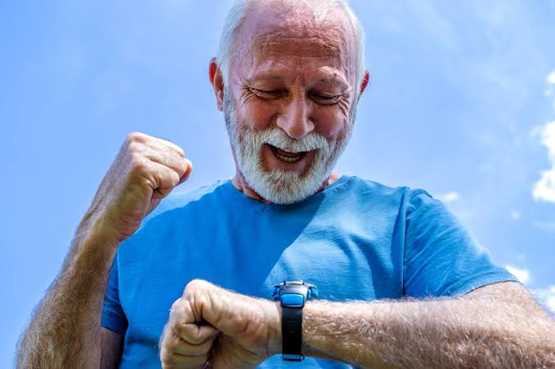
BENEFITS OF THE INTERVENTION
Target group | implication | refrance
Benefits (Patients) | Real-time monitoring enables early detection of symptoms. | Gu et al. (2026)
 | Personalised treatment improves symptom management. | Liu et al. (2026)
 | Improves self-management and independence. | Sun et al. (2025)
 | Reduces falls and improves quality of life. | Moreau et al. (2023); Jin et al. (2026)
Benefits (Healthcare) | Supports clinical decision-making with digital biomarkers. | Janssen Daalen et al. (2024)
 | Enables remote monitoring and efficient NHS care. | Almohammadi (2026); Liu et al. (2026)
 | Improves multidisciplinary collaboration. | Bougea (2025)
Policy | Supports digital healthcare and equitable access. | Sun et al. (2025); Liu et al. (2026)
Research | More long-term RCTs and AI research are needed. | Liu et al. (2026); Jin et al. (2026)
Education | Train healthcare professionals, patients and carers in digital health. | Bougea (2025); Sun et al. (2025)
Notes:
This is a really important intervention for the patient, health professionals, NHS and society at large. By being able to monitor symptoms continuously, patients are involved and any new or increasing signs of problems are identified early on and interventions are taken at the correct time and that is symptom control is improved. Having access to better monitoring can mean that people stay well and independent, and that falls are minimised, which, in turn, can improve quality of life. Healthcare providers enjoy the advantage of objective, real-time data to help them assess with accuracy, and plan treatment with personalisation. Plus, remote monitoring may have the added benefit of improving communication between patient and clinician and decrease the number of non-rewarded, face-to-face appointments. This will help reduce both short and long term healthcare costs for the NHS and hospital admissions if better disease management is achieved. The positive outcomes for society include better ageing, decreasing burden of care and elderly people's increased engagement and participation in community and social events and activities, which improves wellbeing.

Slide 15

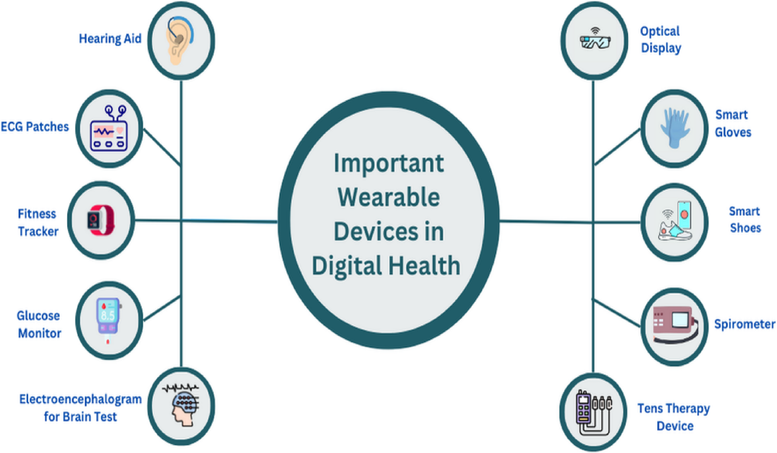
IMPLICATIONS FOR POLICY, RESEARCH, AND EDUCATION
Area | Key Point
Policy | Supports NHS digital health, remote monitoring and equitable access Liu et al. (2026); Sun et al. (2025).
Research | More long-term RCTs and AI-based studies are needed Liu et al. (2026); Jin et al. (2026).
Education | Digital health training for professionals, patients and carers Bougea (2025); Sun et al. (2025).
Public Health | Promotes healthy ageing, early intervention and better access to care Moreau et al. (2023); Gu et al. (2026).
Notes:
Proposed intervention is educationally relevant and policy relevant and is having research impact. It falls within line with the priorities of digital transformation in the NHS, and represents an opportunity for future remote monitoring systems for long term conditions and integrated health care management. The information obtained from interventions can then be used to inform plans for additional investment and national digital health programs. A further research is needed for the long-term effectiveness, patients' compliance with the programmes as well as cost implications of a wearable sensor. With improvements to artificial intelligence, easier detection of the deterioration in symptoms may be possible with wearable devices. Knowledge must also be acquired – both patients and carers, as well as health sector staff, must have the opportunity to learn how to use wearable technology and feel confident doing so as part of their normal health care activity.

Slide 16
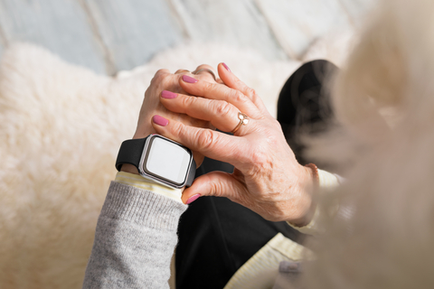
CONCLUSION
Parkinson's disease is a growing public health challenge that affects mobility, independence and quality of life (Moreau et al., 2023).
Wearable sensors enable continuous monitoring, supporting earlier intervention and personalised care (Gu et al., 2026; Liu et al., 2026).
Digital health interventions can improve patient outcomes, reduce hospital admissions and increase NHS efficiency (Liu et al., 2026).
Future research should focus on equitable access, AI integration and routine clinical implementation (Jin et al., 2026; Sun et al., 2025).
Notes:
Finally, Parkinson's disease is an important and increasing public health problem in the older age group in the United Kingdom. The condition affects the ability to be physically functional, to be independent, maintains mental health and puts ever-growing demands on the NHS. These wearable sensor technologies are beginning to be used to continuously monitor individuals in the real world in an objective manner and offer potential to solve current and future problems in digital health. This helps health care providers to detect the decline early, take action on a person's decline and reduces unnecessary frustration. The proposed intervention can have the potential to benefit the patient, promote independent lives, reduce admissions to hospital and increase the efficiency of healthcare delivery. Future development process to realize the benefits in time and with equity in mind should be included, when accessing, technological innovation, systematic evaluation and establishing of a process for monitoring of the wearable sensors in daily clinical use are to be integrated into future development process.

Slide 17
references (member 1)
Almohammadi, A.A. (2026) ‘Digital health interventions in Parkinson’s disease management: A narrative review’, Annals of Movement Disorders, 9(1), pp. 26–35. Available at: https://journals.lww.com/aomd/fulltext/2026/01000/digital_health_interventions_in_parkinson_s.4.aspx?context=latestarticles (Accessed: 11 July 2026).
Bacanoiu, M.V., Rusu, L., Marin, M.I., Piele, D., Rusu, M.R., Danoiu, R. and Danoiu, M. (2025) ‘Digital Health in Parkinson’s Disease and Atypical Parkinsonism—New Frontiers in Motor Function and Physical Activity Assessment’, Journal of Clinical Medicine, 14(12), p. 4140. Available at: https://www.mdpi.com/2077-0383/14/12/4140 (Accessed: 11 July 2026).
Boyle, L.D., Giriteka, L., Marty, B., Sandgathe, L., Haugarvoll, K., Steihaug, O.M., Husebo, B.S. and Patrascu, M. (2025) ‘Activity and behavioural recognition using sensing technology in persons with Parkinson’s disease or dementia: An umbrella review of the literature’, Sensors, 25(3), p. 668. Available at: https://www.mdpi.com/1424-8220/25/3/668 (Accessed: 11 July 2026).
Branco, D.J.R. (2026) Personalized data-driven collaboration in Parkinson’s disease care. Available at: https://repositorio.ulisboa.pt/entities/publication/62ecb3bc-0461-4cb4-b7cc-f4181c81a25b (Accessed: 11 July 2026).
Gu, B., Kim, H.S., Kim, H. and Yoo, J.I. (2026) ‘Advancements in wearable sensor technologies for health monitoring in terms of clinical applications, rehabilitation, and disease risk assessment: Systematic review’, JMIR mHealth and uHealth, 14(1), p. e76084. Available at: https://mhealth.jmir.org/2026/1/e76084/ (Accessed: 11 July 2026).
Jin, J., Jiang, Y., Zhou, Y., Zhu, W., Hua, J., Cheng, W., Shi, Y. and Pan, L. (2026) ‘AI-enabled flexible sensing ecosystems for Parkinson’s disease: Advancing digital biomarkers and closed-loop interventions’, Sensors, 26(7), p. 2071. Available at: https://www.mdpi.com/1424-8220/26/7/2071 (Accessed: 11 July 2026).
Li, H., Zecca, M. and Huang, J. (2025) ‘Evaluating the utility of wearable sensors for the early diagnosis of Parkinson disease: Systematic review’, Journal of Medical Internet Research, 27, p. e69422. Available at: https://www.jmir.org/2025/1/e69422 (Accessed: 11 July 2026).
Mbue, N.D., Tabei, F., Williams, K. and Olanrewaju, K. (2025) ‘Innovative sensor-based approaches for assessing neurodegenerative diseases: A brief state-of-the-art review’, Sensors, 25(17), p. 5476. Available at: https://www.mdpi.com/1424-8220/25/17/5476 (Accessed: 11 July 2026).
Moreau, C., Rouaud, T., Grabli, D., Benatru, I., Remy, P., Marques, A.R., Drapier, S., Mariani, L.L., Roze, E., Devos, D. and Dupont, G. (2023) ‘Overview on wearable sensors for the management of Parkinson’s disease’, npj Parkinson’s Disease, 9(1), p. 153. Available at: https://www.nature.com/articles/s41531-023-00585-y (Accessed: 11 July 2026).
Mughal, H., Javed, A.R., Rizwan, M., Almadhor, A.S. and Kryvinska, N. (2022) ‘Parkinson’s disease management via wearable sensors: A systematic review’, IEEE Access, 10, pp. 35219–35237. Available at: https://ieeexplore.ieee.org/abstract/document/9743908/ (Accessed: 11 July 2026).
National Institute for Health and Care Excellence (NICE) (2024) Parkinson’s disease in adults: Diagnosis and management (NG71). Available at: https://www.nice.org.uk/guidance/ng71 (Accessed: 11 July 2026).
Qian, Y. and Siau, K.L. (2025) ‘Advances in IoT, AI, and sensor-based technologies for disease treatment, health promotion, successful ageing, and ageing well’, Sensors, 25(19), p. 6207. Available at: https://www.mdpi.com/1424-8220/25/19/6207 (Accessed: 11 July 2026).
Sun, Y., Chen, J., Ji, M. and Li, X. (2025) ‘Wearable technologies for health promotion and disease prevention in older adults: Systematic scoping review and evidence map’, Journal of Medical Internet Research, 27, p. e69077. Available at: https://www.jmir.org/2025/1/e69077/ (Accessed: 11 July 2026).

Slide 18
Bloem, B.R., Okun, M.S. and Klein, C., (2021). Parkinson's disease. The Lancet, 397(10291), pp.2284-2303. https://repository.ubn.ru.nl/bitstream/handle/2066/235670/235670.pdf
De Miranda, B.R., Goldman, S.M., Miller, G.W., Greenamyre, J.T. and Dorsey, E.R., (2022). Preventing Parkinson’s disease: an environmental agenda. Journal of Parkinson’s Disease, 12(1), pp.45-68. https://journals.sagepub.com/doi/pdf/10.3233/JPD-212922
Del Din, S., Kirk, C., Yarnall, A.J., Rochester, L. and Hausdorff, J.M., (2021). Body-worn sensors for remote monitoring of Parkinson’s disease motor symptoms: vision, state of the art, and challenges ahead. Journal of Parkinson’s disease, 11(s1), pp.S35-S47. https://journals.sagepub.com/doi/pdf/10.3233/JPD-202471
GOV UK (2018), The UK's data protection legislation, Available at: https://www.gov.uk/data-protection [Accessed: 10th July 2026]
ICO (2026), UK GDPR guidance and resources, Available at: https://ico.org.uk/for-organisations/uk-gdpr-guidance-and-resources/ [Accessed: 10th July 2026]

Slide 19

THANK YOU

