Slide 1

Data Warehousing & Data Mining
ACCA6026
Lecture 4 – Classification Analysis
Prof. Nik Whitehead

Slide 2
Classification Analysis
Assigns data to predefined categories
  Learns patterns from labelled datasets (supervised learning)
Builds a predictive model in two stages
  Learning step (model construction)
  Classification step (predicting class labels)
Uses feature attributes to determine decision boundaries that separate different classes accurately
Many different algorithms available
  Decision trees (ID3, C4.5, CART), logistic regression, SVMs, neural networks, rule‑based methods…
Performance metrics
  Accuracy, precision, recall, F1‑score, and confusion matrices on separate test data
Commonly used
  Spam detection, fraud detection, medical diagnosis, marketing, and pattern recognition

Slide 3
Process of Classification
Training, Validation and Testing Examples
Training Records
Initial Model
Model Construction
Method
Training Set
Validation Records
(1)
2/3:1/3
Model Refinement
Method
Refined Model
50:50
(2)
Initial Model
Test Set
Final Model with
Measured Accuracy
Measuring
Model Accuracy
(3)
Refined Model

Slide 4
Process of Classification
Influential Factors for a Good Model
  Classification Accuracy
    Estimated accuracy during development stage vs. actual accuracy during practical use
  Classification Performance
    Time taken for model construction
    Time taken for classification
  Comprehensibility of the model
    Ease of interpreting decisions by the classification model

Slide 5
Decision Trees
The aim of classification is to put a new data item into a previously-defined cluster (or category)
There are two main approaches for doing this – decision trees and rule sets
Decision trees divide data at a node in some manner
  Most commonly this is by comparing the value of a specified attribute with a constant (parallel to one axis)
  Less commonly, multiple attributes can be compared with more complex functions (oblique or not parallel to an axis)
  Highly complex decision trees may use parallel splits at some nodes and oblique splits at others
Trees are generally used to predict categories but can be used to predict the mean value for a numerical quantity

Slide 6
Decision Trees in Weka
Many algorithms available
  ID3 (only work for categorical attributes)
  J48 (Java implementation of C4.5)
  RandomTree (with K attributes)
  RandomForest (a forest of random trees)
  REPTree (regression tree with reduced error pruning)
  BFTree (best-first tree, using Gain or Gini)
  FT (functional tree, logistic regression as split nodes)
  SimpleCart (CART with cost-complexity pruning)

Slide 7
Decision Tree Induction
The Approach
Input Training Examples
Outlook
sunny
overcast
rain
Humidity
P
Windy
high
normal
true
false
N
P
N
P
Internal Nodes: Attributes
Links: Attribute values
Leaf Nodes: Class labels
Descriptive Attributes
Class attribute

Slide 8
ID3 Algorithm
Algorithm Illustration
Outlook
sunny
overcast
rain
P
Gain(Outlook) = 0.246 bits
Gain(Temperature) = 0.029 bits
Gain(Humidity) = 0.151 bits
Gain(Windy) = 0.048 bits
∴ Outlook is chosen as the root.

Slide 9
ID3 Algorithm
Algorithm Illustration
Training Set(outlook=sunny)
Outlook
sunny
overcast
rain
Humidity
P
Gain(Temperature) = 0.571 bits
Gain(Humidity) = 0.971 bits
Gain(Windy) = 0.020 bits
∴ Humidity is chosen as the root.
high
normal
N
P

Slide 10
ID3 Algorithm
Algorithm Illustration
Training Set(outlook=rain)
Outlook
sunny
overcast
rain
Humidity
P
Windy
Gain(Temperature) = 0.020 bits
Gain(Humidity) = 0.020 bits
Gain(Windy) = 0.971 bits
∴ Windy is chosen as the root.
high
normal
true
false
N
P
N
P

Slide 11
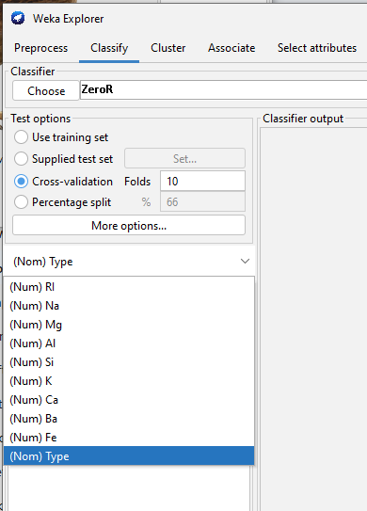
Classification with Weka
On the Preprocess tab open up the ARFF file then swap to the Classify tab
Classifier
  Allows choice of classifier
Test options
  Allows you to choose which testing data you want to test the model on
The dropdown shows the attribute that contains the class identifier
  This will be a (Nom) data type

Slide 12
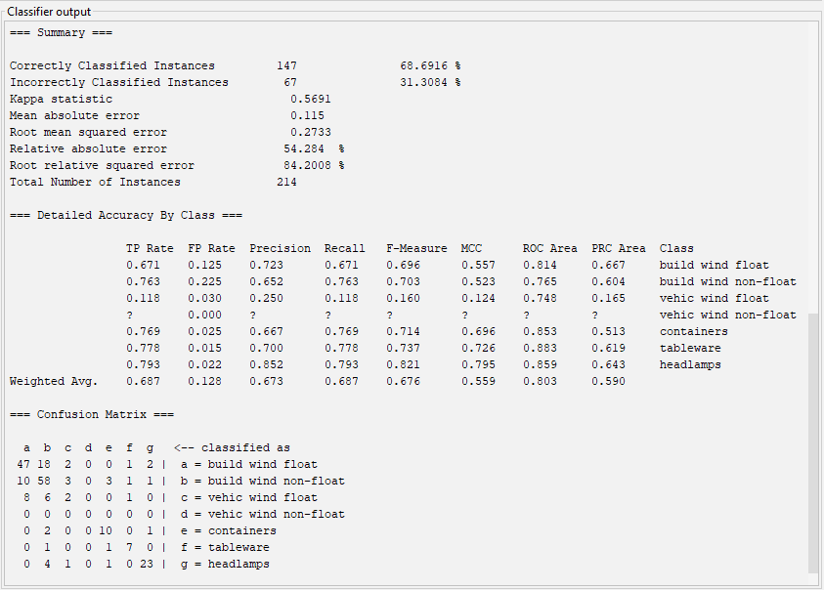
Classification with Weka
Overall Accuracy
Class
Accuracy
Confusion Matrix

Slide 13
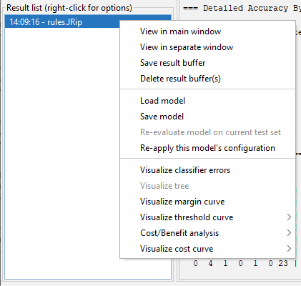
Classification with Weka
Once a model has been built it can be saved
Saved models can be loaded for application to other datasets
Trees and other useful outputs can be viewed using the model visualisation tools

Slide 14
Classification with R
The package RWeka wraps the Java-based Weka library and makes much of its functionality available as R functions
  Good for producing understandable models
  Fits well within CRISP-DM process
  Good for teaching and learning, but not as powerful as other packages for large-scale data mining
The caret package provides an interface to a wider range of data mining tasks
  More black-box solutions
The tidymodels package produces ML models within the tidyverse ecosystem
  Plays well with ggplot2

Slide 15
Exercise – Exploring Split Criteria
Load the glass.arff dataset into Weka
Train the following algorithms
  J48 with Information Gain
  J48 with Gain Ratio
  BFTree with Gini
Compare the structure and accuracy of each tree
  Size – number of leaves, depth
  Accuracy – use a 10-fold CV
  Confusion matrix – what does it misclassify?
  Ease of interpretation
  Which is best at distinguishing between chemically similar samples (e.g. type 1 v. type 2)?

Slide 16
The Problem of Model Overfitting
Any algorithms that build a classification model based on a finite set of training examples tend to have the problem of model overfitting: the model induced from the training examples fits the training examples too well
It reflects the specific features of the examples than features of actual data at large
A fuller tree with more branches towards the leaf nodes may be built in order to classify those few examples;
  Using such trees often results in misclassification
Causes of the problem include presence of noise data, lack of representative training examples, etc.

Slide 17
The Problem of Model Overfitting
Approaches to Tackle the Problem
  Early stopping rule (also known as pre-pruning): tree construction is halted at some stage
  Tree pruning (also known as post-pruning): to “cut back” certain subtrees and replace them with leaf nodes, making the tree smaller and more robust
  Use an independently sampled validation set to assist tree pruning
  Pruning methods:
    reduced error pruning
    cost complexity pruning
    pessimistic pruning and many others

Slide 18
Random Tree and Random Forest
RandomTree
  Selects a random subset of attributes at each node to determine splits, increasing variability between trees
RandomForest
  Builds multiple RandomTrees then combines their outputs (majority vote for classification).
  Uses Bootstrap Aggregation (bagging) to create trees based on repeated sampling of the training dataset.
  Combines these using majority voting or averaging
Advantages and disadvantages
  Fairly accurate, handles multiple datatypes well and limits overfitting
  Computationally expensive, does not extend well, and is effectively a black box technique

Slide 19
Decision Tree Induction
RandomTree approach – pick attributes at random
Temperature
cool
mild
hot
outlook
outlook
windy
sunny
o’cast
rain
sunny
o’cast
rain
true
false
P
P
windy
windy
P
humidity
N
humidity
true
false
true
false
high
normal
high
normal
N
P
P
N
windy
P
outlook
P
true
false
sunny
o’cast
rain
N
P
N
P

Slide 20
Evaluating Tree Accuracy
What to Evaluate?
  Accuracy is measured in terms of error rate
  Details of errors are shown in a confusion matrix.
e.g.
Overall error rate:

Slide 21
Strengths and Weaknesses
Strengths
    Capability of generating understandable rules
    Efficiency in classifying unseen data
    Ability to handle categorical and continuous attributes
    Ability to indicate the most important attribute for classification
Weaknesses
    Error rate increases as the training set contains a small number of instances of a large variety of classes
    The computationally expensive to build
    Single attribute splitting results in class boxes in rectangular shapes.

Slide 22
Decision Tree Induction in Practice
Key Stages
  Selection of class attribute
  Inclusion of descriptive attributes (manual selection of attributes to be used not recommended)
  Ensuring sufficient coverage of all classes and all descriptive values
  Data transformation, if necessary, to suit the solution
  Using a suitable test option
  Setting solution parameters (minimum number of leaf node examples, pruned or unpruned)
  Evaluating model accuracy (confusion matrix details)

Slide 23
Rules
It is very easy to turn a decision tree into a set of unambiguous rules
The antecedent of a rule is a series of tests similar to the tests at the nodes of a decision tree
The consequent of a rule is the class or classes that apply to instances covered by that rule
  This may be a probability function, not just a single class
Generally all antecedents are ANDed together so that all tests must succeed if the rule is to fire
Sometimes antecedents can be ORed together, although this can cause problems
Rules generated from decision trees can be needlessly complex

Slide 24
Decision Tree -> Rules
The Approach
If (Outlook=sunny)
{
if (Humidity=high) Play=N
else Play=P
}
Else if (Outlook=rain)
{
if (Windy=true) play=N
else Play=P
}
Else Play=P
Outlook
sunny
overcast
rain
Humidity
P
Windy
high
normal
true
false
N
P
N
P

Slide 25
Rules -> Decision Tree
It is generally more difficult to go from a set of rules to a decision tree
Often a given rule must be applied more than once, particularly when there are rules of the form
  if A AND B then X
  if C AND D then X
This leads to repeated sub-trees in the tree because trees have problems dealing with AND

Slide 26
Problems with rules
Rules may need to be applied in a specific order
  Rule A then rule B classifies the item as X
  Rule B then rule A classifies the item as Y
If the ruleset gives multiple classifications for an item there are two options
  Report it as not classified
  Report it as the most popular classification (the default)
What happens if a ruleset fails entirely to classify an item?
Machine-learning algorithms that produce rulesets generally produce order-specific rulesets

Slide 27
Exercise – Exploring Split Criteria
Load the glass.arff dataset into Weka
Train the following algorithms
  RandomTree
  RandomForest using default parameters
Compare the structure and accuracy of each tree
  Accuracy – use a 10-fold CV
  Confusion matrix – what does it misclassify?
  Runtime
  Stability – rerun the training and compare the results

Slide 28
Looking Ahead
Next Session: Other
Homework: Read section 11.4 (Learning Algorithms) of Witten, Frank & Hall’s Data Mining: Practical Machine Learning Tools & Techniques (3rd Edition)
  This discusses trees, rules and other learning algorithms available in WEKA

