Slide 1
BMHP5001
Complementary Therapies
Week 5: Using evidence-based/informed practice

Slide 2
MODULE AIM & LEARNING OUTCOMES
AIM(S)
To develop learners understanding of the role of complementary therapies in health and social care and their effectiveness in maintaining health and wellbeing.
LEARNING OUTCOMES
1. Critically understand the principles behind current use of complementary therapies
2. Critically understand the role of complementary therapies in relation and comparison to orthodox treatments
3. Analyse evidence for the efficacy of complementary therapies in sustaining health and wellbeing
4. Evaluate the systems for regulating the use of complementary therapies.

Slide 3
Lesson Objectives
Review on Harvard Referencing System
Review on types of research (qualitative; quantitative) and types of studies
3. Assess the quality of evidence (research papers)
4. Reflect on the quality of studies in CTs
5. Practice research independently

Slide 4
1. Why do we need research?

Slide 5

What is Research?
Who does it? Why do it?

Slide 6




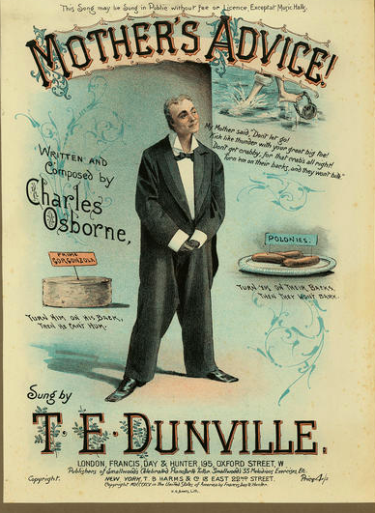
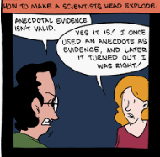

On what basis can CT advice/recommendations be given to clients?

Slide 7
Dangers of anecdotal evidence
‘I beat cancer by eating pineapples’ Brave woman, 31, shuns chemotherapy to self-medicate. Daily Express – 30/03/15
Blog by Colon cancer scientist, Liam Faller
https://biologicallyactive.co.uk/2015/04/01/the-dangers-of-anecdotal-evidence/

Slide 8
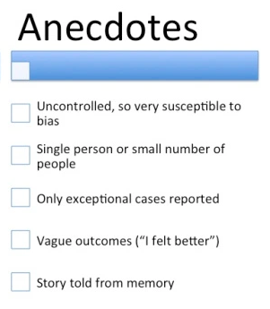
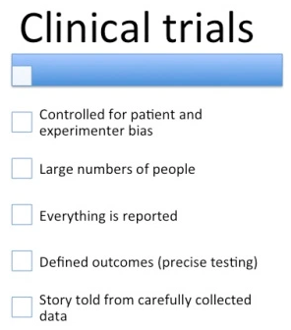
Dangers of anecdotal evidence

Slide 9
Evidence-Based/Informed Practice (EBP)
Safe
Effective
Professional
Credible
Science-based
Reliability
Validity
“EBP improves patient outcomes and performance effectiveness”
(Emparanza,J.I. Cabello, J.B., & Burls, A., (2015) Journal of Evaluation in Clinical Practice, 21(6),1059-1065)
“Quality of care is improved through the integration of the best available evidence into decision-making as routine practice”
(Lehane E, Leahy-Warren P, O'Riordan C, et al. (2019) BMJ Evidence Based Medicine, 24, 103–108.

Slide 10
But Evidence Based Medicine (EBM) has limitations...
“EBM just means blindly following guideline recommendations and trial results. It allows no place for professionalism, it is too rigid, and it does not “fit” the patient in front of me” (Blaine, C., 2019) https://bestpractice.bmj.com/info/toolkit/discuss-ebm/what-does-evidence-based-actually-mean/
“The evidence for EBM is limited to narrow and frequently unrepresentative groups of patients and the extrapolation of this data to individual patients with individual health considerations is fraught with limitations” (Greenfield, S., & Kaplan, S.H. ( 2012), J Comp Eff Res., 1(3), 263–270)

Slide 11
Clinical Practice
Pool of evidence affecting decisions in modern practice
Evidence from relevant clinical research
Decision-modifying evidence outside of relevant clinical research
Large Numbers, statistical conclusions
Single subject, personalized results
External determinants
Internal determinants
Epidemiological
Observation
Large Cohort follow-up studies
Randomised control trials
Family History
Molecular biological methods
Genetic studies
biomarkers
Environmental risk factors
Economic conditions
Social traditions
Personal beliefs
Professional experience
Individual values
Sources of evidence influencing clinical practice (from: Bereczki, D., (2012) Personalized medicine: a competitor or an upgrade of evidence-based medicine? Personalized Medicine, 9(2), 211–221)

Slide 12
2. What are the main types of research?

Slide 13
Scientific Method
begin with broad questions
narrow down, focus in
operationalize
OBSERVE
analyze data
reach conclusions
generalize back to questions

Slide 14
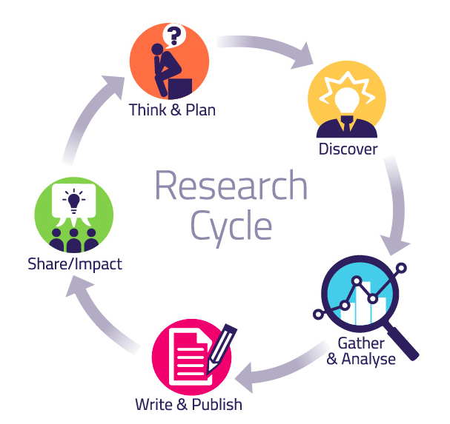
Typical Research Cycle

Slide 15
Two Main Approaches
Quantitative
Qualitative

Slide 16
Two Main Approaches
Quantitative research: Collects, summarises and draws inferences from numerical data i.e. “objective”
Qualitative research: Collects and analyses non-numerical, data such as words, feelings, emotions, impressions and experiences i.e. “subjective”

Slide 17
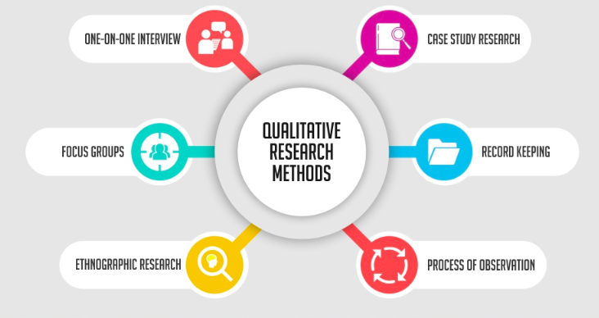
Notes:
Ethnographic research is a qualitative method where researchers observe and/or interact with a study's participants in their real-life environment. Ethnography was popularised by anthropology, but is used across a wide range of social sciences.

Slide 18
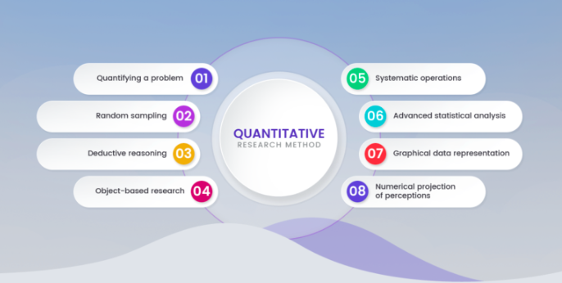

Slide 19
Example of a recent Qualitative study
Are the Claims to Blame? A Qualitative Study to Understand the Effects of Nutrition and Health Claims on Perceptions and Consumption of Food, Benson, T, Lavelle, F McCloat, A, et al (2019) Nutrients, 11(9), 2058; https://doi.org/10.3390/nu11092058

Slide 20
Example of a recent Quantitative study
Education and lifestyle predict change in dietary patterns and diet quality of adults 55 years and over, Thorpe, M. G., Milte, C.M., Crawford, D. and McNaughton. S.A., (2019) Nutrition Journal, 18:67 https://doi.org/10.1186/s12937-019-0495-6

Slide 21
Also Mixed-method studies
Example:
Somerville et al (2019) diabetes and diet study combines quantitative and qualitative analysis

Slide 22
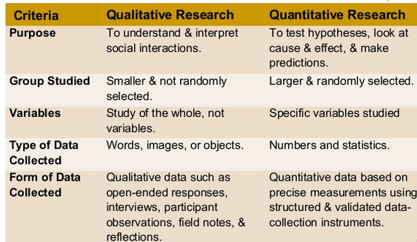
Qualitative vs Quantitative (i)

Slide 23
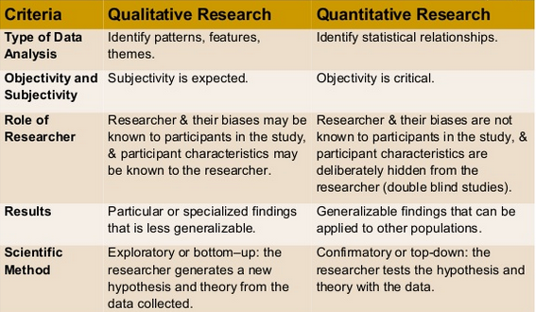
Qualitative vs Quantitative (ii)
Mahmood (2013). http://www.slideshare.net/kmahmood2/mixed-methods-research

Slide 24
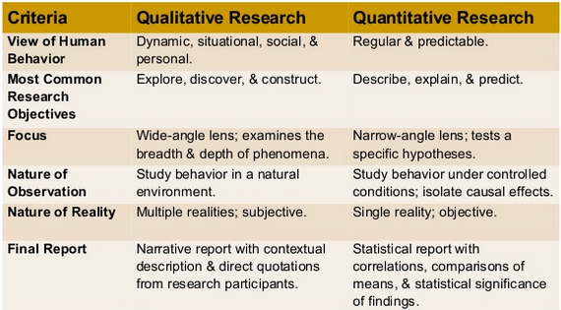
Qualitative vs Quantitative (iii)
Mahmood (2013). http://www.slideshare.net/kmahmood2/mixed-methods-research

Slide 25
3. What kind of studies are there?

Slide 26
Types of studies
Descriptive (such as case studies, observational studies, surveys)
Correlational (such as cross-sectional studies)
Experimental (such as Randomised Controlled Trials, animal and in vitro trials)
Reviews (i.e. literature reviews or systematic reviews)
Meta-analytic (i.e. meta –analyses)
Each have different weaknesses and strengths …

Slide 27
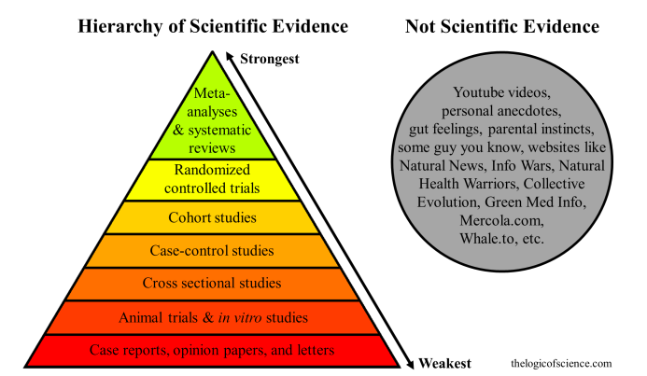
Hierarchy of Evidence
Notes:
A cohort study is a particular form of longitudinal study that samples a cohort (a group of people who share a defining characteristic, typically those who experienced a common event in a selected period, such as birth or graduation), performing a cross-section at intervals through time.

Slide 28
4. How can I find research evidence?

Slide 29
Databases
PubMed https://www.ncbi.nlm.nih.gov/pubmed/ part of MEDLINE (U.S. National Library of Medicine)
AMED (Allied and Complementary Medicine Database)
CINAHL (Cumulative Index of Nursing and Allied Health Literature)
EBSCO (acronym for Elton B. Stephens Co.) free databases www.ebsco.com
Royal Society of Medicine Cochrane library (for meta-analyses)
Google scholar, etc.
Notes:
P

Slide 30
Searching for Articles on a Particular Topic
Choose a database e.g. PubMed (http://www.ncbi.nlm.nih.gov/pubmed)
Enter key word(s) in the search box.
Refine your search for types of articles – e.g.in left hand column under “Article Types” click “Review” to find review studies
Use Boolean Operators “AND” “OR” “NOT” to refine your search further

Slide 31
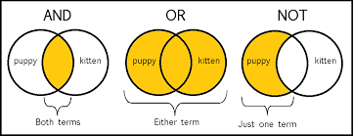
Boolean Operators

Slide 32
Searching Problems
What can you do if you are overwhelmed with TOO MANY references?
What can you do if you have TOO FEW references?

Slide 33
Resolving searching problems
Use a range of databases
Use search terms in different combinations
Refine your search with Boolean operators and database search tools
In PubMed use MeSH (Medical Subject Headings) to search for subheadings, publication types etc
See: MeSH terms explained:

Slide 34
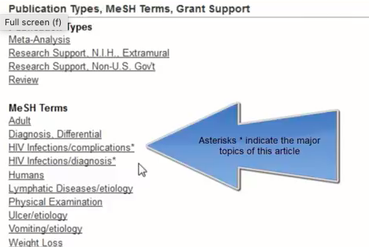
Searching with MeSH Terms

Slide 35
Other search tips
Keep focused. Discard anything not relevant
Keep a record of your search terms and your findings as you go – e.g. use RefWorks or other software
List your references in Harvard Referencing Style as you go along so you won’t have to go back at the end and search for lost ones!

Slide 36
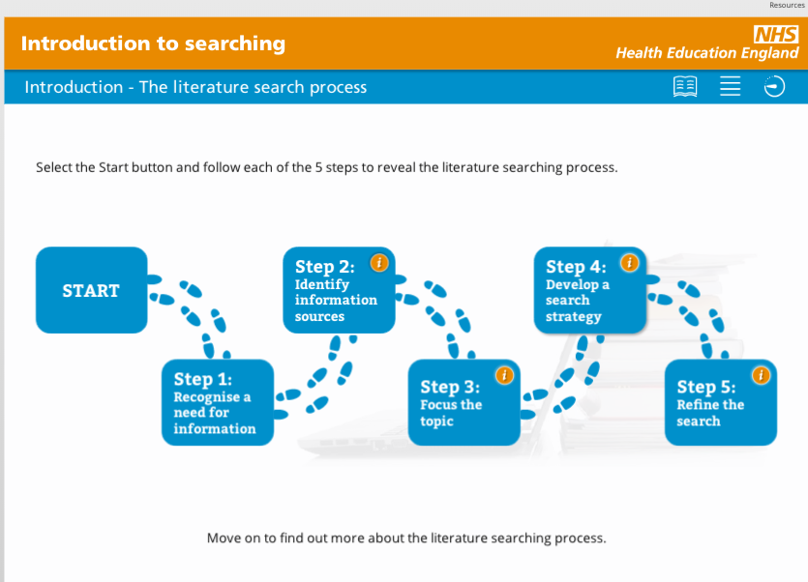
For more information, use this NHS Free E-learning portal: https://portal.e-lfh.org.uk/Component/Details/479951

Slide 37
Research practice
Independent research time (look for papers for your assignment)
Harvard Referencing System – review
Download the Harvard Referencing Guide from the UWTSD website (https://www.uwtsd.ac.uk/library/student-essentials/referencing-handbooks/ )
Use it to practice referencing papers you have found for your assignments.

Slide 38
Reflection/Recap
What did you learn today?
How can you apply this in your practice?

Slide 39
Any questions?

