Slide 1

Round the clock CARE
Domiciliary care facilities
CARE PLAN patient: Mr. Johnson Grey
Living with care the older person
BMHP6009
Care assistant: Naazneen Ara 1810991

Slide 2
Care Plan
This care plan was compiled for the care of Mr. Johnson Grey in a person centered way to best meet Mr. Johnson's needs. I have taken in to consideration the Human rights Act 1998 and the Care Act 2014 to best meet the patients needs
Domiciliary Care is providing care to someone in their own home Round the clock Care are her to support you so that you can remain in the home you love. We are a confident provider to best support your needs
(Care Act 2014, 2021)
(Human Rights Act 1998, 2021)

Slide 3
Personal Detail
Name : Mr. Johnson Grey
Age :71
Date of Birth : 12-10-1950
Address : 23 Spring croft Road
Parkhill
B25 6JM
Next of kin : Mrs. Claire Grey
Relation to patients: Daughter

Slide 4
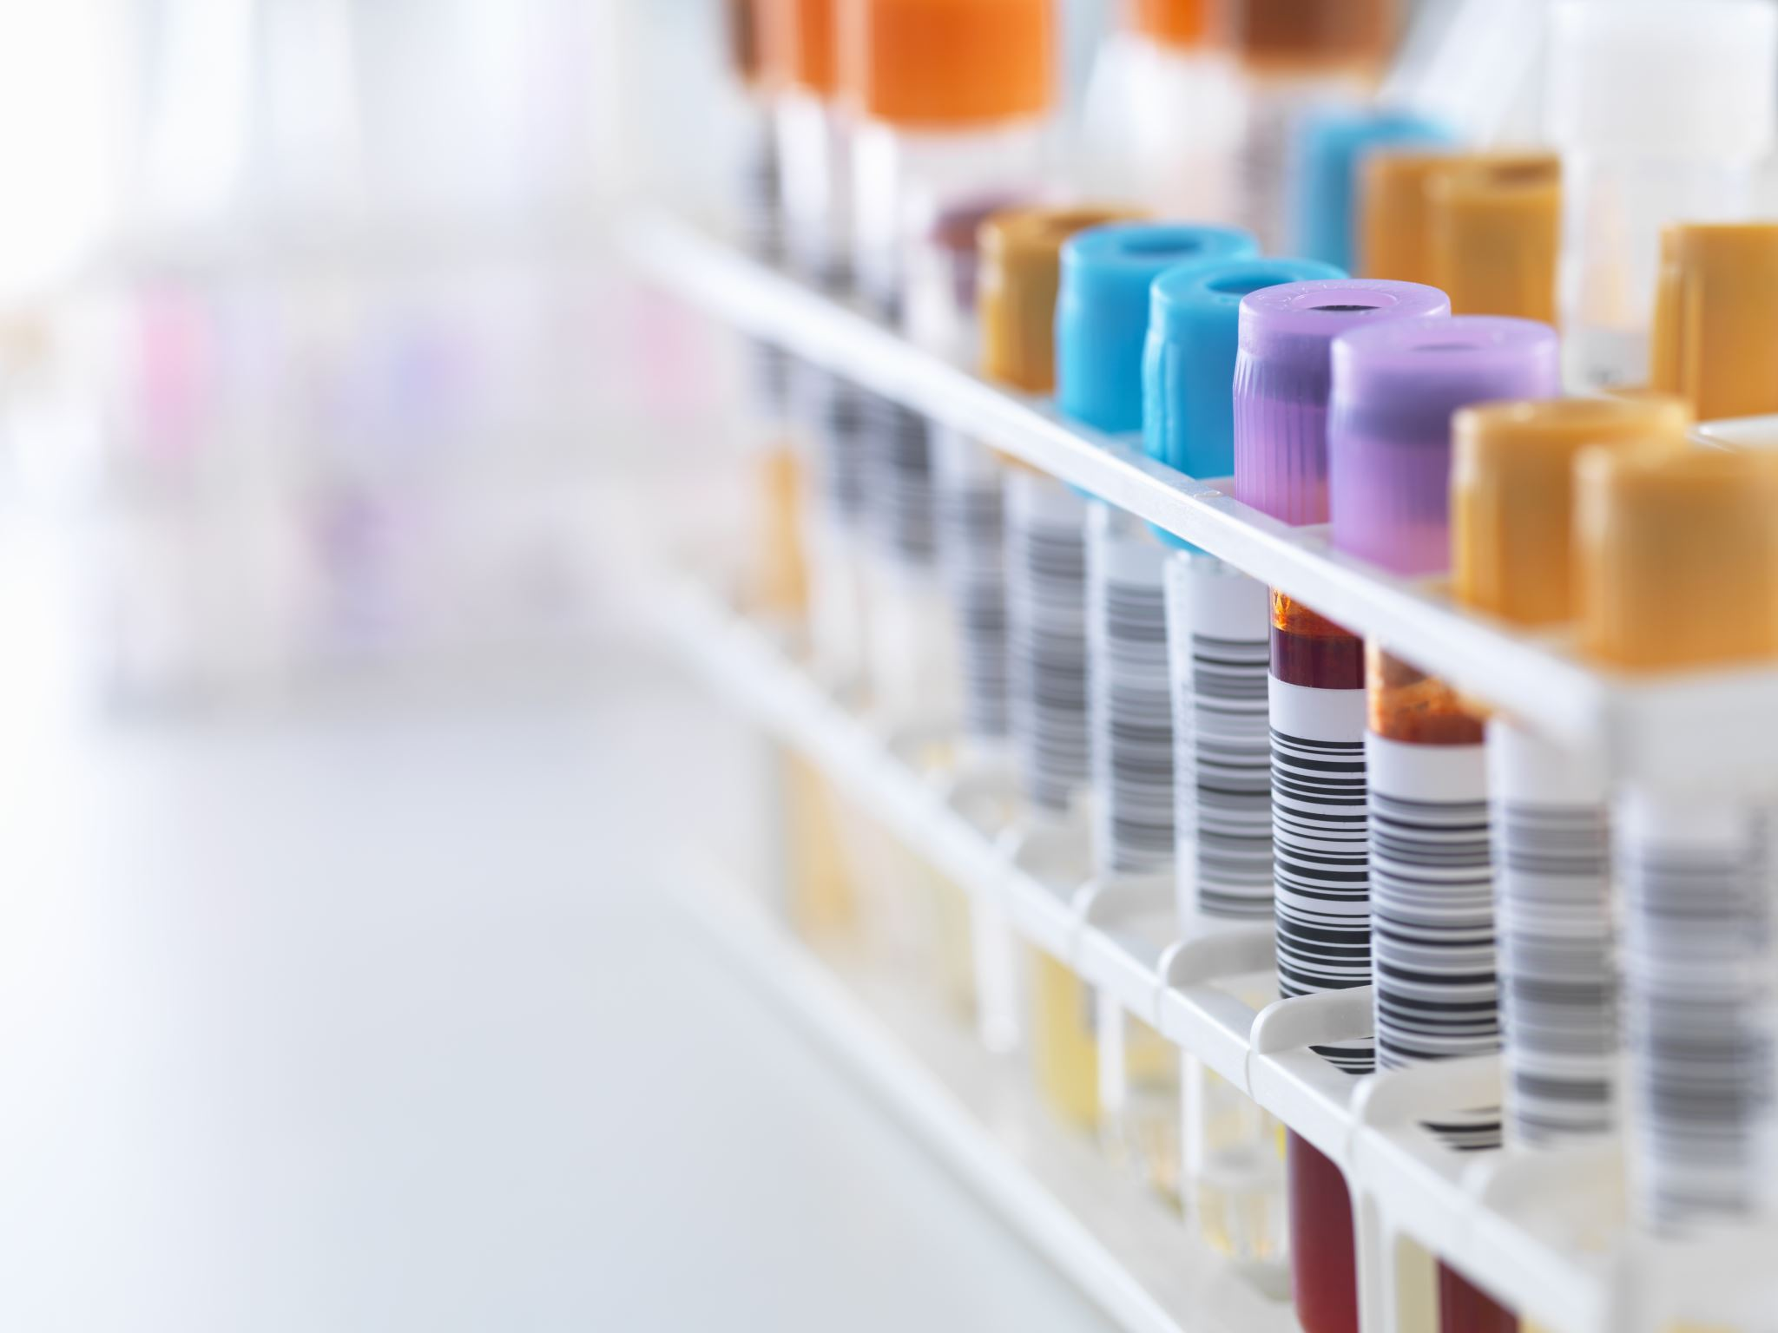
Health and medication
Mr. Johnson has suffered from a stoke in 2010 which has lead him to be less mobile and depressed. Throughout the years his dementia has got worse . Medication and ointment need to be administered by career.
Diabetic (UK et al., 2021)
MEDICATION= Metformin 2 x Times a day
Hight blood pressure (High blood pressure (hypertension), 2021)
MEDICATION= Ramipril 1 x daily
Skin condition Psoriasis (Types of Psoriasis, 2021)
MEDICATION= Hydrocortisone ointment 2 x morning and night
ALERGIES: NUTS

Slide 5
MORBILITY
MR Johnson uses a Zimmer frame to move around the house
COGNATIVE
Mr. Johnson suffers from memory issues
SENSORY
Mr. Johnson suffers from hearing and wears a hearing aid

Slide 6

diet
He has no specific dirty recommendations
Is able to eat all types of food he prefers to have soft textures food
yogurts containing vitamin
Snack on fruits
Take daily vitamins supplements no more than 25micrograms
Drink 2l of water a day

Slide 7

Personal care
Bathing x2 daily
Help changing his clothes
Toileting on commode unless he can be taken to the toilet

Slide 8

ICT
Mr. Johnson sleeps on a control bed to help him move in and out of bed
Guarded gates on his bed due to falls in sleep
Has a electric wheel chair but does not have the confidence use on his own

Slide 9
LIKES
Waking up at 6am and bathing and having breakfast straight after
To be taken walk after breakfast
Enjoys gardening and the out door
To go church every Sunday
To have his grand children to visit on a Saturday
DISLIKES
Does not like to be Infront of the tv allay
Does not like pets
Does not enjoy bananas

Slide 10
Daily Habits and schedule
6am- 8am | Waking up at 6 pm being assisted with a bathed and clothed/Medications taken /breakfast/
9am 12 noon | Taken out in the garden / lunch
1pm -3pm | To go for a walk (activity theory) or doing an activity and being entertained
4pm-6pm | Getting ready for assisted bath before bed /medication
7pm-9pm | Wind down to watch tv before bed /likes to have a light snack
10pm - 12 | Helped in bed by 10 pm

Slide 11

Interests /habits/ important dates
INTEREST
Gardening
Flowers
HABBITS
Can tend to talk about the past and live in the past due to dementia
Having baths at the same time
Wearing socks with his slippers on
Checking the weather first thing in the morning
IMPORTANT DATES
Grand children's birthdays
Amy 6 - dob . 12\04/2016
Bob 4 – dob. 05/08/2018
Timothy 3– dob 19/12/2019

Slide 12

Risk assessment
Mr. Johnson needs to have daily baths for his skin condition taking him up to the bathroom slips and trips
Going upstairs with Mr. Johnson
Assisting him in and out of the bed
Helping him to the commode of the bathroom
Taking the wheel chair in and out the house

Slide 13
references
Legislation.gov.uk. 2021. Human Rights Act 1998. [online] Available at: <https://www.legislation.gov.uk/ukpga/1998/42> [Accessed 26 February 2021].
Legislation.gov.uk. 2021. Care Act 2014. [online] Available at: <https://www.legislation.gov.uk/ukpga/2014/23/contents/enacted> [Accessed 26 February 2021].
UK, D., diabetes, H., diabetes, T., diabetes, T., advice, T., diabetes, E., Professionals, H., news, L., symptoms, S., story, T., 2, P. and diabetes, R., 2021. Diabetes UK - Know diabetes. Fight diabetes. | Diabetes UK. [online] Diabetes.org.uk. Available at: <https://www.diabetes.org.uk/?gclid=CjwKCAiA1eKBBhBZEiwAX3gql9N4CfUwfWzGRWxQCwEsMxQMqcENUoBVIhUStb7LxMhD-xONJXDmoxoCnDIQAvD_BwE> [Accessed 26 February 2021].
nhs.uk. 2021. High blood pressure (hypertension). [online] Available at: <https://www.nhs.uk/conditions/high-blood-pressure-hypertension/> [Accessed 26 February 2021].
Psoriasis Association. 2021. Types of Psoriasis. [online] Available at: <https://www.psoriasis-association.org.uk/types-of-psoriasis?gclid=CjwKCAiA1eKBBhBZEiwAX3gql7QcOH4BNTv2tXsOe7tVsqIOqHkFfi9KIuttvMfnrwPFhcLTjpaLbxoCFG0QAvD_BwE> [Accessed 26 February 2021].

