Slide 1
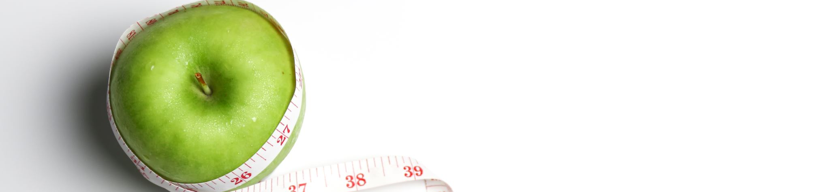

How does social media influence the behaviors around diet and exercise?
Ffion Rees
(2116740)

Slide 2

Introduction
-The influence of social media, how it influences the behaviors around diet and exercise.
-problem statement, social media is placed as the medium reach, having the biggest influence and change to physical activity and diet
-social media being the biggest piece of technology and means of interactions amongst young adults

Slide 3
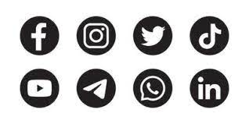
Introduction
As the purpose of the study being the influence of social media…what are the means of networking? And where do the influences come from?
>Facebook >Tik Tok
>twitter >Pinterest
>Instagram
>Snapchat
>Youtube

Slide 4
The aim
-purpose of the study / My study aims is…
-Research question- what are the risks around social media and its influence upon behaviors relating to diet and exercise (fitspiration)?
-Research question- which social media platform has the biggest influence on behaviors around diet and exercise (fitspiration)?
-Research question- what are the types of influences? Positive or negative?
-Hypothesis….

Slide 5
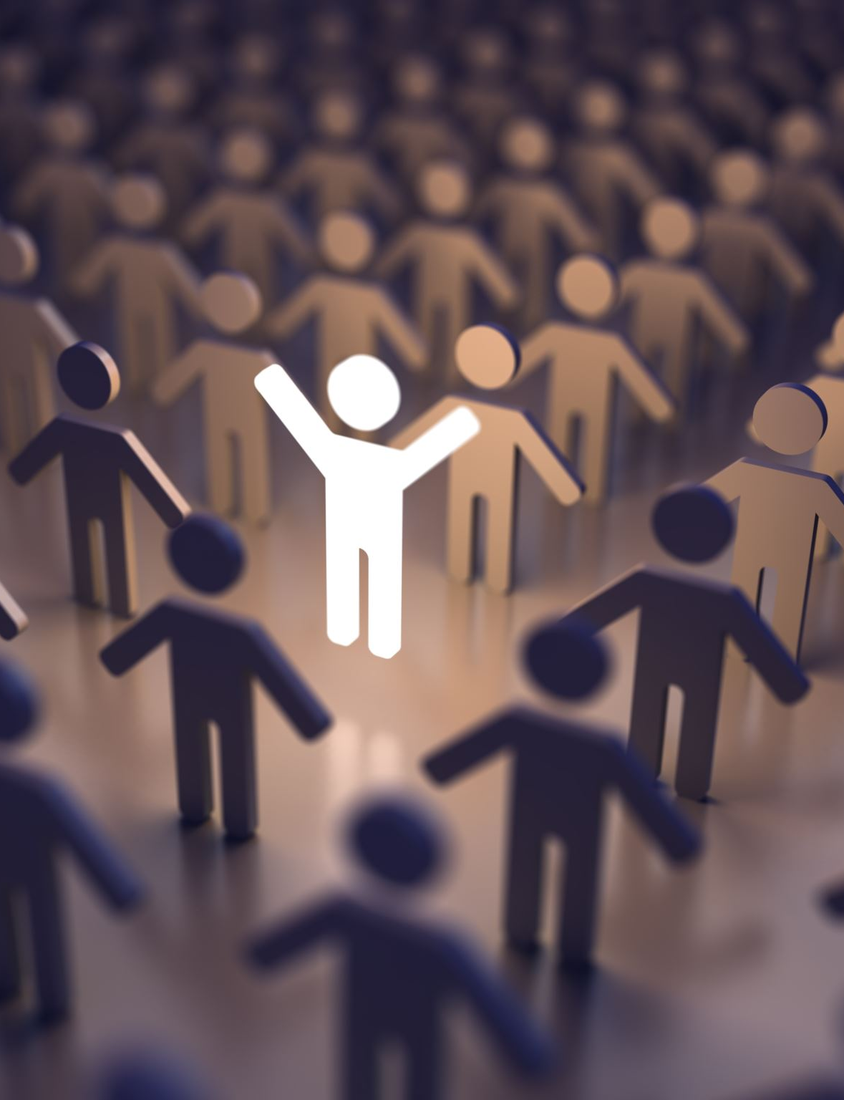
The influences / literature review
Types of influences and how they impact…
Negative influences / positive influences / types of impact
exposure to image related content
Raggatt, M., Wright, C.J.C., Carrotte, E. et al. “I aspire to look and feel healthy like the posts convey”: engagement with fitness inspiration on social media and perceptions of its influence on health and wellbeing.BMC Public Health 18, 1002 (2018).
Goodyear, V.A., Wood, G., Skinner, B. et al. The effect of social media interventions on physical activity and dietary behaviours in young people and adults: a systematic review. Int J Behav Nutr Phys Act 18, 72 (2021).
Rounsefell K, Gibson S, McLean S, et al. Social media, body image and food choices in healthy young adults: A mixed methods systematic review. Nutrition & Dietetics. (2020).
Ethics-

Slide 6
Methodology
Forms of data (qualitative) / (quantitative)
The approach….
Surveys/online surveys
Structured Interviews
Search of literature
to uncover factors such as…
- How an individual is Influenced/ the psychological influences
Opinions around content (formal, visual)
Changes in behaviors
The perceived influences surrounding the influence of social media.

Slide 7

Methodology / analysis
systematic search of the literature
online surveys
interviews
An intervention that using commercial social media platforms.
outcomes related to changes to diet / eating or exercise and changes behaviors qualitative method approach.
Participation selection, number of students (25) / online participants aged (18-30 years old).
Participation selection, variety of university students (18-39 years old) interviews.

Slide 8
Research ethics and data collection
The Data Protection Act 1998.
Use of a privacy notice
University ethical approval
Participant consent

Slide 9
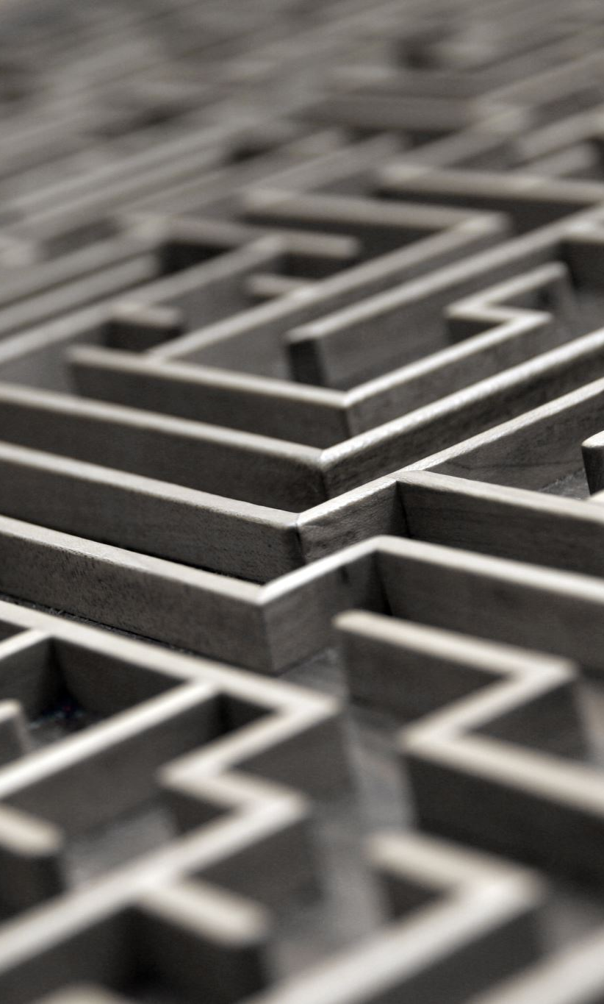
Limitations / strengths
Limitation – Time constraints
Strength – Amount of data
Strength – Diverse sampling
Strength – Well – researched instruments and collection methods
Notes:
This study had some limitations that mainly relate to variation in study design, over-reliance of self-reported measures and sample characteristics, that prevented comparative analysis.

Slide 10
Conclusion
The purpose – To understand the why and how, the kinds of influence social media has upon behavior changes around diet and exercise.
Data analysis
Areas for future research
Widen the scope
The importance of the study

Slide 11
References
Raggatt, M., Wright, C.J.C., Carrotte, E. et al. “I aspire to look and feel healthy like the posts convey”: engagement with fitness inspiration on social media and perceptions of its influence on health and wellbeing.BMC Public Health 18, 1002 (2018). https://doi.org/10.1186/s12889-018-5930-7
Goodyear, V.A., Wood, G., Skinner, B. et al. The effect of social media interventions on physical activity and dietary behaviours in young people and adults: a systematic review. Int J Behav Nutr Phys Act 18, 72 (2021). https://doi.org/10.1186/s12966-021-01138-3
Rounsefell K, Gibson S, McLean S, et al. Social media, body image and food choices in healthy young adults: A mixed methods systematic review. Nutrition & Dietetics. 2020;77:19–40. 10.1111/1747-0080.12581 [PMC free article] [PubMed] [CrossRef] [Google Scholar
Pixie G. Turner & Carmen E. Lefevre ,Eating and Weight Disorders - Studies on Anorexia, Bulimia and Obesity volume 22, pages 277–284 (2017)

Slide 12
Thank you for listening!

