Slide 1
ECES5016
Ymarfer a Dysgu;
Dulliau o rheoli dosbarth
Sesiwn 6
ECES5016
Behaviour and Learning;
Approaches to classroom management
Session 6

Slide 2
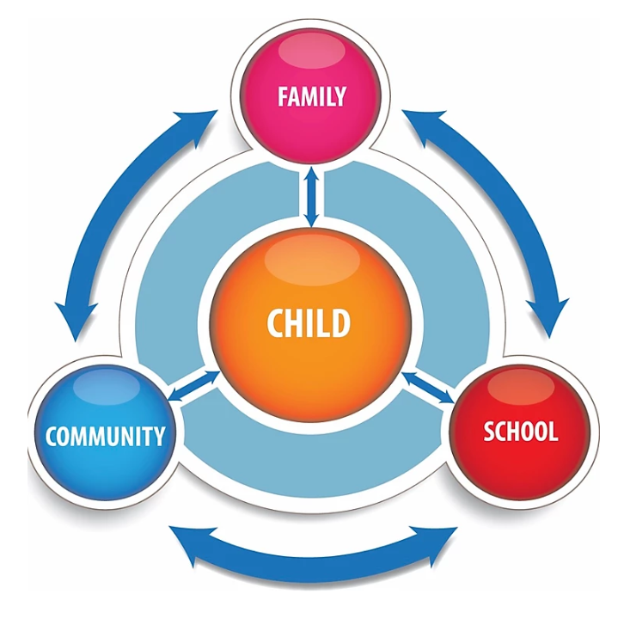
Ymarfer myfyriol & Meddwl person ganolog
Personal Centred Thinking & Reflective Practice

Slide 3
Learning outcomes:
To critically examine how the practitioner’s behavior can influence the classroom environment.
To explore how reflective practice can influence individual behavior in the classroom.

Slide 4

Notes:
Professional standards describe the skills, knowledge, and behaviours that exemplify excellent practice and support professional development. The professional standards form an aspirational framework that empowers you to be the best educator you can be.
professional standards for teachers, leaders, teaching assistants (TAs) and higher level teaching assistants (HLTA).

Slide 5

The Practitioner
Under Teachers’ Standards Part 2 : Personal and Professional Conduct
‘ A Teacher is expected to demonstrate consistently high standards of personal and professional conduct.’
(Woodhouse cited in Denby, 2012)
Notes:
According to Woodhouse cited in Denby (2012) teachers are expected to uphold public trust in the profession and therefore are required to maintain high standards of ethics and behaviour within and outside school.
Find an example of bad practice

Slide 6
The Practitioner’s Practice
The Department for Education (2011) stipulates that teachers have the responsibility of ensuring, under the management of behaviour to ensure a safe and effective learning environment and therefore should:
Set clear rules and routines for behaviour in the classroom, taking responsibility for behaviour in and around school
Have high expectations of behaviour with an established framework for discipline providing a range of strategies
Manage classes appropriately, adopting approaches which are appropriate to pupils’ needs
Maintain good relationships with pupils, exercising appropriate authority
(DfE, 2011)
Notes:
Ellis et al (2015), expresses the extent of this document which indicates explicit recognition that managing behaviours involves a variety of interacting factors with adherence to generic behaviour management systems and techniques and relies on more than a set of strategies.
Adams (2009) stipulates that the behaviour demonstrated outside the school gates is highly influenced by the role of the teacher.
However, it is noted that with the Government push for inclusive educational practices , the introduction of pupils with Special Educational Needs into mainstream classroom is considered inappropriate and compromises the learning of mainstream pupils especially in extreme cases where violence within the classroom permeates out into the wider school and detrimentally impacts upon mainstream pupils and their learning (Adams, 2009).
Rogers (2011) emphasises the need for forward planning of procedures, routines and rules to ensure the smooth running of complex classrooms, ensuring that this system is embedded through discussion, modelling, encouragement and teacher management. The emphasis is placed upon establishing and setting expectations of behaviours, whereby rights and responsibilities consider the essentials for building positive relationships.

Slide 7
The Practitioner’s Practice
To maintain the professional standards the practitioner is expected to:-
Treat pupils with dignity, forming relationships based upon mutual respect, observing appropriate boundaries
Safeguard pupils’ well-being in accordance with statutory legislation
Show tolerance and respect for the rights of others
Should not undermine British values, including democracy, the law, individual liberty and mutual respect and tolerance of those with different faiths
Ensure that personal beliefs are not used to exploit pupils’ vulnerability or to break the law (Woodhouse cited in Denby, 2012)
Notes:
According to Woodhouse, teachers are required to uphold and respect the ethos, policies and practices of the school where they teach, whilst maintaining high standards in their attendance and punctuality.
Furthermore, the professional standards largely reflect what the teacher will be doing rather than the pupils’ response to the standards (Ellis et al , 2015)
Equally teachers are required to have an understanding of statutory frameworks and act upon them in respect to their duties and responsibilities.

Slide 8

The Practitioner and Pupil Engagement
According to Rogers (2015)
‘the teacher’s behaviour and the student’s behaviour have a reciprocal effect on each other and on the ever present “audience” of peers’
Notes:
It is recognised that a practitioner’s behaviour contributes to an incident and its management as much as that of the student. Furthermore, students behaviours will vary between settings and between teachers.
Ellis et al (2015) indicates that teachers should recognise that good relationships are at the heart of good behaviour management and should be able to form positive appropriate professional relationships with their pupils to ensure effective learning and promotion of well-being. This is further advocated by Adams (2009) who highlights the need for peaceful and purposeful classroom environments which will permit learning to occur.

Slide 9
The Practitioner’s Style and Management
Relationship with self
Beliefs, values, self esteem, self efficacy, attributions
Personal Style
Relationship with Others
Relationship with Curriculum (Ellis et al, 2015)
Difference of professional/personal relationships Reciprocity for effective relationships
Importance of positive behaviours
Understands behaviour of students
Knowledge of behaviour management systems
Skills in delivery
Knowledge of school’s systems
Knowledge of strategies for behaviour management
Notes:
According to Ellis et al (2015) These three key areas work in triangulation with one another in so far as a teacher’s attributes in relation to themselves will resonate with their relationship with others i. e personal beliefs will influence the manner in which the teacher engages with students in relation to forming effective behaviours. Equally, a teacher’s strength of self efficacy will determine for example how they respond tin the class room, their ability to problem solve and explore activities which will engage others.

Slide 10

What characteristics make a good practitioner?
TASK

Slide 11

Practitioner’s Behaviour
Relaxed behaviour
Confident, engaging voice, assertive when necessary
Conveying respect, goodwill and humanity
Effective use of eye scanning/eye contact
Body language, communication and posture should convey confidence and authority
Being conscious of own body language when entering another’s personal space
(Rogers, 2015)
Notes:
In portraying these behaviours the teacher is demonstrating positive authority in the classroom which should be maintained in teaching and management to nurture and gain the cooperation from their students (Rogers, 2015). However Rogers equally indicates that leadership and management of pupils towards gaining increased discipline is focused not only on the controlling of others but directed at helping them control and manage themselves, learning and social relationships.
This relates to ‘relational power’ and is developed and sustained through the demonstration of mutual respect. It is further stipulated that a teacher’s authority is based upon effective teaching instead of the status of the position.
Furthermore it is noted that behaviour within social context is driven by goals which are mostly directed at gaining a sense of belonging to a social group, therefore it is important to be conscious that the warranting of continual attention to this behaviour will merely serve to reinforce the behaviour. It is recommended that the teacher adopts tactical ignoring to reduce and stop disruptive behaviour (Rogers, 2015)

Slide 12
What methods should be used to effectively manage a classroom?
TASK

Slide 13
Effective Classroom management
Welcoming the children as they enter the room
Ensuring all children know what is expected of them
Show an interest in the child
Vary the stimulus
Supporting the development of thinking skills
Positive behaviour
Active as a posed to passive teaching techniques
Involve EVERY child

Slide 14
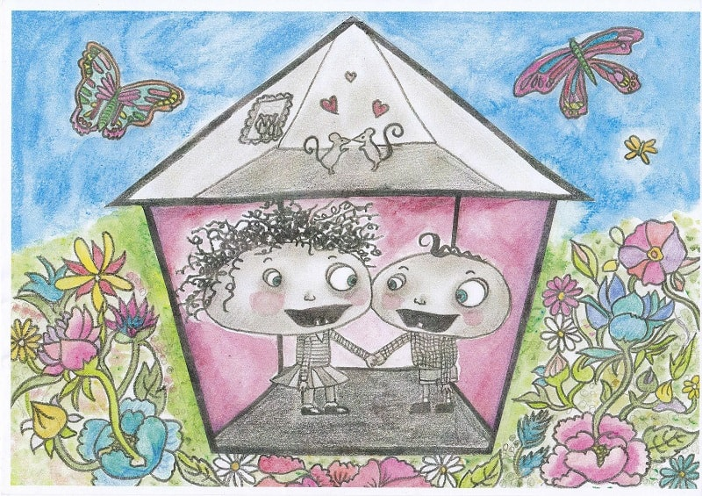
Discussion
There’s no such thing as naughty,
Watch this Ted Talks video and let’s discuss!
https://www.youtube.com/watch?v=bM6Kb2q8Dho

Slide 15
The Evidence
What good practice looks like in reality?
This example is underpinned by research into mixed ability classrooms and the informed practice on behaviour management to develop learning of mixed ability classes (University College London, 2020)
https://www.ucl.ac.uk/ioe/departments-and-centres/centres/best-practice-grouping-students/developing-best-practice-mixed-attainment-english-teaching
(UCL, 2020)

Slide 16
Reflective Practice
‘Reflective Practice’ according to Schön (1983) is defined as,
‘..a process of reviewing an experience from practice in order to describe, analyse and evaluate and so informs learning from practice’
(Reece et al, 2007)

Slide 17
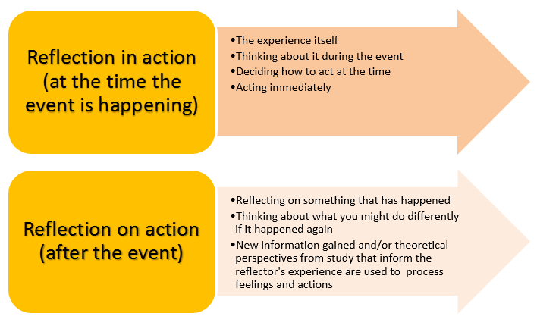
Schön
Pros
  Professional model: gaining professional artistry and increasing professional confidence.
Cons
  highlights the difference between the two types of reflection but does not provide extensive guidance for carrying out either
Notes:
Reflection-in-action, sometimes described as 'thinking on our feet', is the process that allows professionals to reshape the situation or activity on which they are working while it is unfolding. It is generally associated with the experience of surprise: Schon suggests that, by "reflecting-in-action", professionals reflect on unexpected experiences and conduct 'experiments' which serve to generate both a new understanding of the experience and a change in the situation.
Reflection-on-action involves reflecting on an experience, situation or phenomenon after it has occurred. When professionals "reflect-on-action" they explore what happened in that particular situation, why they acted as they did, whether they could have acted differently, and so on. Reflection-on-action is often associated with reflective writing in which professionals reflect on their experiences and examine alternative ways to improve their practice.

Slide 18

How Reflective Practice Impacts Upon Individual Behaviour
The qualities and characteristics of a teacher, combined with the experiences and cultures gained will impact upon what is achieved in the classroom
Outcomes are determined by knowledge, understanding and beliefs about behaviours
The appropriateness of any strategy or intervention on pupil/s and relevance to parents
Need to specify why certain behaviours are expected in accordance with school policies etc.
Notes:
Each teachers personality traits and experiences are unique to themselves and therefore will shape and mould the learning environment according to these.
The ability to reflect and the outcome of such reflection on behaviour is determined by the knowledge, understanding and beliefs held by teachers surrounding behaviour.
Necessary to inform pupils of required behaviours in accordance with school policies regarding rights, responsibilities, safe guarding and health and safety standards.
Equally reflection will require teachers to assess the suitability and the implementation of any intervention/strategy to support learning and to consider the relevance of this adoption for the pupil and parent alike. (Lever, 2011)
Concern that reflection merely serves the meeting of standards and competencies required of the teaching practice, rather than reporting on the histories, systems and conditions pertinent to the setting.
Equally the sharing of practices and experiences between practitioners is constrained due to the extent of exposure to these other sources of information,

Slide 19
Reflection and Behaviour
Being aware of own approach to behaviour management and their own non-verbal communication
Being aware of our behaviours, modelling requirement and how they impact upon others
Being consistent, detaching the behaviour from the individual
Operating within the framework of behaviour policy of the setting
Reflective practice will help to inform Individual Development Plans IDP)
Recognise when additional training and support is needed to manage behaviour
Notes:
According to Rogers (2011) some practitioners have an inherent ability to manage challenging behaviours, due to their perceptive and vigilant and intuitive personalities, however others with less accommodating personalities will require further training and support in this area. In the development of IDP’s where pupils are diagnosed with an additional learning need it is recommended that extreme behaviours be addressed so as to avoid double standards to other pupils.
The development of an IDP needs to be designed using a team approach or whole school approach or multi agency in School Action plus level, to ensure consistency and an informed practice. (Rogers, 2011)

Slide 20
Case Studies
Ben, aged 9, had difficulties controlling his behaviour both inside and outside the classroom. He was very aggressive towards other children and showed staff little or no respect. Teachers often commented how unhappy he looked. His teacher realised that his behaviour was linked to his lack of self-esteem and self-worth. She established this through other staff who often commented how unhappy he looked. During circle time sessions when he was asked to say something positive about himself he either refused or replied with a negative comment, for example “I don‘t like being me”

Slide 21
Case Studies
Darren is ten years of age. He started missing school occasionally at the age of seven. He was reported for being absent repeatedly at the age of nine. His parents repeatedly made excuses for him claiming that he was ill, often with colds or flu. Eventually, the school contacted the education welfare officer who made a home visit. She spoke to Darren and his mother. It turned out that Darren was being repeatedly bullied both physically and verbally. He was often too afraid to go to school. Further investigations showed that he was also the subject of bullying on the school bus to and from school and in the yard during playtimes. His mother had taken him home to see her general practitioner twice following bouts of physical bullying. Darren believed that by reporting the boys who bullied him, he would be subjected to more serious bullying. His mother was also concerned about being victimised within the local community. The bullying started because Darren was smaller than his peers, overweight and not so good at sporting activities

Slide 22
Case Studies
Janine is nine years old. She started missing school at the age of five without good reason. Her mother always condoned her absences and made plausible excuses for her. Following the intervention of her school after the absences became more frequent and prolonged, Janine was found by the education social worker to be living in a caravan with her mother and her boyfriend some 30 miles away from the school‘s catchment area. The conditions inside the caravan concerned the education social worker so much she reported the case to the social services department

Slide 23
Learning outcomes:
To critically examine how the practitioner’s behavior can influence the classroom environment.
To explore how reflective practice can influence individual behavior in the classroom.

Slide 24
Next week -
Monday (Teams) session 7 - Behaviour management programmes in Primary school
Thursday AM (face-to-face) session 8 - Behaviour management programmes in Secondary school and post-16
Thursday PM (face-to-face) assignment and tutorials

Slide 25
References
Adams, K (2009), Behaviour for Learning in the Primary School, Exeter, Learning Matters Ltd.
Denby, N (2012), Training to Teach, London, Sage Publications Ltd.
Ellis, S & Tod, J (2015), Promoting Behaviour for Learning in the Classroom, London, Routledge.
Lever, C (2011), Understanding Challenging Behaviour in Inclusive Classrooms : Harlow, Longman
Reece, I & Walker, S (2007), Teaching, training and Learning, A Practical Guide, Tyne and Wear, Business Education Publishers Ltd.
Rogers, B (2015), Classroom Behaviour: A Practical Guide to Effective Teaching, Behaviour, London, Sage Publications Ltd.
Welsh Government (2012), Practical approaches for behaviour management in the classroom, [Online] Available at; https://gov.wales/sites/default/files/publications/2018-12/practical-approaches-to-behaviour-management-in-the-classroom-a-handbook-for-classroom-teachers-in-primary-schools.pdf (Accessed 4th March 2020)

