Slide 1
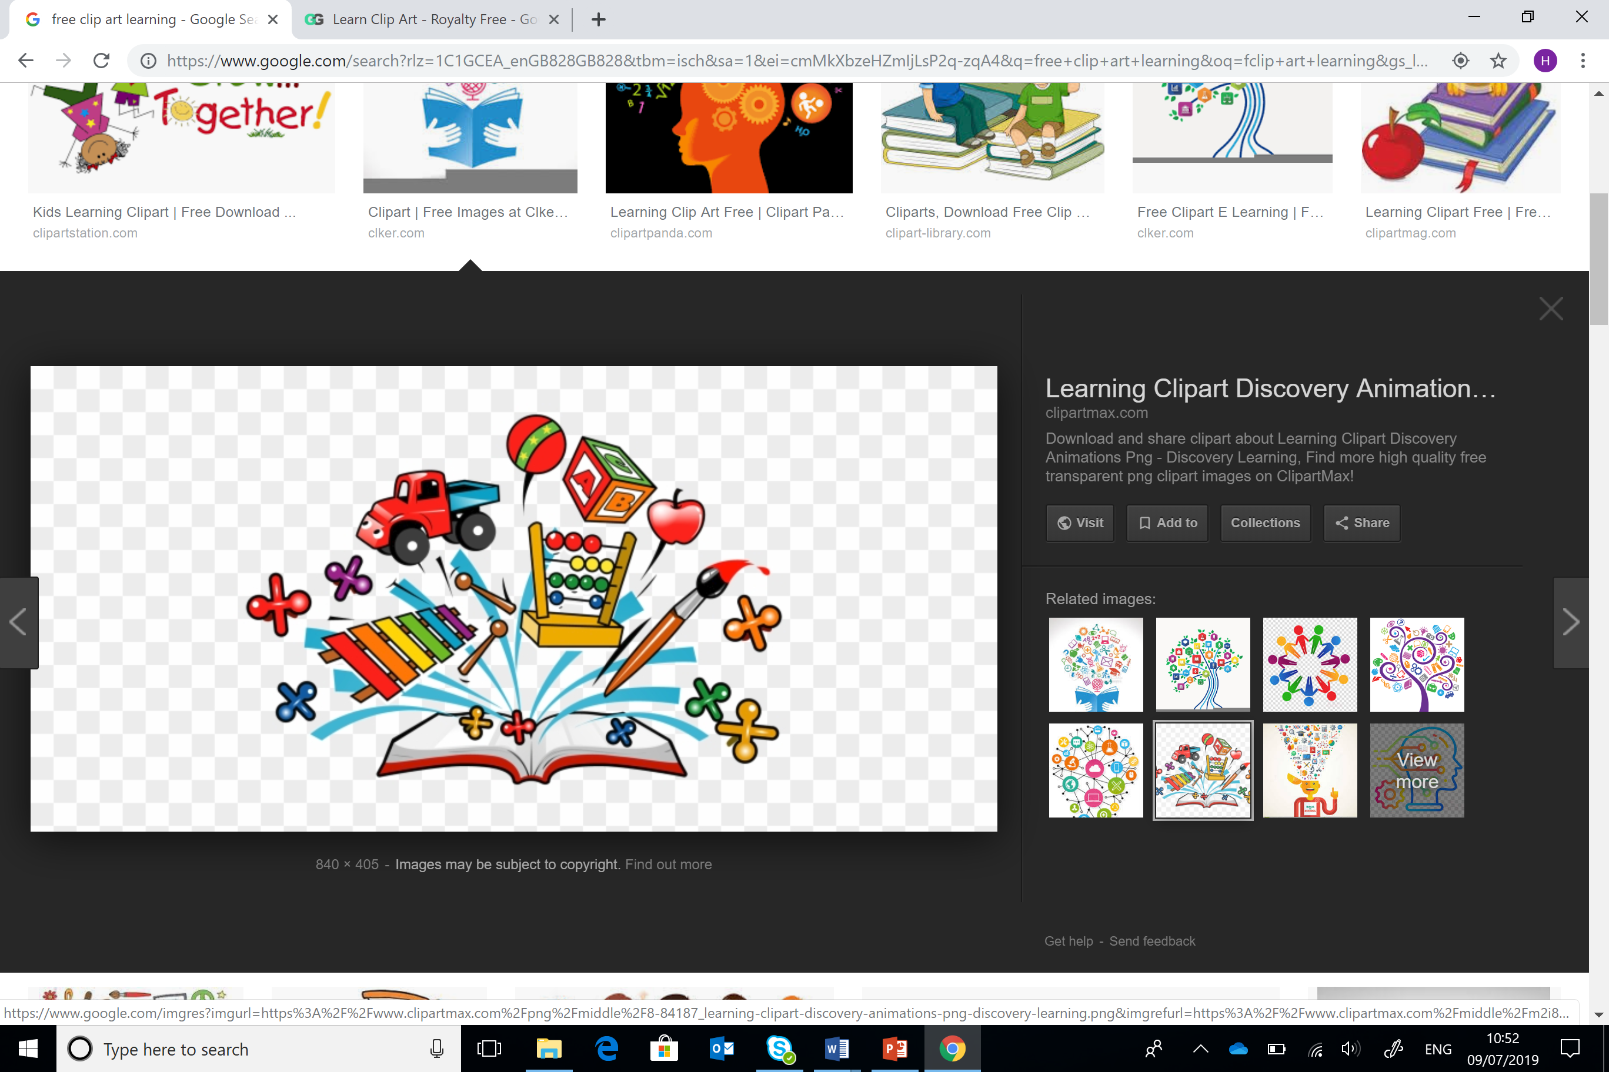
Damcaniaeth Dysgu ac Ymarfer
Learning Theory and Practice
ECES4010/C
Wythnos 1 Sesiwn 2
Week 1 Session 2
Piaget

Slide 2
Gorolwg Sesiwn / Session Overview
Piaget
Relevant learning outcome
Relevance to assignment
Piaget
Deilliant dysgu perthnasol
Perthnasedd i’r aseiniad

Slide 3

Adnoddau modiwl benodol
Module specific resources
Sleidiau darlith
Ymchwil
Tutalen Moodle
Llyfrgell ac Adnoddau Dysgu:
Rhestrau darllen ar-lein
Rhaglen Infoskills
Hanfodion Myfyrywr
Google Scholar
Lecture slides
Research
Moodle page
Library and Learning Resources:
Online resource lists
Infoskills programme
Student Essentials
Google Scholar

Slide 4

Sgiliau Cyflogadwyedd / Trosgwlyddadwy
Employability / Transferable Skills
Cynllunio
Trefnu
Datrys Problemau
Cydweithio
Ymchwilio
Cymryd nodiadau
Cyfathrebu
Hyblygrwydd
Planning
Organising
Problem Solving
Collaborating
Researching
Note taking
Communication
Adaptability
#OAstudiaethiGyflogaeth
#FromHigherEdToHired

Slide 5
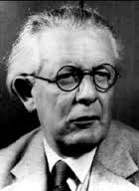
Un ddamcaniaeth seicolegol berthnasol
One relevant psychological theory
Jean Piaget
1896-1980
O’r Swisdir / From Switzerland
1921- cyhoeddi ei erthygl gyntaf am allu
1921- publication of his first article on intelligence
(Boeree,2006)

Slide 6

Datblygiad Gwybyddol
Cognitive Development
Canolbwyntio ar y prosesau gwaelodol sydd yn cyfrannu at sut mae plant yn dechrau
Prosesu gwybodaeth
Datblygu dealltwriaeth cysyniadol
Rhesymu a datrys problemau
Focuses on underlying processes that contribute to how children begin to…
Process information
Develop conceptual understanding
Reason and problem solve

Slide 7

Credai bod natur a magwraeth yn rhyngweithio i greu datblygiad gwybyddol
Caiff plentyn ei eni gyda chynllun gwybyddol sydd yn ‘datblygu’ wrth i’r plentyn aeddfedu
Mae’r amgylchedd yn angenrheidiol er mwyn darparu’r ysgogiad i alluogi sgiliau i ddatblygu
Piaget believed that nature and nurture interact to yield cognitive development
Child is born with inborn plan for cognitive development which unfolds as the child matures
The environment is necessary to provide stimulus to allow these skills to develop

Slide 8

Datblygiad gwybyddol yn digwydd drwy gyfres o gamau hierarchaidd
Plant fel ‘dysgwyr gweithredol’ yn ymwneud a ‘darganfod yr hunan’
Cognitive development occurs through series of universal hierarchical stages
Children as “active learners” engaging in “self-discovery”

Slide 9
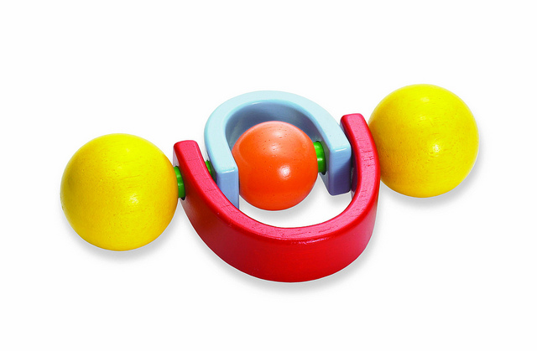
Sgemau Schemas
Gelwir y dull o drefnu a phrosesu gwybodaeth yn sgema
E.e. mae babanod yn ymchwilio eu byd drwy’r sgema o guro pethau
Ways of organizing and processing information are the cognitive structures are called schemas
E.g. banging is a favourite schema used by babies to explore their world

Slide 10
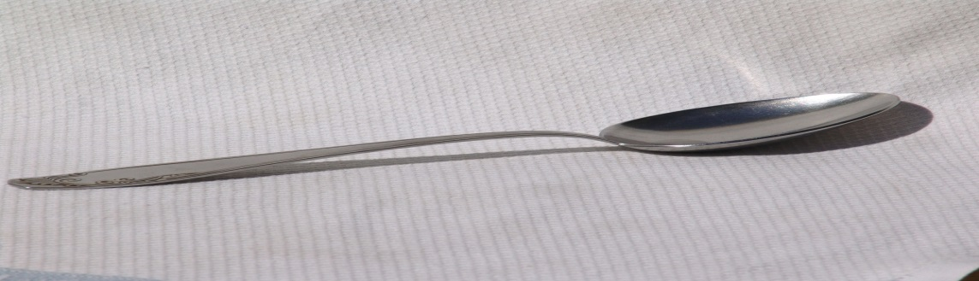
Asimileiddio a Chymhwyso
Assimilation and Accomodation
Asimileiddio – deall profiad newydd / gwrthrych newydd yn nhermau sgema presennol
e.e. gwrthrychau newydd
Assimilation - understanding a new experience / object in terms of an existing schema
e.g. when new objects are incorporated

Slide 11
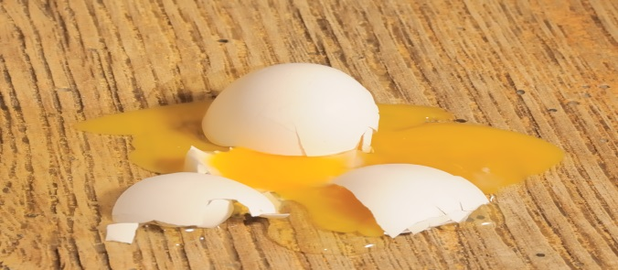
Cymhwyso - cyfaddasu sgema sydd eisoes yn bod
Cydbwysoli- adfer cydbwysedd trwy ddatblygu sgemau newydd neu addasu hen sgemau
Accommodation- modifying an existing scheme
Equilibration - restoring balance by developing new schemes or adapting old ones

Slide 12

Trafodaeth
Discussion
Mewn parau, trafodwch eich profiad o sgemau
Mewn plant
Mewn oedolion
In pairs, discuss your own experience of schemas
In children
In adults

Slide 13
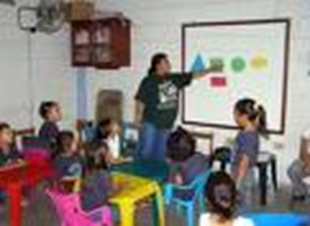
Damcaniaeth Piaget
Piaget’s Theory
Yn cael ei alw’n adeileddol oherwydd mae plant yn adeiladu gwybodaeth eu hunain
Gwelir plant yn:
  Weithredol
  Yn dysgu gwersi pwysig eu hunain
  Wedi ei hysgogi’n gynhenid i ddysgu
Often labeled constructivist because it depicts children as constructing knowledge for themselves
Children are seen as:
  Active
  Learning many important lessons on their own
  Intrinsically motivated to learn

Slide 14

Camau datblygiad Piaget
Piaget’s developmental stages
Datblygiad yn symud drwy gamau hierarchaidd penodol
Newidiadau ansoddol mewn gwybyddiaeth
Plant yn datblygu trwy BEDWAR cam gwybyddol, pob un yn adeiladu ar yr un cynt
Piaget claimed development proceeds in distinct hierarchical stages
Qualitative changes in cognition
Children progress through FOUR stages of cognitive development, each building on the previous one

Slide 15
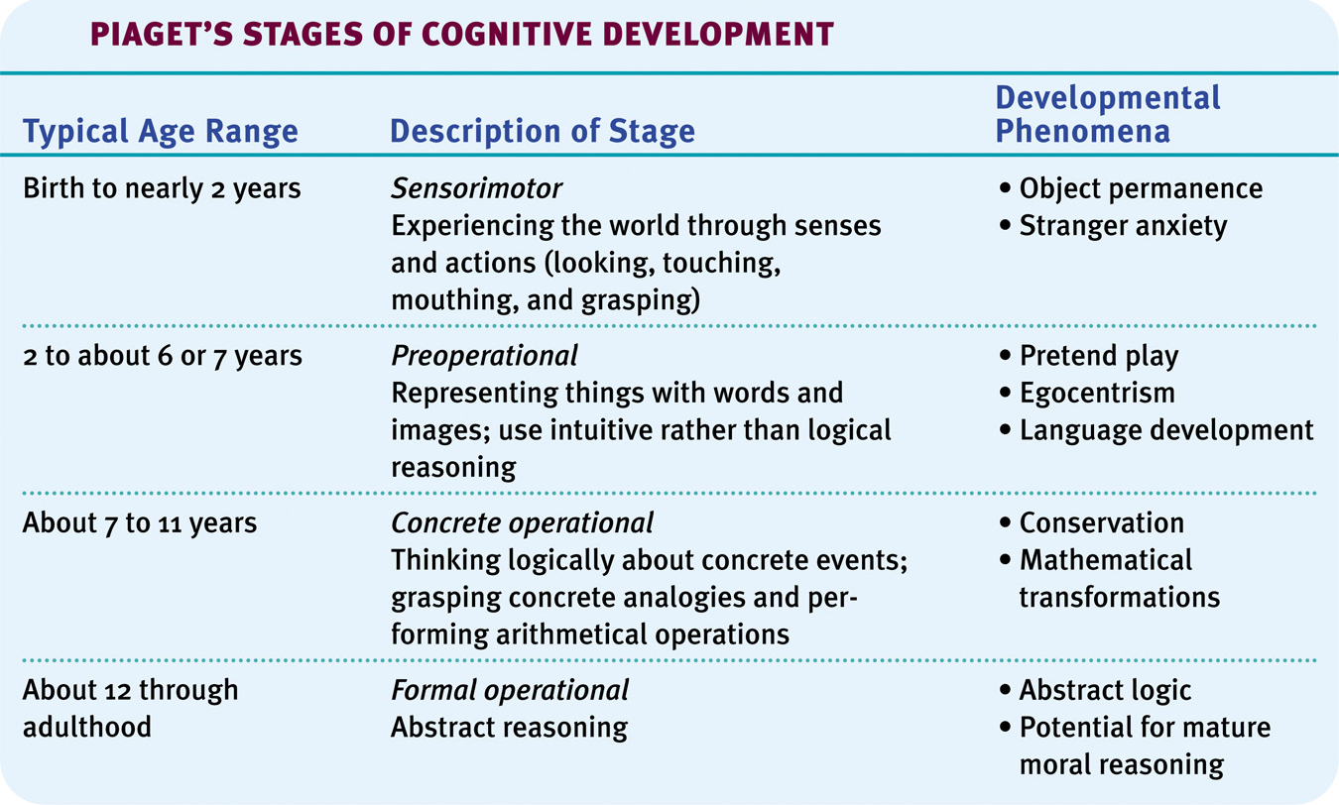
Piaget’s Theory
Damcaniaeth Piaget
Notes:
15

Slide 16
Pre-operational
Cyn-weithredol
Plant heb weithrediadau – y rheolau abstract sydd yn tanategu meddwl rhesymegol oedolyn
O ganlyniad, mae eu meddwl yn anghyson ac yn afresymol o safbwynt oedeolyn
They lack operations – abstract rules that underpin adult logical thinking
As a result their thinking tends to be inconsistent and irrational from an adult’s perspective

Slide 17
Cyfyngiadau ar feddwl plentyn cyn-weithredol
  Egosentraeth
  Animistiaeth
  Canoli
Plant yn parhau i ddatblygu cynrychiolaeth fewnol o'r byd drwy addasu a chymryd i fewn profiadau newydd
Limitations on a pre-operational child’s thinking include:
  Egocentrism
  Animism
  Centration
Children continue to develop their internal representations of the world through adaptation and accommodation of new experiences

Slide 18

Yn ôl Piaget
According to Piaget
Nid yw plant ifanc yn deall fod gan eraill olwg wahanol o’r byd
Tybiant fod pawb arall yn medru gweld beth fedran nhw
Dydy’r egosentraeth yma ddim yn diflannu yn llwyr nes bod y plentyn yn 7 neu 8 oed
Young children do not understand that others have a different view of the world from theirs
They assume that anyone else can see what they can see
This egocentrism does not disappear fully until the child is 7 or 8 years old.

Slide 19



Profi egosentraeth
Tests of egocentrism
1. Three mountains task (Piaget & Inhelder, 1956)
https://www.bing.com/videos/riverview/relatedvideo?q=three+mountains+task+youtube&mid=86661DDE4C5F2DEE4D0E86661DDE4C5F2DEE4D0E&FORM=VIRE
2. Turntable task (Borke,1975)
3. Boy and policemen task (Hughes, 1975)
Task – find out more about task 2 and 3

Slide 20
Beirniadaethau o’r dasg
Criticisms of the task
Modelau Piaget â diffyg nodweddion amlwg i alluogi plant i wahaniaethu un ochr i'r llall
Gallai'r dasg o ail adeiladu’r arddangosfa, neu o ddewis y lluniau addas fod yn rhy anodd i blentyn ifanc
Piaget’s models lacked salient characteristics that could allow children to differentiate one view from the next
The task of reconstructing the display, or choosing the appropriate drawings may be beyond the ability of a young child

Slide 21

Animeiddiaeth
Animism
Y plentyn yn credu fod popeth yn ymwybodol h.y. â theimladau
e.e. y car ddim yn dechrau gan ei fod wedi blino neu’n sal
The child believes that everything is conscious i.e. everything has feelings
e.g. the car won’t start because it is sick or tired

Slide 22

Canoli
Centration
Ffocysu ar un agwedd o gyd-destun tra’n anwybyddu’r lleill – dyma lle mae’r egwyddor gwybyddol o gadwraeth yn dod
This involves focusing on one aspect of a context whilst ignoring others – this is where the cognitive principle of conservation arises

Slide 23
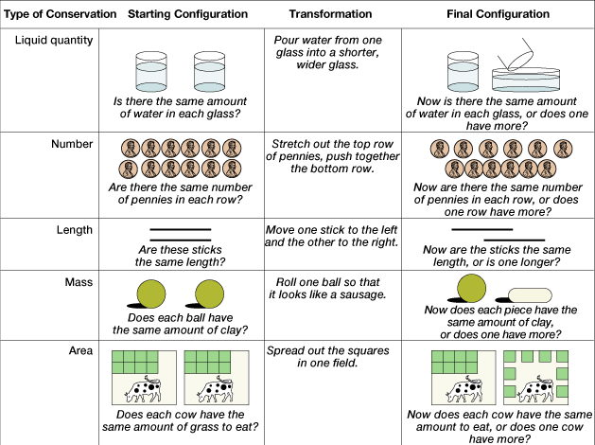
Tasg Cadwraeth
Conservation Tasks
http://www.youtube.com/watch?v=gnArvcWaH6I

Slide 24
Meddwl cyn-weithredol a’r her o gadwraeth
Pre-operational thinking and problems of conservation
Pam mae plant cyn weithredol yn methu tasgau cadwraeth?
Oherwydd nid yw eu meddyliau yn cael eu rheoli gan egwyddorion tu chwith, cyfadferiad a hunaniaeth
Why do pre-operational children fail problems of conservation?
Because their thinking is not governed by principles of reversibility, compensation and identity

Slide 25
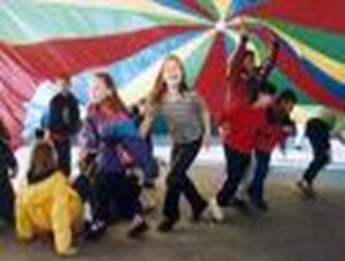
Pe byddai plant yn defnyddio’r egwyddorion hyn, byddet yn dod i’r canlyniad y cedwir yr hylif
Ni chânt eu rheoli gan weithrediadau rhesymegol
Felly yn ‘egosentrig’ ac yn reddfol
If children applied these principles, they would conclude liquid is conserved
Not governed by logical operations
Consequently, it appears egocentric (e.g., 3 mountains task) and intuitive (e.g., conservation tasks)

Slide 26
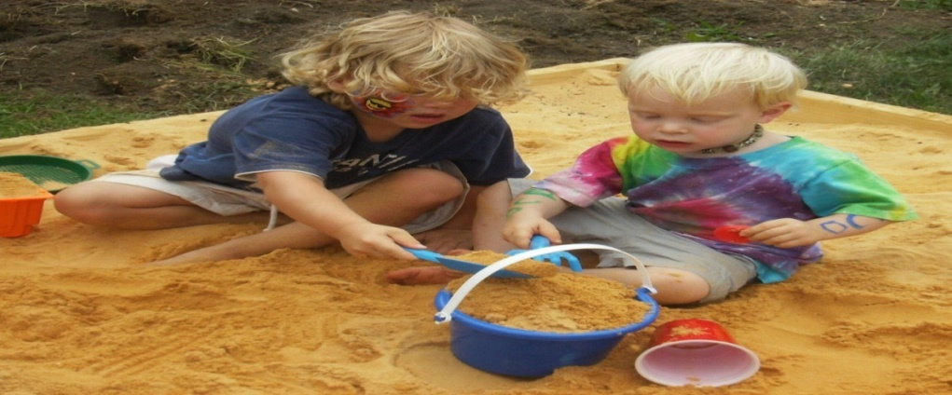
Tasg / Task
Mewn parau, ystyriwch enghreifftiau o weithgareddau yn y Cyfnod Sylfaen ac esboniwch pam fod rhain yn addas ar gyfer plentyn yn y cyfnod cyn-weithredol
In pairs, consider examples of activities in a Foundation Phase setting and explain why these are suitable for a pre-operational child

Slide 27
Goblygiadau Addysgol 1
Educational Implications 1
Defnyddio adnoddau a deunydd gweledol lle’n bosib
Cadw cyfarwyddiadau’n fyr gn ddefnyddio symudiadau yn ogystal â geiriau
Peidio disgwyl disgyblion i weld y gyd o safbwynt pobl eraill yn gyson
Bod yn ymwybodol i'r posibilrwydd efallai fod gan ddisgyblion ystyron gwahanol am yr un gair neu eiriau gwahanol am yr un ystyr.
Use of concrete props and visual aids whenever possible.
Make instructions relatively short, using actions as well as words.
Do not expect the students to consistently see the world from someone else’s point of view.
Be sensitive to the possibility that students may have different meanings for the same word or different words for the same meaning.

Slide 28
Rhoi digon o gyfle i blant i ymarfer sgiliau penodol ymarferol fydd yn gosod y sylfaen ar gyfer tasgau mwy cymhleth fel darllen a deall.
Darparu amrediad eang o brofiadau er mwyn adeiladu sylfaen gadarn i ddysgu iaith a chysyniadau
Give children a great deal of hands-on practice with the skills that serve as building blocks for more complex skills like reading comprehension.
Provide a wide range of experiences in order to build a foundation for concept learning and language.
(McLendon, 2011)

Slide 29
Concrit gweithredol
Concrete operational (7-11)
Dal wedi eu gwreiddio yn y byd concrid
Yn cael trafferth i feddwl yn haniaethol
Flavell (1986 in Slavin 2009, p.37)
An earthbound, concrete, practical-minded sort of problem-solving approach… a theorist the elementary school child is not
Still very much rooted in the concrete world
Have difficulty with abstract thought
Flavell (1986 in Slavin 2009, p.37)
An earthbound, concrete, practical-minded sort of problem-solving approach… a theorist the elementary school child is not

Slide 30

Cyfresiad yn datblygu- y gallu i drefnu pethau yn rhesymegol
e.e. lleiaf i'r mwyaf
Medr trosiad wedyn ddatblygu h.y. adnabod cysylltiadau rhwng dau beth yn seiliedig ar wybodaeth am y trydydd e.e. mae Tom yn dalach na Ben ac mae Ben yn dalach na Sam felly mae Tom yn dalach na Sam
Seriation develops- the ability to arrange things in logical progression
e.g. smallest to largest
Transitivity can then develop i.e. inferring relationships between two objects on the basis of knowledge of a third e.g. Tom is taller than Ben and Ben is taller than Sam therefore Tom is taller than Sam
( Slavin,2009)

Slide 31

Plant yn symud o feddwl egosentrig i feddwl gwrthrychol
Medr plant weld fod eraill yn medru cael canfyddiadau gwahanol
Children move from egocentric thought to decentred or objective thought
Allows children to see that others can have different perceptions
( Slavin, 2009)

Slide 32

Tasg / Task
Mewn parau, ystyriwch sut mae’r weithgaredd ganlynol yn addas ar gyfer plentyn yn y cyfnod concrid gweithredol
In pairs, consider how the following activity is suitable for a child in Piaget’s concrete operational stage

Slide 33
Goblygiadau Addysgol 2
Educational implications 2
  Defnyddio cyfarpar gweledol a modelau
  Darparu cyfleoedd i drafod materion cymdeithasol, gwleidyddol a diwylliannol
  Dysgu cysyniadau eang yn hytrach na ffeithiau a’u lleoli o fewn cyd-destun ystyrol a pherthnasol i’r dysgwr.
  Use visual aids and models
  Provide opportunities to discuss social, political, and cultural issues
  Teach broad concepts rather than facts, and to situate these in a context meaningful and relevant to the learner

Slide 34
Goblygiadau Addysgol 3
Educational implications 3
Darparu cyfleoedd i
  ddosbarthu a grwpio gwybodaeth fwyfwy cymhleth
  ddefnyddio amlinelliadau a hierarchaeth i hwyluso cymhwyso gwybodaeth newydd gyda hen wybodaeth
Allow opportunities to
  classify and group information with increasing complexity
  use outlines and hierarchies to facilitate assimilating new information with previous knowledge

Slide 35
Goblygiadau Addysgol 4
Educational implications 4
  Mae ‘dysgu drwy ddarganfod’ yn rhoi’r cyfleoedd i ddysgwyr ymchwilio ac arbrofi, ac felly hybu dealltwriaeth newydd
  Mae rhoi cyfleoedd sy’n galluogi myfyrwyr o wahanol lefelau gwybyddol i weithio gyda’i gilydd yn aml yn hybu myfyrwyr llai aeddfed i ddatblygu i lefel mwy aeddfed o ddealltwriaeth
  'Discovery learning’ provides opportunities for learners to explore and experiment, thereby encouraging new understandings
  Opportunities that allow students of differing cognitive levels to work together often encourage less mature students to advance to a more mature understanding

Slide 36
Damcaniaeth Piaget yn bwysig iawn o ran y ffordd roedd pobl yn meddwl am ddatblygiadau gwybyddol plant
Datblygiad galluoedd gwybyddol drwy’r rhyngweithiad rhwng natur a magwraeth a’r amgylchedd
Piaget’s theory was hugely important in changing the way people thought about the development of cognitive abilities in children.
Development of cognitive abilities evolves through interaction between innate capacities and the environment

Slide 37
Beirniadaethau o Piaget 1
Criticisms of Piaget 1
Er fod damcaniaeth Piaget yn ddylanwadol hyd heddiw, mae rhai gwendidau nawr yn amlwg
Mae‘r model camau yn ystyried fod meddwl plant yn fwy cyson nag yw e (Seigler,2006)
  Mae plant yn aml yn mynd yn ôl i hen ffordd o feddwl/ymddwyn
Mae babis a phlant yn fwy abl yn wybyddol na gydnabyddwyd gan Piaget
Although Piaget’s theory remains highly influential, some weaknesses are now apparent
  The stage model depicts children’s thinking as being more consistent than it is (Seigler, 2006)
    Child often reverts to old ways of thinking/acting
  Infants and young children are more cognitively competent than Piaget recognised

Slide 38
Beirniadaethau o Piaget 2
Criticisms of Piaget 2
Dywed Huitt a Hummel (1998 ar gael yn Wood, Smith & Grossniklaus, 2014)
  ‘only 35% of high school graduates in industrialized countries obtain formal operations; many people do not think formally during adulthood’.
  Mae hwn yn bwysig yn nhermau datblygu cyfarwyddiadau a deunyddiau cefnogol ar gyfer myfyrwyr sydd yn oedolion, ond efallai yn gyfyngedig yn eu dealltwriaeth o gysyniadau abstract
Huitt and Hummel (1998, in Wood, Smith & Grossniklaus, 2014)
  only 35% of high school graduates in industrialized countries obtain formal operations; many people do not think formally during adulthood’.
  This is important in terms of developing instructions and support materials for adult students, who may be restricted in their understanding of abstract concepts

Slide 39
Beirniadaethau o Piaget 3
Criticisms of Piaget 3
McGonigle, B (1987) wedi gweithio gyda mwncïod
Mwncïod wedi dysgu trefnu maint, siap a lliw hyd at 12 gwrthrych ar sgrin
Yn cyfateb i lefel datblygiad plentyn 6-7 oed
Y tro cyntaf i hyn gael ei weld mewn anifail
‘The monkey did it!’
McGonigle (1987) worked with monkeys
They learnt how to organise the size, shape and colour of up to 12 objects on screen
This reflects a 6-7 year old child development
The first time that this has been demonstrated in animals
‘The monkey did it!’

Slide 40
Ffactorau cymdeithasol
Social factors
Damaniaeth Piaget yn anwybyddu rôl ffactorau cymdeithasol mewn datblygiad dysgu a gwybyddiaeth
Gweld y plentyn fel ‘gwyddonydd’ datblygol- yn datblygu ar wahan i'w fyd cymdeithasol
Damcaniaeth Vygotsky yn canolbwyntio ar ddatblygiad plant fel proses cymdeithasol
Piaget’s theory ignores the role of social factors in learning & cognitive development
Saw child as a developing “scientist” – developing independently from its social world
Vygotsky’s theory in contrast focuses on child development as a social process

Slide 41
Newidiadau i ddamcaniaeth Piaget
Changes to Piaget’s theory
  Y camau oedran wedi eu adolygu yn sgil ymchwil
  Y syniad o newid yn ôl i gamau blaenorol yn debygol
Dull Vygotsky yn ystyried rôl pwerus prosesau cymdeithasol
  The age bands have been reviewed in light of modern research
  The idea of movement back to prior stages is likely
Vygotsky’s approach takes into account the powerful role of social processes

Slide 42
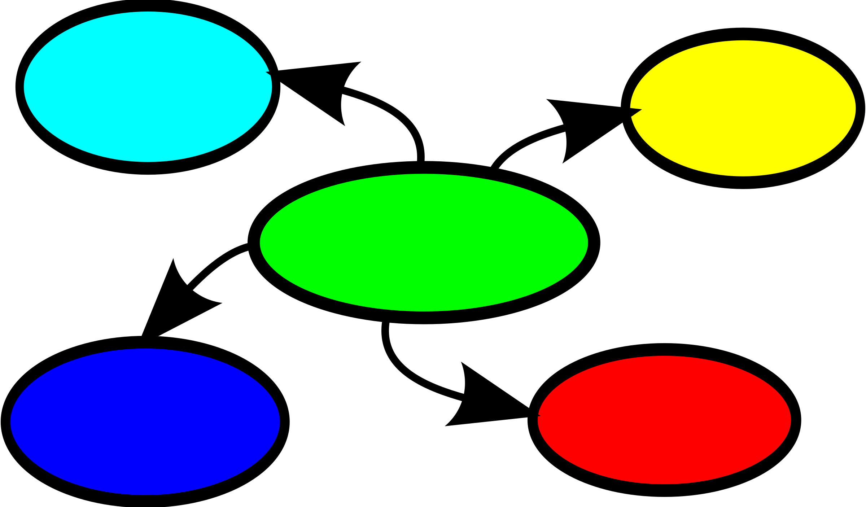
Tasg Map Meddwl
Mind Map Task
Damcaniaeth Piaget o fewn amgylchedd dysgu ac addysgu
Piaget theory within a teaching and learning environment

Slide 43
Llyfryddiaeth References
Boeree, C.G. ( 2006) Jean Piaget 1896 - 1980 Biography. Available at http://webspace.ship.edu/cgboer/piaget.html [ Accessed 23.6.17]
Borke, H. (1975) Turntable Task. Available at https://psycnet.apa.org/record/1975-20825-001 (Accessed 23.01.2023)
Hughes, M. (1975) Policeman Doll. Available at https://quizlet.com/gb/602524140/developmenthughes-policeman-doll-study-1975-flash-cards/ (Accessed 23.01.2023)
McGonigle, Brendan O. (1987) Non-verbal thinking by animals? Nature. Vol 325(7000) Jan 1987, 110-112.
McLendon, K. (2011) Jean Piaget: Cognitive Development in the Classroom. Available at https://www.funderstanding.com/educators/jean-piaget-cognitive-development-in-the-classroom/ (Accessed 23.01.2023)
Seigler, R.S ( 2006) Chapter 11 Microgenetic Analyses of Learning. Available at http://www.psy.cmu.edu/~siegler/siegler06hnbk.pdf [ Accessed 23.6.17]
Slavin, R.E. ( 2009) Educational Psychology. Theory and Practice. New Jersey: Pearson.
Wood, K.C., Smith, H. & Grossniklaus, D. (2014) Piaget’s Stages of Cognitive Development. Available at https://www.researchgate.net/publication/281578915_Piagetian_and_Vygotskian_Approaches_to_Cognitive_Development_in_the_Kindergarten_Classroom (Accessed 23.01.2023)
Image of Piaget ( 2006) Available at http://webspace.ship.edu/cgboer/piaget.html [ Accessed 23.6.17]

