Slide 1
Marketing Plan for Six Senses Resort
Eunice Gredia Tumi
2214171 BMH4005
Presentation

Slide 2
CONTENT
INTRODUCTION---------------------------------------------------------------------------------------------2
MARRIOT HOTEL AND SIX SENSE MOROCCO--------------------------------------------------------3
MISSION STATEMENTS AND OBJECTIVES--------------------------------------------------------------4
VISION--------------------------------------------------------------------------------------------------------5
ORGANIZATION--------------------------------------------------------------------------------------------6
ETHICAL VALUES-------------------------------------------------------------------------------------------7
STRATEGY---------------------------------------------------------------------------------------------------8
S.W.O.T ANALYSIS-----------------------------------------------------------------------------------------9
SOSTACT MODEL-----------------------------------------------------------------------------------------10
3D BUILDING OF SIX SENSES--------------------------------------------------------------------------11
MARKET OPPORTUNITIES----------------------------------------------------------------------------12
COMMUNICATION STRATEGY------------------------------------------------------------------------13
REFERENCES-----------------------------------------------------------------------------------------------14

Slide 3
SOSTAC MODEL
Situation - This session emphasis on finding the current state of affairs in an organization and must answer the question ‘Where are we now?’ The present place of Six Sense hotel and Spa will be located in Accra.
Objective – We will patterner with companies where possible to increases our environmental goals, inviting customers, suppliers and contractors to participate in our efforts -
Strategy – We will use group bookings, direct books, destination marketing, cross promotion sales, guest rewards strategies and revenue management strategies.
Tactics- Six Sense sales strategies are: group bookings, direct bookings, destination marketing, cross promotional sales, guest rewards strategies, revenue management strategies. Other room selling techniques might include upselling, cross-selling, packages, promotions, re-marketing, and local partnerships.
Action Plan - This chapter presents the contents of the action plan- the final product of the project, which is created to help the case hotel to apply revenue management without the use of complicated and expensive Revenue Management System. The chapter is divided into two subchapters. The first subchapter is dedicated to visions, desirable results and guiding principles of the action plan. The second subchapter presents the stages, strategic objectives and key activities groups of the action plan.

Slide 4
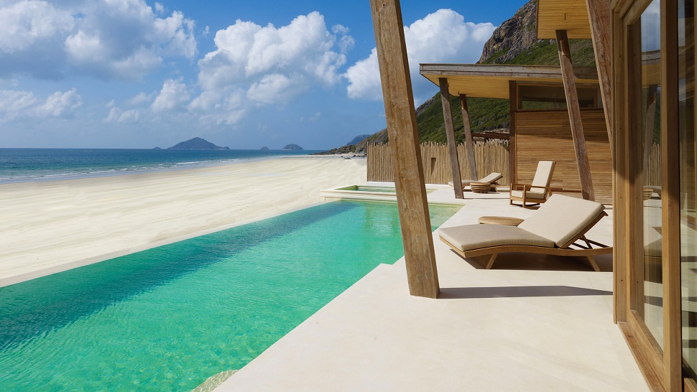
INTRODUCTION
Six Senses Hotel resorts Spas operates 11 resorts and 29 spas in 20 countries under the brand names Six Senses, Evason and Six Senses Spas. Six senses Resort and Spa have grown since the story began in 1995, but have based each chapter on the same ambition: to journey beyond destinations into new experiences and cultures. www.sixsenses.com (3rd March,2023)
Aggressive development plans will triple the portfolio over the next five years with resort, hotel and spa openings underway in Austria, Bhutan, Cambodia, China, Egypt, Fiji, France, India, Indonesia, Italy, Nicaragua, Switzerland, Taiwan, Thailand, Tunisia, United Arab Emirates and United States.www.sixsenses.com 3rd March (2023)
In the process of expansion of Six senses Resort and Spa, It will be purposeful to consider a location in the Sub-Saharan Region of Africa, e.g. Ghana West Africa. The Sub-Sahara African region enjoys the same climate conditions as Morocco of which Six Senses is already established in. A marketing plan for Six Senses to be establish in Ghana West Africa would also allow Six Senses to be in competition with Marriot International Hotel which has recently establish a Brand in Accra – Ghana.

Slide 5
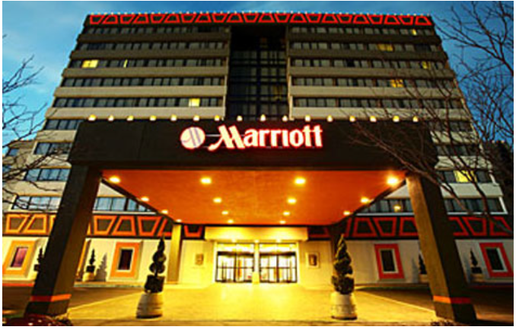
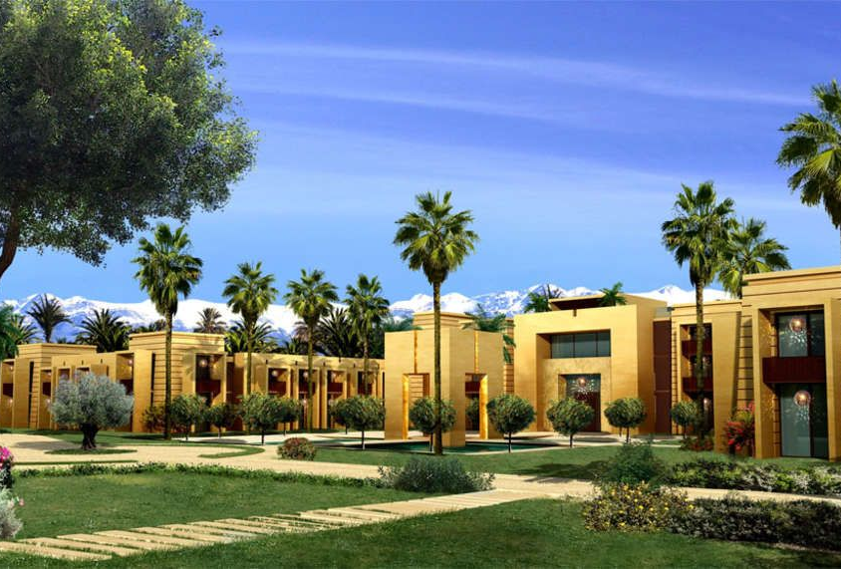
Marriot Hotel-Accra Ghana
Six Sense-Morocco

Slide 6
MISSION STATEMENT & OBJECTIVES
"The mission of our hotel is to provide outstanding lodging facilities and services to our guests. Our hotel focuses on individual business and leisure travel, as well as travel associated with groups meetings .
As with any other for-profit business, the hotel and tourism industry's primary goal is to make a profit. Our hotel focuses on individual business and leisure travel, as well as travel associated with groups meetings . we emphasise high quality standards in our rooms and food and beverage divisions.

Slide 7
VISION
The ideology of our vision is to continue to apply and set the highest standards of service quality and in that way justify and uphold the reputation that we have among the guests, partners, competitors and the wider community. We use and constantly introduce environmentally friendly technologies and processes in order to remain in balance with nature and also meet the needs of contemporary society. Tradition is a testament to our success but in the future we also want to embrace the changes that modern time brings and become more attractive in the market and more interesting to our guests and partners.

Slide 8
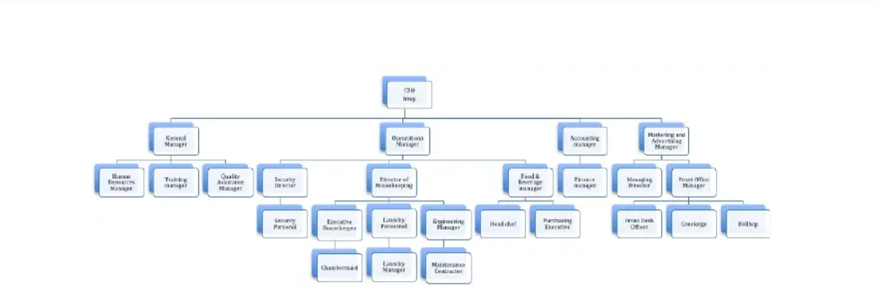
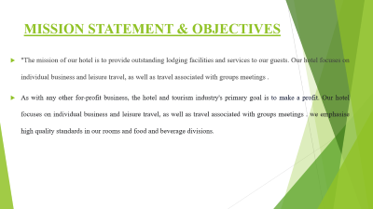
ORGANIZATION CHART
Six Senses Resort Spar will consist of two levels of management with sub-division of their employees that they would be responsible for. As business grows more further, more employees would be needed in our daily operations.

Slide 9
ETHICAL ISSUES
Our services will be provided with high quality and reasonable prices. Environmentally friendly is our priority in operating the business.
(a). Customers - We will treat all customers fairly and gentle by charging them with reasonable prices. We will consider customers as our guests and serve them with pleasure to have them feel very delightful.
(b). Quality - We focus on quality rather than just seeking for profits. Each and every of our products and services will be of high quality and hygienic. To provide services to customers from heart is our obligation.3.
(c). Environment - We will try to be environmentally friendly as well as try to promote “Green marketing” to our customers.

Slide 10
STRATEGY-Our Strategy is based on
PARTNERSHIP WITH GUESTS- Guest satisfaction is the most important thing for us and we try with our quality of services to exceed our expectations. Our goal is to make every guest feel like at home and that for this reason he or she chooses Six Senses Resort and Spa again for their accommodation facility. We provide services at the highest level that will meet the needs and expectations of guests and will recognize their requirements through open communication, satisfaction monitoring and analysis of compliments and complaints.
EMPLOYEES - Accepting new knowledge and technologies is a condition for progress including quality training and education. Because of that our strategy is based on the education and training of all employees and constant communication between all departments of the hotel. We support teamwork, personal responsibility and initiative of each employee.
RELATIONS WITH SUPPLIERS - Purchase as one of the most important departments in the hotel requires a choice of reliable suppliers that allows us to provide the guest, who is the end-user of services, with highest quality and more adequate accommodation in the Hotel. We will base our relationship with suppliers on mutual interests and on the development of good partnership.
SATISFACTION OF INTERESTING PARTIES – Six Senses Resort and Spa will improve the volume and structure of hospitality services, thereby satisfying the wishes and expectations of all parties: guests, business partners, travel agencies, NGO, government and sports institutions, employees, owners and suppliers.

Slide 11
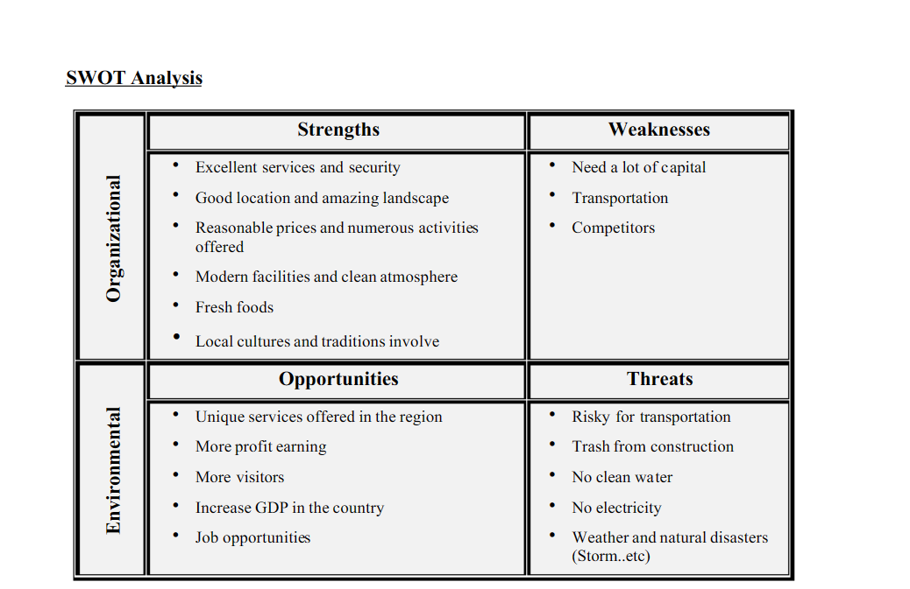
S.W.O.T ANALYSIS

Slide 12
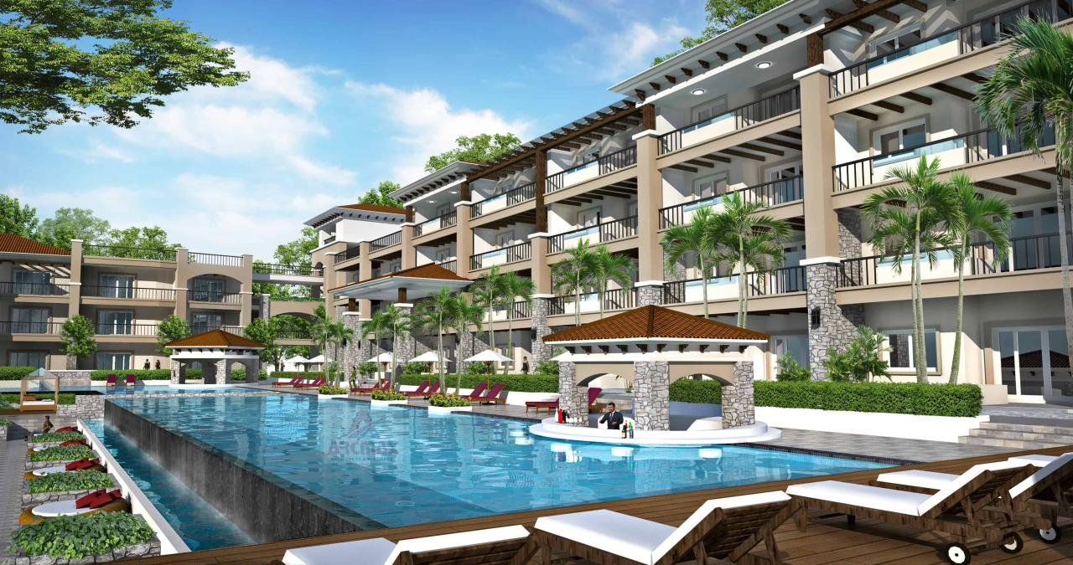
BUILDING OF SIX SENSES RESORT SPA

Slide 13
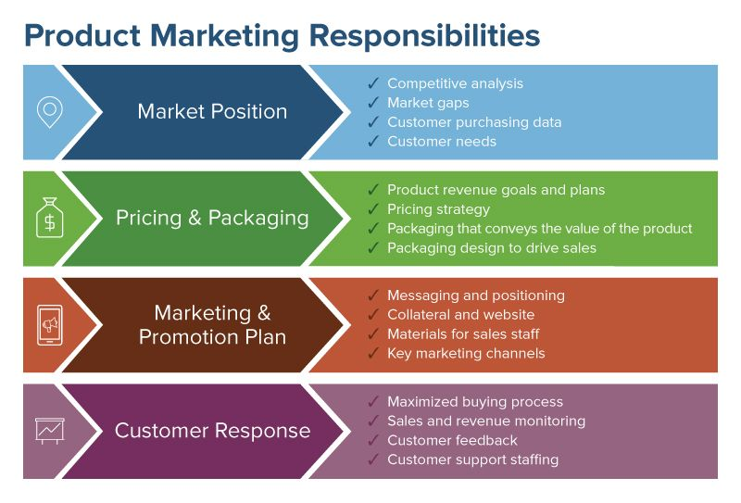
MARKET OPPORTUNITIES

Slide 14
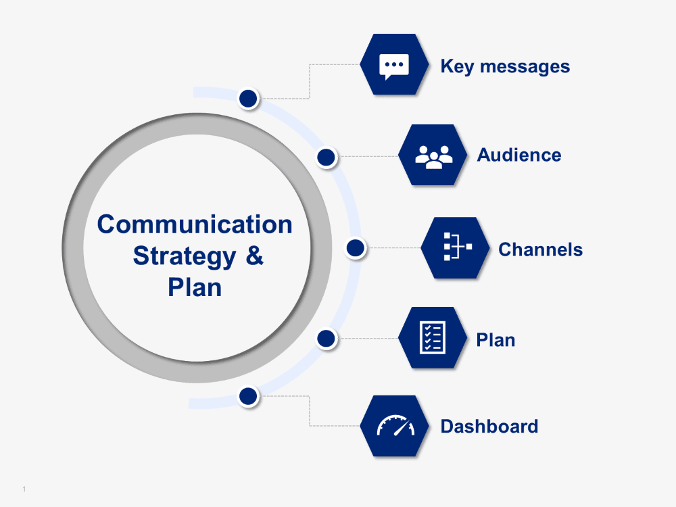
COMMUNICATION STRATEGY

Slide 15
APPENDIX
Fig.1. MARRIOTE HOTEL, ACCRA - GHANA
Fig.2. SIX SENSE - MOROCCO

Slide 16
APPENDIX Continuation
Fig.3. ORGANIZATION CHART
Fig.4. SWOT ANALYSIS

Slide 17
APPENDIX Continuation
Fig.5. SIX SENSE RESORT, GHANA PROPOSED
Fig.6. PRODUCT MARKETING RESPONSIBILITIES

Slide 18
APPENDIX Continuation
Fig.8

Slide 19
REFERENCES
https://arcmaxarchitect.com/hotel-design-and-hotel-building-plans.
(6) Paradise Island Resort_ A Completed Business Plan | Charaxine Pich - Academia.edu
hhttps://www.siteminder.com/r/hotel-distribution/hotel-revenue-management/strategies-increase-hotel-room-sales/#:~:text=Six%20essential%20hotel%20sales%20strategies,%2Dmarketing%2C%20and%20local%20partnerships.
ttps://www.smartsheet.com/sites/default/files/styles/full_width_desktop/public/IC-Product-Marketing-Responsibilities.jpg?itok=0RQ_adYD
www.hotelgrand.com
Vision, Mission & Objective - Fort George Hotel (fortgeorgebelize.com)
https://www.diplomacyandcommerce.rs/marriott-hotels-debut-in-west-africa-with-the-opening-of-accra-marriott-hotel-ghana/
https://www.hospitalitynet.org/news/4044145.html

