Slide 1
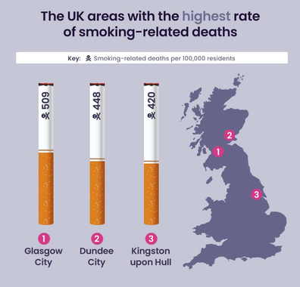
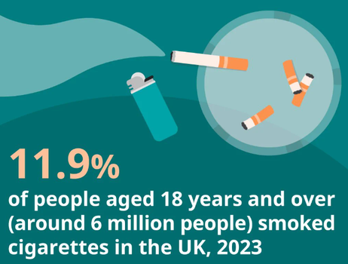
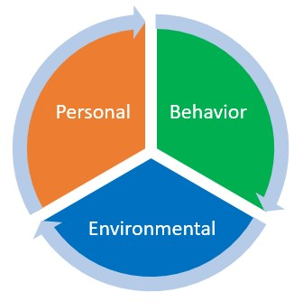

QuitConnect England: A Digital Path to Quitting in England
Student Name: Rikinpuri Swami
Student Number:
Module Code: LCHS7009
Module Title: Population Health and Digital Health Promotion
Lecturer’s name: Diola Bijlhout` and Dr Ping Wu
Assignment Title: Component 2 Poster
Background
Smoking is a significant preventable public-health issue in England. In 2023, 11.6% of adults or over six million people, smoked, while smoking caused about 74,600 deaths in 2019 and 408,700 hospital admissions in 2022–2023 (Gov.uk, 2025). The disadvantaged communities are where harm is concentrated and thus, easy intervention is necessary. The highest death rate due to smoking is recorded in the city of Glasgow, with 509 per 100,000 population, then in Dundee City, 448 and Kingston upon Hull, 420 (Cheung, 2025).
Existing non-digital interventions include local stop-smoking services, behavioural counselling, nicotine-replacement therapy, and prescription drugs, whereas digital interventions include the NHS Quit Smoking app and online personal quit plans (NHS, 2026a; NHS, 2026b). QuitConnect England is a hybrid digital program that consists of personalised quit planning, app and SMS support, moderated peer groups, appointments with an advisor, medication referrals, and optional carbon monoxide monitoring to facilitate long-term quitting.
Health promotion values and principles
Behavioural change theory
The health promotion values are based on the power of people, participation, equity, inclusion, autonomy and person-centred decision-making, which allow individuals to have control over their health (WHO, 2021). QuitConnect also adheres to these principles by providing personalised quit plans, self-monitoring, informed medicine options as well as user-controlled reminders. Peer group participation and advisor contact (moderated) promote shared support and participation, whereas multilingual content, low-data access, SMS and telephone access enhance inclusivity. Digital equity is also encouraged by co-designing with disadvantaged smokers and privacy controls (Busse et al., 2022).
  The Social Cognitive Theory describes behaviour as a mutual interaction of individual beliefs, behaviour and social environment. It has self-efficacy, self-regulation, observational learning, goals, reinforcement and social support as its major constructs (Akbari et al., 2024).
  QuitConnect uses these constructs by using individualised quit targets, craving diaries, tracking progress and coping activities, allowing smokers to track behaviour and build confidence. Abstinence is reinforced by badges, savings feedback and milestone rewards, and role modelling and strategies are offered by moderated peer groups. Environmental support and opportunities to quit are enhanced by adviser contact and medication referrals. Smoking-cessation applications can enhance self-efficacy and motivation, and gamified interventions can enhance engagement and abstinence (Coughlin et al., 2022; Ho et al., 2025). In such a way, the theory connects the digital features and the sustained quitting behaviour.
Expected outcome
With the help of the Social Cognitive Theory, QuitConnect will empower self-efficacy, self-regulation and social support, engagement with quit plans, adviser services and medication. The mechanisms have the potential to enhance quit attempts, relapse management and sustained abstinence. Nevertheless, the results can be undermined by digital exclusion, a decrease in app usage, notification fatigue, privacy issues and false self-reported progress, and thus effectiveness needs to be measured before adoption.
Conclusion
QuitConnect might inform policies which combine accessible digital help with the NHS stop-smoking help, safeguard user information and maintain telephone and SMS options. Advisers should be trained to provide blended cessation services and assist smokers to become digitally and health literate. Before implementation is done across NHS services in England, future studies need to determine long-term abstinence, engagement, cost-effectiveness, accessibility, and outcomes of disadvantaged groups.
  Akbari, M., Mokarami, H., Cousins, R., Taghanaki, C.R., Kaveh, M.H. and Jahangiri, M. (2024) ‘Development and validation of a resilience skills questionnaire for health sector professionals based on social cognitive theory’, BioMed Research International, 2024(1), p. 5660620. https://doi.org/10.1155/2024/5660620
  Busse, T.S., Nitsche, J., Kernebeck, S., Jux, C., Weitz, J., Ehlers, J.P. and Bork, U. (2022) ‘Approaches to improvement of digital health literacy (eHL) in the context of person-centered care’, International Journal of Environmental Research and Public Health, 19(14), p. 8309. https://doi.org/10.3390/ijerph19148309
  Cheung, D. (2025) UK smoking report. Available at: https://nowpatient.com/health-news/uk-smoking-report
  Coughlin, L.N., Bonar, E.E., Walton, M.A., Fernandez, A.C., Duguid, I. and Nahum-Shani, I. (2022) ‘New directions for motivational incentive interventions for smoking cessation’, Frontiers in Digital Health, 4, p. 803301. https://doi.org/10.3389/fdgth.2022.803301
  Gov.uk (2025) Smoking and tobacco: applying All Our Health. Available at: https://www.gov.uk/government/publications/smoking-and-tobacco-applying-all-our-health/smoking-and-tobacco-applying-all-our-health
  Ho, D.S.H.I., Jabir, F., Sallahuddin, S.N., Ahwan, N.A.M., Sathiyaseelan, G., Zahari, M.I., Hassan, M.R. and Nawi, A.M. (2025) ‘The impact of gamification on smoking cessation: A systematic review and meta-analysis’, Tobacco Induced Diseases, 23, pp. 10–18332. https://doi.org/10.18332/tid/203937
  NHS (2026a) Quit smoking. Available at: https://www.nhs.uk/better-health/quit-smoking/
  NHS (2026b) Find the best stop-smoking product for you – Better Health. Available at: https://www.nhs.uk/better-health/quit-smoking/ready-to-quit-smoking/find-the-best-stop-smoking-products-for-you
  WHO (2021) Global strategy on digital health 2020–2025. Available at: https://www.who.int/docs/default-source/documents/gs4dhdaa2a9f352b0445bafbc79ca799dce4d.pdf
References

