Slide 1

Module LCHS4003 Introduction to
Health and Social Care
WEEK 10

Slide 2

WELCOME

Slide 3
Today we will…
The session will include the following items:-
To look at exploring the role of technology within the health and social care sector.
To go through what might be the future of the health and social care sector.
To provide time to undertake a module review of what has been covered and to enable you to complete the module evaluation feedback on the Moodle site.
To take workshop relating to the final assessment task and provide time for points of clarification.

Slide 4
In pairs consider the following question
“What has changed since the inception of the NHS in 1948?”
Consider the developments over the years, what was it like in 1948 to what it is like now in 2022.
Write down your ideas to present back to the whole student group.

Slide 5
Developments and Changes
The goal of the H &SC is that it is free at the point of need.
Since the inception of the NHS the H and SC sector has changed beyond all recognition. There are many changes such as changes in population demographics.
H & SC services are expect to be delivered to meet the needs in modern times. For example, life expectancy in 1948 when the NHS was established the average age of men was 63 years, today the average age is 79 years. For women it was 61 then and is now about 83 years old.

Slide 6
Another change is infant mortality which has fallen drastically e.g., in 1948 it was 31 deaths per 1000 babies born to 3.8 in 2018.
The shift in better health care outcomes is
mainly due to modern age successes in the
range of treatments provided to treat people who have long term health conditions such
as diabetes, COPD (emphysema) or blood pressure illness.
The NHS and SC looks at prevention - to support individuals to make healthy lifestyle
choices, to keep active so as to avoid health or social care needs in the long run.

Slide 7
The adoption of new technologies has supported research, which has been developed to discover other methods in practice delivery advances for better outcomes.
Technologies have changed the way health services are delivered, e.g., how it assists during surgery.
The desire for disease elimination has altered the lives of peoples for the better, e.g., the roll out of mass vaccination programmes to reduce infection or disease such as the MMR (mumps, measles and rubella) Covid-19, the flu virus.

Slide 8
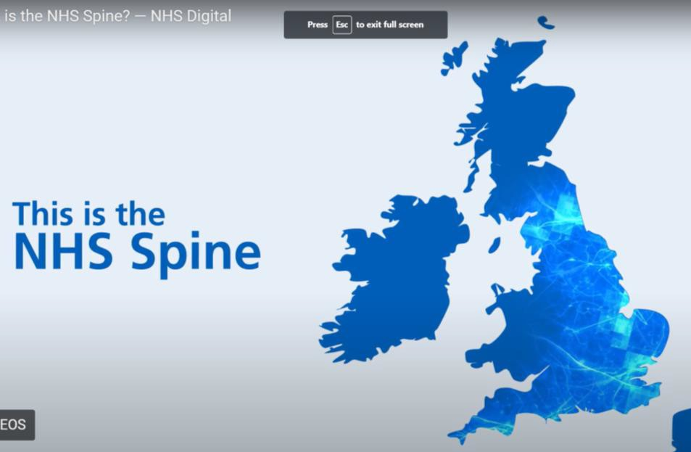
NHS Spine Applications
What is the NHS Spine? — NHS Digital - Bing video

Slide 9

The plan and development
(67) What will patients get out of the NHS Long Term Plan? - YouTube

Slide 10
The NHS plan and developments
10 year plan from 2018 to 2028. The delivery of services within the large budget.
To address important elements in wider society.
How to deliver services to meet citizens needs.
To address core areas of disease prevention, and reduce illnesses.
To collect data on ill health and wellbeing and how this might effect different communities or sectors in society.
To consider health inequalities that might be due to where people live or where they are born.
•

Slide 11
To look at the structure of the NHS and how it is integrated with the social care sector.
To look at how new digital routes develop and how it helps support the delivery of services.
To consult with the public and holding H & SC services accountable.
A needs led service which is based on good outcomes.
Workforce planning, joined up thinking and collaborative working.
Partnerships with the private sector.

Slide 12
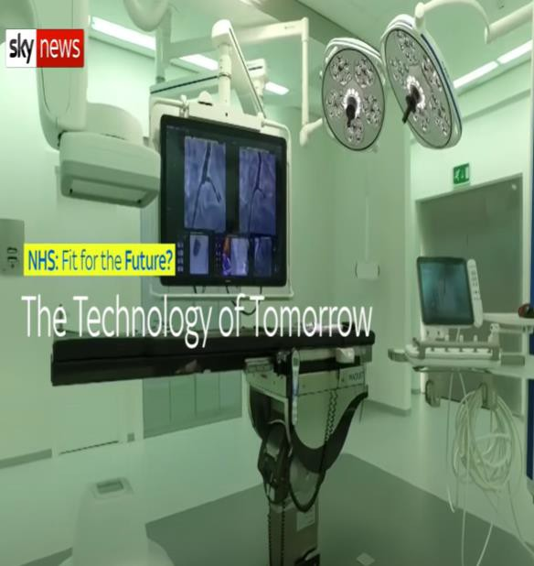
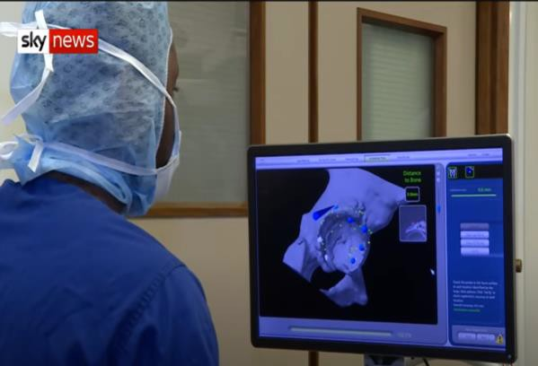
Robotic technology as a way forward
Surgical robots are bring science fiction to life, although these are very expensive.
MAKO machine carrying out hip replacement operations on patients.
The benefit of robotic surgery is it precision to reduce pain and trauma on the patient. This can lead to a shorter recovery time.
Robotics provide accurate information and
feedback loops to help support the surgeon in their roles during an operation. This is about working efficiently during operations, which
includes the assistance of technology to support
the health care team perform its role in the most effective way.
The NHS only has a limited provision for such
robotic technologies at the present time as it is
an expensive provision.

Slide 13
Current and Future Developments
Paperless records as digital records begin to be rolled out.
Scanning of patients' wrist bands. This is where all the patient’s information comes up on the system so that it can be viewed immediately.
Individual’s wearing a bio-senser to monitor all their health observations.
During operations using scanning equipment to help minimise
evasive open surgery.
New scanning equipment to look internally into patients' bodies. This results in there being a hybrid function during operations in theatres. This helps speed up the diagnostic assessment process and provide immediate treatment options within the medical team.

Slide 14
The role of hospital care coming to the patients into the home at a local level due to portable equipment.
Reading a patients DNA to predict what illness might be in their genes/genetic coding.
Decoding a person’s genes to predict the best options and treatment to meet their needs.
History shows that the development of technology can transform health and social care. However, often it is private companies who hold the rains to innovation.

Slide 15
Some of the challenges
Dangers relate to data accuracy, accessing information, hotspots of health and social care demand and clear need assessments e.g., maternity services.
Emergency services, the 111 service and assessment and treatment.
Waiting in ambulances outside of A and E departments waiting to be seen or people waiting in corridor areas as there are no available beds.
Bed-blocking.
Workforce shortages.
World events – the pandemic.

Slide 16
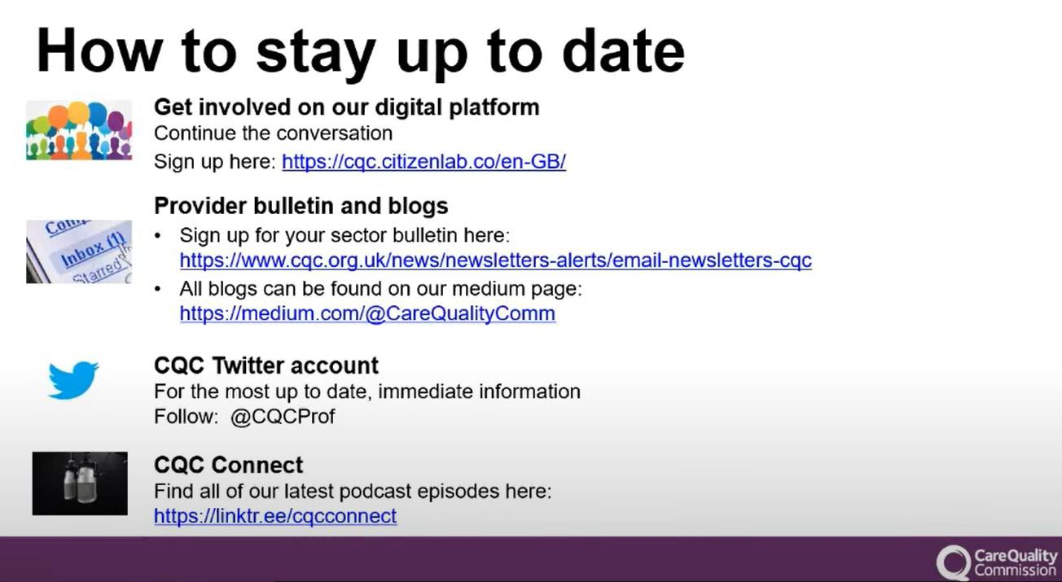

Slide 17

Module Evaluation
Why is it important?

Slide 18

Module Evaluation
You will be given 15 minutes to complete the module evaluation.

Slide 19

Questions?

Slide 20



Slide 21
References
Chambers, D. , Cantrell, A. and Booth, A. (2021) Rapid evidence review : challenges to implementing digital and data-driven technologies in health and social care. Report. The University of Sheffield , Sheffield.
Glasby, J. (2017) Understanding health and social care (3rd edition) Bristol: The Policy Press.
Glasby, J. & Dickinson, H. (2014) Partnership working in health and social care: what is integrated care and how can we deliver it? Bristol: The Policy Press.
Healthcare UK - GOV.UK (www.gov.uk) [Access August 2022].
(67) The NHS of the future – YouTube [Access 2nd November 2022]
What is the NHS Spine? — NHS Digital - Bing video [Accessed 2nd November 2022]

