Slide 1


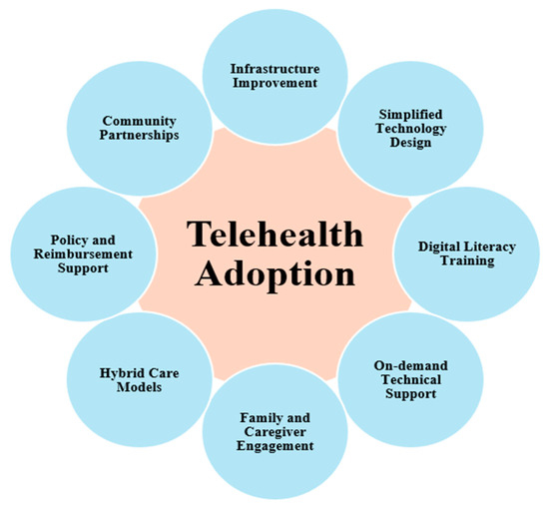
Programme: MSc Public Health and Social Care in Practice
Module Name: Population Health and Digital Health Promotion
Module Code: LCHS7009
Lecturer: Diola Bijlhout
Assignment Title: Component 3 Group Project Presentation
Student Name: Amiben kinteshkumar patel
Student ID : 2526924
Chosen Group: Digital telehealth technology intervention for Postnatal depression among 25-45 targeted age groups.

Slide 2
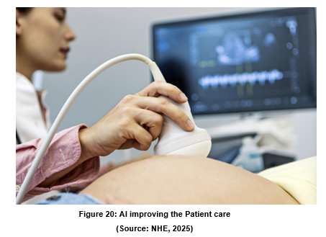
Successful Implementation Needs more than Technology
To make the intervention successful, collaborative stakeholder engagement, organisational readiness and ethical governance required.
Successful implementation needs balancing the postnatal depression patient-care, regulatory compliance and equitable access throughout the intervention process (Zhang et al., 2024).
This section evaluates the implementing barriers, governance considerations that encourage healthcare organisations to adopt AI-enabled telehealth within the NHS maternity services.

Slide 3
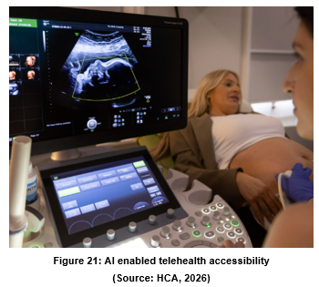
Key stakeholder Supporting Implementation
Families, health visitors and GPs will collaboratively facilitate early postal depression symptoms.
Mental health specialists, NHS organisations and digital software providers provide governance, implementation oversight and funding (Morris et al., 2023).
NHS support and voluntary support will strengthen intervention accessibility by eliminating social stigma by AI enabled telehealth for continuous health monitoring.

Slide 4
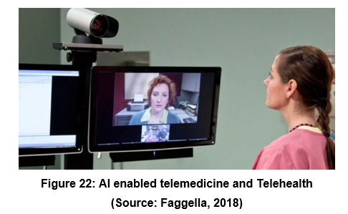
Stakeholder Roles in Intervention Delivery
AI-enabled telehealth will provide routine mental health screening, educating mothers to reduce postnatal depression (Monaci et al., 2025).
Mental health professionals and General practitioners will interpret clinical information to showcase the transparent treatment process through AI enabled telehealth.
AI-enabled telehealth developers will secure digital platforms and ensure compliance with NHS information governance standards.

Slide 5
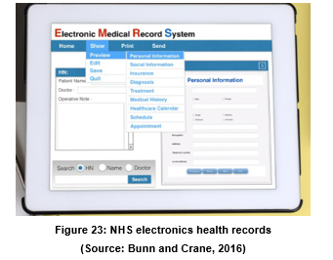
Organisational and Operational barriers
Workforce shortage, increased service demand and limited financial resources might arise to comply with the AI enabled telehealth that will eliminate organisational ability for effective digital intervention implementation.
Continuous technological advancement reduces health professional interest rate due to rapid upgradation of new technologies, which may erode their productivity level (Challoumis, 2024).
Poor implementation among AI enabled telehealth and existing NHS electronic health records might eliminate clinical efficiency and increase the depression of the mother simultaneously.

Slide 6
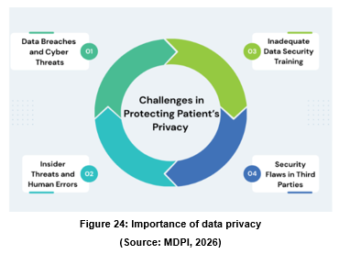
Community and Patient Barriers
Mental health stigma, cultural belief might reduce the mothers motivation level from emerging with digital psychological support services due to lack of poor knowledge of AI enabled telehealth technology.
Socio economic inequalities, inadequate AI telehealth technology experts might restrict equitable participation among the postnatal women across the communities.
Poor AI implementation, data privacy might erode the patient trust on the firm that negatively affects the intervention.

Slide 7
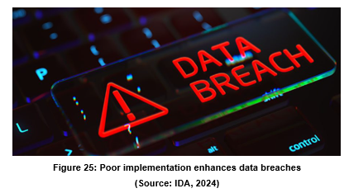
Digital Implementation and Technical Barriers
AI-enabled telehealth might deliver inaccurate recommendations when untrained employees comply with this technology which negatively affects the patient's healthcare.
Poor interoperability between cybersecurity breaches and system failures might erode continuity of safe clinical decision-making processes (Luidold and Jungbauer, 2024).
Over relies on the AI might reduce the clinical judgement, showcasing the importance of Healthcare professional oversights throughout the intervention.

Slide 8
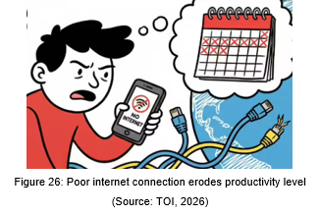
Legal Consideration for AI-enabled
Telehealth
This AI-enabled telehealth venture might face data breaches issues, system glitch and inaccurate output due to lack of skilled employees.
AI enabled telehealth for postnatal depression can face algorithms bias, a lack of human empathy, third party sharing and clinical bias
Poor internet infrastructure, low device access and digital literacy limit care for the postnatal mothers (Aldosari, 2025).

Slide 9
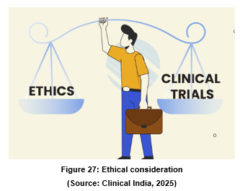
Ethical Consideration in Digital Mental
Healthcare
Ethical consideration in AI enabled healthcare for postnatal depression might face on protecting the patient data from theft, Data glitches and the loss of human empathy (Nunnelley, 2025).
Automated screening tools may misinterpret a mother’s true emotional state, missing severe depression or false-flagging normal stress.
Postnatal recovery relies on deep empathy and human connection which remotes apps fail to deliver through the AI enabled telehealth technology (Yang and Lin, 2026).

Slide 10
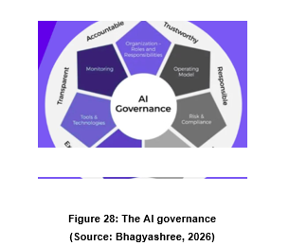
Strategies to Overcome Implementation Barriers
Transparent AI governance and regular Algorithms eliminates bias while strengthening the depressive postnatal patient trust and safety (Diyaolu, 2025).
Workforce training, stakeholder collaboration and sustainable NHS investment collectively enhance long term intervention Scalability and Effectiveness.
Multilingual resources and technical support enhance engagement and accessibility across the diverse postnatal populations across the UK (Diyaolu, 2025).

Slide 11
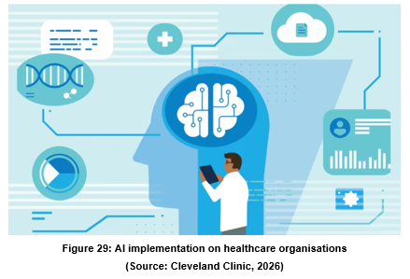
Transition and Key message
Successful AI implementation relies on organisational readiness, ethical governance and effective management.
Patient privacy, healthcare equity enhances the depression of postnatal patients’ strength that enhance the chances of cure of their diseases.
This presentation highly focuses sustainability, future recommendation that contributes to enhancing maternal public health across the UK.

Slide 12
References
Bhagyashree, (2026), AI Governance Framework: Building Responsible AI Systems, Available at: https://www.akto.io/blog/ai-governance-framework
Clinical India, (2025), Ethical Considerations in Clinical Research, Available at:https://www.cliniindia.com/ethical-considerations-in-clinical-research/
Faggella, (2018), Artificial intelligence in Telemedicine and Telehealth – 4 Current Applications, Available at:https://emerj.com/artificial-intelligence-in-telemedicine-and-telehealth/
Bunn S., and Crane, J.,(2016), Electronic Health Records, Available at:https://post.parliament.uk/research-briefings/post-pn-0519/
MDPI, (2026), A Comprehensive Survey of Cybersecurity Threats and Data Privacy Issues in Healthcare Systems, Available at:https://www.mdpi.com/2076-3417/16/3/1511
IDA, (2024), What Is a Data Breach and How to Prevent It?, Available at:https://www.idagent.com/blog/data-breach-duplicate/
HCA, (2026), Exceptional maternity care with a consultant obstetrician, Available at:https://www.hcahealthcare.co.uk/services/departments/maternity/our-maternity-services/consultant-led-delivery
TOI, (2026), Why the internet keeps going down every few weeks, Available at:https://timesofindia.indiatimes.com/technology/tech-news/why-the-internet-keeps-going-down-every-few-weeks/articleshow/125479192.cms
Cleveland Clinic, (2026), How AI Is Being Used in Healthcare — and What It Means for You, Available at:https://health.clevelandclinic.org/ai-in-healthcare
NHE, (2025), AI improving efficiency and patient care, Available at:https://www.nationalhealthexecutive.com/articles/ai-improving-efficiency-and-patient-care
Diyaolu, C., (2025). Multi-agent AI systems for adaptive, culturally-concordant care routing in postpartum depression across medicaid-dependent populations. Int J Adv Res Publ Rev, 2, pp.1-20. Available at:https://www.researchgate.net/profile/Diyaolu-Christianah/publication/391657545_Multi-agent_AI_Systems_for_Adaptive_Culturally-Concordant_Care_Routing_in_Postpartum_Depression_Across_Medicaid-_Dependent_Populations/links/6821500560241d51402929c2/Multi-agent-AI-Systems-for-Adaptive-Culturally-Concordant-Care-Routing-in-Postpartum-Depression-Across-Medicaid-Dependent-Populations.pdf
Zhang, Y., Joly, R., Beecy, A.N., Principe, S., Satpathy, S., Gore, A., Reilly, T., Lang, M., Sathi, N., Uy, C. and Adams, M., (2024). Implementation of a machine learning risk prediction model for postpartum depression in the electronic health records. AMIA Summits on Translational Science Proceedings, (2024), p.1057. Available at:https://pmc.ncbi.nlm.nih.gov/articles/PMC11497630/
Morris, A.C., Ibrahim, Z., Moghraby, O.S., Stringaris, A., Grant, I.M., Zalewski, L., McClellan, S., Moriarty, G., Simonoff, E., Dobson, R.J. and Downs, J., (2023). Moving from development to implementation of digital innovations within the NHS: myHealthE, a remote monitoring system for tracking patient outcomes in child and adolescent mental health services. Digital Health, 9, p.20552076231211551. Available at:https://journals.sagepub.com/doi/pdf/10.1177/20552076231211551
Monaci, M., Javaher, S. and Barello, S., (2025), October. Open Notes in Mental Health: A Scoping Review of Stakeholder Experiences and Implications for Clinical Practice. In Healthcare (Vol. 13, No. 21, p. 2777). Available at: https://pmc.ncbi.nlm.nih.gov/articles/PMC12607305/
Challoumis, C., (2024), September. What challenges does AI present to the Cycle of Money and economocracy. In XIII International Scientific Conference (pp. 384-418). Available at:https://www.researchgate.net/profile/Ilaha-Aliyeva-3/publication/399796120_Communication_Methodology_and_Mutual_Exchange/links/6968df795cc49c35ce7def7f/Communication-Methodology-and-Mutual-Exchange.pdf#page=385
Luidold, C. and Jungbauer, C., (2024). Cybersecurity policy framework requirements for the establishment of highly interoperable and interconnected health data spaces. Frontiers in Medicine, 11, p.1379852. Available at:https://www.frontiersin.org/journals/medicine/articles/10.3389/fmed.2024.1379852/pdf
Aidoo, E.M., (2025). Advancing precision medicine and health education for chronic disease prevention in vulnerable maternal and child populations. World Journal of Advanced Research and Reviews, 25(2), pp.2355-76. Available at:https://www.researchgate.net/profile/Esi-Aidoo/publication/390321913_Advancing_precision_medicine_and_health_education_for_chronic_disease_prevention_in_vulnerable_maternal_and_child_populations/links/67ea0b9449e91c0feacc840e/Advancing-precision-medicine-and-health-education-for-chronic-disease-prevention-in-vulnerable-maternal-and-child-populations.pdf
Aldosari, B., (2025). Cybersecurity in healthcare: New threat to patient safety. Cureus, 17(5). Available at:https://assets.cureus.com/uploads/review_article/pdf/353315/20250606-110762-peu2so.pdf
Nunnelley, S., (2025). Mindful of Machines: Mental Health AI, Rights, and the Role for Law. Available at:https://d1wqtxts1xzle7.cloudfront.net/124803169/Mindful_of_machines-libre.pdf?1759167106=&response-content-disposition=inline%3B+filename%3DMental_Health_AI_Rights_and_the_Role_for.pdf&Expires=1785496120&Signature=VPjpxGCJLTt0P778tb0FCCZXuVNNCJILE~zdxg15tNjW5XENSPx~LnH3rgHxeCCO0uMrIVClTjtKkGhbrYCJowEQ1z5I9KXJHBSg2Wo01~TST7PaAW~BmreptdbUzOeh1I7~V5ItQHCkw3IkqEp3M2E2yRhPMoJ-EKV4QEt3tBiN-CS8vwCiWqPzdk2okiOMeJHHiE0WLgRjUdTTFalTf0G2OJXJUBsFaVkKs-~Eie6PVNVP5PA~aprbUVMuKEbkTLX~D5YnN2uBEtNzQKdLuEwfa0oAwEReuJdubNkzM8nSqMepKYgGQ1baAoUtJ-9hiebeKproqQTKM6laHzucdg__&Key-Pair-Id=APKAJLOHF5GGSLRBV4ZA
Yang, H. and Lin, D.M., (2026). Conversational AI for perinatal mental health: promise, limits, and a human-AI stepped-care framework. Frontiers in Psychiatry, 17, p.1847854. Available at:https://www.frontiersin.org/journals/psychiatry/articles/10.3389/fpsyt.2026.1847854/pdf

