Slide 1
The Communications Mix
Nathan Price & Dee Lee Jones
(Green Family Adventures)
Notes:
Good Afternoon, my name is Dee Lee Jones and this is Nathan Price, and we have created a presentation based on the communications mix of our product.

Slide 2
Chosen Market
Green Family Adventures
Eco-Friendly Families
Niche market
Eco-tourism on the rise: ‘35% globally are likely to book eco-tourism holidays’ – GlobalData (2017)
Many eco-friendly attractions, services and facilities available in Swansea and the Gower Peninsula for families
Family holidays have always been popular among consumers, with Schänzel and Yeoman (2012) claiming that ‘family travel is predicted to grow at a faster rate than all other forms of leisure travel, partly because it represents a way to reunite the family and for family members to spend time with each other, away from the demands of work’.
A market that is rarely discussed/catered for
Notes:
In the previous assignment, I created an itinerary based on the niche market of eco-tourism, while Dee Lee conjured an itinerary based on family consumers. When deciding upon which segment we would base this assignment on, we decided that it would be best to combine the two segments to create an itinerary and organisation catering to the needs of eco-friendly family tourists. Eco-tourism is on the rise in the tourism industry, as stated by GlobalData, a recognized leader in business information and analytics. The company’s public survey research found that ‘35% globally are likely to book eco-tourism holidays’ in 2017, with this figure expected to grow in the following years due to discussions regarding climate change being at the forefront of global news. Family holidays have always been popular among consumers, with Schänzel and Yeoman (2012) claiming that ‘family travel is predicted to grow at a faster rate than all other forms of leisure travel, partly because it represents a way to reunite the family and for family members to spend time with each other, away from the demands of work’. It is because of these findings that we have decided to combine eco-tourism and family tourism segments; to cater for both sectors of customers and provide alternatives and considerations for both of these segments.
Our company is called Green Family Adventures, a self-explanatory organisation that specialises in eco-tourism family holidays in the UK. We believe this name is catchy and also on brand with our products and services. Our business name provides clarity as customers understand what they are booking.

Slide 3
Summary of Itinerary
Monday
The family to depart their hometown and head to the Gower Peninsula for their 4-night summer holiday. Arrive at accommodation, Corn Cottage.
Underfloor heating throughout the entire cottage
Solar panels located on the roof for hot water
Log burning stove
Electric Shower
Electric Kettle
Gas Cooker
Gower Holidays Stay & Explore (2018) = ‘In the village there is local pub, cafe and bistro all only a short walk away from the
cottage. There is a local shop 2 to 3 miles away, it sells most groceries as well as some
local produce.’
Notes:
The family to depart their hometown and head to the Gower Peninsula for their 4-night summer holiday. They will arrive at their accommodation, Corn Cottage, which is an eco-friendly, as they provide underfloor heating throughout the entire cottage, solar panels located on the roof for hot water, log burning stove, electric Shower, electric kettle, gas cooker. After settling in to their accommodation, the family can explore nearby surroundings such as shops and landmarks at their leisure, visit one of many nearby pubs for dinner. Head back to the cottage for the night.

Slide 4
Tuesday
• Head to the Gower Heritage Centre via local bus service
• Learn about the history of the Gower. Also, opportunities to participate in a weaving/spinning woollen mill experience class
• Lunch within the Gower Heritage Centre’s Tea Room
• After lunch, participate in a pottery class within the centre
• Visit the animal park at the Heritage Centre
• Head back to accommodation via bus to get ready for an evening meal
• Visit a local restaurant for dinner nearby accomodation
Notes:
Depart the cottage mid-morning after breakfast and head to the Gower Heritage Centre via local bus service
Families can enjoy some time looking around the centre, learning about the history of the Gower. There are also opportunities to participate in a weaving/spinning woollen mill experience class
Lunch within the Gower Heritage Centre’s Tea Room
Towards mid-afternoon, the family could participate in a pottery class within the centre
After this, the family could visit the animal park at the Heritage Centre
Head back to accommodation via bus to get ready for an evening meal
Visit a local restaurant for dinner
Head back to the cottage for the night

Slide 5
Wednesday
• Head to the North Gower Farmers Market via local bus service
• Look around the farmer’s market, trying some local produce
• Participate in making jewellery, art, woodwork and much more with talented artisans
• Lunch within Heather’s Café on site at the farmer’s market
• Head to Clyne Gardens mid-afternoon via local bus service
• Spend some time within Clyne Gardens, taking in the breath-taking views and landscapes within the area
• Head back to accommodation via local bus service to prepare an evening meal from local produce purchased from the farmer’s market
• Enjoy a meal at the cottage before having a relaxing night in the confinements of Corn Cottage
Notes:
Depart the cottage mid-morning after breakfast and head to the North Gower Farmers Market via bus
Enjoy some free time to look around the farmer’s market, trying some local produce
Participate in making jewellery, art, woodwork and much more with talented artisans
Lunch within Heather’s Café on site at the farmer’s market
Depart the farmer’s market and head to Clyne Gardens mid-afternoon via bus
Spend some time within Clyne Gardens, taking in the breath-taking views and landscapes within the area
Head back to accommodation via bus to prepare an evening meal from local produce purchased from the farmer’s market
Enjoy a meal at the cottage before having a relaxing night in the confinements of Corn Cottage

Slide 6
Thursday
• Head to The Bike Hub via local bus service
• Hire bikes as The Bike Hub is located on Swansea sea front, (travel to Three Cliffs Bay via bike routes, beach fronts and Gower woodlands)
• Arrive at Three Cliffs Bay before having lunch in a nearby café
• After lunch, explore Three Cliffs Bay via cycling
• Visit Pennard Castle within Three Cliffs Bay before relaxing on the beach
• Travel back to The Bike Hub to drop off hired bikes
• Catch a bus back to Corn Cottage to get ready for an evening meal
• Visit a local restaurant for dinner
Notes:
Depart the cottage mid-morning after breakfast and head to The Bike Hub via bus
The family could hire bikes and as The Bike Hub is located on Swansea sea front, they could use these bikes to travel to Three Cliffs Bay via bike routes, beach fronts and Gower woodlands
Arrive at Three Cliffs Bay at mid-day before having lunch in a nearby café
After lunch, explore Three Cliffs Bay via cycling
Visit Pennard Castle within Three Cliffs Bay before relaxing on the beach
Travel back to The Bike Hub to drop off hired bikes
Catch a bus back to Corn Cottage to get ready for an evening meal
Visit a local restaurant for dinner
Head back to the cottage for the night

Slide 7
Friday
• Depart the cottage mid-morning after breakfast and head to Oystermouth Castle via local bus service
• Explore the castle and learn about its history within the Gower Peninsula
• Depart the castle just after mid-day and head to Swansea city centre via bus for lunch in a nearby café
• After lunch, walk to Plantasia
• Enjoy a few hours within Plantasia, learning about a number of animals and the rainforest that is in desperate need of help
• Depart Plantasia in the evening and catch a bus back to the accommodation
• Have an evening meal within the cottage from leftover food purchased from the farmer’s market
• Depart Corn Cottage and head back home
Notes:
Depart the cottage mid-morning after breakfast and head to Oystermouth Castle via bus
Explore the castle and learn about its history within the Gower Peninsula
Depart the castle just after mid-day and head to Swansea city centre via bus for lunch in a nearby café
After lunch, walk to Plantasia
Enjoy a few hours within Plantasia, learning about a number of animals and the rainforest that is in desperate need of help
Depart Plantasia in the evening and catch a bus back to the accommodation
Have an evening meal within the cottage from leftover food purchased from the farmer’s market
After dinner, depart Corn Cottage and head back home

Slide 8
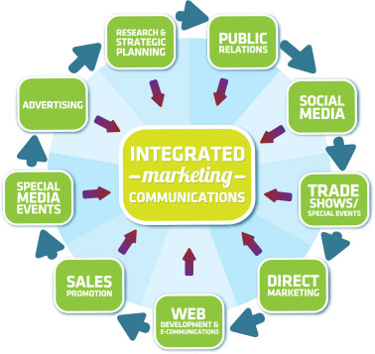
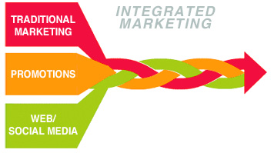
Introduction to Integrated Marketing Communications (IMC)
A concept that has been discussed for decades
‘Generally understood today and has been around for some 35 years.’ – Percy, 2018
A method ‘to force all aspects of the communication programme to deliver a single-minded and unified message to the target market.’ – Yeshin, 2014
Source: Meteora, 2014 Source: Research Methodology, 2013
Notes:
Integrated marketing communications is a concept that has been around for decades. Perry (2018) states that integrated marketing communications ‘is generally understood today and has been around for some 35 years’. It was during this formation period many years ago that academics and businessmen alike began to discuss and analyse differing marketing methods. The conclusion back then has today resulted in integrated marketing communications, a method ‘to force all aspects of the communication programme to deliver a single-minded and unified message to the target market’ (Yeshin, 2014).
The process of integrated marketing communications ensures customers are accustomed to all forms of advertising, whether that be social media, newspaper, email or television; the more advertisements directed towards customers, the better. By surrounding consumers with advertisements from all communication methods, this provides them with a lot of information at the same time and can have the potential to sway these individuals and their spending habits.

Slide 9
Advantages & Disadvantages of Integrated Marketing Communications (IMC)
‘Consumers are hit with hundreds, if not thousands, of marketing messages daily, it’s more important than ever for a brand to be recognizable from one platform to the next.’ – Hendricks, 2018
Advantages:
Brand reinforcement
Effective communication
Competitive advantage
Disadvantages:
Stale advertising campaigns
Lack of creativity
Notes:
Using integrated marketing communications can be the difference between a successful and failing organisation. This is due to those businesses using IMC having significant advantages over those that do not. One of the main advantages of using IMC is brand reinforcement. This is where a company will use all types of advertising to broadcast a single, unifying message that links all their products together to create an overall advertisement spread across multiple platforms. ‘Consumers are hit with hundreds, if not thousands, of marketing messages daily, it’s more important than ever for a brand to be recognizable from one platform to the next’ states Hendricks (2018). An example of this would be TUI, whom recently used television, social media, newspaper and email marketing to broadcast their name change and further state the importance of their customers. IMC also gives organisations more effective communications and the competitive advantage over one that does not use IMC, as repetitive marketing results in consumers being more likely to purchase an/or think about that organisations products or services.
There are however disadvantages to integrated marketing communications. The use of a single brand message by organisations can become stale after a while, especially those that last for months at a time and are shown across all communication methods. These forms of advertising campaigns can also suggest a lack of creativity by a company, as they re-use the same advertisement for all marketing methods and the use of one message for an entire advertising campaign can be considered a waste of money and ineffective. This is due to other offers or information held by the company not being shown due to the current advertising campaigns.
Integrated marketing communications are in general a great idea method for businesses to use. They allow advertising campaigns to reach wider audiences via a number of marketing methods, while also branding the company under one image and message; a sign of unity and professionalism.

Slide 10
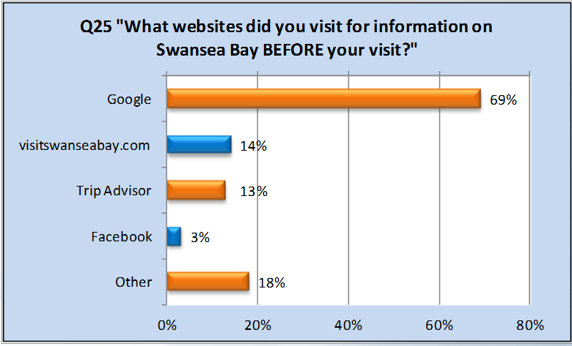
Most Appropriate Media for Marketing Communications for Market
Online/ Social Media
Cyngor Abertawe Swansea Council(2015)–
69% of visitors used Google
14% of visitors used www.visitswanseabay.com
13% of visitors used Trip Advisor
3% of visitors used Facebook
18% of visitors used other
Notes:
The way that the organisation will promote the itinerary will be online via social media, as Cyngor Abertawe Swansea Council, (2015) discusses that 69% of visitors used Google to find information, 14% used www.visitswanseabay.com, 13% used Trip Advisor and 3% used Facebook before they came to visit Swansea Bay. This is demonstrating the importance of the internet for promoting the itinerary, as it is vital for visitors who have not been to Swansea before who need information before their trip. With the internet and technology being advanced modern days, it is most likely that visitors would book the itinerary through online.

Slide 11
Other Appropriate Media for Marketing Communications for Market
Create a Facebook and Twitter Page
‘The internet is a very important tool for visitors who need information – especially those who have not been to Swansea before, of which 60% say they go online for information to help plan their trip’ – Cyngor Abertawe Swansea (2015)
Go to National Parks and other eco tourism destinations and hand out posters to promote Swansea Bay and Gower Pensinula
‘Millennials are also leading the way in sustainable tourism, with 41% arguing that they are interested in booking an eco-tourism holiday.’ – GlobalData (2017)
Notes:
Another way that Green Family Adventures will also market their package holiday is creating a Facebook Page, and this will help us advertise our package. The Facebook page will include our poster so that families can get in contact with us to book the package holiday. The Facebook Page will also include our logo. Green Family Adventures will go to National Parks and other eco tourism destinations to hand out posters, to promote Swansea Bay and Gower Pensinula as a eco friendly area.

Slide 12
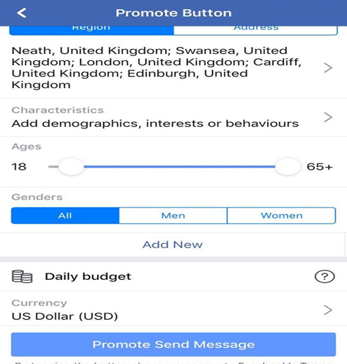
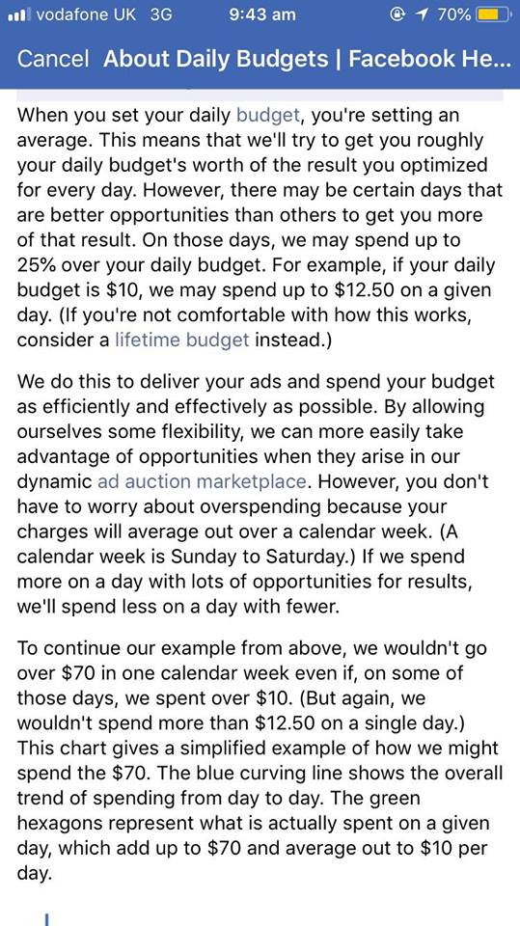
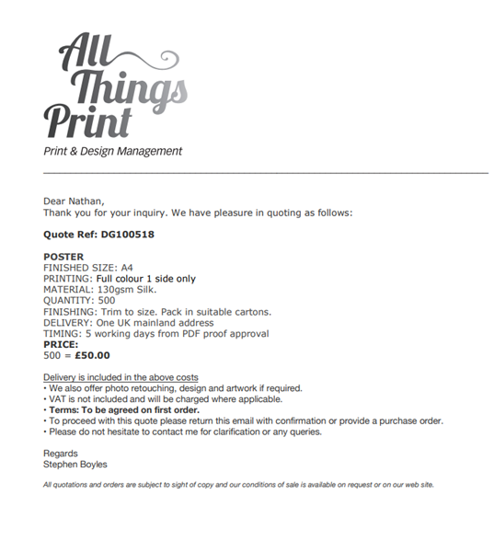
Notes:
To promote our package on our Facebook Page, Facebook has an option to advertise a page across their platform and are linked to Instagram. When start the process of advertising on Facebook, you are met with the diagram which gives businesses the option of area, characteristics, age, gender and budget for the advertising scheme. We set our daily budget $15 a day to advertise over a week in Swansea, London, Cardiff, Edinburgh. However, Facebook do have terms and conditions that we must follow about their advertising,. Prices could rise each day over the daily budget, as some days may provide better opportunities for advertising than others. Due to this, our estimated budget for this promotion method is $105 per week, or £78 when coverted.
To promote our package to National Parks and other eco tourism destinations, Green Family Adventures got in touch with All Things Print, and they have gave us a quote of £50 for 500 posters in full colour, one side only. This will give the opportunity to promote Swansea Bay and Gower Pensinula as a eco-friendly holiday destination. As you can see on the third diagram, this is the response that we had through the company via email.
Both promotion methods add up to a total of £128 per week.

Slide 13
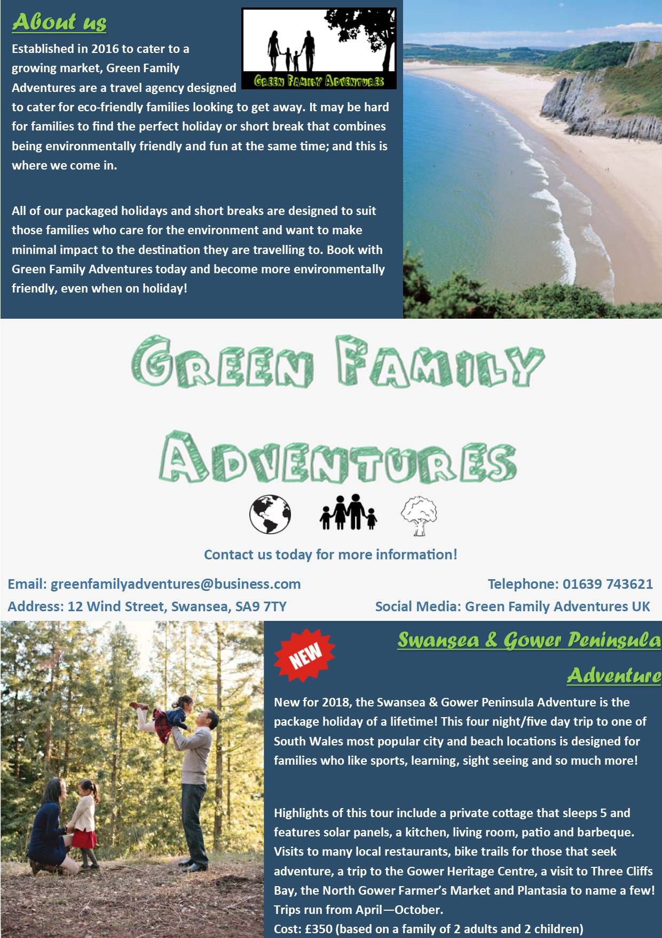

Visual Display of Branding and Key Messages
Notes:
These are the visual displays for our brand. As you can see, our logo features both nature and families to broadcast our message of eco-friendly family holidays. The logo shows the family holding hands, showcasing how Green Family Adventures packages can bring families closer together. Our poster is colourful and modern, showcasing the company logo within it. The poster is designed to appeal to a younger family market, as mentioned previously, millennials are now one of the most likely segments to book an eco-friendly holiday. The poster includes information about the company and the new Swansea and Gower Peninsula Adventure package, showcasing just the right amount of information for potential consumers to take in before considering our business. The colour green can be seen within the logo and poster, as we believe this is a great colour choice for eco-friendly holidays. The depiction of families within both branding materials shows our commitment to ensuring family fun at all times

Slide 14
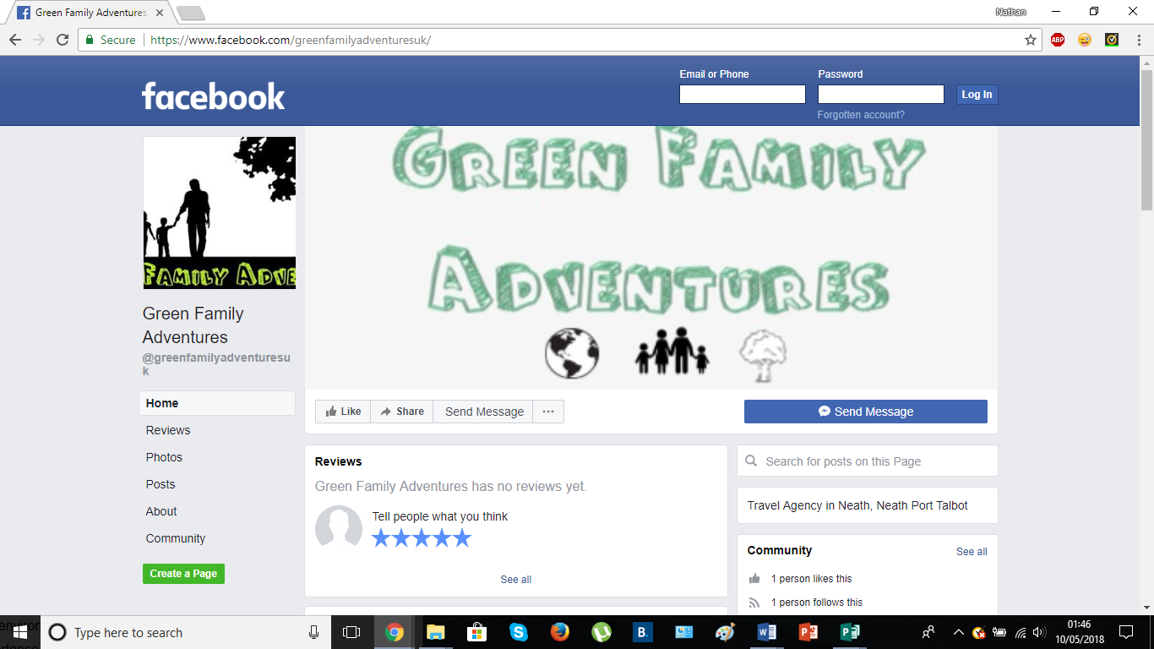
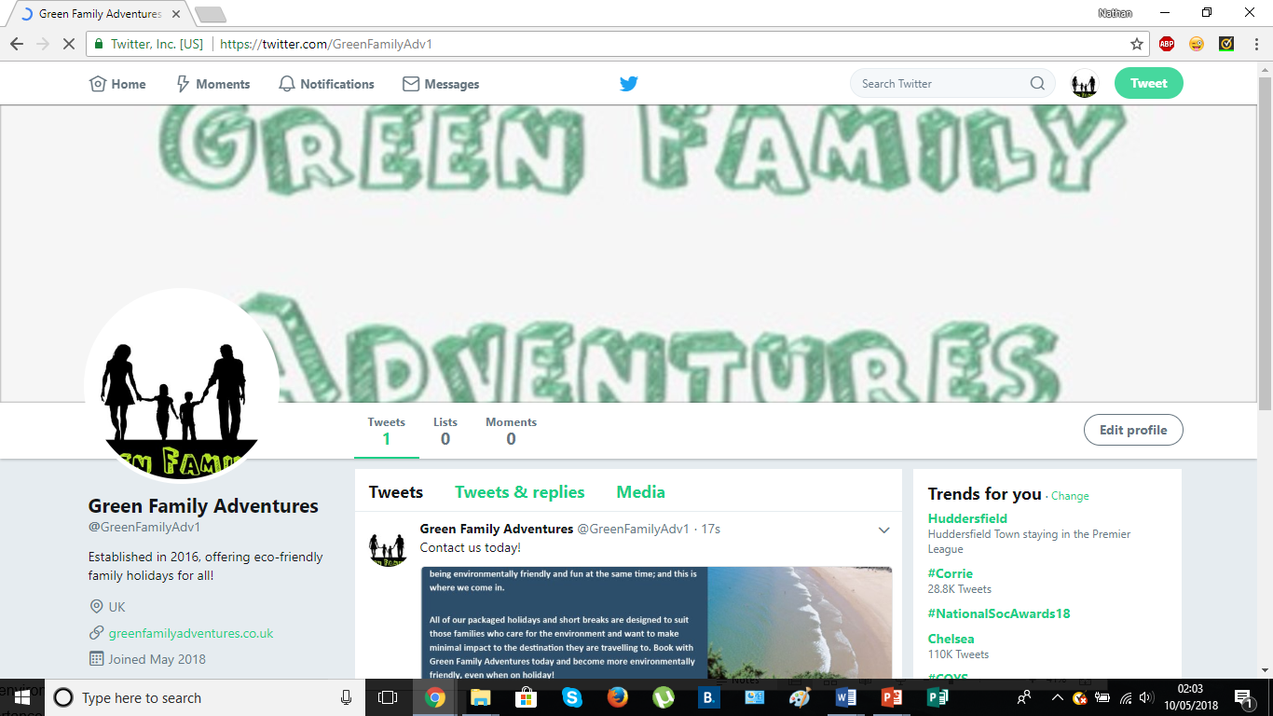
Social Media Marketing
Notes:
The use of social media marketing is highly important for our company. In fact, it is important for all organisations to advertise online in some form, as ‘77% of millennials make a purchase both online and in-store after viewing something on Facebook’ (University of Massachusetts Dartmouth, Centre for Marketing Research). A Facebook and Twitter page have been set up for the company, advertising the marketing materials already created. This type of promotion is perhaps the most important of all, as billions of individuals across the globe are using social media on a daily basis. In an age where individuals have mobile devices to hand at all times, the form of advertising on Facebook and Twitter can be the difference between a moderately successful company and a highly successful company. Therefore, this will be our main form of advertising.
The use of the same usernames for social media allows ease of access for consumers as they will be able to find our business with ease online. Also, we will use the same theme throughout our social media (greens and family images), as this is consistent with our other marketing materials.

Slide 15
Thankyou for Listening!
Any Questions?

Slide 16
References
Cyngor Abertawe Swansea Council, (2015), 'Tourism research and statistics’ ,[Online], Available: https://www.swansea.gov.uk/article/6406/Tourism-research-and-statistics , Last Accessed: [2018, March, 23].
GlobalData. (2017), ‘Global Eco-tourism takes off with 35% of holiday makers now likely to book an eco-holiday’, [Online]. Available: https://www.globaldata.com/global-eco-tourism-takes-off-with-35-of-holiday-makers/, Last Accessed: [2018, March, 24].
Gower Holidays Stay & Explore, (2018) ‘Corn Cottage’, [Online], Available: https://www.gowerholidays.com/accommodation/self-catering/corn-cottage/ , Last Accessed:[2018, May, 8].
Hendrix, B. (2018), ‘Benefits of Integrated Marketing Communications’, [Online]. Available: https://study.com/academy/lesson/benefits-of-integrated-marketing-communication.html, Last Accessed: [2018, March, 27].
Meteora. (2014), ‘IMC: The Anatomy of Successful Marketing’, [Online]. Available: https://meteora.co/imc-the-anatomy-of-successful-marketing/, Last Accessed: [2018, March, 24].
Research Methodology. (2013), ‘Integrated Marketing Communications: Introduction’, [Online]. Available: https://research-methodology.net/integrated-marketing-communications-introduction/, Last Accessed: [2018, March, 24].
Percy, L. (2018), ‘Strategic Integrated Marketing Communications’, (Third Edition), Oxon: Routledge.
Schänzel, H & Yeoman, I. (2012), ‘Trends in family tourism’, Journal of Tourism Futures, Vol. 1 Issue: 2, pp.141-147.
University of Massachusetts Dartmouth, Centre for Marketing Research. (2017), ‘Social Media Marketing Statistics’, [Online]. Available: https://thedma.org/marketing-insights/marketing-statistics/social-media-marketing-statistics/ , Last Accessed: [2018, March, 26].
Yeshin, T. (2012), ‘Integrated Marketing Communications: Holistic Approach’, Woburn: Butterworth-Heinemann, p. 14.

