Slide 1

A Critical Examination of Road Policing’s Role in Disrupting County Lines Crime Networks
Eleonora Alexandra Bunica
2312354
This Photo by Unknown Author is licensed under CC BY

Slide 2

Purpose and Objectives
Purpose
Tackle the pressing issue of county lines crime enabled by road networks and highlight the significant part that road policing plays in disrupting these activities.
Objectives
Evaluate how road policing strategies directly influence the reduction of county lines crime
Highlight successful tactics and statistics
Explore the challenges and limitations faced by road policing

Slide 3
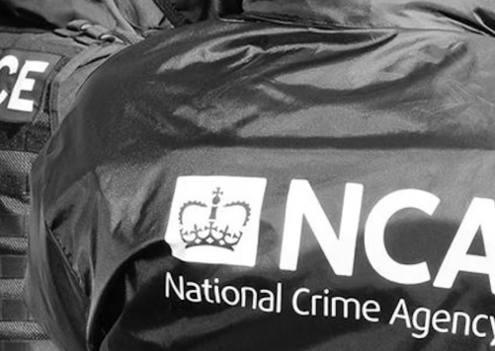
Findings
The national road network continues to be the primary route for drug transportation. Both hired and privately-owned vehicles, are utilised for transporting drugs between and within supply areas (NCA, 2024).
By targeting key transport routes, road policing efforts have disrupted the movement of drugs and weapons across county lines, making it harder for criminal operations to function effectively (College of Policing, 2024).
According to the NCA (2024), the reduction in operational county lines drug network since 2019 can be attributed to improved reporting and heightened operational activity.
Notes:
NCA, 2024
College of Policing, 2024

Slide 4
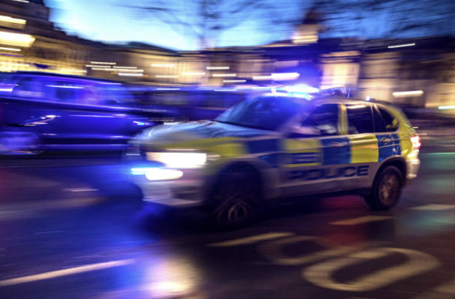
The Role of Road Policing in County Lines Crime
Criminals heavily rely on the road network to facilitate county lines exploitation and other related crimes (Department for Transport, 2020).
Road policing units:
Collect information on suspicious vehicles and individuals, which helps identifying and tracking those involved in county lines activities.
Carry out targeted operations to disrupt county lines networks, including high-visibility patrols in areas known for such crime.
By conducting stops and searches of vehicles, road policing officers can confiscate drugs, cash, and other evidence connected to county lines activities.
(Department for Transport, 2020)
Notes:
Department for Transport, 2020

Slide 5

The Severe Impact that County Lines Gangs have on Communities
“County lines gangs inflict harrowing damage and misery, using violence and intimidation to exploit children and vulnerable people to do their dirty work.”
(Philip, 2024)
Notes:
NPCC, 09.07.2024 (a)

Slide 6

What measures are being taken by road policing to combat county lines gangs?

Slide 7

Policing Responses
Road policing strategies play a crucial role in reducing county lines crime by targeting the transportation and distribution networks used by criminal gangs.
Through focused operations on main roadways, police can intercept drugs being moved between cities and towns, thereby disrupting the supply chain.
Surveillance and monitoring of established routes utilised by county lines gangs help in identifying and arresting criminals.
Road policing frequently involves working together with other agencies, such as the British Transport Police and local authorities, to develop a cohesive response to county lines activities (NPCC, 2024).
Notes:
NPCC, 2024 (b)

Slide 8

The latest County Lines Policing Strategy (2024 to 2027) aims to:
Prevent involvement in County Lines activities, along with the related violence and exploitation.
Protect children and vulnerable adults from county lines harm.
Strengthen communities by increasing their resilience to the dangers of County Lines.
Target offenders, such as Organised Criminal Groups, Urban Street Gangs, and individuals operating County Lines (NPCC, 2024).
Notes:
NPCC, 09.07.2024 (b)

Slide 9

National Study of the Policing of County Lines
The primary aim of this research project is to enhance the experiences and outcomes of policing for both police officers and vulnerable individuals affected by county lines activities.
This involves carrying out focused operations to detect and break up county lines activities, conducting raids, making arrests, and confiscating drugs and assets.
Using technology like the NCLCC Power App, which offers resources and guidance for addressing county lines issues (N8, 2023).
Notes:
N8 policing Research Partnership, 2023

Slide 10
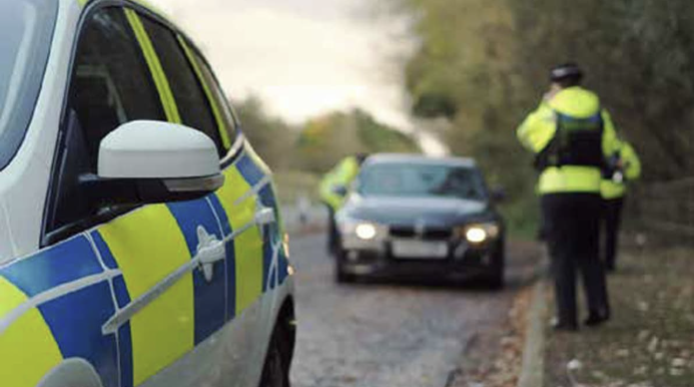
Traffic Stop Leads to Major Drug and Weapon Seizure
On October 2, 2024, Avon and Somerset Police stopped a black BMW on Bond Street in Bristol due to suspicions that it had a cloned number plate.
The suspects were found with a machete, a loaded firearm, and various drugs including cocaine, MDMA, ketamine, 2-CB, and cannabis.
After the vehicle was stopped, the front seat passenger informed the officers that he had a loaded gun concealed in the waistband of his trousers.
Officers seized the firearm, as well as a machete discovered between the driver's seat and the door.
Further searching revealed two carrier bags filled with drugs, estimated to have a street value of nearly £6,000.
“Both men pleaded guilty to all charges and were sentenced at Bristol Crown Court” (Swallow, 2025). One received a prison term of eight years and nine months, while the other was sentenced to four years.
Notes:
BBC, 2024

Slide 11

Statistics
Road policing has led to numerous arrests and significant seizures of drugs, weapons, and cash.
Since the introduction of the Home Office County Lines programme in 2019:
5,627 County Lines have been dismantled.
16,536 individuals have been arrested.
8,817 people have been referred to safeguarding by the police.
As of December 2024, the threat has become more localised, with fewer lines running outside force boundaries. External lines have reduced by 12.2%, while internal lines have increased by 232% (NPCC, 2024).
Notes:
NPCC, 09.07.2024 (b)

Slide 12
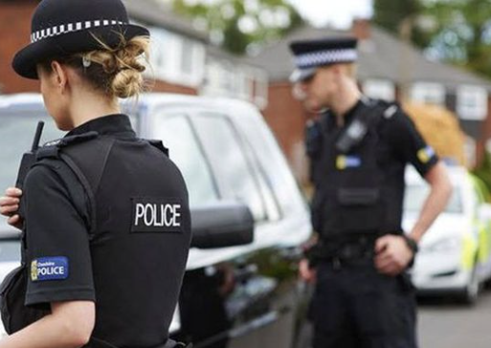
Challenges and Limitations
INTELLIGENCE
There are deficiencies in the intelligence processes. Law enforcement agencies lack sufficient understanding of county lines criminality to tackle it effectively.
RESOURCE LIMITATIONS
Often, the number of officers available is insufficient to cover the large areas affected by county lines activities, making it challenging to effectively monitor and intercept these operations.
JURISDICTIONAL ISSUES
County lines frequently involve crossing jurisdictional boundaries, leading to challenges for law enforcement agencies. Police forces may have different protocols and resources, complicating coordinated efforts.
SHIFTING TACTICS
Disrupting one route or network may simply lead County Lines to adapt and use alternative methods or routes.
Notes:
HMICFRS, 2022
NCLCC, 2024

Slide 13
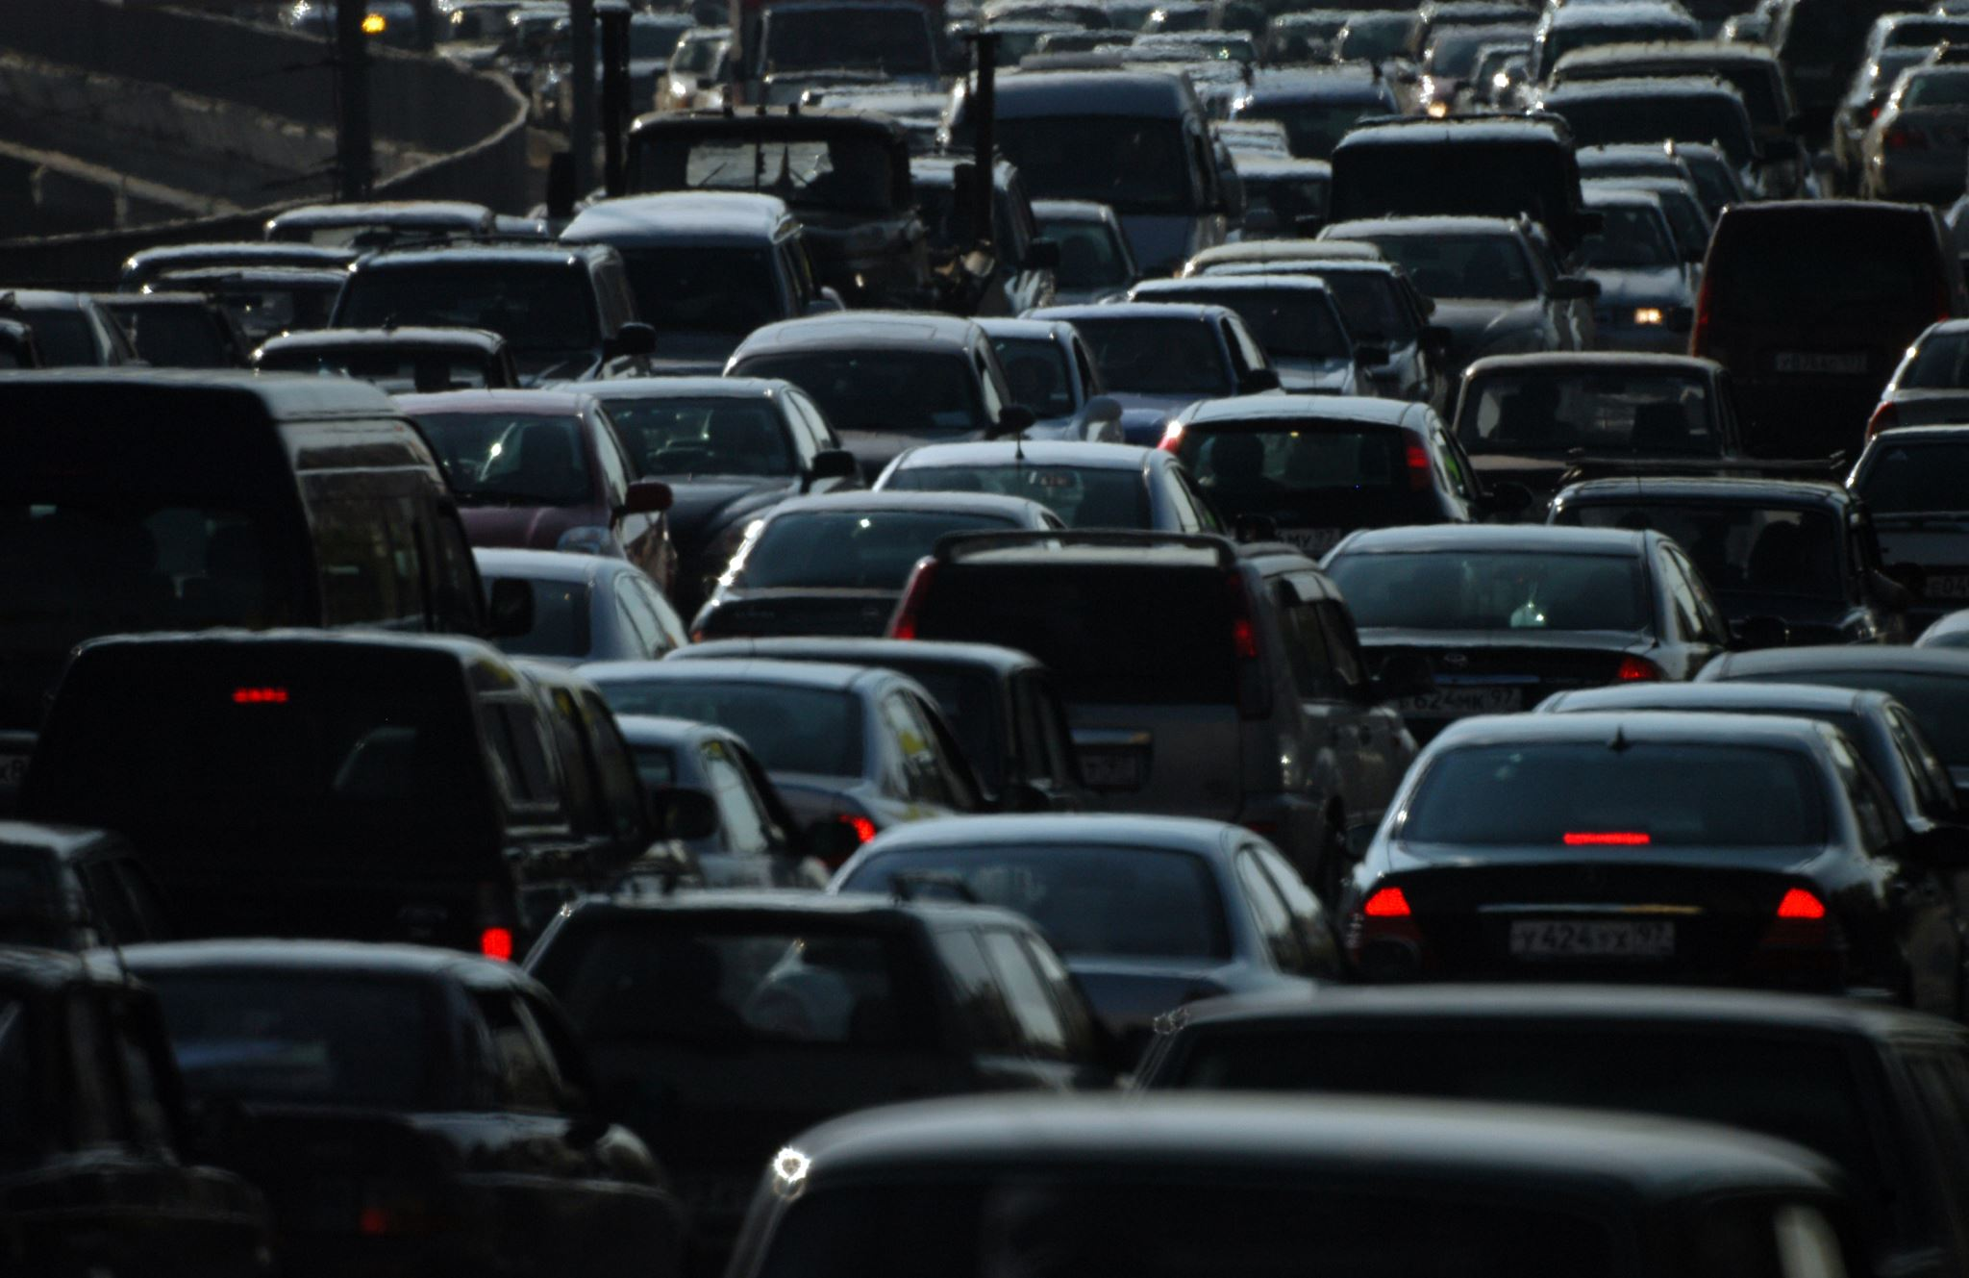
FURTHER CHALLENGES
A new trend has been observed involving the use of cloned number plates on private vehicles, which complicates Automatic Number Plate Recognition.
Additionally, minors who are not yet licensed drivers, are encouraged by offenders to drive illegally to assist in the transportation and distribution of drugs (NCLCC, 2024).
Children involved in CCE might hesitate to identify as victims or assist authorities in prosecuting the offenders. This reluctance often stems from the various negative impacts they may face due to the enforcement of 'justice’(Shaw, 2024).
The difficulties in addressing county lines offending is created by the 43-force structure in England and Wales. This structure obstructs the efficient deployment of personnel, coordination of efforts, and the sharing of intelligence across police border (HMICFRS, 2022).
Notes:
NPCC (2024)
NCLCC, 2024 (d)
Shaw, 2024
HMICFRS (2022)

Slide 14

ADAPTING STRATEGIES
Traditional methods of policing may need to be adapted to address the changing nature of county lines operations. This could include using technology to monitor communications and track movements more effectively (National Police Chief’s Council, 2024).
Notes:
National Police Chief’s Council (2024)

Slide 15

Conclusion
Current strategies collectively contribute to a significant reduction in county lines crime by targeting the logistical aspects of drug distribution and providing support to those at risk of exploitation. However, the challenges highlight the complexity of tackling county lines crime.
Road policing is a crucial component of the overall strategy to combat County Lines. By actively targeting drug trafficking routes and identifying those involved, road policing officers play a significant role in disrupting criminal networks, safeguarding vulnerable individuals and enhancing community safety.

Slide 16

REFERENCES
College of Policing (2024) County Lines, Policing and Vulnerability Study. Available at: County lines, policing & vulnerability study | College of Policing. (Accessed: 12.02.25).
Department for Transport (2020) Roads Policing Review: Call for evidence. Available at: Roads policing review: call for evidence - GOV.UK. (Accessed: 19.02.25).
House of Commons (2022) Serious Youth Violence: County Lines Drug Dealing and the Government Response. Available at: CBP-9264.pdf. (Accessed: 19.02.25).
HMICFRS (2022) The Police and National Crime Agency’s Response to Vulnerable People in ‘County Lines’ Drug Offending. Available at: The police and National Crime Agency’s response to vulnerable people in ‘county lines’ drug offending - His Majesty’s Inspectorate of Constabulary and Fire & Rescue Services. (Accessed: 19.02.25).
Police UK (2022) National Roads Policing Strategy 2022-2025. Available at PowerPoint Presentation (Accessed: 19.02.25).
National County Lines Coordination Centre (2024, a) Disrupting County Lines Policing Strategy. Available at: MET10229 - 00313199 - Disrupting County lines policy strategy_4pp-AW.indd. (Accessed: 12.02.25).
National Crime Agency (2019) County Lines Drug Supply, Vulnerability and Harm 2018. Available at: file. (Accessed: 12.02.25).
N8 Policing Research Partnership (2023) Through the Cracks in County Lines. Available at: N8 Policing Research Partnership | Through the Cracks in County Lines. (Accessed: 12.02.25).
National Police Chief’s Council (2024, a) County Lines Intensification. Available at: Police dismantle hundreds of county line networks. (Accessed: 07.02.25).
National Police Chief’s Council (2024, b) Launch of the County Lines Policing Strategy 2024 to 2027. Available at: Launch of the County Lines Policing Strategy 2024 to 2027. (Accessed: 06.02.25)
National Police Chief’s Council (2024, c) County Lines Strategic Threat Risk Assessment. Available at: County Lines - Strategic Threat Risk Assessment. (Accessed: 12.02.25).
National Police Chief’s Council (2024, d) County Lines becoming more localised. Available at: County Lines becoming more localised. (Accessed: 13.02.25).
Shaw, J. (2024). ‘Won the Battle but Lost the War?’ ‘County Lines’ and the Quest for Victim Status: Reflections and Challenges. Youth Justice, 24(2), 231-247. https://doi.org/10.1177/14732254231202673.
Swallow, B. (2024) Two Man Jailed After Weapons and Drugs seized in Bristol. BBC. Available at: Two men jailed after weapons and drugs seized in Bristol. (Accessed: 28.02.25).

