Slide 1

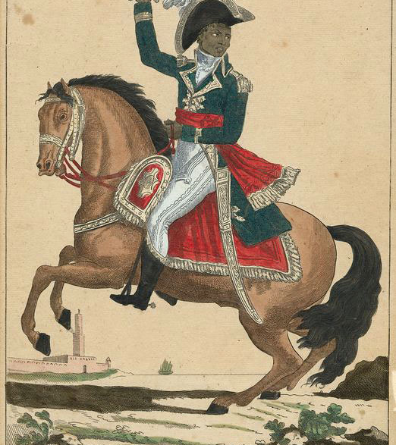
The Modern World
Session 7: The Haitian Revolution
Dr Rhian Elinor Keyse

Slide 2
Discussion questions:
Group 1 | Group 2
How did the social hierarchy of Saint-Domingue shape the early stages of the revolution? | How far did ideas of liberty, fraternity and equality actually apply to colonised people?
What were the complexities and contradictions in Toussaint’s leadership? | How far does the documentary challenge Eurocentric histories of the Age of Revolutions?
How does the documentary deal with the violence of the revolution? | What were the global impacts of the Haitian revolution?

Slide 3
What responsibilities do you think historians have when representing traumatic histories like enslavement and revolution?

Slide 4
Debate:
“This house believes that Louverture’s use of authoritarian methods was justified in order to secure the goals of the Haitian Revolution”

Slide 5
Primary source analysis
What does the 1805 constitution say about the new nation’s priorities?
Article 14 declares that ‘The Haytians shall hence forward be known only by the generic appellation of Blacks’ – what political or symbolic purposes does this serve?
How does the constitution seek to prevent the return of slavery?
What does the Constitution say about gender roles, property, and the family?
Does the document reflect Enlightenment ideals or depart from them?

Slide 6
Tomorrow’s class
Imperialism and Colonialism
Reading: at least one of: Adas, Chandravarkar, or Thomas and Thompson

