Slide 1
Are Staff and Students confident in using technology to collaborate at UWTSD?
Sophie anna Nyari 2122779
Calah Margaret Riley-Lamb 2121869
Sophie Akhtar 2123642
(BMSW4003)

Slide 2



Introduction
Technology is an essential part of the everyday life for students and staff at UWTSD. How do users of technology allow themselves to feel comfortable, confident and certain about the technology they use in their everyday life. This can be within UWTSD or in the outside world. In this project the information that will be shared will be surrounding the differing levels of confidence that users have in collaborating using technology.
The overarching analysis of this project is to support the question.
Are Staff and Students confident in using technology to collaborate?

Slide 3
rationale
How to improve student wellbeing using power of technology (culture-shift.co.uk)
To support this, it suggests that it is very important to interact with the students collaborating to achieve what they want so they can engage more in the future.
By doing this it will make the students education much more enthusiastic and most importantly making them enjoying the time of studying.

Slide 4
Ethical considerations
A common struggle may be that users from differing socio-economic backgrounds may have reduced computer literacy skills, which can therefore negatively affect the use of technology to collaborate, something echoed by Hyndman (Hyndman, 2019). To overcome this barrier to learning, there is not one solution, however Hyndman agrees that a step in the right direction would be to create a ‘shared community of practice’ in where students are using technology regularly to familiarise themselves with how to collaborate effectively (Hyndman, 2019).
On the other hand, the use of technology to collaborate can bring about positive Social-Emotional learning (SEL), as students who can work together despite their location barriers can build SEL skills through experiences, which will benefit them in their further professional and personal lives. The ability to collaborate using technology can allow users to build positive relationships and understand others' emotions, this is something that is resonated by Vander-Ark (Vander-Ark, 2020).

Slide 5
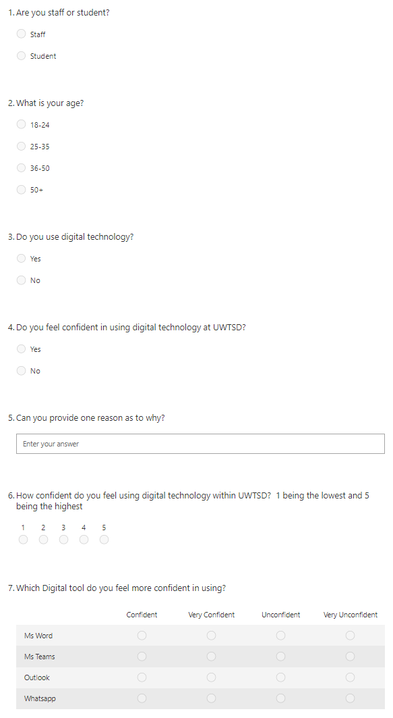
Proposed method of research
Questionnaire
What? – This questionnaire is designed to allow voters to analyse their confidence levels in using technology to collaborate at UWTSD. The research method we have chosen to use is the primary research method.
Who? – Fellow students and staff members within the UWTSD community.
How? – Through using an online questionnaire it allows us to email this to the required people.

Slide 6
Research timeline
The process of completing our research.
We will initially be collecting data through a carefully devised questionnaire which has been created to determine whether users feel confident in using technology to collaborate, and if so which form of technology is there preferred method.
The questionnaire will be provided to voters through email. If the voter chooses to input that they do not feel confident in using technology to collaborate, there is an option within the questionnaire for them to explain exactly why.
When we will receive results, the chosen method of questionnaire will produce an in-detail spreadsheet that will allow us to analyse the data and present the results effectively.
From this, we will then be able to further analyse the collected data and determine appropriate outcomes for how using technology to collaborate can be improved if necessary, or to highlight how it is be used effectively.
Week 1 | Week 2 | Week 3 | Week 4
Planning/ research | Data collection | Analysis | Final report write up
Task | Start date | End date | Number of days
Planning/ research | 04/02/22 | 11/02/22 | 7
Data collection | 11/02/22 | 18/02/22 | 7
Analysis | 18/02/22 | 25/02/22 | 7

Slide 7
Hypothesis
What will we find out?
Through this, we will be able to gain information on the ratio of the people that are confident/not confident in using technology to collaborate. Through the research we have presented a questionnaire and are able to receive these results. For example, we are able to find out which age ranges are more confident and why this may be.
We will then be able to assist people who feel confident in using technology, and on the other hand, support people who do not feel confident in using technology to collaborate by providing key skills through programs that we can offer.

Slide 8
Reference list
Hyndman, B. (2019). Ten Reasons why Teachers can Struggle to use Technology in the Classroom. SCIENCE EDUCATIONAL NEWS, [online] 67(4). Available at: https://researchoutput.csu.edu.au/ws/portalfiles/portal/124325978/34366631_Published_article.pdf.
Shinder, D. (2005). Ethical issues for IT security professionals. [online] Computerworld. Available at: https://www.computerworld.com/article/2557944/ethical-issues-for-it-security-professionals.html.
Vander-Ark, T. (2020). 7 Ways Tech Supports Collaborative Learning. [online] Getting Smart. Available at: https://www.gettingsmart.com/2020/01/11/7-ways-tech-supports-collaborative-learning/.

