Slide 1

NutriPrints
The sustainable nutrition bar made from food waste. Utilising 3D printing processes.

Slide 2
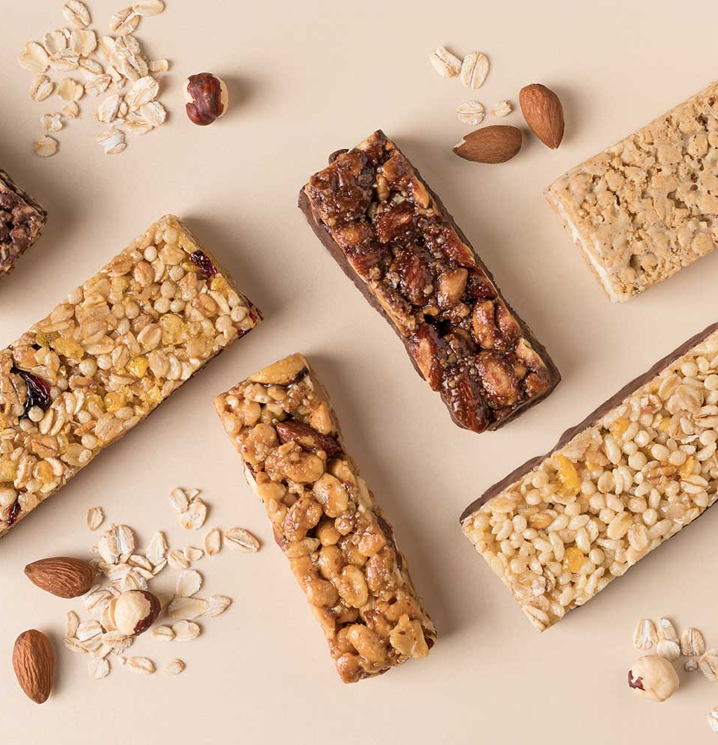
Context
NutriPrints is a nutrition bar company that repurposes food waste and turns it into a nutrient dense snack bar.
We utilise 3D printing during the production of this product.
This idea exists in a few companies across the globe but its not a very common product, especially in the UK.
The target market for this product will be health-conscious consumers and environmentally conscious consumers. As the product will be high in fibre and protein and won't be harmful to the environment through its production.

Slide 3
Industry Improvements
The food industry produces roughly 9.5 million tonnes of waste yearly. NutriPrints has the potential to reduce this by repurposing the food waste and turning it into a snack.
NutriPrints will use under-used surplus foods such as fruit pulp, skins and spent grains in the product, utilising what would usually be discarded.
NutriPrints includes nutrients that are often ignored and forgotten about:
Fiber from fuit skins
Proteins from spent grains and beans
Antioxidants from pulp and by-products.

Slide 4
Argument
Why switch to NutriPrints? It solves a real world problem that has large scale impact – climate change.
You don't have to sacrifice anything.
It tastes great and delivers high quality nutrition.
Reduces guilt around snacking.
We support a circular economy.

Slide 5
Benefits of NutriPrint
Reduces food waste.
Lowers greenhouse gas emissions.
High in natural nutrients.
Less reliance on artificial additives.
Helps consumers meet dietary needs.
Easy way to help the planet.
Meets modern values.
Less manufacturing waste as 3D printing minimizes waste.

Slide 6
Downsides and mitigations
Challenges:
Inconsistent waste ingredients.
Slow printing speed.
High equipment costs.
Consumer skepticism.
Texture/flow issues.
Regulatory hurdles.
Energy use.
Mitigations:
Standardise preprocessing & quality control.
Multi-nozzle printing and multiple printers.
Leasing + grants.
Transparent branding + education.
Fine milling + natural binders.
Strong food safety protocols.
Energy-efficient printing.

Slide 7
Expertise Needed
Food science & nutrition – for safe, nutritious formulations.
Food engineering- to turn waste into usable ingredients.
3D printing engineering - for printer setup and printable mixtures.
Product/food design - to create unique printed shapes & textures.
Food safety & QA - to meet regulations and prevent contaminations.
Sustainability experts - to validate environmental impact.
Business & supply chain - to manage sourcing and scaling.
Branding & marketing - to educate and excite consumers.

Slide 8
Providers
Food scientists & nutritionists – recipe and nutrition balance.
Food engineers - turn waste into usable ingredients.
3D printing specialists - develop printing process and equipment.
Product designers - create shapes, textures and visual appeal.
Food safety professionals - ensure hygiene & legal compliance.
Sustainability experts - validate environmental impact.
Business & logistics team - source waste, manage operations.
Marketing & branding experts - promote the idea to consumers.

Slide 9
Stakeholders with Vested Interests – Who+Why
Farmers & food producers – sell waste + reduce disposal costs.
Ingredient suppliers - new markets + sustainable branding.
Universities - research & innovation opportunities.
Environmental NGO's - food waste reduction aligns with mission.
Retailers – attractive product for eco-conscious buyers.
Waste/logistics companies - new value stream from food waste.
Schools/hospitals - nutritious, sustainable food.
Investors - high growth food tech & sustainability opportunity.
Chefs/influencers - Creative, innovative food platform.

Slide 10
Thank you for listening, all questions are welcome.

