Slide 1
Blockchain inProcurement

Slide 2
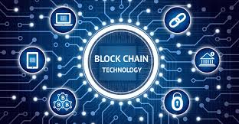

Slide 3
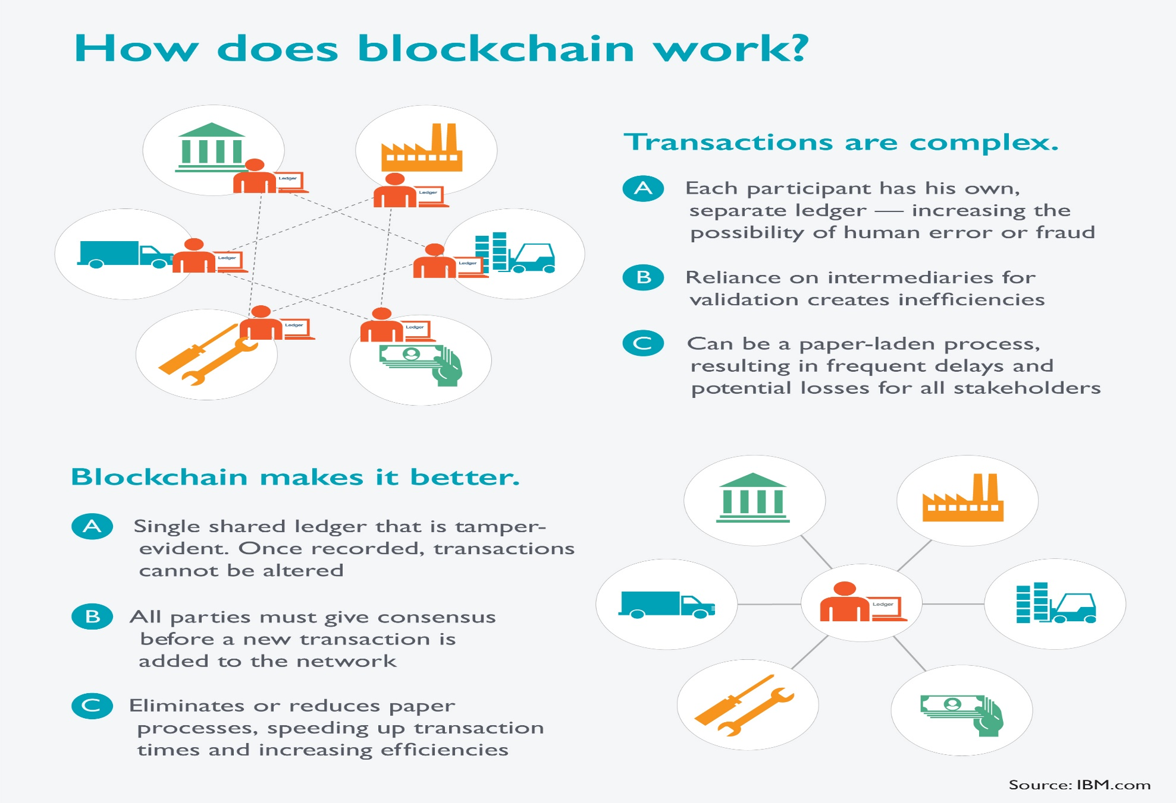

Slide 4
Blockchain Technology
Global complexity in supply chain management has led organizations to look towards technology as their silver bullet; serving as the missing link between people (supply chain actors) and the ability to collaborate at scale.
Blockchain technology is one of the most hyped amongst the currently developing technologies, hypothesized to make one of the greatest impacts in supply chain management — especially procurement

Slide 5
Blockchain in Procurement
Procurement and sourcing may very well be two of the greatest potential areas for impact when talking about blockchain application within supply chain management and procurement
Transparency, reliability and trust are issues that should be considered in procurement.
And, this is not at the fault of procurement professionals, but rather their current lack of technological application.
Procurement excellence is highly reliant upon the compliance of first-tier, second-tier and even third-tier suppliers; the more parties involved in the process, the more complex collaboration becomes.
Technology is the link between people and collaboration at a large scale.

Slide 6
Blockchain in Procurement
Procurement is most valuable when people (suppliers and buyers) are collaborating together and innovatively.
To collaborate efficiently we should look to apply the most innovative technology.
Blockchain could offer that innovative edge that most procurement teams are looking for in both operational and strategic performance.
We must remain realistic: Technology is a means to better performance in a value chain, but without the human knowledge or ability to utilize certain technologies, technology becomes a hindrance.
The acceptance/application of blockchain technology in procurement requires additional studies

Slide 7
Blockchain in Procurement
Despite advancements in digital technologies, procurement processes are challenging by lack of transparency, data inconsistency, trust, and time sensitivity.
Paper-based processes are still common, resulting in reduced transparency across networks.
Companies facing these challenges are using analytics, IT, and big data to improve supply chain visibility.
Newer technologies are replacing older EDI technologies used in the supply chain.
Tendering
Anonymous, yet Transparent
Auditing and Governance
Smart Contracting
Supplier Relationship Management

Slide 8
Tendering
On the more operational side of procurement-based activities, blockchain technology could be applied to enhance tendering for the best suppliers; leading to reduced costs and better quality/performance.
In fact, there is already a start-up that is already beginning the development of such a blockchain solution is working on a blockchain solution that enables smart tendering across the supply chain.
Pallets equipped with RFID tags publish their need to get from point A to point B on the ledger.
Carrier mining applications will then place bids to win the move.
The RFID will then award the job to the bidder with the most suitable conditions and the transaction will be registered on the blockchain.
The shipment will be progressively tracked as the tag moves down the supply chain.

Slide 9
Anonymous and Transparent
Traders, agents and producers are aware of the necessity of supply chain transparency, but that doesn’t always mean they want to share sensitive information about their suppliers.
Blockchain technology offers the ability to balance transparency with anonymity.
Many larger producers do not want to reveal provenance of their goods for fear of losing a competitive advantage.
Blockchain allows information to be transferred in a trustworthy and anonymous way, essentially providing a trust network that allows information to cascade down the chain from raw material onwards, without revealing who people are.

Slide 10
Auditing and Governance
The permanency of data sets/efficiency of data entry onto blockchain networks offers opportunities for easy governance.
This will help procurement teams to eradicate their supplier networks of defective supplier relationships.
It facilitates greater fraud control, and it will also offer transparency into issues of legality such as money laundering and the use of child labour.
While blockchain safeguards fraud control in your suppliers’ organizations, it can also ensure authenticity of your physical production and eliminate counterfeiting.
When your procurement team is able to manage risk, secure sustainable development, safeguard brand value and enhance performance, it’s a pretty good day at the office

Slide 11
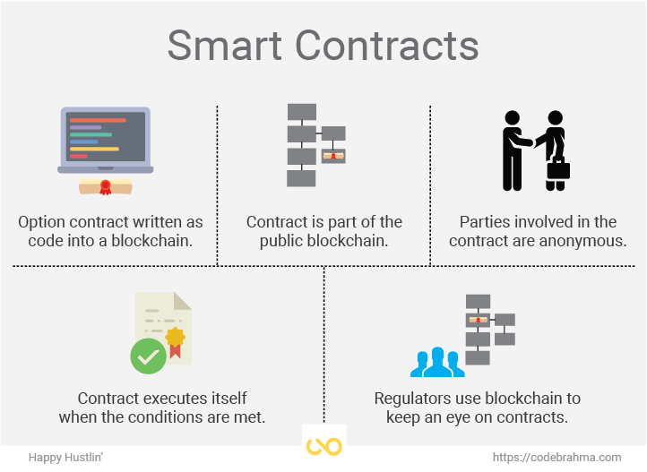
Smart Contracting:- This is a hypothesis of application within a P2P solution, but a feasible one nonetheless. Smart contracting creates an ecosystem of financial reliability for procurement professionals and their supplier base.

Slide 12
Smart Contracting
Purchase-to-pay will never be the same again once technological vendors unlock the key to implementing blockchain networks at scale.
Using smart contracts, where the terms are payable upon receipt, a proof of delivery from a logistics carrier will immediately trigger automatic digital invoicing and payments through the banking system, with no analog gap between customer and supplier.
The result has the potential to radically reduce working capital requirements and dramatically simplify finance operations, with a direct impact to the bottom line.

Slide 13
Supplier Relationship Management
Blockchain technology builds transparency, but also accountability.
Ensuring that suppliers are accountable for their actions builds a platform for compliance and trustworthy relationships.
Due diligence and risk management are inherent elements of a decentralized ledger for data entry. Put a bit simpler… trust recognizes trust.
Distributed data sets, over time, will allow procurement professionals and their suppliers to share a special collaboration, built upon a history of reliable performance data.

Slide 14
Conclusion
Procurement teams can see the bigger picture, and will be open with distributing blockchain networks beyond their own organizations, and develop/join cross-organizational blockchain information networks.
This could reduce competitive edge, allowing other competitor organizations to know what suppliers you’re working with, but it could also prove fruitful — eliminating/ousting untrustworthy suppliers within an entire industry sector

