Slide 1
ECEY6006
Supporting Children with Additional Learning Needs
Introduction to the assignment
Notes:
Notes for Module Team:
You can open the module handbook on the whiteboard and go over details, such as:
Staff details – explain that they have to e-mail their lecturer if absent
Assessment – Panopto guidance can either be watched in their own time or in lectures (sometimes it helps to listen to the guidance together)
Leganto – show where the online reading list is
Additional reading
Take as long as you need – focus of Lecture 1 is the assignment
Slides from the Panopto recording included here

Slide 2
Assignment brief
• In groups, you are required to create and present a webinar of academic posters that focus on children with additional needs.
• Groups should have a minimum of 3 members; no more than 5 members per group.
• Timings: 15 minutes per group member.
For example – 3 members = 45 minutes;
4 members = 1 hour;
5 members = 1 hour 15 minutes;

Slide 3
Assignment brief
• You will need to choose a Chairperson and create a Teams link for the webinar;
The link needs to be shared with each member of the group AND the marker;
You will be informed of your marker once all presentation times have been booked by students;
It will be the group’s responsibility to create an agenda and to share your screen with the marker;
The agenda will need to be e-mailed to the marker 24 hours before the presentation.

Slide 4
Assignment brief
• Individually, you will need to create and present an academic poster that includes:
a) a critical evaluation of how ONE example of an additional need is identified and diagnosed;
b) an analysis of the impact of barriers on the SAME example of additional need;
c) an in-depth exploration into an appropriate support strategy, again for the SAME additional need.

Slide 5
Assignment brief
• Word count of poster – approx, 1,000 words;
Poster and reference list to be submitted on Turnitin by submission date;
You must also upload your script onto Turnitin (check the similarity.

Slide 6
Research
Choose a SEND of interest to you.
For example:
ADHD;
Autism;
Dyslexia;
Mutism.
Notes:
STUDENTS CAN CHOOSE AN ALN NOT ON THE LIST, BUT CARE NEEDED WITH RELATIVELY NEW CONDITIONS AS THERE MAY BE LACK OF INFORMATION/RESEARCH

Slide 7
Research
Undertake independent research:
Research papers;
Organisations’ websites;
Documentaries;
Books/E-books/Reports.
Notes:
Additional resources will be added to Moodle/Teams

Slide 8
Focus on…
How your chosen SEND is identified and diagnosed:
Issues/challenges/benefits.
Potential barriers linked to your chosen SEND:
Possible impact on children.
One example of a strategy used to support your chosen SEND:
Issues/challenges/benefits.

Slide 9


Academic poster
Notes:
As agreed, no actual posters previously submitted will be shared.

Slide 10
Webinar
Once you have booked a slot (timetable on Teams), your marker will contact you via email to confirm date and time.
It is the group’s responsibility to create a Teams link for each group member AND the marker.

Slide 11
Webinar
Each poster should be uploaded onto Turnitin BEFORE the webinar.
BEFORE your allocated time, ensure each group member is present and can share their screens (to share their posters) – you may want to practice this before your actual webinar!!

Slide 12
Webinar
The marker will join your webinar as soon as they can – PLEASE do not call the marker in as they might still be assessing another group.
Your designated Chairperson should start the webinar by welcoming the ‘audience’ and either introduce themselves and all group members or allow group members to introduce themselves.

Slide 13
Webinar
For each ‘individual’, the Chairperson will need to introduce each group member, noting their chosen topic.
One member of the group will be required to monitor the time.

Slide 14
Webinar
After each poster presentation, the Chairperson should invite questions from the ‘audience’. Questions can be asked by group members, including the Chairperson.
After each group member has presented, the Chairperson can provide a summary of each poster and invite questions for a final time.
The Chairperson should thank each group member and the ‘audience’ for listening.

Slide 15
AI – use of Artificial Intelligence
RESEARCH -
You can use Generative AI to find current sources (e-books, journal articles, websites), dated between 2015 and 2025;
You can ask Generative AI to summarize the information from the sources you have found.
This is to check that the source is suitable for your assignment.
The summary should not be transferred into your own work (this is plagiarism).

Slide 16
AI – use of Artificial Intelligence
STRUCTURE -
You can use Generative AI to find suitable headings to help organise the content of your work.
You should not ask Generative AI to help structure paragraph order.

Slide 17
AI – use of Artificial Intelligence
PROOFREADING -
You can ask Generative AI to help proofread your work.
Do not use any wording suggested by Generative AI (this is plagiarism).

Slide 18
AI – use of Artificial Intelligence
CREATIVE -
You can use Generative AI to find a template for your poster.

Slide 19
Mark allocation
Individual mark /80
Group mark /20
= 100%

Slide 20
Marking criterion 1 – 10 marks
Evidence of research, referencing and reference list:
Correct and consistent referencing on the poster;
Clear verbal referencing;
Correctly formatted reference list;
Approximately 30 sources;
Wide use of journal articles.

Slide 21
Marking criterion 2 – 10 marks
Ability to demonstrate in-depth knowledge of an appropriate support strategy for your chosen ALN
In-depth explanation of your chosen strategy;
In what way does the strategy support your chosen ALN?
Benefits? Issues? Challenges?
Compare and contrast practice/research findings;

Slide 22
Marking criterion 2 – 10 marks
Ability to demonstrate in-depth knowledge of an appropriate support strategy for your chosen ALN
Consistent use of ‘However…’;
Discuss why perspectives/findings are different;
Support with references.

Slide 23
Marking criterion 3 – 40 marks
In relation to your chosen ALN:
Ability to critically evaluate the process of identification and diagnosis /20
Practitioners/Parents’ awareness of your chosen ALN;
Consider the process of getting a diagnosis;
Benefits? Issues? Challenges?

Slide 24
Marking criterion 3 – 40 marks
In relation to your chosen ALN:
b) Ability to analyse the impact of barriers /20
Choose ONE or TWO barriers;
Possible impact on children?
Compare and contrast practice/research findings;

Slide 25
Marking criterion 3 – 40 marks
In relation to your chosen ALN:
b) Ability to analyse the impact of barriers /20
Consistent use of ‘However…’;
Discuss why perspectives/findings are different for several sentences;
Support with references.

Slide 26
Marking criterion 4 – 10 marks
Ability to create and present an academic poster
Appropriate balance between paragraphs and bullet points;
Appropriate choice of images (no cartoons);
Effective use of colour and font;
Clear title;
Student details – module code and student number;

Slide 27
Marking criterion 4 – 10 marks
Ability to create and present an academic poster
Clear sections;
Clear introduction and conclusion;
Compare and contrast practice/research findings;
Consistent use of ‘However…’;
Correct and consistent referencing.

Slide 28
Marking criterion 5 – 30 marks
a) Group work – effective teamwork, evidence of preparation, timing, digital skills /20
Effective use of Teams;
Evidence of a well-rehearsed webinar;
Evidence of engagement between group members;
Relevant choice of questions.

Slide 29
Marking criterion 5 – 30 marks
b) Structure of presentation /10
Structure of presentation (introduction, main body, conclusion);
Intonation, pace, volume;
Professional presentation;
Accuracy of spoken language.

Slide 30
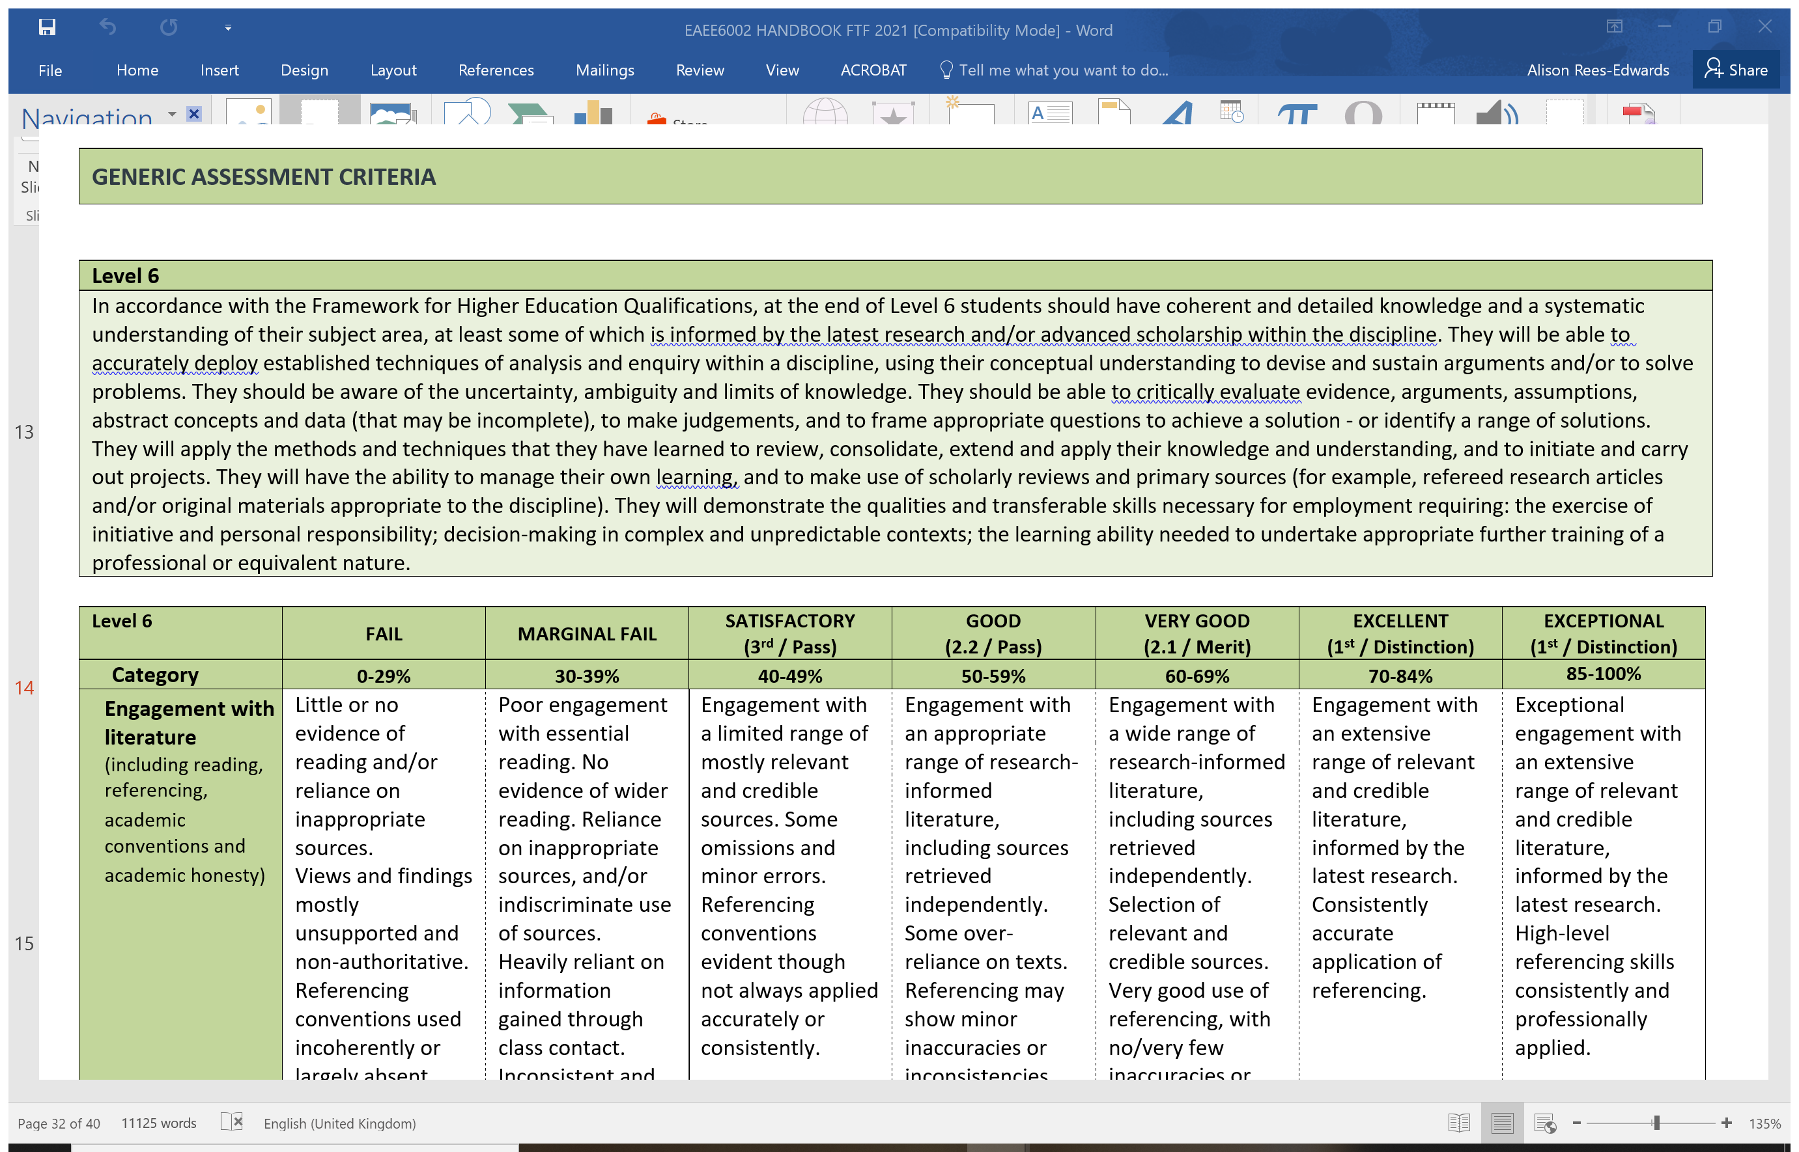

Slide 31
ICT issues?
IT Service Desk
ITServiceDesk@uwtsd.ac.uk
0300 500 5055

Slide 32
Support from the team
Reread the Academic Skills guidance(Moodle);
Drop-in tutorial during Week 3 of module;
Prepare for tutorials;
Responses to emails within 48 hours (usually office hours, Monday – Friday).

Slide 33
Additional support
What is a webinar?
Clickmeeting (2020) What is a Webinar? The Simplest Explanation You Will Get. Available at: https://www.youtube.com/watch?v=dZBX54MA7O0 [Accessed: October 18 2021].
Stratvert, K. (2021) How to use Webinars in Microsoft Teams. Available at: https://www.youtube.com/watch?v=c7crgJhNWJk [Accessed: October 18 2021].

Slide 34
Additional support
How to chair a meeting?
Cardiff University (2015) How to CHAIR an academic session. Available at: https://www.youtube.com/watch?v=6iwP1hMjxjs [Accessed: October 18 2021].
Girdler, A. (2020) How to Run a Virtual Meeting [BEST PRACTICES]. Available at: https://www.youtube.com/watch?v=NPVTLroz2Ck [Accessed: October 18 2021].

Slide 35
Final considerations…
Submission details – module handbook/Panopto/Teams
Research from academic sources (less/no websites);
Aim for the 10% over the word count/timing;
Check your similarity on Turnitin (poster/script);
Have you critically analysed/evaluated and made links with theory?
Extenuating circumstances.

Slide 36
Late Submissions
Present within 7 working days – no EC – capped at 40%;
Present after 7 working days – no EC – staff not permitted to assess.

Slide 37

Questions about the assignment?
DO NOT RELY ON FRIENDS/PEERS.
(Source: Facebook)

Slide 38
Problem/Question?
Alison Rees Edwards
a.rees-edwards@uwtsd.ac.uk

Slide 39

Good luck!

